Slide 1
First and Second Corinthians
Lesson 11
Stewardship and Mission

Slide 2
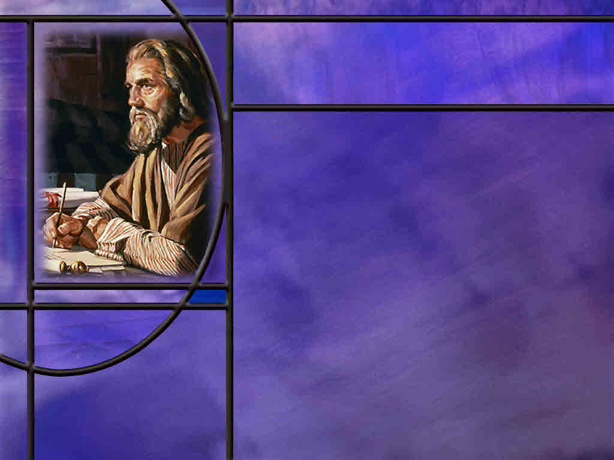
Memory Text
2 Corinthians 8:9 NKJV
For you know the grace of our Lord Jesus Christ, that though He was rich, yet for your sakes He became poor, that you through His poverty might become rich.
What is grace?
How do you think the Corinthians came to know the grace of our Lord Jesus Christ?
What does Paul say about the grace of our Lord Jesus?
Notes:
B2:
1. Grace is often defined as God’s unmerited favor toward mankind.
2. It is God treating us with love, mercy, compassion, and forgiveness when we actually deserve eternal death for our sins.
3. It is God’s grace that saves us from eternal death and grants us eternal life.
4. Paul writes in Eph 2:5 “for by grace you have been saved.”
5. And he explains further in Eph 2:8-9
Ephesians 2:8-9 NKJV - For by grace you have been saved through faith, and that [the salvation by faith] not of yourselves; it is the gift of God, ⁹ not of works, lest anyone should boast.
6. God’s grace is based on His love for us:
7. For God so loved the world … that He gave His only Son.
8. That’s grace. That’s God’s unmerited favor toward us sinners.
9. That whosoever believes in Him should not perish but have eternal life!
10. That’s Grace! That’s God’s unmerited favor toward us sinners.
11. When we receive God’s grace by receiving Jesus as our Savior from sin, we are saved by grace through faith.
12. Justice is getting what you deserve.
13. Mercy is not getting the penalty you deserve.
14. Grace is receiving the good gift that you haven’t earned and don’t deserve.
15. When we receive God’s grace given to us in Jesus who died for our sins, God can lay our sins on Jesus, who paid the just penalty for them.
16. God’s justice is satisfied by the death of His Son.
17. He can then be merciful to us sinners and not punish us for our sins.
18. But more than that, He can be gracious unto us, forgiving our sins, placing Christ’s perfect righteousness to our account, and giving us eternal life in His Kingdom.
19. So biblical grace is God’s undeserved, freely given love in action—most fully seen in God’s forgiveness of our sins and the new life offered us through Jesus Christ.
B3:
1. Undoubtedly, they came to know the grace of the Lord Jesus by the preaching of Paul and his coworkers.
2. Paul preached the gospel of salvation by grace through faith.
3. When he came to Corinth he said:
1 Corinthians 2:2 NKJV - For I determined not to know anything among you except Jesus Christ and Him crucified.
4. In 1 Corinthians, as Paul is there defining what the gospel is, he writes:
1 Corinthians 15:1-2 NKJV - Moreover, brethren, I declare to you the gospel which I preached to you, which also you received and in which you stand, ² by which also you are saved, if you hold fast that word which I preached to you--unless you believed in vain.
5. So they heard the gospel, the received the gospel, they stood fast on the gospel truth, and they were saved by believing the gospel.
6. And what is the gospel? Paul goes on to define it in these words:
1 Corinthians 15:3-4 NKJV - … Christ died for our sins according to the Scriptures, ⁴ and that He was buried, and that He rose again the third day according to the Scriptures,
7. So the Corinthians knew the grace of our Lord Jesus Christ because they had heard and received the gospel of salvation by grace through faith.
B4:
1. First, though Jesus was rich…
When was Jesus rich?
2. He was never rich on earth.
3. So here Paul is referring to the glory of Jesus before His incarnation when He was Michael, the captain of the angelic hosts of heaven, the eternal Son of God, creator of the universe, and co-reagent with the Father of all of His creation.
4. Indeed, Jesus before His incarnation was incredibly rich in material things, in honor, in power, in authority.
5. He was God, one with the Father and the Spirit.
How did Jesus become poor for our sakes?
6. He stepped down from His throne in glory and took our humanity upon His divinity.
7. He was born in a stable; raised as a carpenter’s son by common parents, became an itinerant preacher without a home of his own, and died with not much more than the clothes on his back.
8. This is amazing grace.
9. God the Son trades His throne for a manger and a cross.
10. He leaves the holiness of heaven for our sin-polluted world.
11. He leaves the adoration of angels for rejection, ridicule, and crucifixion by His own creatures.
How did we become rich through His poverty?
12. By the grace of God, you’re rich!
13. You’re an heir of the Kingdom!
14. Jesus is preparing a place for your there that you will really love.
15. You will someday walk on streets of gold!
16. Not because you deserve to but because of the grace of God in saving you!
17. We have a gracious God who meets our greatest need.
18. Our greatest need is to be forgiven of our sins and be reconciled to God.
19. And that gives us eternal life which all the money in the world cannot purchase.
20. There is an acronym the spells grace that I believe perfectly fits Paul’s wonderful description of Grace in this passage.
21. The acronym is G-R-A-C-E which stands for “God’s Riches At Christ’s Expense.”
22. We will enjoy God’s riches by what Christ suffered to provide for our forgiveness.
23. It is grace that makes Christianity different from all the other religions of the world.
24. Salvation is not something that we can earn by our good works.
25. It is something that our loving God gives us if we will receive the gracious gift of His Son and trust Him for the forgiveness of our sins.

Slide 3
Overview
In chapters 8 – 9 of 2 Corinthians Paul encourages the Corinthian believers to participate in the plan for collecting an offering for the churches in Judea and Jerusalem. He praises the generosity of the Macedonians, appeals to the Corinthians, assures them of the integrity of those who will handle the funds, and encourages them with the blessings of generosity.
  Appeals for Generosity
  Planned Giving
  Benefits of Generosity
  Summary

Slide 4
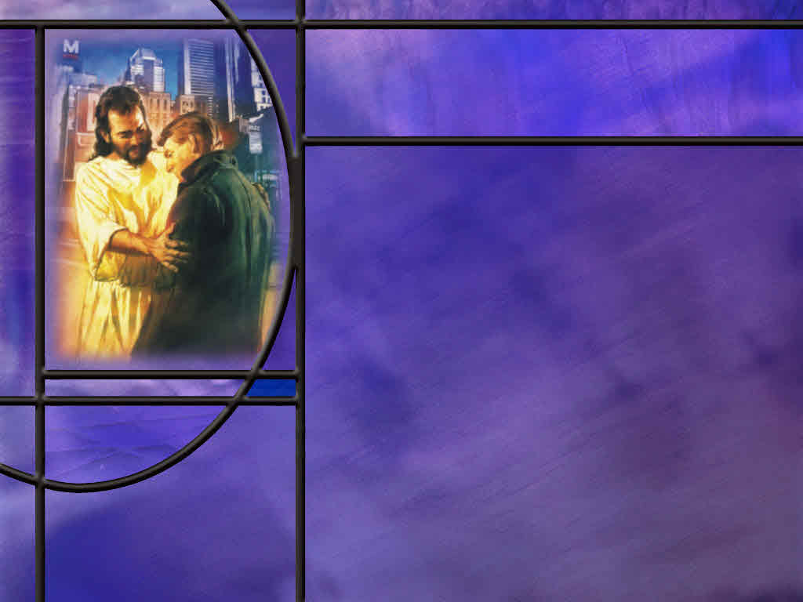
Appeals for Generosity
What had happened in Judea that had contributed to the poverty of the saints in that area? (Acts 11:27-30)
How did Paul use the Macedonian response to the latest collection to motivate the Corinthians? (2 Cor 8:1-5)
What appeal does Paul make directly to the Corinthians to follow the grace displayed by their Lord? (2 Cor 8:9)
What assurances does Paul give that the money collected will go to the intended recipients? (2 Cor 8:18-20)
Notes:
B1:
[See notes on linked slide.]
B2:
[See notes on linked slide.]
B3:
[See notes on linked slide.]
B4:
[See notes on linked slide.]

Slide 5
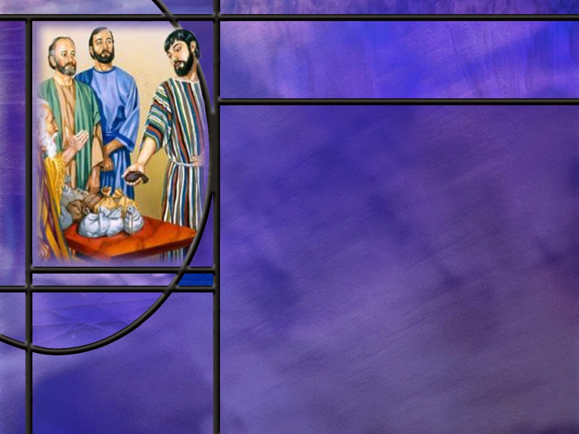
Planned Giving
What plan did Paul give for collecting this offering when it was first proposed? (1 Cor 16:1-4)
What guiding principles does Paul give the Corinthians for giving?
  2 Cor 9:7
  2 Cor 8:12
  2 Cor 8:10-11
  2 Cor 8:8
Notes:
B1:
[See notes on linked slide.]
B2:
[See notes on linked slide.]

Slide 6
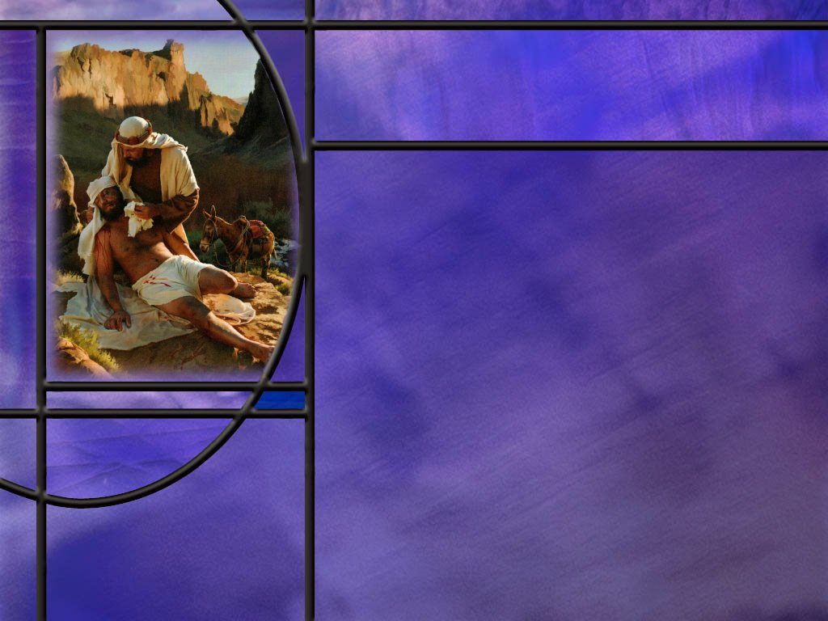
Benefits of Generosity
What results can we expect from generous giving? (2 Cor 9:8-13)
How does Paul justify taking up an offering for Jews that these Gentiles have never met? (Rom 15:26-27)
How does Paul end this two-chapter exposition on Christian giving? (2 Cor 9:15)
Notes:
B1:
[See notes on linked slide.]
B2:
[See notes on linked slide.]
B3:
[See notes on linked slide.]

Slide 7
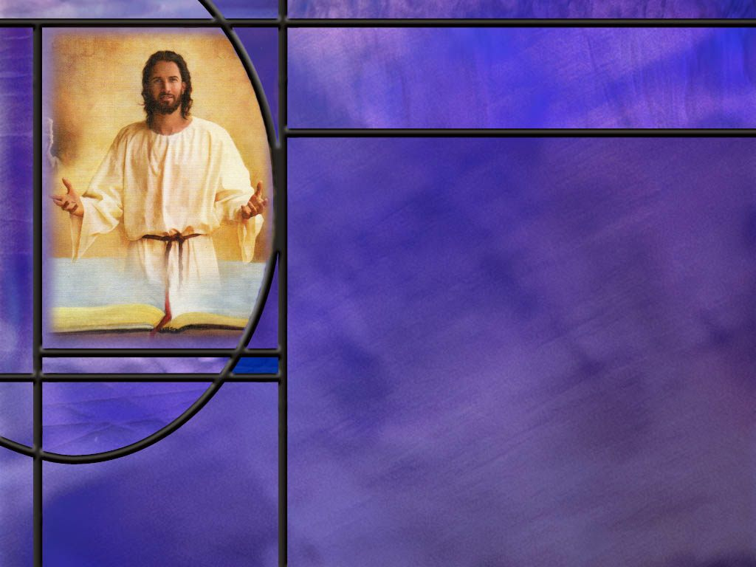
Summary
In 2 Cor 8-9, Paul is encouraging the Corinthian church to follow through on a promised financial collection for poor believers in Jerusalem.
This is at least the second collection Paul has taken, the first following a severe famine and food shortage in Judea, probably between his first and second missionary journeys.
Paul commended the churches in Macedonia for their eager and generous giving with joy , noting that they had first given themselves to the Lord.
Their generosity shows that true giving flows from grace and devotion, not from surplus or pressure.

Slide 8
Summary
Paul’s instructions for all the churches was to lay aside a portion of their daily income on the first day of the week for this collection and store it up at home.
This had nothing to do with Sunday worship. Paul kept the Sabbath in Corinth, and Sunday was a work day.
Paul’s key principle in his appeal to the Corinthians was to recall the grace of our Lord Jesus Christ, who gave up the riches of heaven to become poor and die for our sins so that we might be rich as a result.
When we understand, receive, and appreciate this amazing grace, it will change our hearts through the work of the Holy Spirit and make us loving, gracious, and generous like Him.

Slide 9
Summary
Paul’s principles for Christian giving included: Deciding in your own heart what God would have you to give, giving cheerfully and eagerly, not grudgingly, giving generously but within your means, following through in your financial commitments to the Lord’s work, and letting your giving be an expression of your love for Christ and others.
Paul assures us that God supplies resources so believers can continue to be generous.
Paul ends this section by coming back to the grace of God, thanking Him for the inexpressible gift He has given us in Christ.
Will you follow Paul’s teaching by seeing your giving as an expression of grace that flows from God’s inexpressible gift to us?

Slide 11
Acts 11:27-30 ESV
Now in these days prophets came down from Jerusalem to Antioch. ²⁸ And one of them named Agabus stood up and foretold by the Spirit that there would be a great famine over all the world (this took place in the days of Claudius). ²⁹ So the disciples determined, every one according to his ability, to send relief to the brothers living in Judea. ³⁰ And they did so, sending it to the elders by the hand of Barnabas and Saul. [R]
Notes:
Q1: When this famine hit the region, what did the saints in Antioch of Syria decide to do?
1. They decided to take up an offering in Antioch, to provide relief for the Christians living in Judea.
2. Paul and Barnabas took this offering to Jerusalem and gave it to the elders there so that it could be distributed to the affected churches around Jerusalem and in Judea.
3. This famine was also recorded in secular historical sources of that time.
4. Josephus and some Roman writers describe serious food shortages in the eastern Mediterranean during Claudius’s reign, with a severe Judean famine commonly dated around AD 45–48.
5. So this was an earlier relief offering collected in Antioch to help the poor in Jerusalem and Judea who were apparently affected by this severe famine.
6. And being Christians, they would probably not receive much help from the Jews who would still maintain the levers of power in Jerusalem.
7. So this would be an offering taken up a few years earlier than the one Paul is now collecting in Greece from the Macedonians and the Corinthians.
8. But it shows that there was a very real need for the Christians in Judea many of whom would be former Jews and now be ostracized from their society.
9. This first offering was likely taken between Paul’s first and second missionary journey.
10. The offering in our lesson this week was a later offering taken during Paul’s third missionary journey.

Slide 12
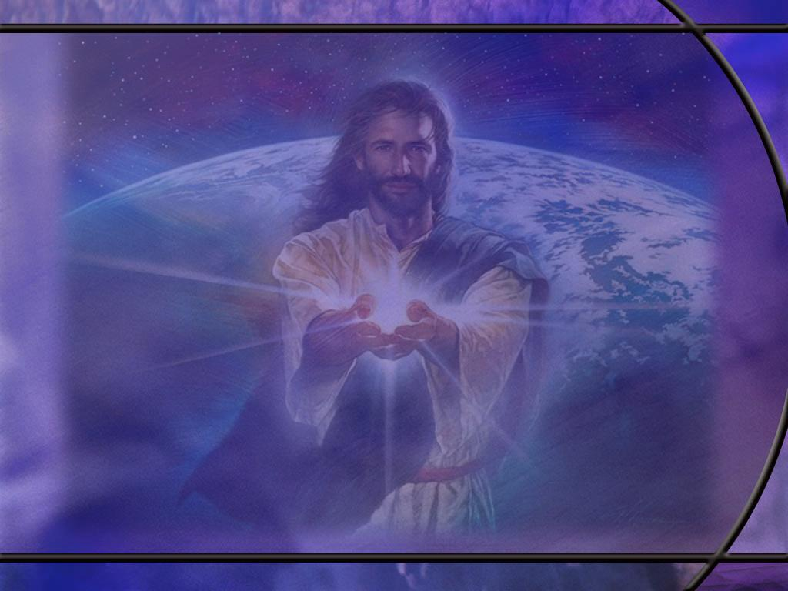
2 Corinthians 8:1-5 NLT
Now I want you to know, dear brothers and sisters, what God in his kindness has done through the churches in Macedonia. ² They are being tested by many troubles, and they are very poor. But they are also filled with abundant joy, which has overflowed in rich generosity. ³ For I can testify that they gave not only what they could afford, but far more. And they did it of their own free will. ⁴ They begged us again and again for the privilege of sharing in the gift for the believers in Jerusalem. ⁵ They even did more than we had hoped, for their first action was to give themselves to the Lord and to us, just as God wanted them to do. [R]
Notes:
Q1: What churches is Paul commending here?
1. These were the churches in Macedonia that Paul had established on his second missionary journey when he entered eastern Europe.
2. These were the churches of Philippi, Berea, and Thessalonica.
3. They were located in the northern part of the country of Greece today.
4. Corinth was located in southern Greece, in the old days called Achia.
Q2: How did these Macedonian churches give toward the relief effort in Jerusalem?
1. They gave willingly.
2. Paul testifies that they gave even more that what they could afford.
3. Even though they were poor themselves, they overflowed with rich generosity.
4. Even though they had trials of their own, they were filled with joy and begged for the privilege of helping with this relief effort.
Q2: What does Paul point out in verse 5 here that was at the heart of their motivation?
1. Paul says that before they had given to his relief effort, they had given themselves to the Lord.
2. So their motivation for giving was an appreciation of what the Lord had given to them.
Q3: Is there a lesson there for us?
1. If we would be cheerful givers in the Lord’s work, we must first give our hearts to the Lord.
2. If Christ has our heart, He will also have our wallet or purse.
3. Jesus said, “where your heart is, there will your treasure be also.”
4. If your heart is with Jesus, so your treasure will be with Him also.
5. I like the old German expression: “The last shirt has no pockets.”
6. We cannot take it with us, but we can send it on ahead.
7. Jesus told us to lay up for ourselves treasures in heaven.
8. And one way we can do that is to help meet the needs of fellow brothers and sisters here on earth.
9. “In as much as ye have done it unto one of the least of these my brethren, ye have done it unto me.” (Matt 25:40)

Slide 13
2 Corinthians 8:9 ESV
For you know the grace of our Lord Jesus Christ, that though he was rich, yet for your sake he became poor, so that you by his poverty might become rich. [R]
Notes:
Q1: How much did Jesus give?
1. This is our memory text that we discussed in the introduction.
2. Jesus held nothing back.
3. He gave all that He had to give.
4. He gave his very life for us.
5. He became poor that we might become rich.
6. This is amazing grace!
7. The God that created us became one of us, and allowed His own creatures to put Him to death.
8. And it was all so that He could forgive our sins and give us eternal life.
9. This provides the ultimate motivation for giving back.
10. When we really understand and appreciate God’s grace, we will want to reflect His graciousness to others.
11. Since we know the grace of our Lord Jesus Christ, let’s ask the Holy Spirit to give us that kind of grace that will make us gracious and generous toward God and others in need.

Slide 14
2 Corinthians 8:18-20 NLT
We are also sending another brother with Titus. All the churches praise him as a preacher of the Good News. ¹⁹ He was appointed by the churches to accompany us as we take the offering to Jerusalem--a service that glorifies the Lord and shows our eagerness to help. ²⁰ We are traveling together to guard against any criticism for the way we are handling this generous gift. [R]
Notes:
Q1: What assurance is the apostle Paul giving here to the Corinthian church?
1. He is assuring them that a multitude of honest people will be watching over this offering as it is transported to Jerusalem.
2. Not only the apostle Paul and Titus, both well loved and accepted by the Corinthian church, but also other well-respected preachers of the faith that had been appointed by the churches who gave the offerings.
3. Paul wants to make sure that nobody can criticize him for the way this offering is handled.
4. He wants the complete offering to go to the saints in need.
5. No transportation fees; no pass-through administrative fees; no sticky fingers dipping into the money bag.
6. He is using men recognized as having unimpeachable integrity to get the gifts collected to the saints in need.
7. In our churches, we need the same level of integrity in our handling of the Lord’s money.
8. This is a sacred trust that we must be honest and faithful in handling he Lord’s money.

Slide 15
1 Corinthians 16:1-4 ESV
Now concerning the collection for the saints: as I directed the churches of Galatia, so you also are to do. ² On the first day of every week, each of you is to put something aside and store it up, as he may prosper, so that there will be no collecting when I come. ³ And when I arrive, I will send those whom you accredit by letter to carry your gift to Jerusalem. ⁴ If it seems advisable that I should go also, they will accompany me. [R]
Notes:
Q1: What is Paul’s plan for collecting this relief offering for the saints in Jerusalem?
1. On the first day of the week everyone is to set aside some money and store it up at home.
2. That way when Paul comes to get the collection, it will be all ready for him to pick up.
3. No one will have to go to the bank or sell property to be able to give.
4. Here again, Paul’s plan is to use people who have been accredited by the churches that give to accompany the gift to Judea.
5. And Paul expects that he too will go with them and watch over this precious offering.
Q2: Is this a Sunday morning worship service where they are dropping their offering into the collection plate?
1. No!
2. In the Roman empire, Sunday was not recognized as a day of rest until Constantine made it so in 321 AD.
3. In Corinth, Sunday was a normal work day in 50 AD when Paul ministered there.
4. Luke records that Paul kept the Sabbath in Corinth for 18 months.
5. He never kept Sunday and they never did either.
6. Paul is saying that their offerings for the Lord should be from the first work day of the week, Sunday.
7. His principle was: put God first and live on what you make the rest of the week.
8. This money was to be set aside at home from the first of their daily wages during the week.

Slide 16
2 Corinthians 9:7 ESV
Each one must give as he has decided in his heart, not reluctantly or under compulsion, for God loves a cheerful giver.
Notes:
Q1: What is Paul saying about giving in this verse?
1. First, he is saying that each one should decide for themselves what to give.
2. This is a matter between them and God.
3. Pary about it; ask God what you should give; make a decision on your own without somebody else telling you how much you should give.
4. Give what you can give cheerfully.
5. Don’t be a reluctant giver.
6. If you are not able to give a certain amount cheerfully, go with a smaller amount.
7. God wants us to give willingly and cheerfully.
[Go to next slide.]

Slide 17
2 Corinthians 8:12 NLT
Whatever you give is acceptable if you give it eagerly. And give according to what you have, not what you don't have.
Notes:
Q1: What principle is Paul giving them here?
1. Give in proportion to what you have.
2. If you give it all, then you have nothing on which to live.
3. You become worse off then the person you are trying to help.
4. God does not want us to take a vow of poverty unless we have that gift.
5. Most of us don’t have it.
6. Paul mentions it in:
1 Corinthians 13:3 KJV - And though I bestow all my goods to feed the poor, … and have not love, it profiteth me nothing.
7. If you bestow all your goods to feed the poor, then you become the poor.
8. Give in proportion to what you have.
9. Paul commended the Macedonian churches for giving according to their means:
2 Corinthians 8:3 ESV - For they gave according to their means, as I can testify, and beyond their means, of their own accord,
[Go to next slide.]

Slide 18
2 Corinthians 8:10-11 NIV
And here is my judgment about what is best for you in this matter. Last year you were the first not only to give but also to have the desire to do so. ¹¹ Now finish the work, so that your eager willingness to do it may be matched by your completion of it, according to your means.
Notes:
Q1: What principle for giving is Paul giving us here?
1. Follow through on your financial commitment to the Lord’s work.
2. After you have made a decision on how much to give, follow through on it.
3. Here the Corinthians had been the first to give for the relief in Jerusalem.
4. But apparently, they had not been laying aside their offerings and accumulating their contributions as they did at first.
5. So Paul is encouraging them to get back to their first desire to help and complete their contributions.
6. Again, he emphasizes according to their means.
[Go to next slide.]

Slide 19
2 Corinthians 8:8 NLT
I am not commanding you to do this. But I am testing how genuine your love is by comparing it with the eagerness of the other churches. [R]
Notes:
Q1: Is Paul commanding them to give any amount or percentage large or small?
1. No! They can give nothing if they choose.
2. But he is saying that there is a correlation between our giving and our love.
3. Paul says he can gauge how genuine our love is by the eagerness of our giving.
4. Not necessarily the amount, but the eagerness with which we give.
5. You can tell he is going to be drawing a comparison between Corinth and the Macedonian churches in their eagerness to give, adding a little motivation for the saints at Corinth to be generous.
6. Paul doesn’t want to be embarrassed by having the Corinthian church start out strong in being the first to give, but fizzle out in the end.
7. In fact, he writes in:
2 Corinthians 9:2 NIV - For I know your eagerness to help, and I have been boasting about it to the Macedonians, telling them that since last year you in Achaia were ready to give; and your enthusiasm has stirred most of them to action.

Slide 20
2 Corinthians 9:8, 11-13 NIV
And God is able to bless you abundantly, so that in all things at all times, having all that you need, you will abound in every good work. ... 11 You will be enriched in every way so that you can be generous on every occasion, and through us your generosity will result in thanksgiving to God. 12 This service that you perform is not only supplying the needs of the Lord's people but is also overflowing in many expressions of thanks to God. 13 Because of the service by which you have proved yourselves, others will praise God for the obedience that accompanies your confession of the gospel of Christ, and for your generosity in sharing with them and with everyone else. [R]
Notes:
Q1: What benefits does Paul cite here for those who give generously to the Lord’s work?
1. First, God will abundantly bless the giver so that they will have all that they need.
2. And if they have all they need, they can continue to abound in good works.
3. Second, God will enrich them in every way so they can continue to be generous on every occasion.
4. Third, their generosity will result in thanksgiving to God.
5. Fourth, what they give will supply the needs of the Lord’s people.
6. Fifth, God will be praised for the effect the gospel has had on you, making you a generous and loving person.
7. Others will see your good works and glorify your Father which is in heaven.
8. In the end, the glory goes back to God for His grace which has made us loving and gracious people.

Slide 21
Romans 15:26-27 NIV
For Macedonia and Achaia were pleased to make a contribution for the poor among the Lord's people in Jerusalem. ²⁷ They were pleased to do it, and indeed they owe it to them. For if the Gentiles have shared in the Jews' spiritual blessings, they owe it to the Jews to share with them their material blessings. [R]
Notes:
Q1: How have the Gentiles shared in the spiritual blessings of the Jews?
1. During this time, Jerusalem was the apostolic center of the Christian church.
2. It was in Jerusalem on the day of Pentecost that the Holy Spirit was poured out and the gospel message went forward to Jerusalem, Judea, Samaria, and then to the Gentile world.
3. It is the apostles who received from Jesus the great commission to make disciples of all nations.
4. It is the apostles to whom Jesus gave the authority to write His testimony and deliver the Christian faith to the church.
5. Everything that the Gentiles learned about Salvation came from the apostles of Christ, who for the most part, still called Judea their home.
6. So Paul is arguing that the Gentiles who have found salvation in Christ owe a debt of gratitude to their Jewish brothers in the faith who shared the gospel with them.
7. The Jewish Christians gave their Gentile brothers the gospel truth; it is only fitting that the Gentile brothers should respond in love and appreciation.
8. Here we see the blessings of the unity that Christ can bring to people who are united by love for Him.

Slide 22
2 Corinthians 9:15 NIV
Thanks be to God for his indescribable gift!
[R]
Notes:
1. What a beautiful ending!
2. He brings it all back to the grace of God.
3. God has given us a gift in Jesus Christ that words cannot describe.
4. It is beyond our ability to fully appreciate or fully express our gratitude for what He has done for us in Christ.
5. We will continue to study the science of salvation in the age to come.
6. But for now, let us join the apostle Paul in giving thanks to God for His indescribable gift.
7. What do you say?

