Slide 1
The Gift of Prophecy
Lesson 5
Revelation and Inspiration

Slide 2
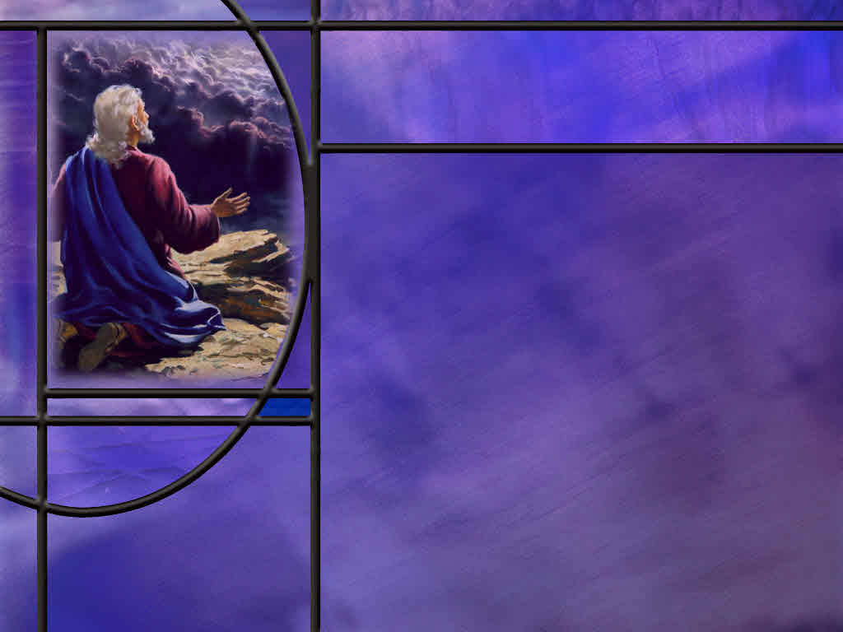
Memory Text
Revelation 1:1-2 NKJV
The Revelation of Jesus Christ, which God gave Him to show His servants--things which must shortly take place. And He sent and signified it by His angel to His servant John, ² who bore witness to the word of God, and to the testimony of Jesus Christ, to all things that he saw.
What does John claim as the origin of the message of the book of Revelation?
When are the things of this revelation to take place?
How does John refer to divine revelation in verse 2?
Notes:
B2:
1. He claims that the message has a divine origin.
2. God gave it to Jesus; Jesus gave it to an angel; the angel gave it to John the apostle; and the apostle John wrote it down to make it available to the servants of Jesus, namely, us.
B3:
1. John says they “must shortly take place.”
2. Well we know that they all didn’t take place “shortly.”
3. The book of Revelation includes the second coming, the resurrection, the millennium, the judgment of the wicked, the new heaven and the new earth, the end of the curse, and life in the kingdom.
4. So, there are many things in the book of Revelation that have not taken place even after nearly 2,000 years.
5. So, we understand that these things would begin to take place soon.
6. The seven letters to the seven churches of Asia Minor were seven actual churches.
7. The first one, Ephesus, represented the apostolic church of the first century.
8. And the great controversy vision of chapter 12 begins with the birth of Christ and His being caught up to God and to His throne.
9. This prophecy is typical of the great apocalyptic outline prophecies we find in Daniel and Revelation that begin in the day of the prophet and end with the coming of Christ and the establishment of His kingdom.
B3:
1. He uses two terms to refer to the divine revelation he received: The Word of God and the Testimony of Jesus Christ.
2. These words or words similar to them will be used a number of times in the book of revelation to refer to divine revelation.
3. Just seven verses later, John writes this:
Revelation 1:9 NIV – I, John, your brother and companion in the suffering and kingdom and patient endurance that are ours in Jesus, was on the island of Patmos because of the word of God and the testimony of Jesus.
4. What is John saying in this verse:?
5. He is saying that he is suffering as a follower of Jesus by being exiled on the isle of Patmos because of his faithfulness to the Word of God and the Testimony of Jesus.
6. So here the same two phrases for divine revelation are used as in verse 2 of our memory text.
7. Is there a difference between the Word of God and the Testimony of Jesus?
8. I believe there is.
9. I believe John uses the Word of God to refer to the OT, and the Testimony of Jesus to refer to the NT.
10. During NT times, the NT was in the process of being developed.
11. It was not until the end of the first century that John completed his Gospel and Revelation.
12. It was even later until the NT books were recognized as canonical.
13. As the NT was developing, the apostles could refer to the OT scriptures as the Word of God, as they often did.
14. But the inspired writings of the apostles to form the NT were referred to as the testimony of Jesus or the faith of Jesus, or simply, “the faith.”
15. The NT message centered in Jesus Christ, what He did, what He taught, how He died and rose again, how He intercedes for us in the heavenly sanctuary, and how He’s coming again.
16. The book of Acts is the history of the church He established.
17. The epistles expound on the doctrines of His church and how we should live to please Him.
18. The apostolic witness and inspired writings were the testimony both from Jesus and about Jesus, and they were preserved as the 27 books of the NT that we accept today as canonical.
19. In fact, in our memory text, John says that he recorded as a witness in this book all that he saw.
20. So the book of Revelation is a part of the testimony of Jesus through His apostle, John.
21. Here we can see that the Testimony of Jesus is more than the end-time gift of prophecy that identifies God’s last-day remnant.
22. Rather it is the historical apostolic witness that defines the Christian faith beginning in apostolic times.
23. Faithfulness to the word of God and the testimony of Jesus has been the hallmark of true believers throughout the history of the Christian faith.

Slide 3
Overview
God has used a variety of methods to communicate with us including: nature, dreams, visions, the spoken word, the written word, thought inspiration, verbal inspiration, direct transcription, and enacted parables.
  Nature
  Prophets
  Apostles
  Summary

Slide 4
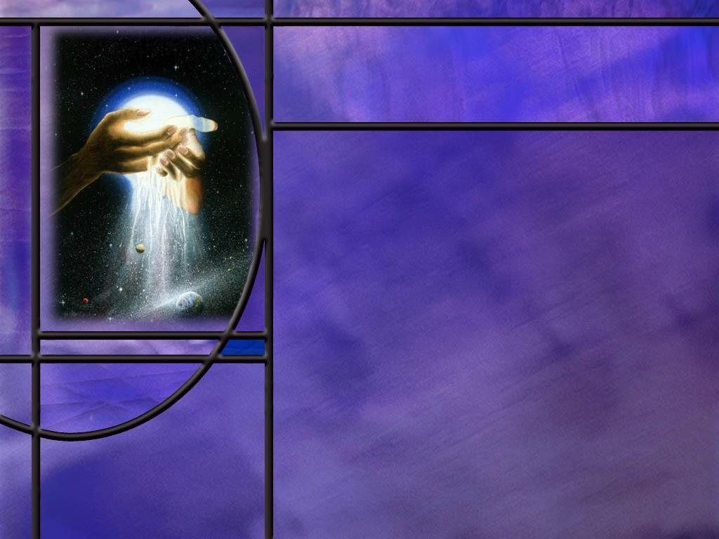
Nature
How did the apostle Paul begin his presentation to the Greek philosophers at the Areopagus? (Acts 17:24)
What can we know about God from observing the natural world? (Rom 1:20)
What could you misunderstand about God looking only at nature?
Notes:
B1:
[See notes on linked slide.]
B2:
[See notes on linked slide.]
B3:
1. We could misunderstand the character of God looking only at nature.
2. It is not clear from nature now that God is love.
3. The survival of the fittest is often accompanied by destruction of the weakest.
4. “Nature is red of fang and claw.”
5. We need to understand that nature as we see it is the result of sin and the curse.

Slide 5
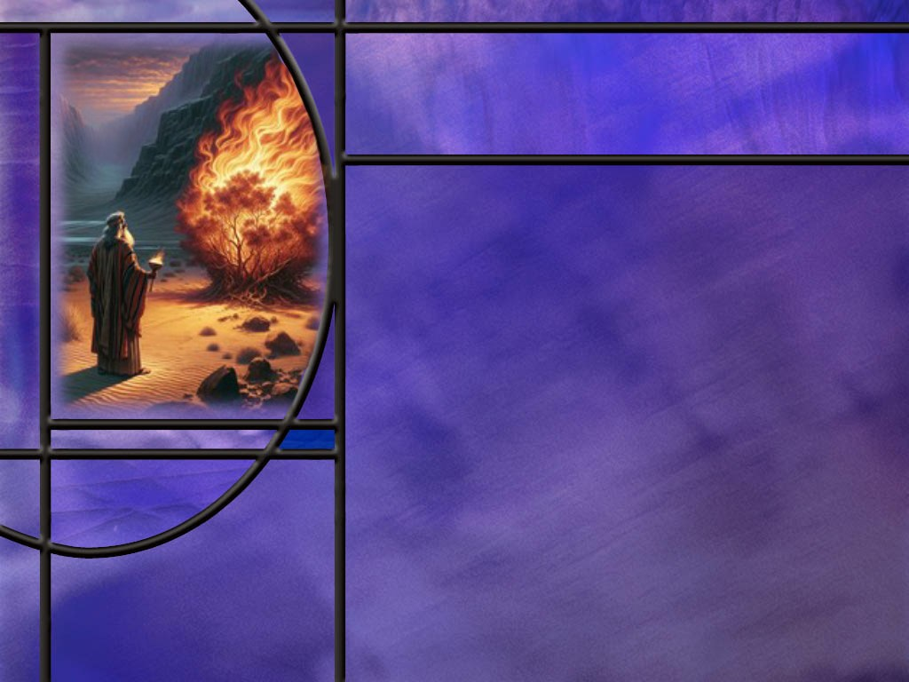
OT Prophets
How did God communicate with Moses? (Ex 3:4,14-15)
How did God communicate His covenant law to Moses? (EX 31:18)
How did God communicate with Daniel? (Dan 2:3,19,36)
What unusual request did the Lord make of the prophet Hosea? (Hosea 1:1-3)
What other type of inspiration do we see in the OT? (2 Tim 3:16-17)
Notes:
B1:
[See notes on linked slide.]
B2:
[See notes on linked slide.]
B3:
[See notes on linked slide.]
B4:
[See notes on linked slide.]
B5:

Slide 6
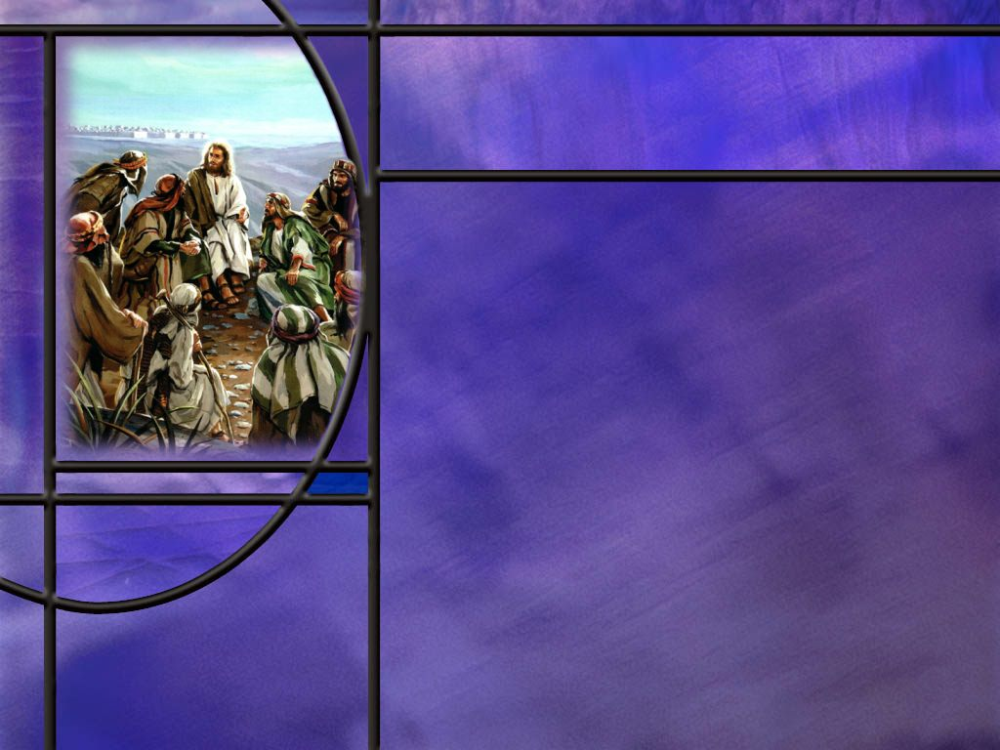
NT Apostles
How did God communicate with His NT apostles? (Luke 6:13)
Where do we see the very words of God being spoken in the NT?
How does Luke explain the origin of his information for the gospel that he wrote? (Luke 1:1-4)
Notes:
B1:
[See notes on linked slide.]
B2:
All through the gospel accounts we see Jesus speaking words.
We see His teaching in the sermon on the mount.
We see His parables about the kingdom of God.
When we hear Him speak in scripture we hear the very words of God.
He said if you have seen me, you have seen the Father.
And we can extrapolate that to say: if you have heard me you have heard the Father.
B3:
[See notes on linked slide.]

Slide 7
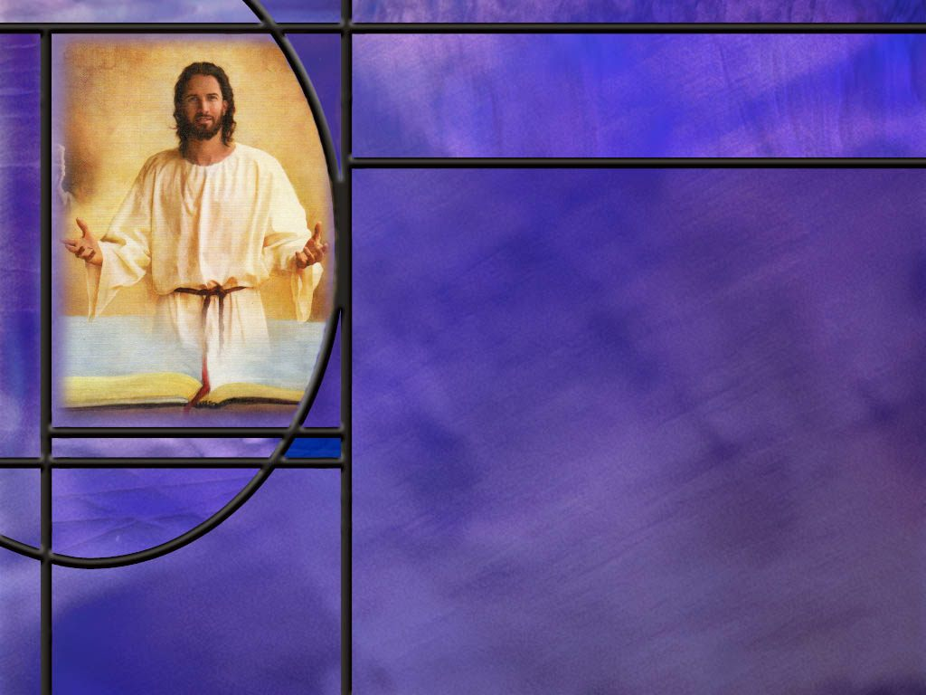
Summary
God speaks to us through the general revelation of creation and the special revelation of His word.
Creation clearly demonstrates the power and divine nature of the Creator so no one has an excuse for not knowing God.
The vast amount of information in the DNA of every living cell demands an intelligent Creator since information does not arise by chance and random events.
However, nature alone cannot always be a reliable indicator of our God of love, Because of the fall and the curse, nature no longer reflects the goodness of God’s original creation.

Slide 8
Summary
God used a variety of ways to communicate with the OT prophets.
Most notably with Moses, God spoke directly to His prophets.
They would hear His voice and pass His words on to the people either verbally or in writing with a “Thus says the Lord.”
When they are quoting the actual words of the Lord, their words would be verbally inspired.
At other times, when not quoting the Lord, their speaking and writing would be thought inspired where they express the thoughts conveyed by the Holy Spirit in their own vocabulary and style.
God also communicated to them in dreams, visions, drama, and by angels.

Slide 9
Summary
In NT times, God spoke through His Son.
Jesus spoke the very words of God and spent 3 ½ years training His disciples to be apostles.
To the apostles He gave the authority to speak and write the Testimony of Jesus defining the apostolic Christian faith, and culminating eventually in the books of the NT.
From Luke’s account of how he developed his gospel, it is reasonable to conclude that the apostles wrote with their own vocabulary and style under the guidance of the Holy Spirit who inspired them with thoughts.
Will you ask the Lord to speak to you this week through creation and His word?

Slide 11
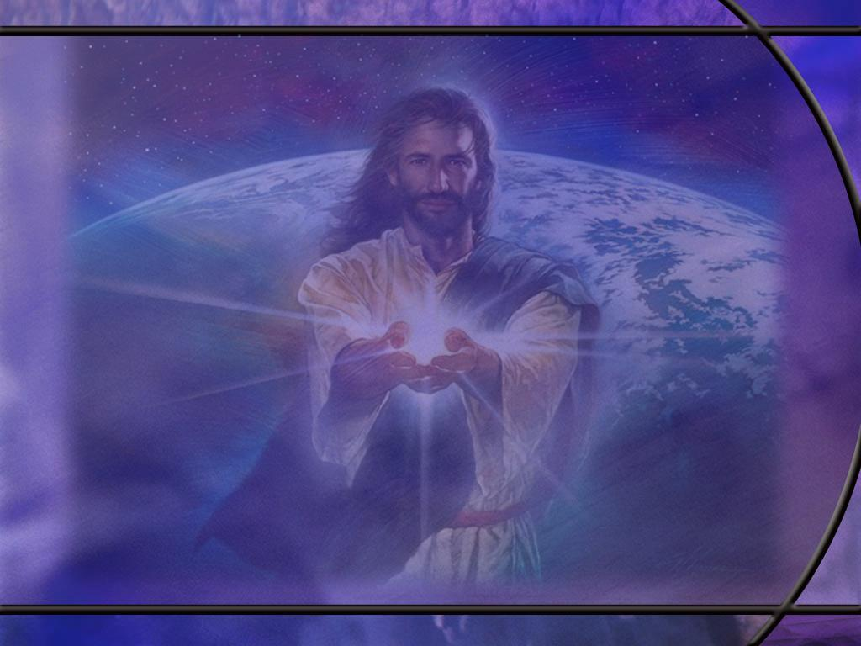
Acts 17:24 NIV
"The God who made the world and everything in it is the Lord of heaven and earth and does not live in temples built by human hands. [R]
Notes:
1. You will remember that Paul was walking around in Athens and saw an alter with the inscription “to the unknown God.”
2. Just to make sure they didn’t miss an important god, they worshipped the unknown god.
3. So Paul uses that as a springboard to introduce them to the true living God of the Bible.
Q1: Where does Paul start in presenting the truth about the living God?
1. He starts with creation.
2. He said the true God made the world and everything in it.
3. He is the Lord of heaven and earth, but He doesn’t live in temples made by human hands.
4. This God is not on display in some temple.
5. But we can know that He exists because we can see the things He has made.
Q2: Why is it important to establish God as the Creator of all things in order to present a believable case for God?
1. God is eternal, immortal, and invisible.
2. We cannot see Him, hear Him, smell Him or touch Him.
3. We sing the hymn “He Lives:” The course ends with the words, “You ask me how I know He lives, He lives within my heart.”
4. That may be proof of God’s existence to you, but to others it is just a subjective feeling that you have.
5. What real objective evidence do we have for the existence of God?
6. I think the best objective evidence of God that we have is the creation that we see all around us.
7. How can we explain the specified complexity of living things apart from a God who designed them and put them together and made them work.
Q3: Who are the “Greek philosophers” of our day that need to be convinced that there is a God who has created the universe.
1. We know from statistical surveys that those who claim to be Christians in our country are declining.
2. More and more people are identifying as “nones” as having no religious affiliation.
3. Church attendance for main-line denominations is declining in western cultures as is attendance at Catholic churches.
4. The late Bro. Sam Bacchiocchi had a saying about church attendance in Europe:
“Most people attend church only three times in their life: When they’re hatched, when their matched, and when they’re dispatched!!”
5. Belief in God is declining as our societies become more secular and less religious.
6. So we have some interesting data on our next slide.
[Go to next slide.]

Slide 12
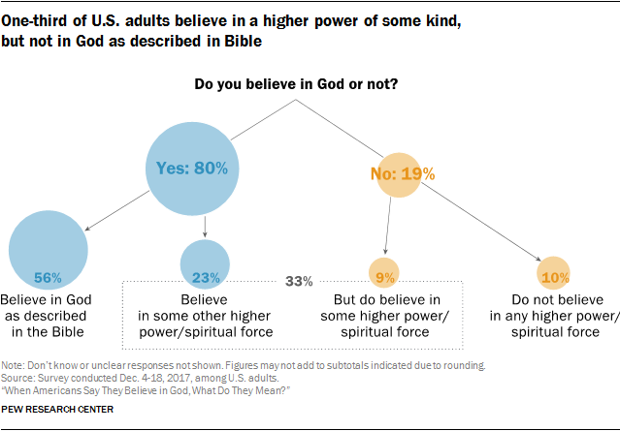
[R]
Notes:
1. Here we have a breakdown of the beliefs of adults in the USA.
2. These data are from surveys in 2017 by the Pew research center.
3. So 80% say they believe in God, and about 20% say they do not.
4. But of the 80% who say they believe in God, only 56% believe in the God of the Bible: 23% say they believe in some higher power or spiritual force.
5. Of the 19% who say they don’t believe in God, almost half, 9%, say they believe in some higher power or spiritual force.
6. Only about 10% are atheists in the traditional sense that do not believe in any higher power or spiritual force.
7. So the point is: here in our country only a little over half, 56%, believe in the God of the Bible while 33% believe in some higher power or spiritual force.
8. So if we are thinking of reaching the unreached, what kind of a mission field do we have right here in our own country?
9. Five and a half people out of ten believe in the God of the Bible; 4.5 people out of ten do not believe in the God of the Bible.
10. So we don’t have to travel to a far country to find people who are unreached.
11. We can just look around us in our own country where about 45% don’t believe in the God of the Bible.
12. One more point here: This is what people say they believe in a survey.
13. In practice, there are many people who claim to believe in God but live as if there is no God.
14. These are what I would call practical atheists.
15. And I think that the practical atheists in our country probably account for the majority of people.

Slide 13
Romans 1:20 NIV
For since the creation of the world God's invisible qualities--his eternal power and divine nature--have been clearly seen, being understood from what has been made, so that people are without excuse. [R]
Notes:
Q1: What does Paul say demonstrated conclusively the divine nature and power of God?
1. He says it is the creation we see all around us.
2. The heavens that declare the glory of God.
3. The biosphere here on earth that contains the living things He created.
4. The beauty, design, and complexity of the natural world require a Creator.
5. Our Creator is a God of order, beauty, the infinite, the infinitesimal, the complex, the elegantly simple
6. Yes, our world is fallen, but it still declares the glory of the God who created it.
7. We can know without a doubt that the universe did not create itself.
8. The creation requires a Creator.
9. Those who deny that there is a Creator will be without excuse in the judgment.
Q2: What things of nature are most impressive to you in declaring the existence and power of God?
1. To me: the greatest evidence for a Creator is the specified complexity of biological organisms.
2. There is no possible way that the complex biochemical relations and reactions that make things live could have come about by chance.
3. This is the law of biogenesis: Life comes only from life, so the first life had to be created.
4. The incredible amount of information in the DNA that is present in every cell requires a creator.
5. Information does not arise by chance and random events.
6. It requires an intelligent source, which is God.
7. Here is the question that I posed to Perplexity AI:
8. What is the information content of a single human cell in terms of equivalent pages of the encyclopedia Britannica?
9. Answer:
A commonly repeated comparison says that the DNA in the nucleus of one human cell contains enough information to fill about 1 million encyclopedia pages—roughly 40 complete sets of the traditional 25,000-page, 23-volume Encyclopaedia Britannica*, or about 920 Britannica-sized volumes.
God the Creator put that much information in each one of your cells.
Amazing!!
God still speaks through creation.
Q3: What could you misunderstand about God looking only at nature?
1. We could misunderstand the character of God looking only at nature.
2. It is not clear from nature now that God is love.
3. The survival of the fittest is often accompanied by destruction of the weakest.
4. “Nature is red of fang and claw.”
5. We need to understand that nature as we see it is the result of sin and the curse.

Slide 14
Exodus 3:4, 14-15 ESV
When the LORD saw that he turned aside to see, God called to him out of the bush, "Moses, Moses!" And he said, "Here I am." ... ¹⁴ God said to Moses, "I AM WHO I AM." And he said, "Say this to the people of Israel: 'I AM has sent me to you.'" ¹⁵ God also said to Moses, "Say this to the people of Israel: 'The LORD, the God of your fathers, the God of Abraham, the God of Isaac, and the God of Jacob, has sent me to you.' This is my name forever, and thus I am to be remembered throughout all generations. [R]
Notes:
Q1: How is God communicating with Moses in this passage?
1. God is speaking to Moses directly.
2. Moses is quoting God.
3. His words are set off with quotation marks.
4. When God is speaking this is verbal inspiration.
5. Moses hears God speak and writes down the exact words that God says.
6. And when OT prophets do this, they are speaking the very words of God.
7. This is not thought inspiration where Moses is trying to recall what he heard God say.
8. So when OT prophets say, Thus says the LORD…, they are quoting the very words that God said to them.
9. I did a search of this exact phrase in the ESV and it returned 417 verses in which this exact phrase appears.
10. And they are followed by a quotation of what the Lord actually says.
11. It is interesting that these all appear in the OT. Not a single time does this phrase appear in the NT.
12. Plus there are many others in which the prophet may say something like, “The word of the Lord came to me saying…”
13. Or “This is what the Lord says.”
14. In many cases the prophet is speaking the very words of the Lord when he says things like:
“You shall know that I am the LORD.” (1 Kings 20:13)
“I am the LORD and there is no other, besides me there is no God.” (Isa 45:5)
15. Surely no Israelite would have thought that the prophet was speaking his own words in such cases.
Jeremiah 1:9 ESV – …And the LORD said to me, "Behold, I have put my words in your mouth.”
16. The OT prophets spoke the very words of God by quoting what He said.
Q2: How does Moses describe how he spoke with the LROD?
Exodus 33:11 ESV – Thus the LORD used to speak to Moses face to face, as a man speaks to his friend.
1. They would speak to each other as friends.
2. They would carry on a conversation with each other.
3. That doesn’t necessarily mean that Moses saw the face of the Lord, since the Lord was in the pillar of cloud or fire.
4. But they talked one-on-one, man-to-man so to speak, like two friends would talk.
5. God also spoke to Samuel when he called him to be a prophet.
6. The LORD spoke to Joshua when He appeared to him as the captain of the Lord’s host, and to Manoah and his wife, the parents of Samson, and with Jacob at Bethel.
7. And to all the prophets who would pass on a Thus says the LORD…

Slide 15
Exodus 31:18 Deut 10:4 ESV
And he gave to Moses, when he had finished speaking with him on Mount Sinai, the two tablets of the testimony, tablets of stone, written with the finger of God.
And he wrote on the tablets, in the same writing as before, the Ten Commandments that the LORD had spoken to you on the mountain out of the midst of the fire on the day of the assembly. And the LORD gave them to me. [R]
Notes:
Q1: Who wrote the Ten Commandments on the tables of stone?
1. In Exodus 31`:18 we have the Lord writing the Ten Commandments on the first tables of stone that Moses broke.
2. And in Deuteronomy, we have Moses saying that the Lord also wrote with His finger the commandments a second time
Q2: What kind of inspiration should we attribute to these words written on tables of stone?
1. This is not thought inspiration.
2. This is not verbal dictation.
3. This is not a prophet speaking the very words of God.
4. This is God Himself writing his message with His own finger on tables of stone.
5. This is divine transcription.
6. This is God writing exactly what He wanted us to hear and understand and remember.

Slide 16
Daniel 2:3, 19, 36 ESV
And the king said to them, "I had a dream, and my spirit is troubled to know the dream." ... ¹⁹ Then the mystery was revealed to Daniel in a vision of the night. Then Daniel blessed the God of heaven. ... ³⁶ "This was the dream. Now we will tell the king its interpretation. [R]
Notes:
Q1: What dream did Nebuchadnezzar dream in Daniel 2?
1. This was the dream of the image made of various metals, gold, silver, bronze, iron, and iron mixed with clay.
2. Apparently, the King could not remember the details of the dream.
3. But in answer to prayer, God gave Daniel a vision of the dream and its interpretation.
4. This is the first of Daniel’s great outline prophecies extending from Nebuchadnezzar to the coming of Christ to set up His kingdom on earth.
5. So God is here revealing the future through His prophet Daniel.
6. God gives a dream to Nebuchadnezzar and the interpretation to Daniel.
7. We see the same thing in chapter 4.
8. Nebuchadnezzar has a dream of the great tree that was chopped down and Daniel was given the interpretation that the king would spend seven years thinking he was a animal.
9. In chapters 7 and 8 we have visions that God gives Daniel: the four beasts from the sea and the rise of the Little Horn, and the ram and the he-goat, the self-exaltation of the little horn and the cleansing of the sanctuary after 2300 days.
10. These outline prophecies go from Daniel’s day to the second coming of Jesus.
11. In chapter 9 God sends Gabriel to give Daniel the 70-week prophecy and provide a starting point for the 2,300-day prophecy.
12. So God is speaking to Daniel through dreams, visions, and angelic messengers to help him understand and pass on to us God’s message of future events.
13. God also spoke to Isaiah through a vision of the Lord in the temple upon his throne high and lifted up .
14. He also spoke the words the Lord told him to speak.
15. There is that wonderful answer to Hezekiah’s prayer.
Isaiah 38:1-2, 4-5 ESV – 1 In those days Hezekiah became sick and was at the point of death. And Isaiah the prophet the son of Amoz came to him, and said to him, "Thus says the LORD: Set your house in order, for you shall die, you shall not recover." 2 Then Hezekiah turned his face to the wall and prayed to the LORD, ... 4 Then the word of the LORD came to Isaiah: 5 "Go and say to Hezekiah, Thus says the LORD, the God of David your father: I have heard your prayer; I have seen your tears. Behold, I will add fifteen years to your life.”
16. What a wonderful answer to prayer!
17. Here we have Isaiah speaking the very words of God to Hezekiah with a “Thus says the Lord”..

Slide 17
Hosea 1:2-3 ESV
When the LORD first spoke through Hosea, the LORD said to Hosea, "Go, take to yourself a wife of whoredom and have children of whoredom, for the land commits great whoredom by forsaking the LORD." ³ So he went and took Gomer, the daughter of Diblaim, and she conceived and bore him a son. [R]
Notes:
Q1: What message was the Lord sending through this strange request for Hosea to marry a prostitute?
1. The Lord was sending the message that Hosea’s marriage was a type of Israel’s relationship to the Lord.
2. As his wife was unfaithful, so Israel was unfaithful to the Lord.
3. This is an enacted parable using the prophet to illustrate how the people are in danger of judgment.
4. So they had three children and the Lord named them Jezreel, No Mercy, and Not my People.
5. These names were significant in warning God’s people of their danger in persisting in idolatry.
6. God used these warnings to call the people back to faithfulness.
Q2: What point was God making in Ezek 4:1-8?
1. This is another enacted warning of judgment to come.
2. There God told Ezekiel to make a miniature representation of Jerusalem and make a siege against it.
3. This was to be an enacted illustration of the judgement that would come upon Jerusalem through the siege of Nebuchadnezzar.
4. So God can use these illustrations to communicate in ways that are memorable, His messages of warning to His covenant people.

Slide 18
2 Timothy 3:16-17 NKJV
All Scripture is given by inspiration of God, and is profitable for doctrine, for reproof, for correction, for instruction in righteousness, ¹⁷ that the man of God may be complete, thoroughly equipped for every good work. [R]
Notes:
Q1: What Scripture is Paul primarily referring to in this passage?
1. Well, He says all scripture.
2. If we look at the context, he is probably referring primarily to the OT Scriptures.
3. The previous verse says:
2 Timothy 3:15 NKJV – and that from childhood you have known the Holy Scriptures, which are able to make you wise for salvation through faith which is in Christ Jesus.
4. Timothy’s childhood Scriptures would be primarily the OT Scriptures.
5. The NT scriptures were still being developed when Paul wrote his epistles.
6. There was no list of inspired canonical NT books at that time.
7. However, we can apply his words to NT scripture that is the authoritative writings of the apostles and their close associates.
8. Peter considered Paul’s writings to be Scripture as we learn from
2 Peter 3:15-16 NIV –Bear in mind that our Lord's patience means salvation, just as our dear brother Paul also wrote you with the wisdom that God gave him. ¹⁶ He writes the same way in all his letters, speaking in them of these matters. His letters contain some things that are hard to understand, which ignorant and unstable people distort, as they do the other Scriptures, to their own destruction.
9. In any case, all Scripture would definitely include the OT Scriptures.
10. So what seems to make the most sense is that much of scripture is thought inspired.
11. The Holy Spirit moves upon the minds of men to convey divine thoughts.
12. And these inspired men write down these thoughts in their own words.
13. This combination of divine and human results in the word of God for both the OT and the NT.
14. The OT written by prophets and others, the NT written by apostles and their associates.
15. In some cases we know the authors of the OT books, in some cases, we do not.
16. Once we get p[ast the first five books of Moses, we are not sure of the authors of Joshua, judges, Ruth, 1 &2 Samuel, 1&2 kings, 1&2 Chronicles, Esther, and job.
17. In these historical books, where we don’t have prophets speaking the very words of God, we have to assume that the historical events are accurately recorded by scribes or writers that received thought inspiration from the Holy Spirit.
18. Much of Psalms and Proverbs is thought inspired scripture rather than verbally inspired with a Thus says the Lord.
19. Nevertheless, we take it all as the authoritative word of God.
20. To summarize, in the OT we see prophets speaking directly with God, hearing his words, writing them down and passing them on the us. They also received messages by dreams, visions, and enacted parables or illustrations, and were instructed in understanding by angels.
21. When the prophets were quoting the words of the Lord, their words are verbally inspired.
22. When not quoting the Lord or speaking His words, their writing is thought inspired.
23. Other non-prophet authors of OT Scripture such as David and Solomon and those writing historical narrative where thought inspired by the Holy Spirit and wrote in their own words.
24. Finally, one portion of OT Scripture is divinely transcribed: the Ten Commandments written by the finger of God..

Slide 19
Luke 6:13 NIV
When morning came, he called his disciples to him and chose twelve of them, whom he also designated apostles: [R]
Notes:
Q1: How did God communicate His messages to the apostles of Jesus?
1. So here we have the new paradigm of Hebrews 1:1-2.
2. While God spoke in times past to the fathers through the prophets, He has in these last days spoken to us by His Son.
3. God the Son took on flesh and blood and was made in the likeness of man.
4. He became Emmanuel, God with us.
5. The Word was made flesh and dwelt among us.
6. God the Son communicated with His disciples, 12 of which he designated as apostles.
7. He spoke to them face-to-face.
8. He lived with them, prayed with them, ate with them, worshipped with them, taught with them, healed with them, and never left them for 3.5 years.
9. In Jesus, they saw what God was really like.
10. They experienced His love, His grace, His forgiveness, His goodness, His patience, all the wonderful character traits of God.
11. They became the inspired authoritative writers of the Testimony of Jesus culminating in the NT.

Slide 20
Luke 1:1-4 NLT
Many people have set out to write accounts about the events that have been fulfilled among us. ² They used the eyewitness reports circulating among us from the early disciples. ³ Having carefully investigated everything from the beginning, I also have decided to write an accurate account for you, most honorable Theophilus, ⁴ so you can be certain of the truth of everything you were taught. [R]
Notes:
Q1: How does Luke describe his experience in writing his gospel?
1. He does not attribute the words that he wrote as being verbally dictated by God.
2. He doesn’t say that he heard the voice of God and wrote down what God said.
3. That would have been verbal inspiration, much like the OT prophets verbally heard the words of God and wrote them down.
4. Instead, Luke says that he carefully researched and investigated eyewitness reports circulated by the early disciples or apostles.
5. He believes he has come up with an accurate and orderly account of the life of Christ.
6. Here we see Luke doing his best from a human perspective to organize and validate the account, and we see the Holy Spirit, working on Luke’s thinking to make sure the account is accurate.
7. This we can describe as thought inspiration.
8. The HS guides the thinking, but the author uses his own vocabulary and style of writing to express himself.
9. In Scripture, we see different writing styles used by different authors.
10. Paul writes differently that Peter and John.
11. The HS guides all the authors to make sure the result is accurate and consistent and the overall message is infallible.

