Slide 1
First and Second Corinthians
Lesson 5
All to the Glory of God

Slide 2

Memory Text
1 Corinthians 10:31 NKJV
Therefore, whether you eat or drink, or whatever you do, do all to the glory of God.
How encompassing is this command from the apostle Paul?
How did God describe His glory to Moses?
What do you think it means to live to the glory of God?
How does living to the glory of God fulfill His purpose for creating us? (Isa 43:7)
Notes:
B2:
1. This is a foundational principle for Christian living.
2. It covers the simple things that we all must do to stay alive: eating and drinking.
3. And it extends to everything else we do!
4. No action in the Christian life falls outside of this verse.
5. This is a very simple rule for living the Christian life.
6. Whatever you do, do it all to the glory of God.
7. If we can live to the glory of God, we will be living a life that pleases God and fulfills the purpose for which He created us.
B3:
1. Do you remember in Ex 33 where Moses asked to see God’s glory?
Exodus 33:18-19 NIV - 18 Then Moses said, "Now show me your glory." 19 And the LORD said, "I will cause all my goodness to pass in front of you, and I will proclaim my name, the LORD, in your presence. I will have mercy on whom I will have mercy, and I will have compassion on whom I will have compassion.
2. Moses wanted to see the glory of the Lord, perhaps the brilliance of His presence unveiled.
3. And the Lord answers by saying He will cause all His goodness to pass in front of Moses, including His mercy and compassion.
4. So, in the Lord’s definition, His glory is not so much his shining presence but His character of goodness and grace.
5. And in Ex 34, when the Lord hides Moses in the cleft of the rock and passes before him, this is the description the Lord gives of His character:
Exodus 34:6-7 ESV - The LORD passed before him and proclaimed, "The LORD, the LORD, a God merciful and gracious, slow to anger, and abounding in steadfast love and faithfulness, ⁷ keeping steadfast love for thousands, forgiving iniquity and transgression and sin, but who will by no means clear the guilty…"
6. So, the glory of God is the goodness of God, His steadfast love and faithfulness, His patience, His mercy, His grace, His forgiveness for thousands of generations of those who love Him and repent of their sins, and His justice for those who do not.
B4:
1. If the glory of God is the character of God, then living to the glory of God must mean to live in a way that reveals His character.
2. To live to the glory of God means to make God look good.
3. It means to live in such a way that we display His character traits of love, grace, mercy, compassion, faithfulness, forgiveness, and justice.
4. Our objective in life should not be to make ourselves look good, but to give all the credit and honor for any good we do to the One who has saved us and is the source of any goodness we have.
Matthew 5:16 KJV - Let your light so shine before men, that they may see your good works, and glorify your Father which is in heaven.
5. To live to the glory of God is to live in such a way that we make God look good.

Slide 3
Overview
In our lesson this week, Paul deals with more problems in the Corinthian church. In eating and drinking, don’t be a stumbling block. In mission, be a help not a hindrance. In idolatry, avoid the demonic. In all things, glorify God.
  Food Offered to Idols
  Selfless Service
  Fleeing Idolatry
  Summary

Slide 4
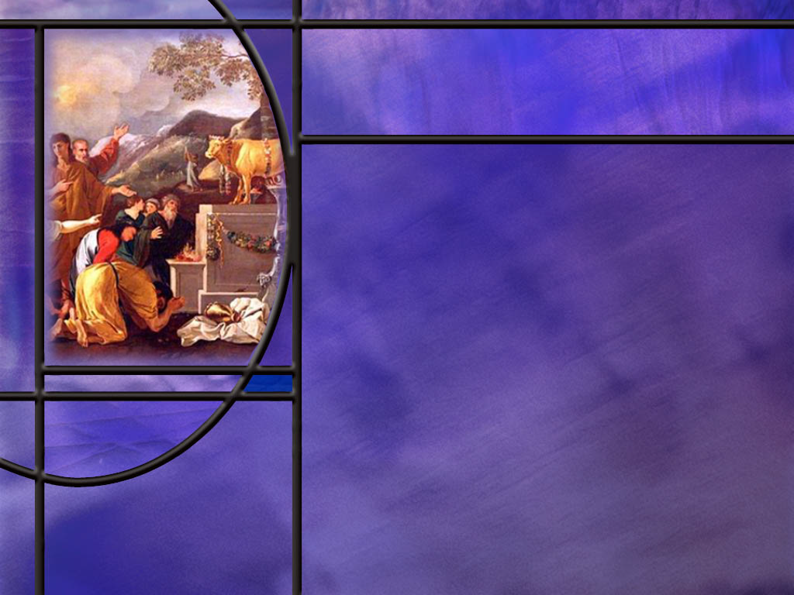
Food Offered to Idols
How does Paul begin his teaching of food offered to idols? (1 Cor 8:1-3)
What knowledge does Paul affirm concerning the idols worshipped in pagan temples? (1 Cor 8:4)
What is Paul’s concern, then with eating food offered to idols? (1 Cor 8:7,9,13)
How does Paul summarize his guidance at the end of chapter 10? (1 Cor 10:27-28)
In what other areas may we be more apt to cause our brothers to stumble?
Notes:
B1:
[See notes on linked slide.]
B2:
[See notes on linked slide.]
B3:
[See notes on linked slide.]
B4:
[See notes on linked slide.]
B5:
1. None of us are going to be asked to eat food sacrificed to idols.
2. So how can we apply Paul’s teaching here to our Christian lives today?
3. Where might we cause our brother to stumble?
4. There are some Christians, perhaps even some Adventists who believe that the Bible does not condemn alcohol in moderation, only drunkenness.
5. But if we choose to drink in moderation, we could be a stumbling block to other Christians or to our own family and friends, particularly our children.
6. Paul’s teaching in Romans 14 echoes his teaching here in 1 Corinthians.
Romans 14:21 ESV - It is good not to eat meat or drink wine or do anything that causes your brother to stumble.
7. With alcohol, we are dealing here not just with matters of conscience but with an addiction that can ruin a life.
8. Why fluff the pillow on the devil’s bed?
9. The Bible says that drunkards will not inherit the kingdom of God.
10. Stay as far away as you can from the devil’s devices.
11. You don’t have to be a Christian to recognize the evils of alcohol.
12. The Adventist health message s another area where we can become a stumbling block.
13. An emphasis on healthful diet and living before people are ready can drive them away.
14. We need to give the Holy Spirit time to work.
15. Not everyone can become a vegan overnight.
16. How many of us have really given up cheese and say no to pizza?
17. On the other hand, those who eat meat should not be extoling the virtues of a high protein red meat diet to those who have chosen a simpler and healthier alternative.
18. Another area where we might be a stumbling block is in Sabbath observance.
19. The Bible says we should not be buying of selling on the Sabbath.
20. Some may think it is ok to go out and purchase a meal on the Sabbath.
21. Others would insist on purchasing food before and after the Sabbath.
22. Some travel on the Sabbath and purchase gas.
23. Others would be sure to fill up before the Sabbath and after.
24. Some do the dishes on the Sabbath; others leave them in the sink.
25. We need to be careful in our Sabbath observance not to tempt others to violate their conscience by our own choices.
26. Other areas where we may be a stumbling block is our choice of TV programs or movies or entertainment venues.
27. These can have an influence on our children and family members.
28. While we may have the freedom to watch questionable content, make sure we are not causing others to stumble.
29. Our entertainment should be positive and uplifting.
30. Finally we night think of being a stumbling block in the way we talk about others.
31. We don’t need any slander, gossip, bitterness, revenge, or malice in the church.
32. We want people who are loving and uplift others and give them the benefit of the doubt.
33. We need to think before we speak and ask ourselves these questions based on “think” as an acronym:
T- Is it true?
H- is it helpful?
I- is it Important?
N- is it necessary?
K- is is kind?

Slide 5
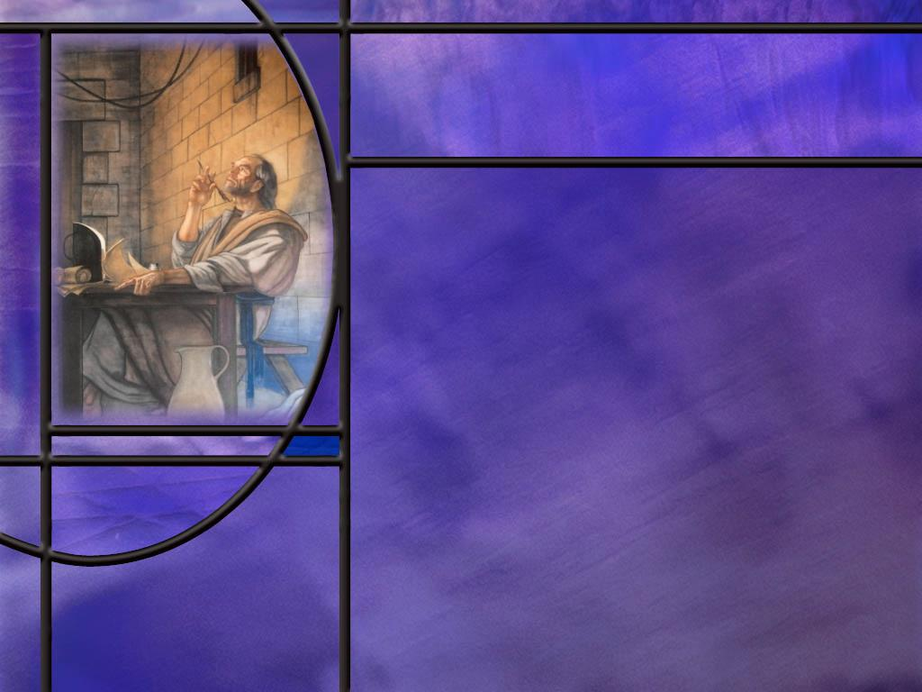
Selfless Service
What rights does Paul claim as an apostle and minister of the gospel? (1 Cor 9:4-6)
How does Paul use the temple service to support his right to be supported? (1 Cor 9:13-14)
Though he claims the right of support, what support did Paul actually take? (1 Cor 9:12,15,18)
How did the apostle Paul approach different groups of people to win them to Christ? (1 Cor 9:19-23)
How does Paul’s description of his selfless service in chapter 9 fit together with his guidance in chapter 8 on food offered to idols?
Notes:
B1:
[See notes on linked slide.]
B2:
[See notes on linked slide.]
B3:
[See notes on linked slide.]
B4:
[See notes on linked slide.]
B5:
1. Paul’s message in 1 Corinthians 9 is that he has real apostolic rights (including the right to be financially supported and to “eat and drink” as other apostles do).
2. But he deliberately chooses to forgo those rights so that nothing will hinder the gospel or cause others to stumble.
3. So, Chapter 9 functions as a personal illustration of the principle he gives in chapter 8 about food offered to idols:
4. Christian freedom is real, but love for others and faithfulness to God may require voluntarily limiting that freedom.
5. In other words, 1 Corinthians 9 answers the question: “If we have freedom, why limit it?”
6. Paul’s answer: because the gospel and the spiritual welfare of others matter more than my rights.
7. This is the same reason he tells the “strong” in Corinth to refrain from any use of food that causes a brother to stumble.
8. Your brother’s welfare is more important than your rights to eat as you please.

Slide 6
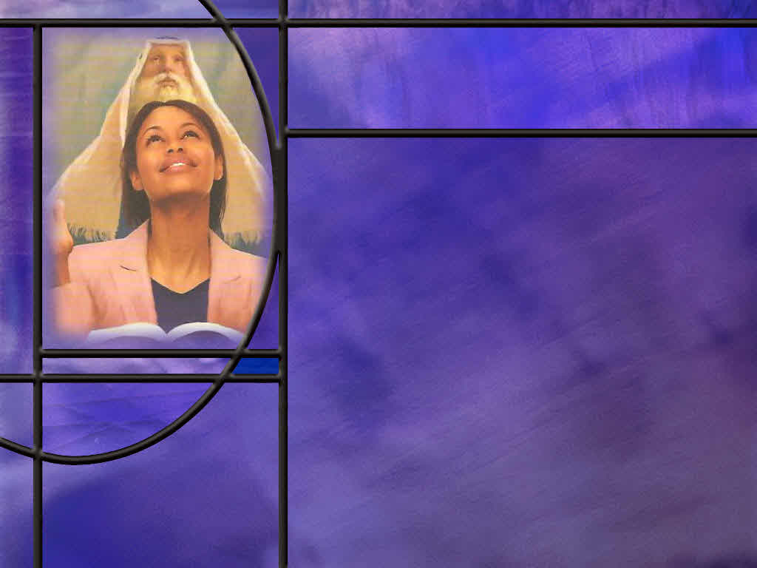
Avoiding Idolatry
After reminding his readers of Israel’s unfaithfulness to God including their idol worship, what encouraging promise does he give them? (1 Cor 10:13-14)
What does Paul point out about idolatry that makes it particularly dangerous? (1 Cor 10:19-20)
How does Paul end his argument on food offered to idols?
Notes:
B1:
[See notes on linked slide.]
B2:
[See notes on linked slide.]
B3:
1. Basically he ends it with our memory text.
1 Corinthians 10:31 KJV - 31 Whether therefore ye eat, or drink, or whatsoever ye do, do all to the glory of God.
2. You can share communion in the church to the glory of God, but you can’t eat at the idol’s table in a pagan temple inhabited by demons to the glory of God.
3. You can eat meat from the market in your own home to the glory of God without asking if it has been sacrificed to idols.
4. But if it has been identified as sacrificial meat, you cannot eat it to the glory of God because it may cause a brother to stumble or be taken as evidence that your faith has been compromised.
5. His principle is that we should not demand our own rights but, in love, think of how our action will affect others who see us.
6. He ends this section by again citing his own example.
1 Corinthians 10:33 ESV - just as I try to please everyone in everything I do, not seeking my own advantage, but that of many, that they may be saved.
1 Corinthians 11:1 ESV - Be imitators of me, as I am of Christ.
7. And, of course, that is what Jesus did too: He came to die that many might be saved.

Slide 7
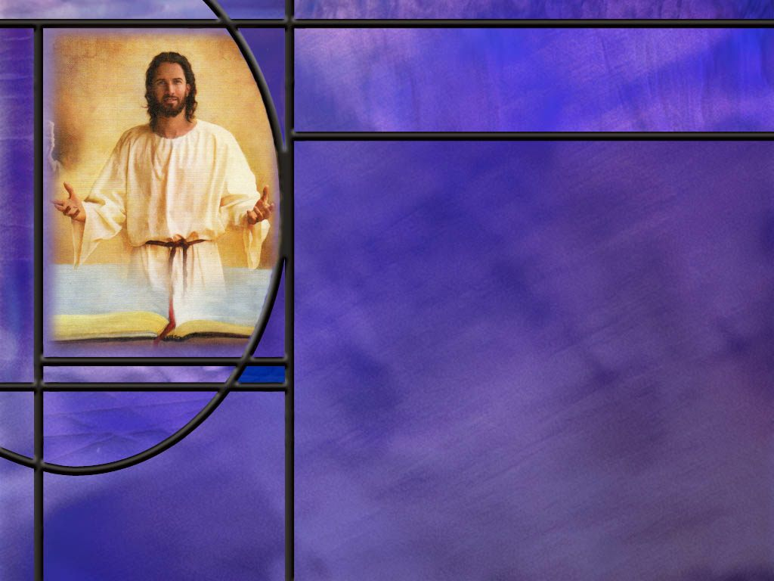
Summary
In 1 Corinthians 8–10, Paul addresses a problem in Corinth: whether believers may eat food that has been sacrificed to idols.
Apparently, some in Corinth believed that since idols are nothing and there is only one God, eating meat offered to idols is harmless.
Paul agreed theologically, but set a higher practical standard: love limits liberty.
The danger is not the food but the effect of one’s actions on others.
If a “strong” believer eats in an idol’s temple, a weak brother may be emboldened to do the same against his conscience and thus be led into sin.
Love for our brother should prevent us from being a stumbling block to him.

Slide 8
Summary
This principle is applicable to many other areas of life in the church.
Paul illustrates this principle with his own life.
He has apostolic rights that he has chosen to forgo, so as not to put an obstacle in the way of the gospel.
He works to support himself, so he can present the gospel free of charge.
He becomes “all things to all people” to win some, adapting to their ways without compromising the truth.
If an apostle can forgo his rights for the gospel, surely the “strong” in Corinth can forgo certain meals for the sake of a weak brother.

Slide 9
Summary
Paul encourages the Corinthian church to learn from Israel’s experience.
He instructs them to flee idolatry.
He informs them that there are demonic powers behind the idols to whom the Gentiles sacrifice.
Thus, eating food in an idol’s temple as part of a cultic meal is forbidden.
Food in the marketplace or served in a private home is to be received with thanksgiving, but If someone explicitly says, “This has been offered in sacrifice,” then do not eat.
The principle is well summarized in our memory text.
Will you aim your life this week, in whatever you do, at bringing glory to God?

Slide 11
Isaiah 43:7 ESV
“everyone who is called by my name, whom I created for my glory, whom I formed and made." [R]
Notes:
1. This is the Lord speaking about the gathering of Israel, and we can apply this to the gathering of the redeemed.
Q1: According to this verse, why did God create us?
1. He created us for His glory.
2. He created us to be the recipients of His goodness, His steadfast love and compassion, His grace and mercy and faithfulness and forgiveness.
3. In the Presbyterian church where I grew up, we had a statement of faith called the Westminster Confession.
4. It was a question-and-answer format that enumerated our beliefs.
5. The first question was, “What is the chief end of man?”
6. That is equivalent to asking, What is the chief purpose of mankind?
7. Here is the answer that was given in the Westminster Confession:
8. “The chief end of man is to glorify God and enjoy Him forever.”
9. As Adventists, I think we can agree.
10. Our chief purpose in life is to bring glory to God, and, in the end, to enjoy Him forever through resurrection and eternal life.
11. We glorify God by living a life that pleases God: trusting Jesus as our Savior, living in obedience to His commandments, confessing our sins and receiving His forgiveness, growing in love for Him each day, sharing His love with those around us, meditating on His word, communing with Him in prayer, letting our light shine in this world of darkness…
12. Here’s a second reason that God created us in the words of the 24 elders:
Revelation 4:11 KJV - Thou art worthy, O Lord, to receive glory and honor and power: for thou hast created all things, and for thy pleasure they are and were created.
13. Our highest pleasure will be found in bringing pleasure to our Creator by living to His glory.

Slide 12
1 Corinthians 8:1-3 ESV
Now concerning food offered to idols: we know that "all of us possess knowledge." This "knowledge" puffs up, but love builds up. ² If anyone imagines that he knows something, he does not yet know as he ought to know. ³ But if anyone loves God, he is known by God. [R]
Notes:
1. Here it appears that Paul is moving on to another question raised by the Corinthian church in a letter they wrote to Paul s mentioned in 1 Cor 7:1.
2. So now, in response to their letter, he is moving from advice on marriage to food offered to idols.
Q1: What does Paul begin talking about to introduce the subject of food offered to idols?
1. He starts by talking about knowledge.
2. The words know and knowledge are used 7 times in these three verses.
3. Paul introduces the word knowledge in the first verse with the words in quotations there.
4. This may have been a saying in the culture of Corinth speaking of worldly knowledge as opposed to divine revelation.
5. And Paul draws a contrast between worldly knowledge and love.
6. His key statement here is “knowledge puffs up but love builds up.”
7. His point is not that knowledge is bad, but that knowledge without love inflates the individual rather than the church, whereas love builds up and strengthens the body of believers.
8. So his point in this section is that our knowledge of truth has to be combined with agape love from God in order to be edifying in the church.
9. When we love God and trust in His Son, the HS will produce agape love in our hearts that will unify and build up the church.

Slide 13
1 Corinthians 8:4 ESV
Therefore, as to the eating of food offered to idols, we know that "an idol has no real existence," and that "there is no God but one." [R]
Notes:
Q1: If you have an idol made of marble in the image of one of the Greek or Roman gods or goddesses in a temple, what is it really?
1. It is really just a piece of stone that has no real being or life it itself.
2. It obviously cannot think or act or speak or influence anything.
3. As Christians, we know that there is only one true living God.
4. He is the only wise and powerful and true God who is omnipotent, omniscient, omnipresent, transcendent, imminent, and changeless in character.
5. So Paul is making the argument that, for some who are convinced of this truth, there is no harm in eating food that is offered to a stone!
6. It is really not a god.
7. It has no being.

Slide 14
1 Corinthians 8:7,9,13 ESV
However, not all possess this knowledge. But some, through former association with idols, eat food as really offered to an idol, and their conscience, being weak, is defiled. ... 9 But take care that this right of yours does not somehow become a stumbling block to the weak. ... 13 Therefore, if food makes my brother stumble, I will never eat meat, lest I make my brother stumble. [R]
Notes:
Q1: How may some who are “weak” view the food offered to idols?
1. They may see the idol as a real god of which the stone image is only a representation.
2. This is exactly what you will find if you question a Roman Catholic about the worship of images in the RC church.
3. “Oh,” they will say, ”We are not worshipping this image of the virgin Mary. It is just a representation to remind us of the real virgin Mary up in heaven.”
4. Well, the virgin Mary is not a god, and she is not up in heaven answering prayers.
5. So, a similar view may have been held by some who had come out of the pagan worship of the Greek and Roman pantheon of gods.
Q2: What was Paul’s concern for these “weak” believers that had recently been converted to the Christian faith?
1. He was concerned that the strong believers who saw no problem with eating food offered to idols would become a stumbling block to the weak.
2. Here is what he says in verse 10:
1 Corinthians 8:10 ESV - For if anyone sees you who have knowledge eating in an idol's temple, will he not be encouraged, if his conscience is weak, to eat food offered to idols?
3. So, Paul’s council to the strong brother is to eat what he wants in private but don’t eat if there is someone present who may be tempted to violate his conscience by what he sees you doing.
4. Here Paul gets back to the theme of love in the church.
5. Temper your knowledge and your rights and freedoms in the Lord with love for others in the church.
6. Paul makes himself a personal example in the last verse here.
7. If there is a chance he could make his brother stumble, he will not eat meat at all.
8. And, as Adventists, we know that a diet without meat would be better for him anyway.

Slide 15
1 Corinthians 10:27-28 ESV
If one of the unbelievers invites you to dinner and you are disposed to go, eat whatever is set before you without raising any question on the ground of conscience. ²⁸ But if someone says to you, "This has been offered in sacrifice," then do not eat it, for the sake of the one who informed you, and for the sake of [his] conscience-- [R]
Notes:
Q1: What is Paul’s concern in the situation he describes here?
1. It seems to be that the unbeliever will think the Christian is compromising his faith by eating food offered to a pagan idol.
2. By refusing to eat what has been offered to the idol, the Christian can witness that he has undivided loyalty to the true God and to Him alone.
3. This is consistent with other guidance on this issue in the early church.
4. The Jerusalem council in Acts 15 gave this decree:
Acts 15:28-29 ESV – “For it has seemed good to the Holy Spirit and to us to lay on you [Gentiles] no greater burden than these requirements: ²⁹ that you abstain from what has been sacrificed to idols, and from blood, and from what has been strangled, and from sexual immorality. If you keep yourselves from these, you will do well. Farewell.“
5. So Paul is saying here, for the sake of our Christian witness in the pagan world, if someone tells you this meat has been sacrificed to idols, don’t eat it.
6. Otherwise, assume that it has not been sacrificed to idols, you don’t have to ask.

Slide 16
1 Corinthians 9:1, 4-6 ESV
Am I not free? Am I not an apostle? Have I not seen Jesus our Lord? Are not you my workmanship in the Lord? ... ⁴ Do we not have the right to eat and drink? ⁵ Do we not have the right to take along a believing wife, as do the other apostles and the brothers of the Lord and Cephas? ⁶ Or is it only Barnabas and I who have no right to refrain from working for a living? [R]
Notes:
Q1: What does Paul claim here as his rights as an apostle and minister of the gospel?
1. He claims the right to eat and drink, to have his daily meals provided.
2. He claims the right to get married and take a believing wife with him like the other apostles.
3. He claims the right to not have to work to support himself during his apostolic ministry.
4. He goes on in verse 7 to draw some analogies to other workers.
1 Corinthians 9:7 ESV - 7 Who serves as a soldier at his own expense? Who plants a vineyard without eating any of its fruit? Or who tends a flock without getting some of the milk?
5. Then he points out that Moses commanded farmers not to muzzle the ox that is treading grain.
6. His point is that he has a right to expect support for his ministry.

Slide 17
1 Corinthians 9:13-14 ESV
Do you not know that those who are employed in the temple service get their food from the temple, and those who serve at the altar share in the sacrificial offerings? ¹⁴ In the same way, the Lord commanded that those who proclaim the gospel should get their living by the gospel. [R]
Notes:
Q1: How did the priests in the temple get fed?
1. The priests and Levites lived off of the tithe.
2. They shared in the sacrificial offerings presented at the temple.
3. Paul is saying the same should be true for those who minister in the NT gospel.
Q2: When Jesus sent out the 70 disciples, how much food were they to take with them?
1. They were to take nothing to sustain them.
Luke 10:4-5, 7 ESV - Carry no moneybag, no knapsack, no sandals, and greet no one on the road. 5 Whatever house you enter, first say, 'Peace be to this house!' ... 7 And remain in the same house, eating and drinking what they provide, for the laborer deserves his wages.
2. Based on the Lord’s example, Paul is saying that he too deserves support for his gospel ministry.

Slide 18
1 Corinthians 9:12, 15, 18 ESV
If others share this rightful claim on you, do not we even more? Nevertheless, we have not made use of this right, but we endure anything rather than put an obstacle in the way of the gospel of Christ. ... ¹⁵ But I have made no use of any of these rights, nor am I writing these things to secure any such provision. For I would rather die than have anyone deprive me of my ground for boasting. ... ¹⁸ What then is my reward? That in my preaching I may present the gospel free of charge, so as not to make full use of my right in the gospel. [R]
Notes:
Q1: How much support did Paul take from those to whom he preached?
1. He took nothing.
2. He fully supported himself by working as a tentmaker.
3. His desire was to put no obstacle in the way of the gospel of Christ.
4. He said he would rather die than have to charge people to hear the gospel of salvation.
5. He would not claim his right of support so that he could present the gospel free of charge.
6. So here we see Paul’s selflessness as a servant of Christ.
7. His love for the Lord and for the lost motivated him to support himself so others could hear the gospel for free.

Slide 19
1 Corinthians 9:19, 23 NLT
Even though I am a free man with no master, I have become a slave to all people to bring many to Christ. ... ²³ I do everything to spread the Good News and share in its blessings. [R]
Notes:
1. Between these two verses, Paul describes his ministry to various groups of people.
2. “When I was with the Jews, I lived like a Jew to bring the Jews to Christ.”
3. “When I am with the Gentiles who do not follow the Jewish law, I too live apart from that law so I can bring them to Christ.
4. “When I am with those who are weak, I share their weakness, for I want to bring the weak to Christ.”
5. “I am made all things to all men, that I might by all means save some.”
Q1: What analogy does Paul use to describe how he prepares to preach the gospel.
1. He uses the analogy of an athlete training for competition.
2. He is in the race to win the prize, an incorruptible prize.
3. He goes into training and is temperate in all things.
4. He runs with purpose; he lands every punch.
5. He disciplines his body to preach with purpose.

Slide 20
1 Corinthians 10:13-14 ESV
No temptation has overtaken you that is not common to man. God is faithful, and he will not let you be tempted beyond your ability, but with the temptation he will also provide the way of escape, that you may be able to endure it. ¹⁴ Therefore, my beloved, flee from idolatry. [R]
Notes:
Q1: What is the promise of this verse?
1. First, the Lord will not allow us to be tempted above our ability to resist the temptation.
2. Second, He will provide a way of escape that we may be able to endure it.
Q2: If this is true, why do we fall into sin so many times when we are tempted?
1. It must be that we don’t recognize or take the way of escape provided.
2. Many times, we may react to the situation without stopping to look for the way of escape.
3. Flashes of anger in reaction to the stimuli come very quickly.
4. We react without even realizing we are being tempted.
5. We speak without stopping to think and evaluate the situation.
6. Or perhaps we do recognize the temptation but don’t choose the way of escape that the Lord provides.
7. We would rather get revenge than stop and pray and forgive.
8. If we sin, it is not because God failed, but because we did not take the exit He provided.
9. This is particularly true of idolatry.
10. This is a conscious decision to worship something other than the true living God of the Bible.
11. And we can avoid it by quoting the Scriptures as Jesus did.
12. It is written: Thou shalt have no other gods before Me.

Slide 21
1 Corinthians 10:19-20 NKJV
What am I saying then? That an idol is anything, or what is offered to idols is anything? ²⁰ Rather, that the things which the Gentiles sacrifice they sacrifice to demons and not to God, and I do not want you to have fellowship with demons. [R]
Notes:
Q1: Who does Paul point to as the power behind idols and idolatrous religions?
1. He says that when Gentiles sacrifice to their idols, they sacrifice to demons.
2. Satan and His demonic hosts are only too willing to take the worship offered to idols as worship to themselves.
3. This has been Satan’s desire from time he rebelled in heaven: he wants to be worshipped.
4. So, idols are not just representations of some false god that has no power.
5. They are the habitation of demons and lead their worshippers to demonic enslavement.
6. People pray to their idols and the demonic powers can act to bring about changes and influences that make it seem like the idol has heard and answered their prayer.
7. So people can be sucked into the demonic world of spiritism.
8. No wonder God describes himself as a jealous God: He wants us to be faithful to Him as our loving husband, not committing spiritual adultery with demonic forces that will lead to our destruction.

