Slide 1
First and Second Corinthians
Lesson 2
The Message of the Cross

Slide 2

Memory Text
1 Corinthians 1:18 NIV
For the message of the cross is foolishness to those who are perishing, but to us who are being saved it is the power of God.
Into what two groups of people does this verse divide humanity?
What is the message of the cross?
How do those who are perishing see the cross?
How do those who are being saved see the cross? (Rom 1:16-17)
Notes:
B2:
1. Here Paul looks at all of humanity and sees “those who are perishing” and “those who are being saved.”
2. In the end, we either perish or are saved.
3. The same was true in Noah’s day.
4. Those in the ark were saved from the flood and those outside perished.
5. And Jesus said that when He comes again it will be as it was in the days of Noah.
6. The world will be divided into two groups of people: those who are saved and those who are lost.
7. When He comes, probation is closed, every case is decided, the saved will meet Him in the air, the lost will be destroyed at His coming. (2 Thes 1:9)
8. So even now, Paul sees this division in the human race between those who are perishing and those who are being saved.
B3:
1. The message of the cross is the Gospel, the good news about what Christ did there to save us by dying for our sins.
2. It is at the cross that God gave to fallen humanity His amazing gift of grace.
3. The cross made it possible for sinners to be saved.
4. Paul summarized the difference that the cross makes in Rom 6:23
Romans 6:23 KJV - For the wages of sin is death; but the gift of God is eternal life through Jesus Christ our Lord.
5. Here again we see the two groups of humanity:
6. Those who are perishing receive the wages of sin: death.
7. Those who are being saved receive eternal life as a gift of grace because of what Jesus did on the cross.
8. He took our penalty of death so that we can be forgiven and receive eternal life.
9. This is the message of the cross.
B4:
1. To them it is foolishness.
2. This would be particularly true in the Greek and Roman culture that prevailed in Corinth.
3. Corinth was a city that admired public speaking, intellectual and philosophical skill, pride, and social status.
4. The God’s that were worshipped in these cultures were all considered to be super human and powerful.
5. In that setting, a Savior who died by Roman execution did not look impressive; it looked like defeat, not victory.
6. Crucifixion was the most humiliating forms of death in the Roman world, especially reserved for slaves and traitors.
7. So proclaiming “Christ crucified” would have sounded scandalous to Jews and absurd to Gentiles, because it reversed ordinary ideas of honor, strength, and divine favor.
8. In our culture today we still have many who consider the message of the cross foolishness.
9. These would be mostly atheists, agnostics, and secularists who deny the authority of the word of God and treat the Bible as a myth.
10. These have an evolutionary and humanistic worldview that excludes the God of the Bible.
B5:
[Hold link]
1. We see the cross as the power of God.
2. The cross is the power of God to save sinners.
3. God doesn’t save sinners by ignoring their sin.
4. He saves them by sending His own Son to pay the penalty of death for their sins.
5. Paul expands on the power of God in Rom 1:16-17
[Click link]

Slide 3
Overview
In Corinth, Paul was determined to preach the gospel of Christ and Him crucified, risen, and coming again. While some would see such preaching as foolishness, in reality, it is the wisdom and power of God to save sinners.
  The Gospel
  God’s Wisdom and Power
  Paul’s Preaching
  Summary

Slide 4
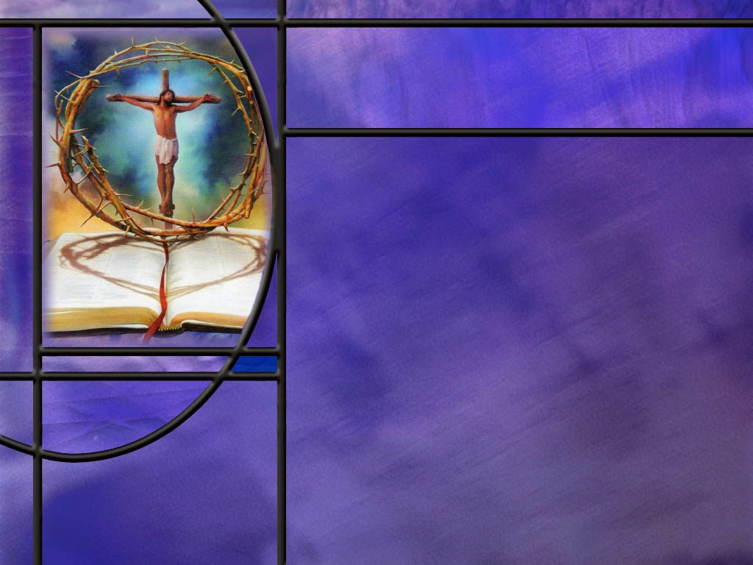
The Gospel
What is the meaning of the word “Gospel?”
How would you define in your own words the gospel of salvation?
What verse of Scripture is often called the gospel in a nutshell? (John 3:16)
How does the apostle Paul give the bad news of sin and the good news of the gospel? (Rom 6:23)
What does the apostle Paul include in His definition of the gospel? (1 Cor 15:1-4)
How does Paul describe the gospel in Rom 3:24-26?
Notes:
B1:
1. Gospel comes from the Greek euangelion (yoo-ang-ghel'-ee-on).
2. It simply means good message or good news.
3. Now there are all kinds of things in the Bible that are good news, but not all good news is the gospel as the NT writers describe it.
4. Jesus came preaching the gospel of the Kingdom.
5. This was the good news that Jesus was the King of a kingdom that someday would be established and last forever.
6. And those who would be His disciples would be gathered into that Kingdom of glory.
7. But when Jesus died on the cross for the sins of the world, the word “gospel” took on a new dimension.
8. The gospel became the good news about how to be saved.
9. So the gospel that we preach after the cross is the gospel of salvation.
B2:
1. The gospel of salvation is the good news that Jesus Christ died for our sins and rose again, and sinners are saved at His return by loving Him, trusting Him, and receiving Him as their Savior and Lord, trusting in His shed blood for the forgiveness of their sins and eternal life with God.
B3:
[See notes on linked slide.]
B4:
[See notes on linked slide.]
B5:
[See notes on linked slide.]
B6:
[See notes on linked slide.]

Slide 5
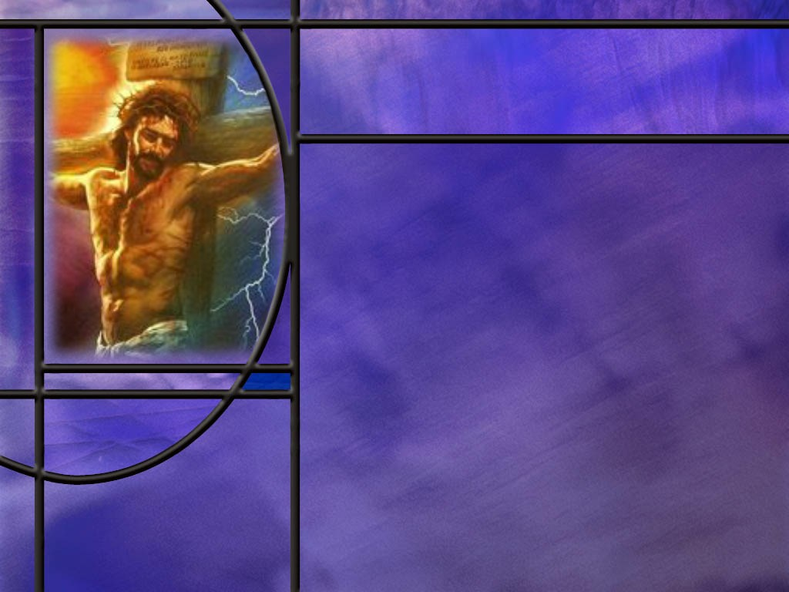
God’s Wisdom and Power
How does Paul contrast the wisdom of the world with the wisdom of God? (1 Cor 1:19-21)
What objections did the Jews and Greeks have o the gospel Paul preached? (1 Cor 1:22-24)
What are the Jews and Greeks missing when they think of Jesus as a crucified and defeated Messiah?
What can we say to scoffers we encounter to convince them that it is not foolish to believe in Christ.
In God’s wise and powerful plan of salvation, who gets the glory? (1 Cor 1:31)
Notes:
B1:
[See notes on linked slide.]
B2:
[See notes on linked slide.]
B3:
1. They are missing Christ’s resurrection, His ascension, His high priestly ministry, and His coming again to save the redeemed.
2. The resurrection is God’s stamp of approval on all that Jesus said and did.
3. Paul writes in:
Romans 1:3-4 NKJV - Jesus Christ our Lord, …was … declared to be the Son of God with power according to the Spirit of holiness, by the resurrection from the dead.
3. We do not worship a dead defeated Messiah but one who is victorious over death and the grave, the one who will give us the victory too when He returns.
4. Paul will get to this in chapter 15 of 1 Corinthians.
1 Corinthians 15:54, 57 NKJV - So when this corruptible has put on incorruption, and this mortal has put on immortality, then shall be brought to pass the saying that is written: "Death is swallowed up in victory." ... 57 But thanks be to God, who gives us the victory through our Lord Jesus Christ.
5. We too will be victorious over death through the cross of Christ.
6. The cross is not a defeat; it is the apex of God’s plan of redemption and victory for Christ and those He has redeemed.
B4:
1. The only real evidence we have to go on for faith in Jesus Christ is found in the Bible.
2. So we have to provide evidence for why we believe the Bible is the word of God.
3. There are two key words here: Bible and God.
4. Let’s start with the second word first: the evidence is overwhelming that there is a God.
5. Here’s a very simple proof called the law of cause and effect: everything that has a beginning has a cause; the universe had a beginning; therefore, the universe had a cause.
6. This cause must be beyond the universe because the universe cannot cause itself. So the cause must be beyond time and space. It must be timeless, spaceless, immaterial, uncaused, and very powerful.
7. This cause we call God.
8. The fact that God created is validated by the specified complexity of even the simplest living things which could never have come to life by time and chance.
9. So God created the living things on earth for a purpose.
10. God chose to reveal His purpose, His love, and His plans to mankind through the inspired writings of the prophets and apostles that are collected into a book we call the Bible.
What evidence do we have that the Bible is true?
1. There are a number of reasons: It’s uniqueness, it’s confirmation by archaeology, the wealth of manuscript evidence, its careful transmission by meticulous scribes, and its ability to change lives.
2. But the greatest objective evidence that the Bible is God’s word is its fulfilled prophecy.
3. The Bible makes hundreds of predictions hundreds of years in advance concerning cities, countries, and kingdoms; concerning individuals and events; concerning the Messiah and His mission, and concerning the times that things would occur.
4. And these prophecies come to pass as the Bible has predicted.
5. To summarize: creation proves God exists and has created us with a purpose in mind.
6. Fulfilled prophecy proves that the Bible is God’s word through which He communicates His plan and purpose for our lives.
7. We also have a personal testimony of what Christ has done for us and how he has forgiven our sins, changed our lives, and given us hope.
8. Armed with these, we have legitimate reasons for faith in the Lord Jesus Christ.
B5:
[See notes on linked slide.]

Slide 6
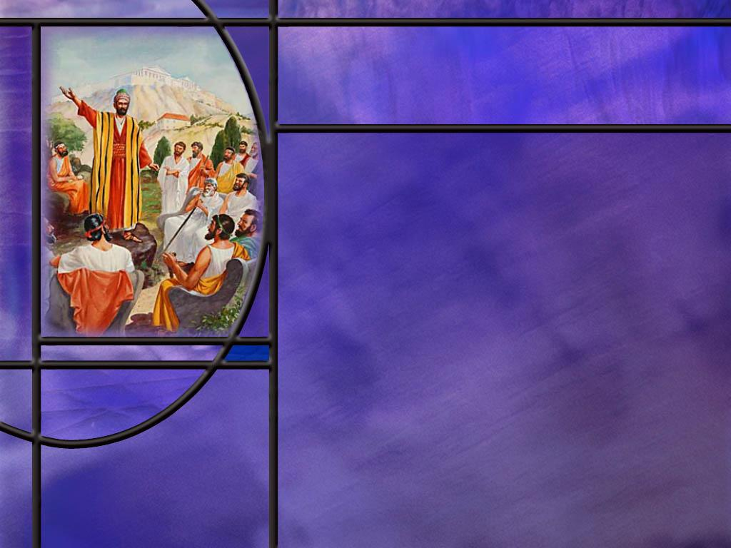
Paul’s Preaching
What was the focus of Paul’s preaching as he began his ministry in Corinth? (1 Cor 2:1-2)
How did Paul describe his preaching in Corinth? (1 Cor 2:3-5)
Notes:
B1:
[See notes on linked slide.]
B2:
[See notes on linked slide.]

Slide 7

Summary
As Paul began his ministry in Corinth, he determined to focus his ministry on Christ and Him crucified.
This we understand as a reference to the gospel of salvation by grace through faith.
Paul’s clearest definition of the gospel is that Christ died for our sins, was buried, and rose the third day according to the scriptures. To that we could add His return to give us eternal life.
The gospel of salvation is the good news that Jesus Christ died for our sins and rose again, and sinners are saved at His return by loving Him, trusting Him, and receiving Him as their Savior and Lord, trusting in His shed blood for the forgiveness of their sins and eternal life with God.

Slide 8
Summary
In the Roman and Greek culture of Corinth, the message of a crucified Messiah would naturally be ridiculed as foolishness.
What they needed to know was that God raised Jesus from the dead, placed His stamp of approval on all that Jesus said and did, gave Him all authority in heaven and earth, and He is coming back to save the redeemed and give them eternal life.
The cross is not a defeat; it is the apex of God’s plan of redemption and victory for Christ and those He has redeemed.
Paul insists that true wisdom and power is found in Jesus Christ. He is the power of God in the sense that His sacrifice for our sins allows God to forgive us sinners and save us and give us eternal life in His Kingdom.

Slide 9
Summary
He is the wisdom of God in the sense that God’s saving plan is revealed, carried out, and made known in Jesus, especially through the cross and the resurrection.
In His wisdom, God has chosen a way of salvation that defeats sin, humbles human pride, and reconciles sinners to himself.
God’s wise and powerful plan of redemption gives us nothing to boast about. We can add nothing to the perfect righteousness that is ours by faith in Christ.
In facing the challenge of preaching in Corinth, Paul describes himself as weak, fearful, and trembling, but he preached the word in the power of the Spirit providing a solid foundation for faith.
Will you hold fast to the gospel that saves?

Slide 11
Romans 1:16-17 ESV
For I am not ashamed of the gospel, for it is the power of God for salvation to everyone who believes, to the Jew first and also to the Greek. ¹⁷ For in it the righteousness of God is revealed from faith for faith, as it is written, "The one who is righteous by faith shall live." [R]
Notes:
Q1: Where do we see the Power of God in this text?
1. Paul says it is in the Gospel.
2. The Gospel is the message of the cross.
3. The cross displays the power of God to forgive sins and bring salvation to everyone who believes.
4. Those perishing look at the cross as the defeat for Jesus, being cursed by being hung on a tree.
5. Those being saved look at the cross as the power of God to forgive sins and declare sinners to be righteous when they trust in Jesus and lay their sins on Him.
6. Our greatest need is to be forgiven and have a perfect righteousness placed to our account.
7. And the cross of Christ give God the power to do that.

Slide 12

John 3:16 KJV
For God so loved the world, that he gave his only begotten Son, that whosoever believeth in him should not perish, but have everlasting life. [R]
Notes:
Q1: What, if anything, would you add to this verse to make it perfectly clear?
1. What about those who say, “Oh I believe that Jesus was a great moral teacher and set a good example of how to live.”
2. Is that enough to be saved?
3. No!
4. We have to believe in Jesus as our own personal Savior and lay our sins on Him, asking for forgiveness.
5. Just to make this verse perfectly clear, I would read it this way: “whosoever believeth in Him for the forgiveness of sins should not perish, but have everlasting life.
6. That makes it clear that the kind of belief needed for eternal life is the kind that justifies us and makes us righteous.
7. This is righteousness by faith.

Slide 13
Romans 6:23 KJV
For the wages of sin is death; but the gift of God is eternal life through Jesus Christ our Lord. [R]
Notes:
Q1: What’s the bad news of this verse?
1. The wages of sin is death.
2. And elsewhere Paul writes: “All have sinned and come short of the glory of God. (Rom 3:23)
Q2: And what’s the good news?
1. The gift of God is eternal life through Jesus Christ our Lord.
2. So the good news is that eternal life comes as a gift from God.
3. It is not something that we earn or merit. It is all of grace.
4. And it comes through Jesus Christ.
5. The implication of this verse is that through a relationship with Jesus Christ, our sins are forgiven so that we are no longer subject to the wages of sin.
6. So again, this verse points to justification as the key to eternal life.
7. And justification is the declaration that we are not guilty.
8. Remember justify: just-as-if-I had not sinned.

Slide 14
1 Corinthians 15:1-4 KJV
Moreover, brethren, I declare unto you the gospel which I preached unto you, which also ye have received, and wherein ye stand; 2 By which also ye are saved, if ye keep in memory what I preached unto you, unless ye have believed in vain. 3 For I delivered unto you first of all that which I also received, how that Christ died for our sins according to the scriptures; 4 And that he was buried, and that he rose again the third day according to the scriptures: [R]
Notes:
Q1: What did Paul preach to the Corinthians?
1. The gospel.
Q2: When they received the gospel, believed it, and stood firm in it, what did it do for them?
1. It saved them.
2. There may be a lot of things we can call “good news,” but the gospel that Paul is talking about here is what saves is.
3. It is the good news of salvation in Jesus Christ.
4. Paul also takes a swipe here in verse two at the false doctrine of “once saved always saved.”
5. Instead, he is saying, “once saved, always saved, as long as you stay saved.”
6. If you apostatize and turn from the gospel, you have “believed in vain.”
Q3: What is the essence of the gospel that Paul delivered to them?
1. Three points:
2. Christ died for our sins, He was buried, and He rose again the third day.
3. And it all happened according to the prophecies of Scripture.
4. The essence of the gospel can be reduced to five words: “Christ died for our sins.”
5. His burial proved that He was dead; His resurrection proved that God accepted His sacrifice for our sins and we have a living Savior.
6. So the essence of the gospel is that our sins can be forgiven by laying them on Christ.
7. This is justification by faith in the blood of Jesus.

Slide 15
Romans 3:24-26 NIV
and all are justified freely by his grace through the redemption that came by Christ Jesus. 25 God presented Christ as a sacrifice of atonement, through the shedding of his blood--to be received by faith. He did this to demonstrate his righteousness, because in his forbearance he had left the sins committed beforehand unpunished-- 26 he did it to demonstrate his righteousness at the present time, so as to be just and the one who justifies those who have faith in Jesus. [R]
Notes:
Q1: Verse 24: How are we justified and declared “not guilty?”
1. We are justified by the grace of God because Jesus died to redeem us from the wages of sin.
2. That’s the gospel!
3. It is further explained in the first part of verse 25.
4. In the shedding of His blood, Christ became a sacrifice of atonement.
5. Atonement is “at-one-ment” with God.
6. He atoned for our sins by paying the penalty for them, so we can be forgiven and reconciled to God.
7. And this shedding of blood for the forgiveness of sins is to be received by faith.
8. In verse 24 we have the grace of God providing our redemption, and in verse 25 we have the faith of mankind receiving it.
9. We are saved by grace, God’s part, through faith, our part. (Eph 2:8-9)
Q2: Whose sins committed beforehand were left unpunished?
1. These would be the righteous of OT times all the way back to Adam and Eve.
2. God was patient waiting for the atoning sacrifice of Christ, which paid the penalty for their sins as well.
3. The writer to the Hebrews reminds us:
Hebrews 10:4 KJV - For it is not possible that the blood of bulls and of goats should take away sins.
4. Paul says here that God included them in the forgiveness that Jesus would bring when He died for the sins of the whole world.
5. Even though they didn’t know to call upon the name of Jesus and trust Him as their sacrifice, they were to be included in those who were to be forgiven by His shed blood.
6. As long as they repented and confessed their sins, trusting in the living God to provide for Himself the atoning sacrifice that would cover their sins, they would be saved by grace through faith.
7. Essentially, they were looking forward to the sacrifice of Jesus without knowing who He was.
8. Here in the heart of his wonderful presentation in Romans of justification by faith, Paul reminds us that the sacrifice of Jesus reaches all the way back to the first sin.
9. This is consistent with Hebrews 9:15 which says that “Christ died to set them free from the penalty of the sins they had committed under that first covenant.”
10. The sacrifice of Christ is retroactive. Their forgiveness was provisional until Christ died on the cross for their sins.
11. So when Christ died, we can now see the justice of God.
12. He provided for Himself the sacrifice that would forgive sins both under the old covenant and the new.

Slide 16
1 Corinthians 1:19-21 NIV
For it is written: "I will destroy the wisdom of the wise; the intelligence of the intelligent I will frustrate." ²⁰ Where is the wise person? Where is the teacher of the law? Where is the philosopher of this age? Has not God made foolish the wisdom of the world? ²¹ For since in the wisdom of God the world through its wisdom did not know him, God was pleased through the foolishness of what was preached to save those who believe. [R]
Notes:
Q1: How does Paul begin his discussion of divine vs. human wisdom?
1. He begins with Scripture: “It is written.”
2. Here in verse 19 Paul quotes the prophet Isaiah in Isa 29:14.
3. The Lord would overturn the wisdom of the wise.
4. Human brilliance cannot discover the true God of the Bible on its own.
5. We can see from the natural world around us that there is a Creator beyond our comprehension.
6. We can marvel at the order, the complexity, the design, the beauty of His creation.
7. We can see His eternal power and godhead from the things He has made.
8. But the natural world alone cannot reveal the meaning and purpose of life.
9. It cannot tell us how to relate to God, how to know Him, how to serve Him, how to please Him, how to worship Him, how to be saved by Him and live in His presence.
10. In verse 20, Paul asks what have we learned from human wisdom?
11. He declares that God has made foolish the wisdom of the world.
Q2: Left to its own, what forms of religion have human wisdom and reasoning given us?
1. Those in our culture who claim to be the intellectual elite have gravitated to skepticism, atheism, and humanism.
2. They have accepted the lie of evolution and think that there is no God who created them and no purpose and meaning in life beyond what they create for themselves.
3. They reject the Bible as God’s truth, and miracles as unscientific.
4. They have no hope beyond the grave.
5. Such is the result of human wisdom in our culture.
6. In other cultures, human wisdom has devised false religions and false gods: idolatry, ancestor worship, the immortality of the soul, reincarnation, and salvation by human achievement.
7. Paul concludes in verse 21 that “the world through its wisdom did not know God.”
Q3: How did God’s true wisdom correct the false wisdom of the world?
1. God revealed His plan of salvation at the cross of Christ.
2. And it is the preaching of the Gospel, the message of the cross, that saves those who believe.
3. While the world might think that the cross is foolishness, it is God’s plan of salvation for all who believe.
4. It is grace that sets Christianity apart from every other religion in the world.
5. We are not saved by our good works.
6. We are saved by the grace of God, sending Jesus to die for our sins.
7. And we receive that grace by faith, trusting in Jesus to forgive our sins and place His righteousness to our account.

Slide 17
1 Corinthians 1:22-24 NIV
Jews demand signs and Greeks look for wisdom, ²³ but we preach Christ crucified: a stumbling block to Jews and foolishness to Gentiles, ²⁴ but to those whom God has called, both Jews and Greeks, Christ the power of God and the wisdom of God. [R]
Notes:
Q1: What kind of a Messiah were the Jews expecting?
1. By and large, the Jews were expecting a conquering Messiah that would sit on the throne of king David.
2. They were expecting that He would deliver them from Roman domination.
3. The second psalm was generally viewed as a messianic psalm.
4. It speaks of the anointed one as a conquering king.
5. Here are a couple of verses:
Psalm 2:8-9 NKJV - Ask of Me, and I will give You The nations for Your inheritance, And the ends of the earth for Your possession. ⁹ You shall break them with a rod of iron; You shall dash them to pieces like a potter's vessel.’ “.
6. They were not looking for a humble carpenter to die for their sins.
7. In fact, to be hung on a tree was considered to be cursed by God.
8. Paul mentions this in Gal 3:13
Galatians 3:13 NKJV - Christ has redeemed us from the curse of the law, having become a curse for us (for it is written, "Cursed is everyone who hangs on a tree"),
9. Here he is quoting Deut 21:23.
10. So, it is not surprising that Paul met some opposition from the Jews.
11. But Paul had plenty of ammunition in the Messianic prophecies of the OT to convince them that, at His first coming, the Messiah would be a Suffering Servant, and only at His second coming, a conquering king.
Q2: What about the Greeks and the Romans? Why would they think a crucified Messiah would be foolishness.
1. Their gods were all super-human, always successful, always victorious.
2. They would never imagine that a real god could be crucified.
3. How could a god be so humiliated and defeated as to die on a cross?
4. To believe in such a god would be foolishness.
5. Their distain for such a god can be seen in the ridicule they heaped upon Christians.
6. An example is shown in the next slide.
[Go to next slide]
[Return here]
Q3: What does Christ become to those Jews and Greeks who believe the gospel that Christ died for our sins?
1. Christ becomes the power of God and the wisdom of God.
2. He becomes the power of God in the sense that His sacrifice for our sins allows God to forgive us sinners and save us and give us eternal life in His Kingdom.
3. What can wash away my sins? Nothing but the blood of Jesus!!
4. There is power in the Blood. Power to redeem, cleanse, and save the worst of sinners.
5. Christ is also the wisdom of God.
Q4: In what sense is Christ the wisdom of God?
1. Christ is the wisdom of God in the sense that God’s saving plan is revealed, carried out, and made known in Jesus, especially through the cross and the resurrection.
2. What looks like weakness or foolishness to the world is actually God’s wise way of saving believers.
3. God has chosen a way of salvation that defeats sin, humbles human pride, and reconciles sinners to himself.
4. That is why Paul can pair “power” and “wisdom” together:
5. The cross looks foolish and powerless to the world, but it is actually God’s wise and powerful act of redemption.

Slide 18
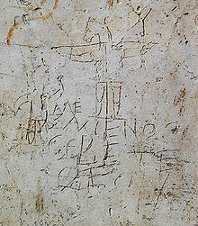
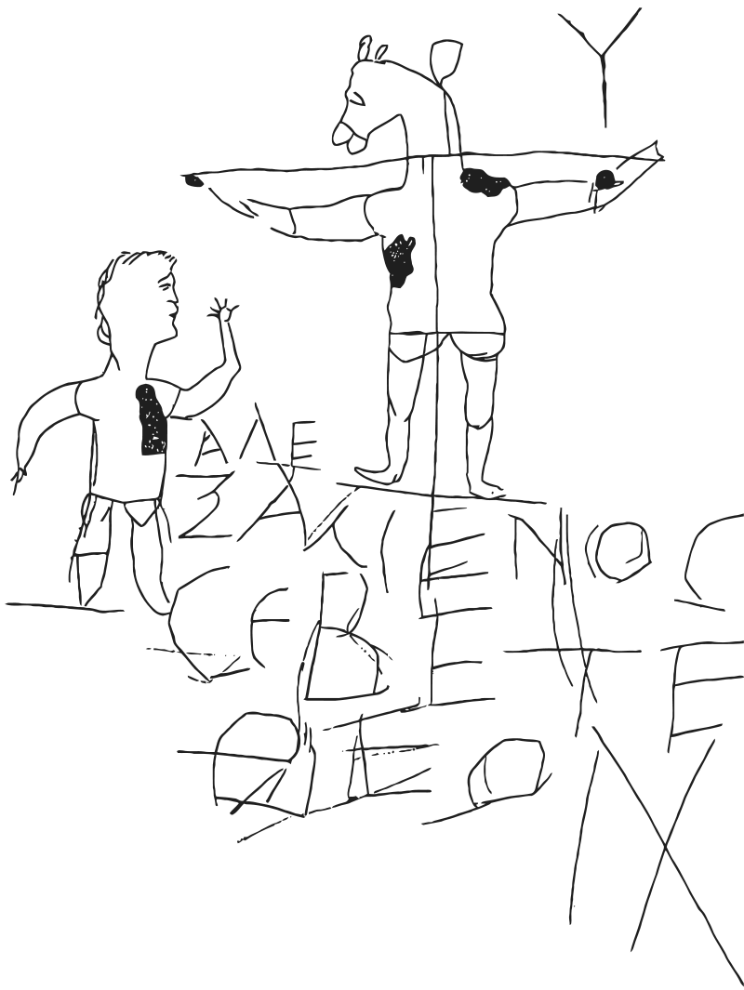
Early Roman graffiti mocking Christian worship.
The inscription reads: "Alexamenos worships [his] God".
Notes:
1. On the left is the famous Alexander graffiti found in Rome in the 1800’s.
2. It dates back to the 1st to 3rd centuries AD.
3. The actual graffiti is on the left while a reproduced drawing is on the right.
4. This is an example of persecution of Christians for the cross of Christ, considered foolishness by the Greeks and Romans.
5. This graffiti was scratched on a plaster wall of a school in Rome used for the training of page boys.
6. This is a drawing of a cross with the body of a man being crucified and having the head of a donkey.
7. To the left of the cross is a drawing of a man raising his hand to worship the figure.
8. The inscription says: “Alexamenos worships [his] God.”
9. So here we get an idea of how foolish some of the Greeks and Romans found the idea of a crucified god.
[Return to previous slide.]

Slide 19
1 Corinthians 1:31 NKJV
that, as it is written, "He who glories, let him glory in the LORD." [R]
Notes:
Q1: To whom does the praise and glory belong for the plan of redemption?
1. God’s wise and powerful plan of redemption gives us nothing to boast about.
2. It is all of grace.
3. It is God’s unmerited favor toward mankind.
4. Christ takes our sin and gives us His righteousness.
5. We are justified by His shed blood.
6. We are sanctified by the Holy Spirit that is given to all who are justified.
7. Our part is simply to trust in Jesus, depending on Him to save us.
8. There is nothing we can add to His perfect righteousness.
9. There is no good work we can brag about that added to our salvation.
10. There is no merit even in our faith, because saving faith puts its trust in Jesus not in ourselves.
11. Glory to God alone! (One of the five “solas” of the Reformation).

Slide 20
1 Corinthians 2:1-2 ESV
And I, when I came to you, brothers, did not come proclaiming to you the testimony of God with lofty speech or wisdom. ² For I decided to know nothing among you except Jesus Christ and him crucified. [R]
Notes:
Q1: What was central to Paul as he began the work in Corinth?
1. Paul saw as his central task, preaching the gospel.
2. He was in Corinth to make disciple for Christ and to organize them into a Christian church.
3. The gospel was fundamental to that effort.
4. The church can get involved in a lot of different activities and ministries.
5. We can have a Dorcas society that helps the needy.
6. We can have a soup kitchen that feeds the hungry.
7. We can have pot lucks that build community and friendships.
8. We can have cooking schools and health fairs and seminars on the health message.
9. We can have grief recovery seminars and stop smoking clinics.
10. But until people are confronted with the gospel, they will not become disciples of Jesus and desire to be baptized into the church.
11. This is a challenge for pastors and preachers.
12. Every sermon should seek to find a way to include Christ and Him crucified.
Q2: When Paul speaks of the gospel, what else is included besides Christ and Him Crucified?
1. In his definition of the gospel in 1 Cor 15:1-4, Paul says:
1 Corinthians 15:3-4 NKJV - … Christ died for our sins according to the Scriptures, ⁴ and that He was buried, and that He rose again the third day according to the Scriptures,
2. So the Gospel includes the death of Christ for our sins and His resurrection on thje third day.
3. This goes along with what Paul writes in Rom 10:9
Romans 10:9 NKJV - if you confess with your mouth the Lord Jesus and believe in your heart that God has raised Him from the dead, you will be saved.
4. So, believing the resurrection of Jesus is part of the gospel that saves.
5. I would add one more thing to the gospel.
6. Paul doesn’t include it here, but it seems to make sense if we are talking about what saves us.
7. We are not ultimately saved until Jesus returns to save us.
8. We need to be resurrected or translated before we can enter the Kingdom of God.
9. Particularly as Adventists that believe the biblical state of the dead, without the second coming when we put on immortality, we are dead and perish.
10. So the full gospel is the message that Christ died for our sins, He was raised from the dead, and he will save us when He returns as He promised.

Slide 21
1 Corinthians 2:3-5 ESV
And I was with you in weakness and in fear and much trembling, ⁴ and my speech and my message were not in plausible words of wisdom, but in demonstration of the Spirit and of power, ⁵ so that your faith might not rest in the wisdom of men but in the power of God. [R]
Notes:
Q1: How does Paul describe his preaching here?
1. He describes himself as weak and fearful and trembling.
2. But I don’t think that means his preaching was weak, fearful and trembling.
3. Because he says his preaching was in demonstration of the Spirit and of power.
4. This reminds us of his thorn in the flesh, a reminder of his weakness and limitations.
5. But then he says “when I am weak, then I am strong.”
6. In using a weaker vessel, more glory goes to God.
7. Perhaps that is what he is saying here.
8. He comes to Corinth with weakness, fear, and trembling, facing a task much bigger than for what he alone brought to the effort.
9. But the Spirit of God empowered him to share the gospel effectively.
10. It was not with human wisdom and logic that he preached.
11. It was not with finely honed oratory that captivated the audience.
12. It was in demonstration of the Spirit and of power.
13. This could well mean that the Spirit used Paul to base his preaching on the divinely inspired word of God.
14. As Paul would later write to Timothy:
2 Timothy 4:2 KJV - Preach the word; be instant in season, out of season; reprove, rebuke, exhort with all longsuffering and doctrine.
15. Paul preached the word so that their faith would rest on the power of God, not on human wisdom.

