Slide 1
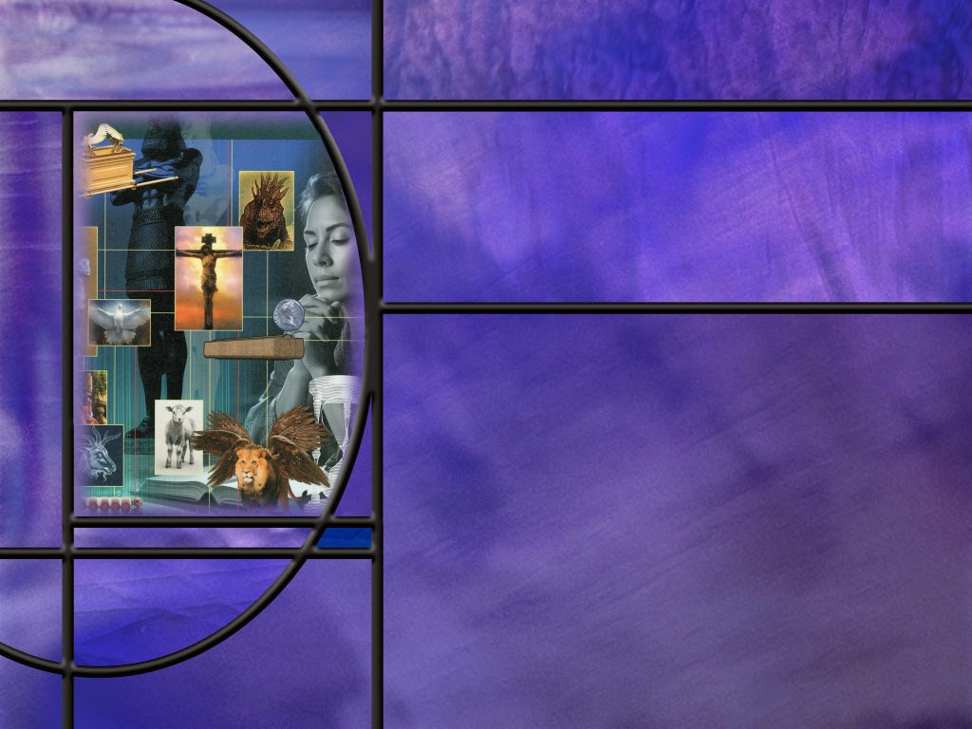
Allusions Images Symbols: How to Study Bible Prophecy
Lesson 11
Ruth and Esther

Slide 2
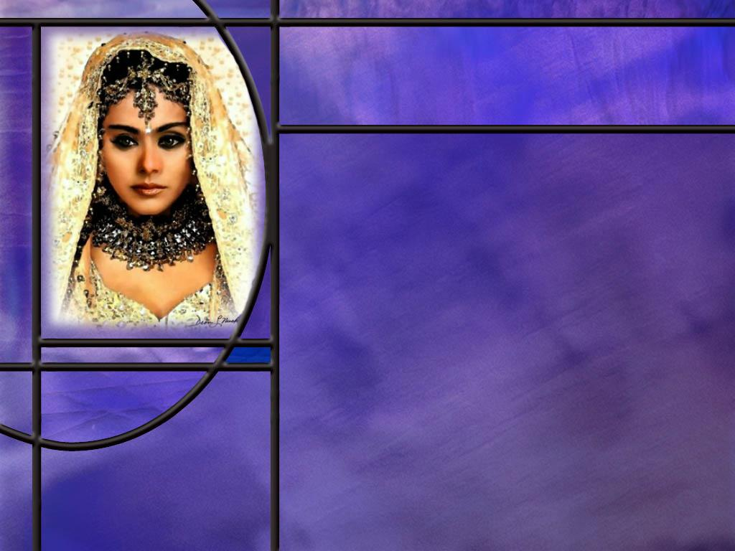
Memory Text
Esther 5:2 NKJV
So it was, when the king saw Queen Esther standing in the court, that she found favor in his sight, and the king held out to Esther the golden scepter that was in his hand. Then Esther went near and touched the top of the scepter.
What chance was Esther taking by coming before the king without being summoned?
How did Esther prepare for going before the king? (Esther 4:16)
What confidence can we have as we come before our King?
Notes:
B2:
1. It was not without some fear and trepidation that she stood there before the king.
2. She was actually taking her life in her hands.
3. We find the background story in Esther chapter 4.
4. The wicked Hamen, who is a type of Satan, had conspired against Mordecai and all the Jews of the kingdom of Persia to have them killed on a particular day, the 13th of Adar.
5. King Ahasuerus had signed the decree, not knowing that Esther, his queen, was a Jew who would have to be executed if the decree was carried out.
6. Esther wanted to go before the king and plead for her life and the life of her people, but Persia had a law about going before the king.
7. Here is what she said to her cousin Mordecai:
Esther 4:11 NKJV - "All the king's servants and the people of the king's provinces know that any man or woman who goes into the inner court to the king, who has not been called, he has but one law: put all to death, except the one to whom the king holds out the golden scepter, that he may live. Yet I myself have not been called to go in to the king these thirty days.“
8. So, if she goes in to the king without being called, she’s taking her life in her hands.
9. Her only hope is that the king will hold out his golden scepter to receive her.
B3:
[See notes on linked slide.]
B4:
1. We are invited to come boldly before the throne of grace:
Hebrews 4:16 NKJV - Let us therefore come boldly to the throne of grace, that we may obtain mercy and find grace to help in time of need.
2. We don’t have to be summoned to come before our King.
3. Our High Priest does not have office hours; we don’t need an appointment.
4. We can pray anytime amd anywhere.
5. We can pray without ceasing.
6. Jesus ever lives to make intercession for us.
7. When He is our Savior, Lord, and King, we will not have to fear, “if I perish, I perish.”
8. His promise is “whosoever believeth in Him shall not perish but have everlasting life.”

Slide 3
Overview
Ruth discovered a life-transforming relationship with Boaz, her kinsman-redeemer. So too may our lives be transformed as we fall in love with our kinsman-Redeemer, Jesus. As Esther was instrumental in delivering her people from the predations of Haman, so, we too can look forward to deliverance from the predations of Satan by our coming King.
  Ruth and Naomi
  Ruth and Boaz
  Esther and Haman
  Summary

Slide 4
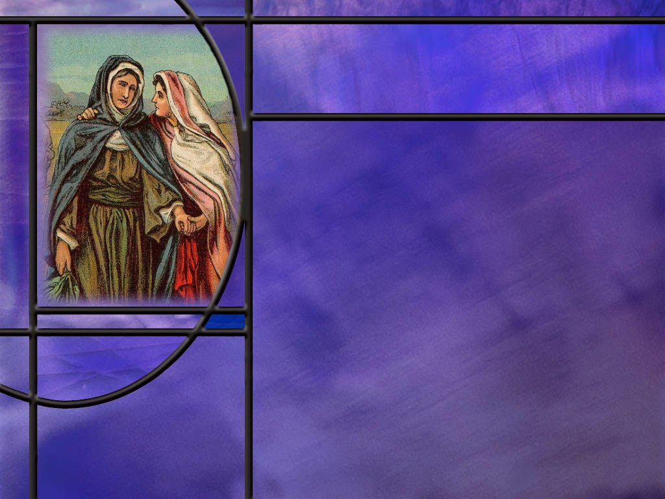
Naomi and Ruth
What misfortune befell the family of Elimelech? (Ruth 1:1-5)
What did Ruth urge her daughters-in-law to do as she headed back to Bethlehem?
How strong was the bond between Ruth and her mother-in-law, Naomi? (Ruth 1:16-17)
What do the choices of Ruth and Orpah have to do with the Great Controversy?
Notes:
B1:
[See notes on linked slide.]
B2:
1. She urged them to return to the homes where they grew up, and to find a husband to take the place of her sons who had died.
2. They both wept and wanted to go with her, but she finally convinced Orpah to return home, and she did so.
3. But Ruth refused.
B3:
[See notes on linked slide.]
B4:
1. Here we see two choices: one to go forward and the other to turn back.
2. In choosing to go forward with Naomi, Ruth was choosing her God, Yahweh, and her people, God’s chosen people, Israel.
3. To turn back, Orpah was choosing the idols of Moab and a people that did not know the true God or worship Him.
4. We are confronted with the same two choices in the GC.
5. We can choose to serve the true God by receiving His Son Jesus as our Savior from sin and fellowship with God’s people.
6. Or we can choose to worship the idols of this world: the lust of the flesh, the lust of the eyes, and the pride of life.
7. We can follow Ruth toward God and His people or Orpah toward idols and the enemies of God’s people.
8. Our destiny depends on the choice we make.

Slide 5
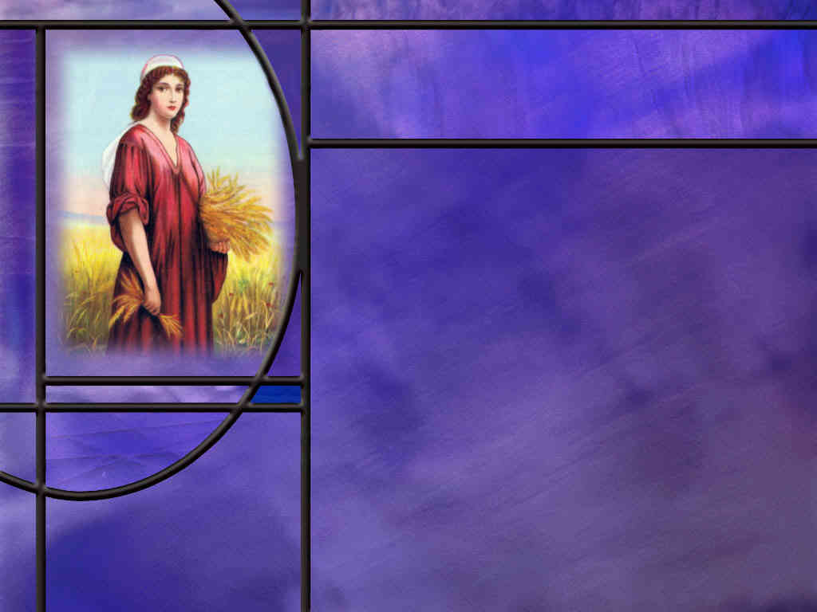
Ruth and Boaz
What kind of man was Boaz? (Ruth 2:1-23)
How did Ruth respond to Boaz? (Ruth 2:10,13)
What did it mean in OT times to redeem someone as their kinsman-redeemer?
How did Ruth ask to be redeemed? (Ruth 3:8-9)
What did Boaz have to do to redeem Naomi and Ruth? (Ruth 4:9-10)
How has Jesus become our kinsman-redeemer?
To whom did Jesus pay the ransom to redeem us?
Notes:
B1:
[See notes on linked slide.]
B2:
[See notes on linked slide.]
B3:
1. The redeemer was the next of kin, a family member.
2. The redeemer could buy back a slave related to him or pay his debt to keep him from going into slavery.
3. The redeemer could also marry his relative’s widow to redeem her from childlessness.
4. This was based on the law of levirate marriage, in which a brother or close relative was obliged to marry his brother’s widow if the brother had no children.
5. This would prevent the dead brother from losing his name and possessions among the people of God.
6. This was the kind of kinsman-redeemer that Boaz was to Ruth.
B4:
[See notes on linked slide.]
B5:
[See notes on linked slide.]
B6:
1. First, Jesus became our kinsman by becoming one of us.
2. In the incarnation, He joined the human family and was born with human flesh.
3. He had all the physical liabilities of humanity but none of the sinful propensities.
4. He was fully human so He could be the kinsman for every sinner.
5. Like the kinsman redeemer, Jesus wants to marry His bride, the church.
6. He doesn’t just pay the ransom; He marries the ransomed.
7. He wants to have an intimate relationship with us forever and ever.
8. He wants us to be fruitful citizens of His kingdom.
9. He wants to shower us with His love, and He wants us to respond by loving Him back.
10. That relationship can begin as soon as we accept Him as our kinsman and Redeemer.
B7:
1. Even though we were enslaved by the devil, it was not to the devil that the ransom was paid.
2. Redemption is a metaphor for what Christ did in becoming our substitute and dying in our place.
3. The best we can do is to say that the ransom was paid to the justice of God.
4. God’s justice was satisfied by the substitutionary death of Christ for the sins of the world.
5. As the creator, His life was worth more than all of His creatures.
6. As the sinless Son of God, His death was sufficient to pay for the sins of the world.

Slide 6
Esther and Haman
What caused Haman to hate Mordecai and desire to destroy all the Jews? (Esther 3:2.5)
Of what other exiles does Mordecai remind you in his refusal to worship Haman?
What was Esther’s request of the king at the second banquet? (Esther 7:3-4)
What positive benefits resulted from God’s working through Esther and Mordecai? (Esther 8:17)
How should we respond if we face the death decree for refusing the Mark of the Beast?
Notes:
B1:
[See notes on linked slide.]
B2:
1. In the previous kingdom of Babylon, Shadrach, Meshach, and Abednego refused to bow down and worship Nebuchadnezzar’s image.
2. Their refusal marked them for death in the fiery furnace.
3. Mordecai’s refusal marked him for death along with all of his people, and all their goods could be plundered by those who killed them.
B3:
[See notes on linked slide.]
B4:
[See notes on linked slide.]
B5:
1. Let’s resolve to be faithful to the end, no matter how severe the threats against us.
2. In the words of Queen Esther: “If I perish, I perish.”
3. If we perish in the death decree, this is only the first death.
4. It is God who will have the final say on who lives eternally and who perishes in the second death.
5. Our security, regardless of the threats we face, is in our relationship with Jesus.
1 John 5:12 NKJV - He who has the Son has life; he who does not have the Son of God does not have life.
Let’s choose life by choosing Jesus!

Slide 7
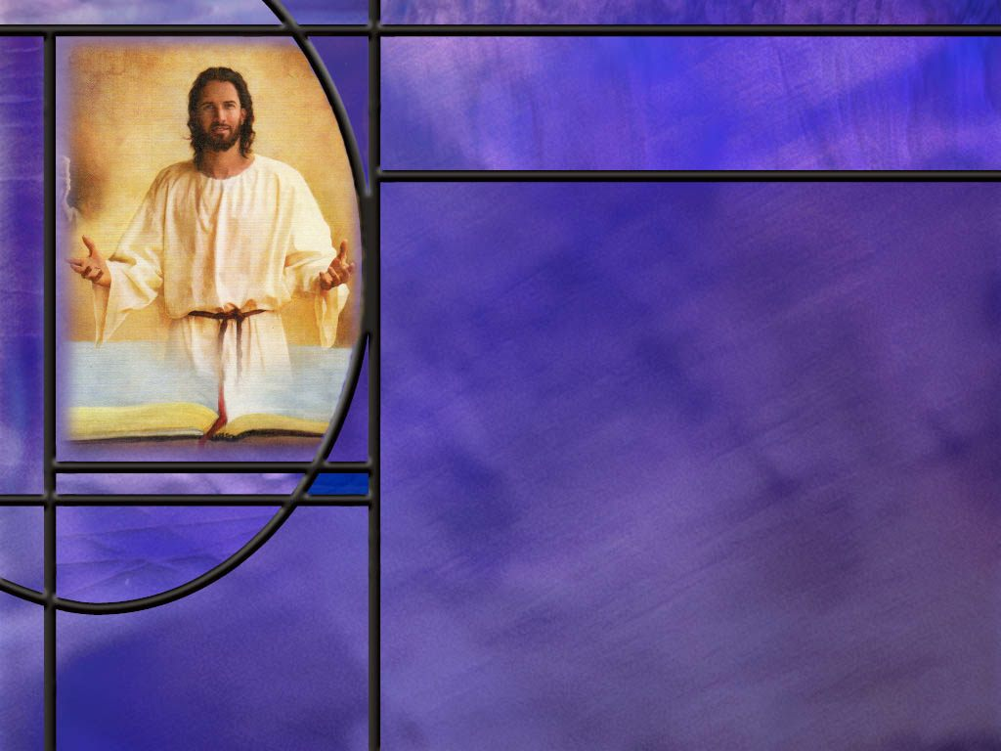
Summary
The stories of Ruth and Esther are memorable narratives of how God is able to deliver His people.
Naomi was so discouraged by the loss of her husband and two sons that she wanted to changer her name to Mara (bitter).
But she was supported by a daughter-in-law who refused to abandon her and a God who was able to deliver her and work all things together for good.
Back in Bethlehem, Ruth found work gleaning in the fields of Boaz, a relative of her dead husband and a godly man who showed her great kindness.
Their relationship of love and respect for each other provided a firm foundation for marriage.

Slide 8
Summary
Ruth “proposed” to Boaz by laying at his feet at night, and asking him to spread the corner of his covering over her and be her kinsman-redeemer.
We too have a kinsman-Redeemer. Understanding Boaz as a type of Christ, we need to kneel at the feet of Jesus, ask Him to spread the corner of His righteous robe over us, forgive our sins, and redeem us.
Through their new relationship with their kinsman-redeemer, God worked all things together for good for Naomi and Ruth.
In the story of Esther, Haman is a type of Satan out to destroy all who will not bow in worship before him.
Esther responded to the death decree with three days of fasting and prayer.

Slide 9
Summary
Then she courageously went before the king without being summoned saying, “If I perish, I perish.”
God turned the tables completely on Haman and his wicked plans.
When the king discovered that his queen was a Jew and that Mordecai, who had saved his life, was a Jew, he ordered Haman hung on the gallows he had built for Mordecai.
God’s people were completely delivered and now regularly celebrate the feast of Purim in remembrance.
If you have to face the death decree for refusing the mark of the beast, will you do so with confidence in a God who is able to work all things together for good?

Slide 11
Esther 4:16 NKJV
[Message to Mordecai] "Go, gather all the Jews who are present in Shushan, and fast for me; neither eat nor drink for three days, night or day. My maids and I will fast likewise. And so I will go to the king, which is against the law; and if I perish, I perish!“ [R]
Notes:
Q1: What preparation did Esther make for going before the king?
1. Well, I’m sure she made herself beautiful and appealing, but that’s not what the Bible records.
2. What did she do? She fasted for three days along with all her attendants.
3. And she sent word to Mordecai to have all the Jews in the capital city fast along with her.
Q2: Now what usually goes along with fasting?
1. Prayer always goes along with biblical fasting.
2. Biblical fasting is not to lose weight; it is to clear your mind to seek God with all your heart.
3. It is to take away the distraction of the routine of preparing food and eating so that you can devote yourself fully to seeking God in prayer.
4. So even though prayer is not specifically mentioned here, it is assumed to be the very reason for fasting.
5. And she had every reason to pray: she was taking her life in her hands and needed divine intervention to soften the king’s heart toward her.
Q3: How were their prayers answered?
1. The king held out his scepter to her and received her warmly. (Memory text)
Q4: Is there a lesson for us here?
1. Before we undertake a major step in ministry for the Lord, we need to prepare as well.
2. We need to spend time in earnest prayer, perhaps with fasting as well, to seek the Lord’s favor and guidance.
3. The best way for us to prepare for the challenges of life is to surrender to the will of God and seek His Spirit to lead us in the path we should go.
Proverbs 3:5-6 NKJV - Trust in the LORD with all your heart, And lean not on your own understanding; 6 In all your ways acknowledge Him, And He shall direct your paths.

Slide 12
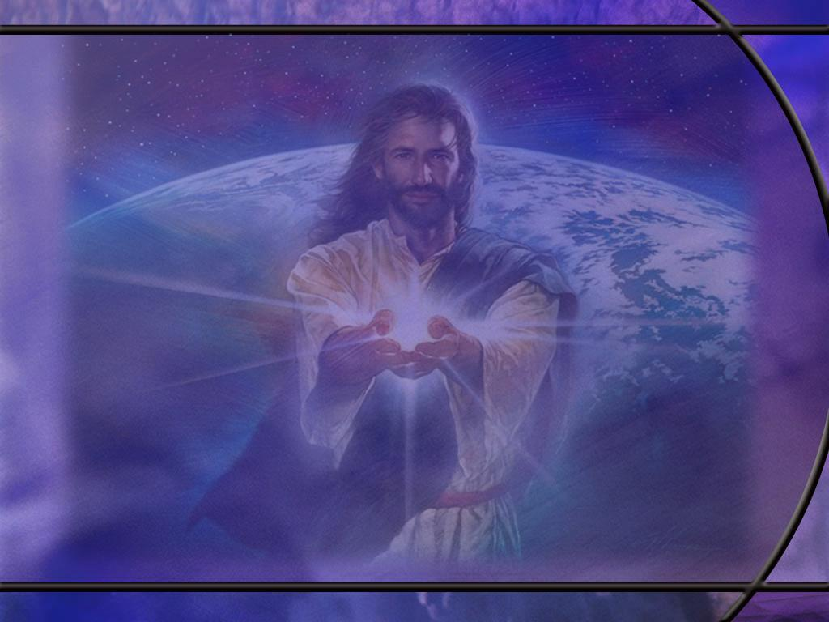
Ruth 1:1-5 ESV
In the days when the judges ruled there was a famine in the land, and a man of Bethlehem in Judah went to sojourn in the country of Moab, he and his wife and his two sons. ² The name of the man was Elimelech and the name of his wife Naomi, and the names of his two sons were Mahlon and Chilion. … ³ But Elimelech, the husband of Naomi, died, and she was left with her two sons. ⁴ These took Moabite wives; the name of the one was Orpah and the name of the other Ruth. They lived there about ten years, ⁵ and both Mahlon and Chilion died, so that the woman was left without her two sons and her husband. [R]
Notes:
Q1: How do you think Naomi is feeling at this point?
1. Maybe a little bit like Job?
2. The Lord has given and the Lord has taken away?
3. She was probably pretty discouraged at this point.
4. In fact, when she got back to Bethlehem, she wanted to change her name.
Ruth 1:20 ESV - She said to them, "Do not call me Naomi; call me Mara, for the Almighty has dealt very bitterly with me.
5. The word Mara means bitter.
6. So she, like Job, questioned the Lord: Why me, why now, why this?
7. Often in Hebrew thought, what the Lord does not prevent, he causes.
8. But as we learn from the book of Job, the cause of evil is often the work of Satan, not God.
Q2: Even though Naomi found herself in a very difficult situation, what resource did she still have on her side?
1. She had a God who loved her and was able to deliver her from her distress.
2. Romans 8:28 tells us something about the God she served.
Romans 8:28 NIV - And we know that, in all things, God works for the good of those who love him, who have been called according to his purpose.
3. God is in the business of bringing good out of the discord that Satan sows.

Slide 13
Ruth 1:16-17 ESV
But Ruth said, "Do not urge me to leave you or to return from following you. For where you go I will go, and where you lodge I will lodge. Your people shall be my people, and your God my God. 17 Where you die I will die, and there will I be buried. May the LORD do so to me and more also if anything but death parts me from you." [R]
Notes:
Q1: What kind of family ties do we see here between these two women?
1. They loved each other.
2. Ruth’s love for Naomi was stronger than her love for her own mother, her own home, her own countrymen, her own gods.
3. Naomi must have made a very positive impact on this young woman’s life.
4. While she may have realized that life would be easier in her own country where she could remarry and start over, it didn’t matter.
5. She loved Naomi too much to abandon, her.
6. One has to wonder if it was not only Naomi, but Naomi’s God that compelled her to seek a life in a nation where the true God was worshipped rather than idols.
7. Here she says, “Your God will be my God.”
8. And in the last line, she uses the LORD’s name, Yahweh (all caps), to swear her allegiance to Naomi.

Slide 14
Ruth 2:1, 4, 8-9 ESV
Now Naomi had a relative of her husband's, a worthy man of the clan of Elimelech, whose name was Boaz. ... 4 And behold, Boaz came from Bethlehem. And he said to the reapers, "The LORD be with you!" And they answered, "The LORD bless you." ... 8 Then Boaz said to Ruth, "Now, listen, my daughter, do not go to glean in another field or leave this one, but keep close to my young women. 9 Let your eyes be on the field that they are reaping, and go after them. Have I not charged the young men not to touch you? And when you are thirsty, go to the vessels and drink what the young men have drawn." [R]
Notes:
1. To get a better understanding of Boaz, we should read the whole chapter…
Q1: What can we glean from these verses about the kind of man Boaz was?
1. First, Scripture calls him a worthy man.
2. He was worthy of honor and praise among his fellow men.
3. He was a man of virtue.
4. Second, he was a godly man.
5. He greeted others with a godly blessing, “The LORD be with you.”
6. Third, he was kind, considerate, protective, and generous.
7. He wanted Ruth to be safe, and he knew she would be safe among his workers.
8. He told his young men not to touch her.
9. He told her to drink what she wanted from the water vessels for the workers.
10. He was complimentary.
11. He told Ruth how much he appreciated all she had done for Naomi.
12. And he invoked God’s blessing upon her saying:
Ruth 2:12 ESV - The LORD repay you for what you have done, and a full reward be given you by the LORD, the God of Israel, under whose wings you have come to take refuge!"
13. As we go on in the story, we find that Boaz was generous with his food, made sure Ruth got plenty to glean, and that she was not reproached or embarrassed by the other workers.
14. He was a kind, loving man with a big heart who loved the Lord and wanted the best for Ruth.

Slide 15
Ruth 2:10, 13 ESV
Then she fell on her face, bowing to the ground, and said to him, "Why have I found favor in your eyes, that you should take notice of me, since I am a foreigner?" ... ¹³ Then she said, "I have found favor in your eyes, my lord, for you have comforted me and spoken kindly to your servant, though I am not one of your servants.“ [R]
Notes:
Q1: How does Ruth respond to the kindness of Boaz here?
1. She is very humble and very respectful.
2. She calls him lord (lower case), and she calls herself his servant.
Q2: What characteristics exhibited by Boaz and Ruth provide a good foundation for marriage?
1. Boaz was kind and loving; Ruth was kind and respectful.
2. Love and respect are essential to a good marriage that will last.
3. Now both husband and wife should love and respect each other.
4. But it is true that women have a greater need for love and men have a greater need for respect.
5. The apostle Paul points this out at the end of Ephesians 5.
6. He tells wives to submit themselves to their own husband as unto the Lord.
7. And he tells husbands to love their wives even as Christ also loved the church and gave himself for it.
8. He summarizes his instructions to husbands and wives with these words:
Ephesians 5:33 ESV - However, let each one of you love his wife as himself, and let the wife see that she respects her husband.
9. Love and respect should form the foundation of Christian marriages that follow the Biblical ideal.

Slide 16
Ruth 3:8-9 NLT
Around midnight Boaz suddenly woke up and turned over. He was surprised to find a woman lying at his feet! ⁹ "Who are you?" he asked. "I am your servant Ruth," she replied. "Spread the corner of your covering over me, for you are my family [or kinsman] redeemer." [R]
Notes:
Q1: Who is proposing to whom?
1. This is actually Ruth proposing to Boaz.
2. She is asking him to become her kinsman-redeemer.
3. Apparently, this is the way it was done.
4. If someone wanted to be redeemed, they had to ask.
Q2: If Boaz is a type of Christ, how does this reflect how we are redeemed.
1. Certainly, Christ is willing to be our Redeemer.
2. That’s why He died.
3. But the point of the type here is that we need to ask Him to be our redeemer.
4. We need to kneel at His feet and ask Him to spread the corner of His righteous robe over us.
5. We need to receive Him as our Redeemer, and ask Him to forgive our sins.
6. Only when we permit Him to deal with our sins can He redeem us from eternal death.
7. We cannot be redeemed until we are justified by grace through faith.
8. We need to come to Jesus and ask Him to be our Savior from sin.

Slide 17
Ruth 4:9-10 NIV
Then Boaz announced to the elders and all the people, "Today you are witnesses that I have bought from Naomi all the property of Elimelek, Kilion and Mahlon. ¹⁰ I have also acquired Ruth the Moabite, Mahlon's widow, as my wife, in order to maintain the name of the dead with his property, so that his name will not disappear from among his family or from his hometown. Today you are witnesses!“ [R]
Notes:
1. So this was a meeting in the city gate of Bethlehem where Boaz gathered a group of witnesses and another relative of Elimelek.
2. This was a closer relative than Boaz, so he had first dibs on purchasing the land.
3. He was actually going to buy the land until Boaz informed him that he would also have to marry Ruth.
4. At that point, the closer relative backed out and told Boaz to go ahead and be the redeemer.
Q1: What did Ruth and Naomi receive as a result of this transaction?
1. They were both redeemed.
2. Ruth married Boaz and they took Naomi into their home
3. They had a new relationship with their kinsman-redeemer.
4. They were no longer destitute widows, but had family to care for them.
5. Ruth conceived and bore a son that they named Obed.
6. He was the father of Jesse and the grandfather of David.
7. Indeed, the Lord worked all things together for good for those who love Him.

Slide 18
Esther 3:2,5 NIV
All the royal officials at the king's gate knelt down and paid honor to Haman, for the king had commanded this concerning him. But Mordecai would not kneel down or pay him honor. ... ⁵ When Haman saw that Mordecai would not kneel down or pay him honor, he was enraged. [R]
Notes:
Q1: Why do you think Mordecai refused to kneel down before Haman?
1. No doubt, he saw it as an act of worship forbidden by the commandments of God.
2. The first commandment says “Thou shalt have no other gods before me.”
3. The second commandment forbids bowing down to a graven image, and if that’s wrong, maybe Mordecai figured it was also wrong to bow down to a human person.
4. It is interesting that the author of Esther, maybe Mordecai himself, never mentions God, worship, prayer, commandments, or sacrifice.
5. This, no doubt, was intentional, perhaps to emphasize that God was the unseen hand behind everything that happened in the book.
6. So the reason given by the author of the book is that Mordecai was a Jew.
7. But, read with the eyes of faith, we know that, if Mordecai was a Jew, then he would obey the commandments of God.
Q2: Who else thought he deserved worship and desired to be exalted to be like God?
1. Lucifer, lifted up with his own pride and sense of self-importance, desired to be worshipped.
2. In Isa 14:14, Isaiah quotes Lucifer as saying:
Isaiah 14:14 NKJV - I will ascend above the heights of the clouds, I will be like the Most High.’
3. As he tempted Jesus in the wilderness, Satan still wanted to be worshipped.
Matthew 4:8-9 NKJV - Again, the devil took Him up on an exceedingly high mountain, and showed Him all the kingdoms of the world and their glory. ⁹ And he said to Him, "All these things I will give You if You will fall down and worship me."
4. So Haman here is a type of Satan.
5. He is demanding worship from Mordecai.
6. Haman is so filled with rage that he decides to kill not only Mordecai but all the Jews in all the 127 provinces of Persia.
7. So he places God’s chosen people under a death decree for refusing to worship him.
8. Sound familiar from Revelation 13?
Revelation 13:15 KJV - 15 And he had power to give life unto the image of the beast, that the image of the beast should both speak, and cause that as many as would not worship the image of the beast should be killed.

Slide 19
Esther 7:3-4 NIV
Then Queen Esther answered, "If I have found favor with you, Your Majesty, and if it pleases you, grant me my life--this is my petition. And spare my people--this is my request. 4 For I and my people have been sold to be destroyed, killed and annihilated.“ [R]
Notes:
Q1: After the suspense of two long banquets that lasted for days, what request does Esther make of the king?
1. She wants the king to spare her life and the life of her people.
2. It may seem a bit amazing, but this appears to be the first time the king finds out that Queen Esther is a Jew and Mordecai, who saved his life, is also a Jew.
3. He loves Esther so much that he has already promised to grant her request up to half of his kingdom.
4. Haman begs the queen for his life and in doing so, falls onto the couch where she is reclining.
5. The king turns and sees Haman “molesting” his wife.
6. That’s the final straw. The king is enraged.
Q2: What ironic fate does Haman suffer on the orders of the king?
Esther 7:10 NKJV - So they hanged Haman on the gallows that he had prepared for Mordecai. Then the king's wrath subsided.
1. Haman had built a 75-ft-high gallows on which to hang Mordecai.
2. Ironically, it was Haman that was hanged on his own gallows.

Slide 20
Esther 8:17 NKJV
And in every province and city, wherever the king's command and decree came, the Jews had joy and gladness, a feast and a holiday. Then many of the people of the land became Jews, because fear of the Jews fell upon them. [R]
Notes:
Q1: How did God deliver His people from the death decree that had been signed by the king?
1. In the Persian empire, once a law was signed, it could not be changed.
2. So the king could not rescind the law calling for the annihilation of the Jews.
3. So the king, with the help of Mordecai, issued another decree allowing the Jews to defend themselves and annihilate anyone that tried to kill them.
Q2: How did things turn out for God’s people in the end?
1. First the Jews were saved from genocide.
2. Their principal enemy, Haman, was executed.
3. Mordecai was exalted to second in command in the kingdom of Persia.
4. Mordecai and Esther had a tremendous influence for good on king Ahasuerus.
5. Many of the people of the Persian kingdom became Jews through the influence of Mordecai and Esther.
6. Jews today still celebrate the feast of Purim to commemorate this great deliverance.

