Slide 1
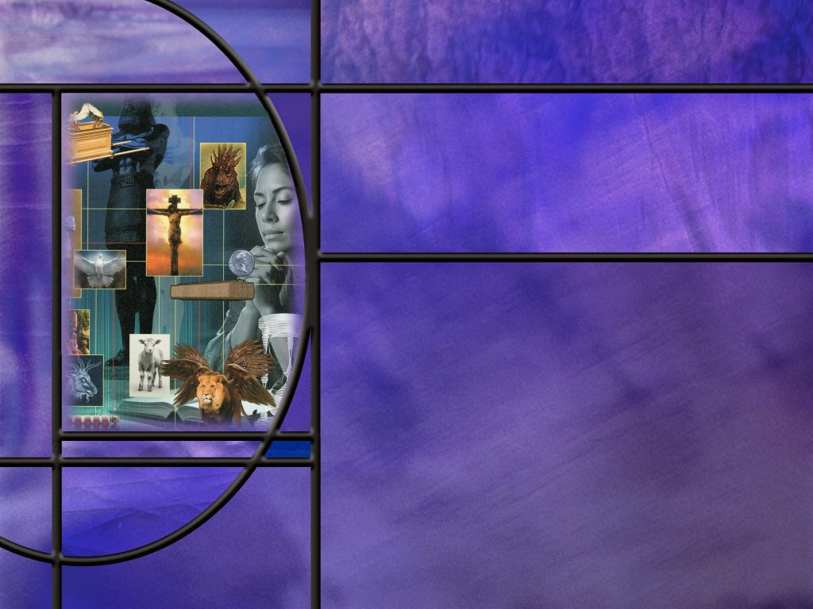
Allusions Images Symbols: How to Study Bible Prophecy
Lesson 10
Upon Whom the Ends Have Come

Slide 2
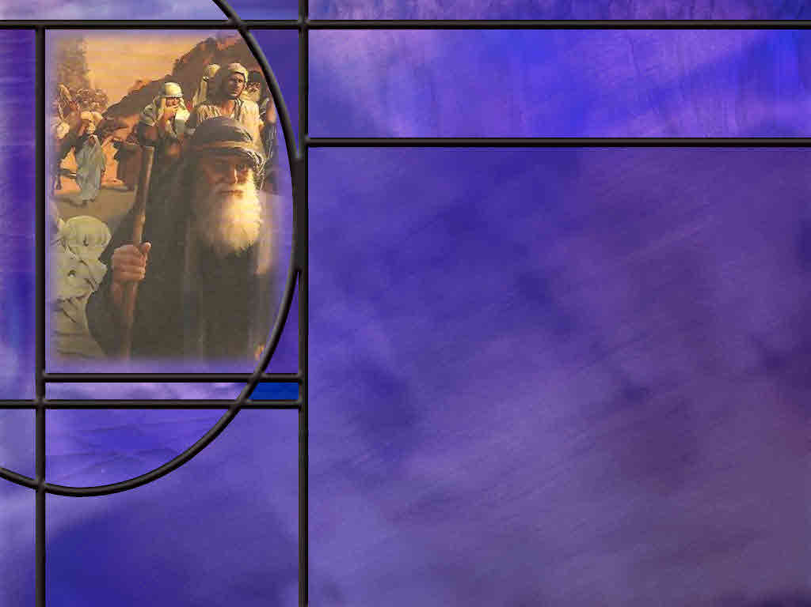
Memory Text
1 Corinthians 10:11 NKJV
Now all these things happened to them as examples, and they were written for our admonition, upon whom the ends of the ages have come. ¹² Therefore let him who thinks he stands take heed lest he fall.
Of whom is Paul speaking when he says “these things happened to them?”
What happened to these people when they sinned against the Lord in the wilderness?
Why is it important for us to read about what happened to them?
Is God’s retributive judgment unjust? Why or why not?
Notes:
B2:
1. The context for this verse begins in 1 Cor 10:1 where Paul refers to those who came through the sea and were under the cloud.
2. In verse 5 he says that God was not pleased with most of them and their bodies were scattered in the wilderness.
3. He says they all ate the same spiritual food, and drank the same spiritual drink.
4. In the wilderness we know that they all ate the manna that God provided and all drank of the water than came from the Rock.
5. So here Paul is describing the experience of the Israelites as they wandered in the wilderness before entering the Promised Land.
6. Paul goes on to list some of the sins that were committed by the Israelites during their wanderings: Idolatry, sexual immorality, grumbling and complaining, and testing the Lord.
B3:
1. They were judged, condemned, and punished on the spot.
2. This is what the theologians refer to as the “retributive judgment” of God.
3. This is judgment from God that occurs before the day of judgment.
4. The wicked are punished for their sins in a direct and obvious way in order to send a message to others of the importance of obedience.
5. The flood in Noah’s day was retributive judgment on sin.
6. Only 8 were saved in the ark, the rest perished because of their sins.
7. God made a new beginning with Noah and his family and corrected the downward spiral of the human race.
8. God’s retributive judgment fell on Sodom and Gomorrah for their sexual perversion, sending a message that we still need to heed today.
9. Ananias and Saphira were destroyed by retributive judgment for their sin of lying to the Holy Spirit.
10. And great fear fell upon the early church. (Acts 5:5)
11. God wanted to make sure that the early church got started on the trajectory of truth and obedience.
12. We see the same thing in the wilderness.
13. God is beginning a new work with some 2 million slaves that He has freed from bondage in Egypt.
14. In order to make sure that they get started in the right direction, God doesn’t wait for the final judgment to settle accounts.
15. He brings some severe judgments upon sin that sends a very clear message to the rest of the Israelites.
16. As time goes on in the history of the Israelite nation, we see less retributive judgment and more patience in God’s dealing with His chosen people.
17. But even then, God eventually has to let His people go into exile for their persistent idolatry.
B4:
1. Paul says that their history was written for our admonition; it was written to teach us and warn us.
2. These things happened to them as examples to us.
3. As he says in verse 12, we need to take heed to what happened to them lest we fall into the same pattern of rebellion and sin.
4. Were these positive or negative examples?
5. For the most part, they were negative examples.
6. In other words, don’t follow their example.
7. Of course, Moses, Joshua, and Caleb set good examples, but for the most part, the Israelites set bad examples.
8. Before he gets to verse 11 in this passage, Paul writes:
1 Corinthians 10:6 NKJV - Now these things became our examples, to the intent that we should not lust after evil things as they also lusted.
9. We need to be warned by God’s judgements on their sins, that He is no less angry today when we commit the same sins.
10. Thank God that He doesn’t treat us with the same retributive judgments today.
11. In His patience, He offers us the probation of a lifetime to repent, confess, and ask forgiveness.
B5:
1. Of course, we can never say that God is unjust in any way.
2. God’s retributive judgment always has a greater good in mind.
3. From the very first sin, God has warned us that the wages of sin in death.
4. In fact, God told Adam and Eve “in the day that thou eatest thereof thou shalt surely die.”
5. God would be just in carrying out the death penalty for sin as soon as we committed it.
6. God is not obliged to grant us a period of time to repent and confess our sins.
7. But because God loves us even when we sin, He is merciful and gracious to us.
8. He is kind and patient and provides us every opportunity to hear the Holy Spirit’s conviction, repent, confess our sins, and trust in the blood of Jesus our Substitute and Savior.
9. Forgiveness is all about God’s grace, something that we sinners do not deserve, but something that we really need.
10. And for those who trust in Jesus as their Savior, God’s judgment is restorative.
11. Our sins are laid on Jesus, who pays their penalty, and we are reconciled to God.
12. Hallelujah!

Slide 3
Overview
The OT Scriptures are full of examples of God’s judgment on wickedness and sin. They teach us that God will by no means pardon the guilty but bring every work into judgment. Our only hope as sinners is to be “in Christ” where there is no condemnation.
  Noah and Judgment
  Sodom and Judgment
  Judgement is Coming
  Summary

Slide 4
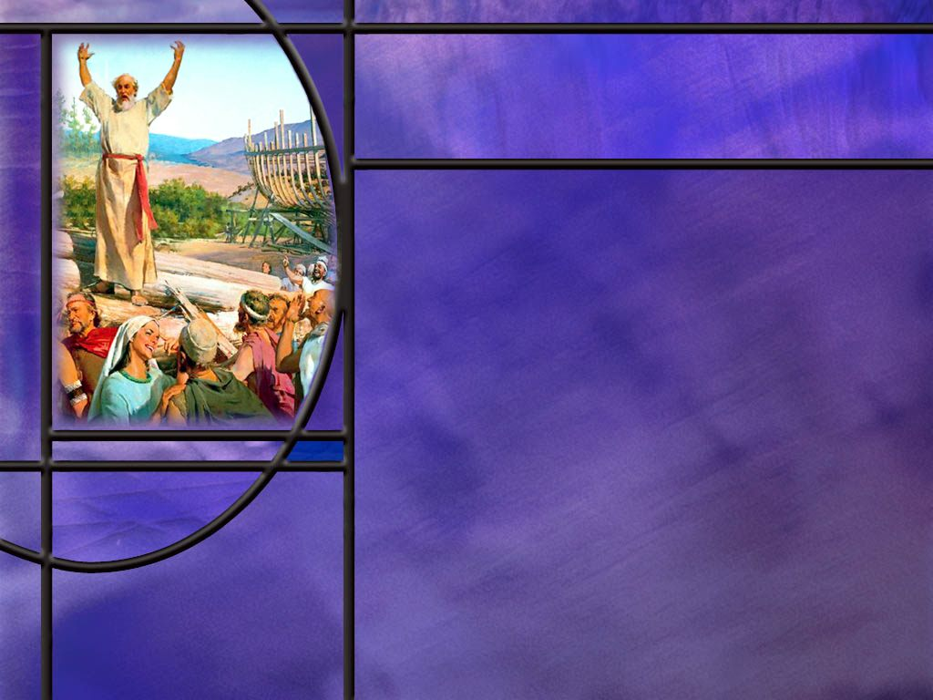
Noah and Judgment
How did Jesus compare His second coming to the days of Noah? (Matt 24:37-39)
How long did Noah have to warn the people that a flood was coming? (Gen 6:3,8-9)
What was the problem in Noah’s day, lack of knowledge or lack of faith?
When Jesus returns in power and glory to save the righteous and destroy the wicked, how do the wicked respond? (Rev 6:15-17)
What encouragement can we take from Noah’s lack of success in reaching the lost?
Notes:
B1:
[See notes on linked slide.]
B2:
[See notes on linked slide.]
B3:
1. If Noah preached for 120 years or even 75 years, it had to be a lack of belief rather than a lack of knowledge.
2. Everyone was warned. The all saw this humongous boat being built for at least 75 years.
3. They saw the animals, moved by God, getting onto the ark.
4. But nobody joined Noah and his family.
5. So, while the Bible doesn’t explicitly say so, we can assume the people of Noah’s day scoffed at his message and ridiculed the idea of a flood.
6. Peter hints at this in 2 Peter 3:3-4
2 Peter 3:3-4 ESV - 3 knowing this first of all, that scoffers will come in the last days with scoffing, following their own sinful desires. 4 They will say, "Where is the promise of his coming? For ever since the fathers fell asleep, all things are continuing as they were from the beginning of creation."
7. He is picking up on Jesus’ words that His second coming will be like the days of Noah.
8. Today unbelievers scoff at the idea of Jesus coming again in the clouds of glory to raise the righteous and destroy the wicked.
9. And Peter implies that the people before the flood were saying the same thing.
10. “Nothing like that has happened since the creation of the world, so how could it happen now?”
11. Peter goes on to say that the scoffers in the last days are willfully ignorant of the flood by which God judged the world for their wickedness.
12. And they are also willfully ignorant of the judgment by fire that is coming next.
13. The willful ignorance is not that they have not been told; it is that they have not believed.
B4:
[See notes on linked slide.]
B5:
1. Noah preached for 120 years and only 8 souls including himself were saved.
2. That seems like a very meager harvest for so long a ministry.
3. But the good news is that he saved his immediate family.
4. He was faithful in his preaching, and that is what Gd expects of us.
5. We are to sow the seed and trust in the Lord for the harvest.
6. We can plant, or we can water, but God gives the increase.

Slide 5
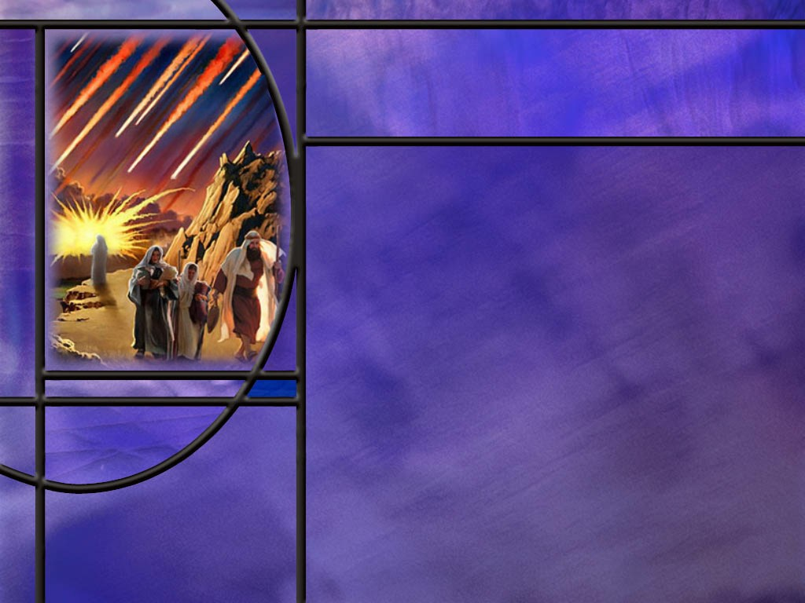
Sodom and Judgment
What mission was the LORD and His two angels on before meeting with Abraham? (Gen 18:20-21)
How many righteous people could have saved Sodom and Gomorrah from destruction? (Gen 18:32)
How “righteous” were Lot and his two daughters? (Gen 19:31,32,36)
What was the sin of Sodom and its inhabitants? (Gen 19:4-5)
What is happening to our society today? Are we drifting toward Sodom and Gomorrah?
What lesson should we take from the destruction of Sodom and Gomorrah?
Notes:
B1:
[See notes on linked slide.]
B2:
[See notes on linked slide.]
B3:
[See notes on linked slide.]
B4:
[See notes on linked slide.]
B5:
1. Our society is in a moral free fall.
2. Many of our cities have become post-Christian secular societies where the ruling elite actively distain anything Christian.
3. The woke left in this country sees Christians as their enemy, and our morality the opposite of theirs.
4. We see it in the current debate over abortion.
5. They want complete freedom to murder the unborn for any reason up to the moment the baby enters the birth canal.
6. This is depriving the very weakest among us of life, liberty, and the pursuit of happiness to say nothing of violating the 6th commandment.
7. We have struck down the sodomy laws.
8. We have legalized homosexual marriage.
9. We have biological men in women’s sports, and bathrooms, and locker rooms and prisons.
10. The left can’t define what a woman is because science no longer matters to them.
11. People get to make up their own sex and their own pronouns, and they expect us to celebrate their insanity.
12. We have public school teachers pushing transgender ideology on our innocent kids in kindergarten through grade 4.
13. It was Billy Graham’s wife, Ruth, that is credited with the quote: “If God doesn’t punish America, He’ll have to apologize to Sodom and Gomorrah.”
14. We need a revival of true godliness.
15. Lord, get us back to biblical morality!!
B6:
1. God does not wink at sin.
2. He holds the guilty accountable.
3. Judgment is coming.
4. It may not be the immediate retributive Judgment like fell on Sodom and Gomorrah, but judgment is coming.
5. We can be thankful that God appears not to be using retributive judgments to guide His people today.
6. He now gives us a lifetime to respond to the conviction of the Holy Spirit, and come to Jesus for forgiveness of sin and to receive a new life in Him.
7. So, let’s take advantage of the probation He has granted us.
8. Paul writes:
2 Corinthians 6:2 KJV - … behold, now is the accepted time; behold, now is the day of salvation.
9. And the writer to the Hebrews adds:
Hebrews 3:15 KJV - 15 … To day if ye will hear his voice, harden not your hearts, as in the provocation.
10. There is no guarantee that we will live to see tomorrow.
11. So today, let us make our calling and election sure by trusting Jesus for the forgiveness of our sins.
12. We can then be confident that we will receive no condemnation in the judgment.

Slide 6
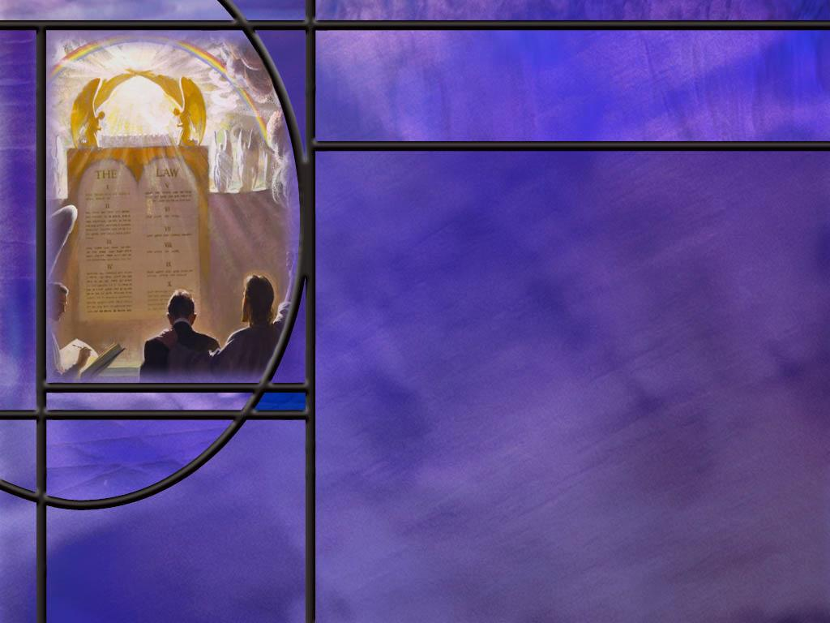
Judgment is Coming
What does Paul write about the certainty of judgment? (2 Cor 5:10)
What different phases of judgment does the Bible describe, and for whose benefit are they conducted?
When the first angel declares that “the hour of His judgment has come,” to which phase of judgment must he be referring?
Notes:
B1:
[See notes on linked slide.]
B2:
1. Let’s just review quickly the various phases of judgment.
2. There are two investigative judgments and two executive judgments.
3. The first investigative judgment is the pre-advent judgment of all who claim to be worthy of salvation.
4. This judgment takes place in heaven before Jesus returns the second time.
5. This judgment is for the benefit of the unfallen angels who audit the decisions of God in saving those who believe.
6. When Jesus comes His reward is with Him, and He carries out the first executive judgment.
7. This is the executive action referred to in the parable of the sheep and the goats.
8. Those who are worthy are resurrected in the first resurrection or translated if living.
9. They are taken to heaven with Christ.
10. Those who are not worthy are slain by the brightness of His coming and the glory of His power.
11. If they are already dead they stay dead and face their final punishment at the end of the millennium.
12. During the millennium we have the investigative judgment of the wicked.
13. This judgment is for the benefit of the saved so that they will see that God has dealt fairly with the wicked who are lost.
14. The saved participate in the judgment by auditing the judgments of God concerning lost people and lost angels.
1 Corinthians 6:2-3 (NKJV)
² Do you not know that the saints will judge the world? …³ Do you not know that we shall judge angels?
15. God makes the decisions, the saints audit those decisions during the millennium.
16. At the end of the millennium there is another executive judgment.
17. This is the Great White Throne Judgment in Revelation 20 where the wicked are finally judged and punished.
B3:
1. The three angel’s messages are God’s last call before the coming of Jesus.
2. Therefore, this judgment must refer to the pre-advent judgment in heaven now going on.
3. Daniel 7 gives us a description of this judgment, where the Son of Man comes before the Ancient of Days and receives a kingdom.
4. The judgment involves the Father, the Son, and the unfallen angels and results in the Little Horn losing his dominion and Jesus sharing His kingdom with the saints.
5. This implies the second coming and the resurrection of the righteous in order for the saints to possess the kingdom with Jesus as their King forever.
6. If the pre-advent judgment has been going on since 1844, what is just around the corner?
7. The next event in Revelation 14 after the three angel’s messages is the coming of the Lord Jesus Christ.
8. When the everlasting gospel is preached to every nation, kindred, tongue, and people, Jesus will come.
9. You can count on His own words:
Matthew 24:14 KJV - 14 And this gospel of the kingdom shall be preached in all the world for a witness unto all nations; and then shall the end come.
10. Let’s be ready and waiting to greet Him with praise and rejoicing on that day!

Slide 7
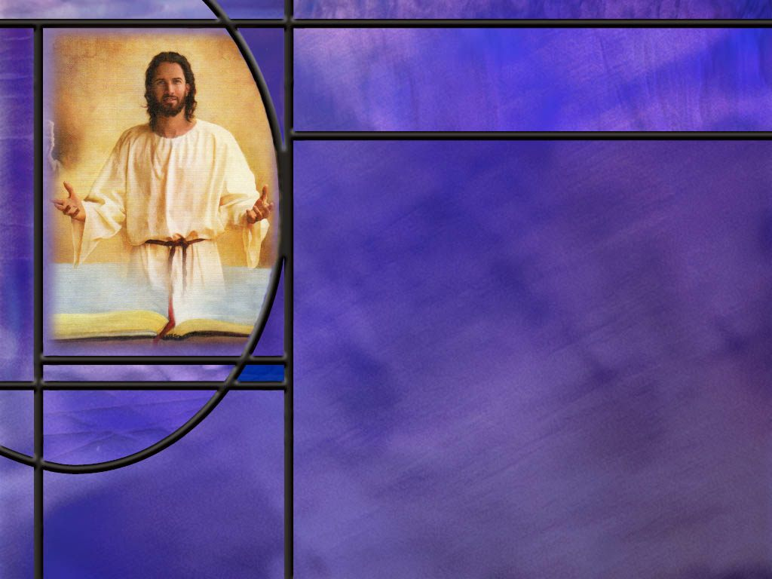
Summary
Noah is described as a righteous man, blameless, and one who walked with God. He was a preacher of righteousness who remained undeterred by those who rejected his message. He was faithful and obedient to all that God commanded Him to do. His works demonstrate that his faith was genuine.
Noah’s example encourages us to be faithful too as our culture descends into unbelief and ridicule of Christian values.
Because his heart was fixed on heavenly things, he was willing to use his time, talents, and treasures to proclaim the gospel of righteousness to his generation, all of whom, except for his family, rejected his pleas to enter the ark of safety.

Slide 8
Summary
The Lord came down to carry out an investigative judgment on Sodom, to make plain to Abraham, Lot, and their descendants, the evidence against Sodom and the sinfulness of their sin.
Abraham bargained God down from 50 righteous to 10 in order to save Sodom, but not even five righteous could be found.
Jesus warned us to remember Lot’s wife so that we would look up at His return rather than look back.
Our own culture seems to be rapidly drifting in the same direction. Today we need Christians that will stand for God’s truth against the forces of evil, and pray for God’s forgiveness and mercy in judgment against us.

Slide 9
Summary
The retributive judgments of God are a stark warning to us that God does not wink at sin: judgment is coming.
The Bible describes four phases of judgment: two investigative (pre-advent and millennial) and two executive (2nd coming and 3rd coming).
The investigative judgements are for the benefit of the unfallen angels and for the redeemed saints who audit the judgments, examine the books, and conclude that the judgments of God are just, true, and fair.
God’s transparency in the judgment vindicates Him against all the accusations of Satan.
Will you trust in the Lord Jesus Christ today as your Advocate in the judgment?

Slide 11
Matthew 24:37-39 NKJV
"But as the days of Noah were, so also will the coming of the Son of Man be. ³⁸ "For as in the days before the flood, they were eating and drinking, marrying and giving in marriage, until the day that Noah entered the ark, ³⁹ "and did not know until the flood came and took them all away, so also will the coming of the Son of Man be. [R]
Notes:
Q1: When the flood came in Noah’s day, how many groups of people were there?
1. Judgment divided the human race into two groups: the saved and the lost.
2. Noah and his family received grace and continued to live.
3. All those outside the ark perished.
4. Jesus uses this as a type of the separation that will occur at His second coming.
5. Again, there will be just two groups: those who are saved by grace and those who are lost.
6. So the judgment on sin in Noah’s day is a type of the judgment that will occur at the second coming of Christ.
7. In the type, i.e., in Noah’s day, the life and death were temporal.
8. That is, Noah and his family went on to live a few more years before they died.
9. In the antitype, i.e., when Jesus comes, that life and death will be eternal.
10. Those who are saved receive immortality and those who are lost are destined for eternal death.

Slide 12
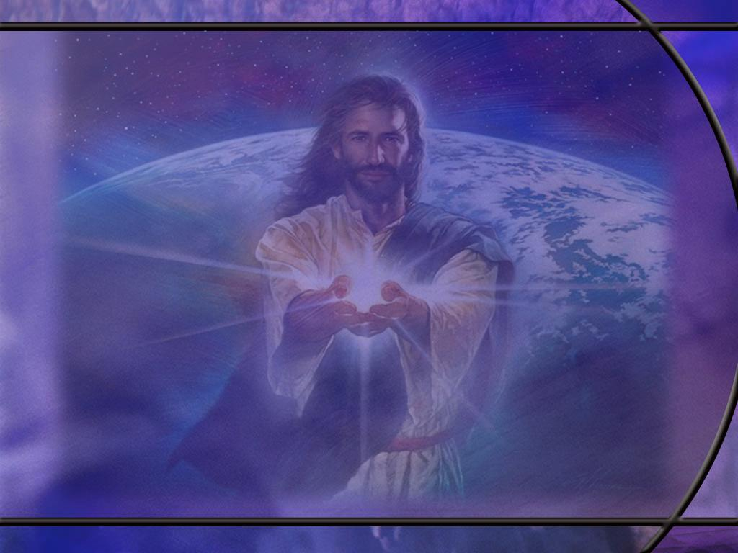
Genesis 6:3, 8 NKJV
And the LORD said, "My Spirit shall not strive with man forever, for he is indeed flesh; yet his days shall be one hundred and twenty years." ... ⁸ But Noah found grace in the eyes of the LORD. ⁹ … Noah was a just man, perfect in his generations. Noah walked with God. [R]
Notes:
Q1: Who else walked with God?
1. Remember Enoch?
2. He was the great grandfather of Noah.
3. The Bible says:
Genesis 5:24 NKJV - And Enoch walked with God; and he was not, for God took him.
4. So Noah also walked with God and he found grace in the eyes of the Lord.
5. God didn’t take Noah but used him to build and ark to save life that God had created.
Q2: How many years of warning did God give Noah of the coming flood?
1. It says that God decided to destroy the world 120 years before the flood came.
2. We presume that he passed that message on to Noah as He walked with him.
3. 2 Peter 2:5 tells us that Noah was a “preacher of righteousness.”
4. So Noah could have been preaching for 120 years that a flood was coming.
Q3: How long did it take Noah to build the ark?
1. The traditional answer is that it took him 120 years, but the Bible doesn’t actually say that.
2. In Gen 6:18, God promised to save Noah and his family.
Genesis 6:18 ESV - But I will establish my covenant with you, and you shall come into the ark, you, your sons, your wife, and your sons' wives with you.
3. This was right after God instructed Noah to build the ark and gave him instructions for how to build it.
4. So here it appears that when Noah received the instructions for building the ark, his 3 sons were grown and married and could help Noah build the ark.
5. From the genealogy in chapter 5 we are told that Noah was 500 years old when he had his first son.
6. The flood account says that Noah was 600 years old when the flood came.
7. So, if we assume it took 25 years for his kids to grow up and get married, then the four of them would spend 75 years building the ark.
8. This was an amazing project for four men to complete, regardless of the time it took.

Slide 13
Revelation 6:15-17 ESV
Then the kings of the earth and the great ones and the generals and the rich and the powerful, and everyone, slave and free, hid themselves in the caves and among the rocks of the mountains, ¹⁶ calling to the mountains and rocks, "Fall on us and hide us from the face of him who is seated on the throne, and from the wrath of the Lamb, ¹⁷ for the great day of their wrath has come, and who can stand?" [R]
Notes:
Q1: How do these people respond to the second coming of Jesus?
1. They are anything but glad to see Him.
2. They are not saying,
Isaiah 25:9 KJV - 9 …Lo, this is our God; we have waited for him, and he will save us: this is the LORD; we have waited for him, we will be glad and rejoice in his salvation.
3. They are saying the exact opposite.
4. “Rocks and mountains fall on us and hide us from the face of the Lord and from His wrath.”
5. Now this may be figurative language, but the point is clear.
6. They are not saying who is this, and what is happening?
7. They seem to know that the judgment of God has come upon them and they are not ready.
8. As in Noah’s day, not for lack of warning or lack of knowledge, but for lack of belief and lack of obedience.

Slide 14
Genesis 18:20-21 NIV
Then the LORD said, "The outcry against Sodom and Gomorrah is so great and their sin so grievous ²¹ that I will go down and see if what they have done is as bad as the outcry that has reached me. If not, I will know.“ [R]
Notes:
Q1: Did God have to come down to Sodom to see how bad the sin was there?
1. No. God sees and knows all from heaven.
2. So this is another investigative judgment, not for God’s benefit, but for ours.
3. We see God holding His creatures accountable so that they will understand God’s view of sin and its wages.
4. We have seen this investigative judgment in Eden after the fall, with Cain and Abel, at the time of the flood, at the tower of Babel, and now at Sodom and Gomorrah.
5. This judgment allows us to see the evidence against these sinful cities and be warned against such perverted behavior ourselves.

Slide 15
Genesis 18:32 NKJV
Then he said, "Let not the Lord be angry, and I will speak but once more: Suppose ten should be found there?" And He said, "I will not destroy it for the sake of ten.“ [R]
Notes:
1. You recall this story I am sure.
2. Abraham started at 50 righteous and bargained God down to 10.
3. Even for only 10 righteous people, God would spare the city.
4. The Lord did not spare the city, but He did spare the four “righteous” people in it.
5. The angels told Lot to take his wife and two daughters and flee into the hills.
Q2: How many made the escape from Sodom?
1. Only three.
2. Lot’s wife looked back and was turned to a pillar of salt.
3. So we have maybe three “righteous” people.
4. Were they really righteous or just not as bad as the rest of the Sodomites?
5. Paul says, “There is none righteous, no not one.” Rom 3:10.
6. We are all sinners in need of forgiveness and the righteousness of God that comes by faith.

Slide 16
Genesis 19:31-32, 36 NIV
One day the older daughter said to the younger, "Our father is old, and there is no man around here to give us children--as is the custom all over the earth. ³² Let's get our father to drink wine and then sleep with him and preserve our family line through our father." ... ³⁶ So both of Lot's daughters became pregnant by their father. [R]
Notes:
Q1: How righteous are Lot and his two daughters?
1. This is the best that Sodom could produce?
2. A father that gets drunk and commits incest with his two daughters, and two daughters that plan the whole thing to begin with.
3. What a sad commentary on the characters of these three whom the Lord rescued from the destruction of Sodom and Gomorrah.
4. At least these three were willing to leave Sodom, which is more than we can say about Lot’s wife.
Q2: What was her fate as she looked back longingly toward the city in direct defiance of the angel’s command?
1. Turned into a pillar of salt.
2. Jesus Himself referred to her during His ministry when He said:
Luke 17:32 KJV - Remember Lot's wife.
3. He was warning us of how to leave behind this world when Jesus comes again.
4. We need to look up to see our redemption, not look back longing for what we have to leave behind.

Slide 17
Genesis 19:4-5 NIV
Before they had gone to bed, all the men from every part of the city of Sodom--both young and old--surrounded the house. 5 They called to Lot, "Where are the men who came to you tonight? Bring them out to us so that we can have sex with them.“ [R]
Notes:
Q1: What kind of sin is this?
1. This is homosexual perversion.
2. The men of the city wanted to have sex with the two men, actually the two angels, who came to visit Lot.
3. They wanted to sodomize them.
4. So, as if the reputation of Sodom was not bad enough, here the two angels come to investigate, and they become the objects of homosexual rape.
5. What further proof is needed of the complete perversion of this city.
Q2: How many of the men of Sodom were involved in this attempt at homosexual rape?
1. All the men from every part of the city.
2. Everybody except Lot it would seem.
3. No wonder God could not find 10 righteous in the city.
Q3: What did Lot offer the Sodomites in place of the two angels?
1. This is incredible to me that he would offer his two daughters, both of whom were engaged but still virgins, to be raped by this mob.
2. To me, that’s not the actions of a “righteous man.”
3. Hopefully the angels would have put a stop to that and protected his daughters.
4. But the Sodomites refused, preferring homosexual sex.
5. So the angels pulled Lot back into the house and struck the Sodomites blind so that they couldn’t find the door.
6. God destroyed Sodom and Gomorrah the next day after Lot and his two daughters were allowed to escape.
7. In spite of the incredible wickedness of these people, Abraham prayed for them and interceded on their behalf that God would spare them and give them time to repent.
8. So following his example, we too can lift up in prayer sinners that are in need of a Savior.
9. Their sin may be disgusting, but God can save even disgusting sinners.
10. However, in the end, God respects our free will in the matter of salvation.
11. So don’t be discouraged if your intercessions bear no more fruit than Abraham’s.

Slide 18
2 Corinthians 5:10 ESV
For we must all appear before the judgment seat of Christ, so that each one may receive what is due for what he has done in the body, whether good or evil. [R]
Notes:
1. Paul writes something very similar in Romans 14:10-12
Romans 14:10, 12 ESV - For we will all stand before the judgment seat of God; ... 12 So then each of us will give an account of himself to God.
2. So my question is this:
Q1: Where and when does this happen?
1. I think the most logical place for this to happen would be in the pre-advent judgment in heaven.
2. That judgment is now going on, we believe, since the time of the end in 1844.
3. We see this judgment described in Daniel 7.
4. It is for the benefit of the unfallen angels, since they have an interest in who is saved and lost.
5. God knows them that are His, because He can read our hearts and see our faith.
6. But the angels need to see that our faith is genuine by investigating our deeds.
7. Do our works testify that our faith is genuine?
8. It is this judgment that reveals who are the saved and who are lost.
9. When Christ returns, His reward is with Him; the angels know who to resurrect and who to leave in their grave.
10. Jesus says in:
Revelation 22:12 KJV - And, behold, I come quickly; and my reward is with me, to give every man according as his work shall be.
11. But here is the surprising thing: no human being is actually present for the pre-advent judgment.
12. We are either living on earth or in the grave awaiting the second coming to be resurrected.
13. So how do we stand before the judgment seat of Christ and give an account of ourselves to God in the pre-advent judgment?
14. The only answer I can come up with is that we don’t actually appear physically before the judgment seat of Christ.
15. Instead, Christ our Advocate, perfectly represents us and argues our case in the pre-advent judgment.
Q2: Is it possible that we appear before the judgment seat of Christ after the resurrection?
1. If this is the case, we have already received the ultimate reward of eternal life.
2. What is left to be judged and rewarded?
3. Are there different levels of reward in heaven depending on how we have used our gifts here on earth?
4. Would the parable of the talents suggest that?
5. I don’t think the Bible is very clear on the when and where.
6. Other texts that may suggest different rewards for the redeemed are:
Hebrews 11:35 KJV - Women received their dead raised to life again: and others were tortured, not accepting deliverance; that they might obtain a better resurrection:
7. So, if you die as a martyr, you apparently receive a better resurrection.
1 Corinthians 3:12-15 NIV - 12 If anyone builds on this foundation [of Jesus Christ] using gold, silver, costly stones, wood, hay or straw, 13 their work will be shown for what it is, because the Day will bring it to light. It will be revealed with fire, and the fire will test the quality of each person's work. If what has been built survives, the builder will receive a reward. 15 If it is burned up, the builder will suffer loss but yet will be saved--even though only as one escaping through the flames.
8. This text could imply different rewards for the way we build on the foundation of Jesus Christ.

