Slide 1
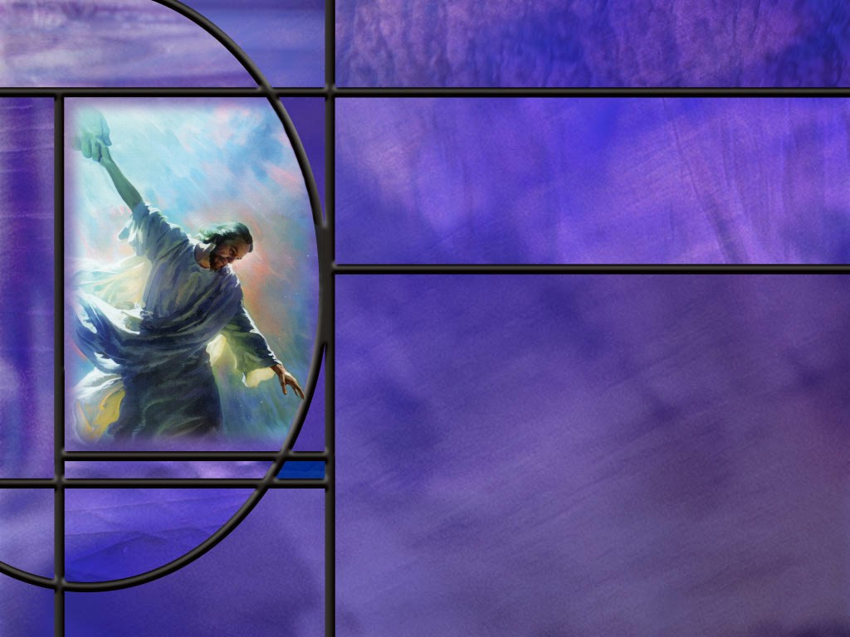
Uniting Heaven and Earth: Christ in Philippians and Colossians
Lesson 9
Reconciliation and Hope

Slide 2
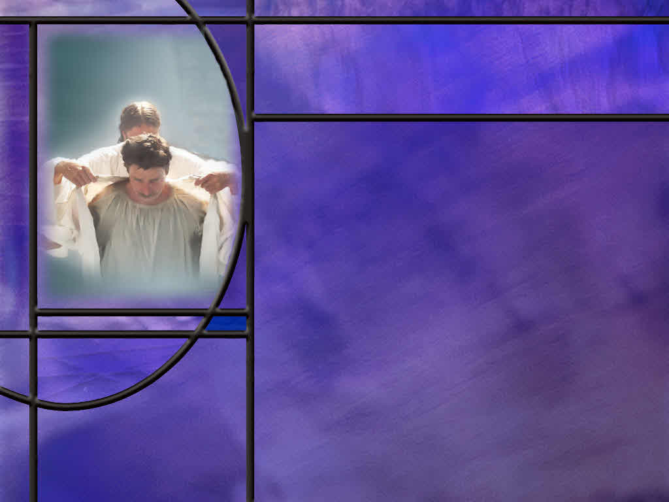
Memory Text
2 Corinthians 5:21 NKJV
For He made Him who knew no sin to be sin for us, that we might become the righteousness of God in Him.
Who are the He and Him of this verse?
What is the “Great Exchange” described in this verse?
What does God do with sin for the redeemed?
How does our justification in heaven affect our life here on earth?
Notes:
B1:
1. This is a memory text that should be memorized by every Christian.
2. It is a verse that encapsulates the Gospel.
3. It describes how God deals with sin and makes us righteous.
B2:
1. The “He” is God the Father.
2. The “Him” is God the Son, Jesus Christ.
3. Here at the beginning of the verse, both Father and Son are involved.
4. Then look at the end of the verse:
5. We become the righteousness from God the Father in Him, God the Son.
6. Both Father and Son are intimately involved with this transfer of sin and righteousness.
7. Martin Luther has called this verse “The Great Exchange,” or the “Wonderful Exchange.”
B3:
1. The Great Exchange described in this verse is the essence of the Gospel.
2. In Christ, we exchange our sin for His righteousness.
3. It is like exchanging a bag of garbage for a Rolls Royce.
4. In fulfillment of the everlasting covenant made between Father and Son from the foundation of the world, Jesus Christ died on the cross for the sins of all mankind.
5. He Himself was sinless, but He suffered the death penalty for our sins.
6. So, when we are “in Christ” the Father can accept the death of His Son in place of our death.
7. In that sense, Christ bears our sins and becomes sin for us.
8. When we receive Christ as our Savior, confess our sins, and trust in His blood for our forgiveness, God forgives us and declares us justified or not guilty.
9. This is justification by faith or righteousness by faith.
10. And since our sins are all forgiven and we are cleansed, we have a standing in the courts of heaven as perfectly righteous, like Jesus our sinless Savior.
11. His perfect righteousness is placed to our account.
12. This is the Gospel, the good news of salvation by faith in Christ.
13. The gospel that saves us is stated very simply by the apostle Paul in 1 Corinthians 15:3-4
1 Corinthians 15:3-4 NKJV – that Christ died for our sins according to the Scriptures, ⁴ and that He was buried, and that He rose again the third day according to the Scriptures,
14. So the gospel includes Christ’s death for our sins and His resurrection from the dead.
15. We need a living Savior to come back and save us.
B4:
1. It is important to note here that God does not ignore sin, or overlook sin, or say “that’s ok, it doesn’t matter.”
2. Sin is a very serious thing.
3. All through the OT times, the sanctuary service taught that the wages of sin is death.
4. Sinners would bring an innocent sacrifice and confess their sin over it, and the innocent animal would die in place of the sinner.
5. Without shedding of blood there is no remission (Heb 9:22)
6. This is “substitutionary atonement.”
7. God punishes the substitute instead of the sinner.
8. So when we accept Jesus as our Savior and our Substitute, God lays our sins on Him.
9. As our divine Creator His value is infinitely beyond the value of those He died for, so He needs to be sacrificed only once for all.
10. And God accepts the death of His Son as the just punishment for our sins and imputes the perfect righteousness of Christ to our account.
11. Is this Good News?
12. Indeed, Christ died for our sins according to the scriptures!
B5:
1. When we trust Jesus as our Savior and lay our sins on Him, God declares us righteous in the courts of heaven.
2. He adopts us into His family and gives us eternal life.
3. He sets us apart for a holy use and fills us with the Holy Spirit.
4. The HS gives us a new birth and begins to produce the fruit of the Spirit and the gifts of the Spirit in our lives.
5. We begin to grow in grace and live a life of obedience to God because we love Him for saving us.
6. Although we never reach the full measure of the stature of Christ, we are prepared to meet God as soon as we are justified.
7. We are totally acceptable to God when Christ’s righteousness is imputed to our account.
8. God’s judgment fell on Christ so that His grace could fall on us.
Illustration:
In the days of the pioneers, when men saw that a wind-swept prairie fire was coming, what would they do? Since not even the fastest of horses could outrun it, the pioneers took a match and burned the grass in a designated area around them. Then they would take their stand in the burned area and be safe from the threatening prairie fire. As the roar of the flames approached, they would not be afraid. Even as the ocean of fire surged around them, there was no fear, because fire had already passed over the place where they stood.
When the judgment of God comes to sweep men and women into the lake of fire, there is one spot that is safe. Nearly two thousand years ago, the wrath of God was poured out on Calvary. There the Son of God took the wrath that should have fallen on us. Now, if we take our stand by the cross, we are safe for time and eternity.

Slide 3
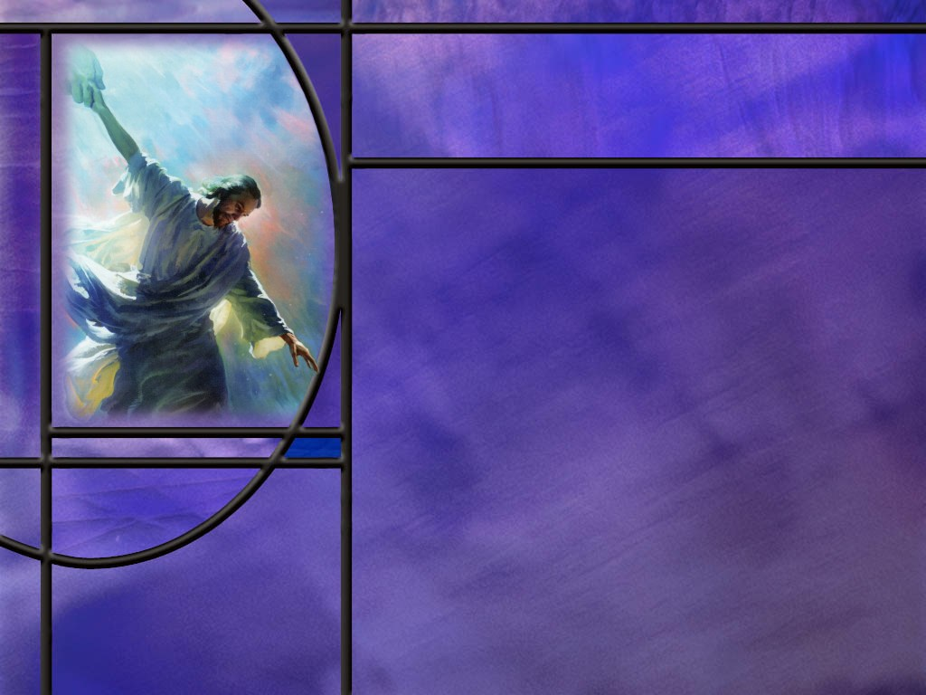
Overview
Paul draws a stark contrast between the old life and the new of those who have been reconciled to God and are continuing in faith. He reveals the mystery of the ages that the gospel is for everyone. His desire is to present his converts to God as complete in Christ energized in his efforts by the power of Christ.
  Reconciled
  Revealing Mysteries
  Perfected in Christ
  Summary

Slide 4
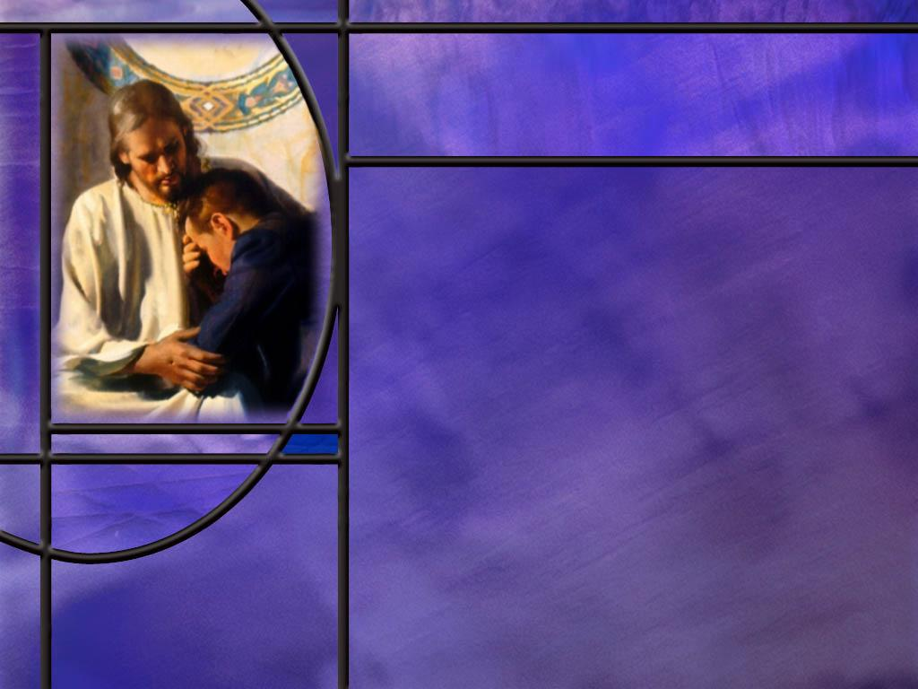
Reconciled
How does Paul describe the old life of the Colossian Christians? (Col 1:21)
What change from the old man does Paul describe in the next verse? (Col 1:21-22)
What condition does Paul give for continuing in a state of reconciliation with God? (Col 1:23)
Notes:
B1:
[See notes on linked slide.]
B2:
[See notes on linked slide.]
B3:
[See notes on linked slide.]

Slide 5
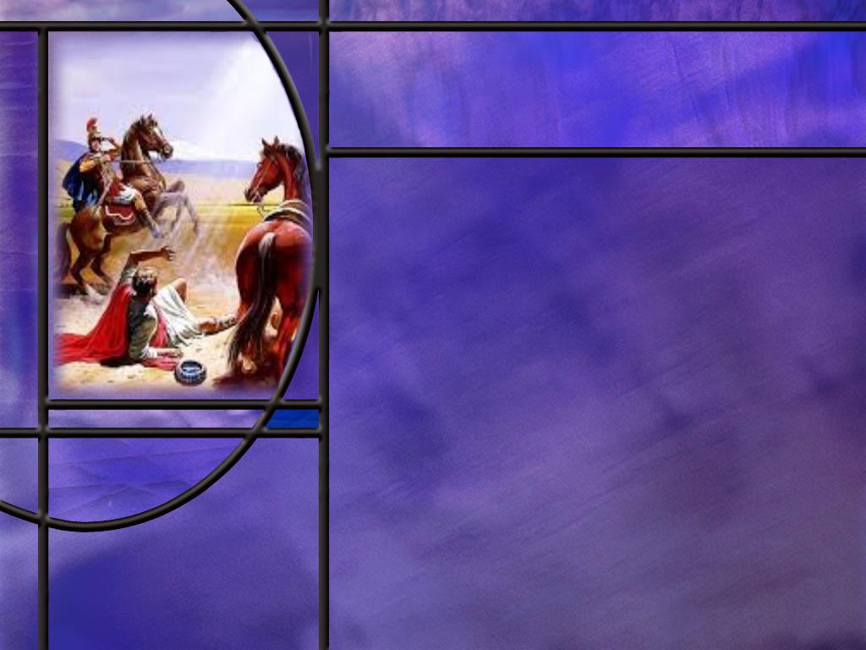
Revealing Mysteries
What spin does Paul put on his sufferings as he preaches Christ? (Col 1:24-25)
What is the mystery to which Paul refers in this passage? (Col 1:26-27)
How does the parallel passage in Ephesians confirm our understanding of this mystery? (Eph 3:4-6)
Notes:
B1:
B2:
[See notes on linked slide.]
B3:
B4:
[See notes on linked slide.]

Slide 6

Perfected in Christ
What does Paul see as the end result of “Christ in you the hope of glory?” (Col 1:28)
Where does Paul find the strength to continue his ministry for the Gentiles? (Col 1:29)
Notes:
B1:
[See notes on linked slide.]
B2:
[See notes on linked slide.]

Slide 7
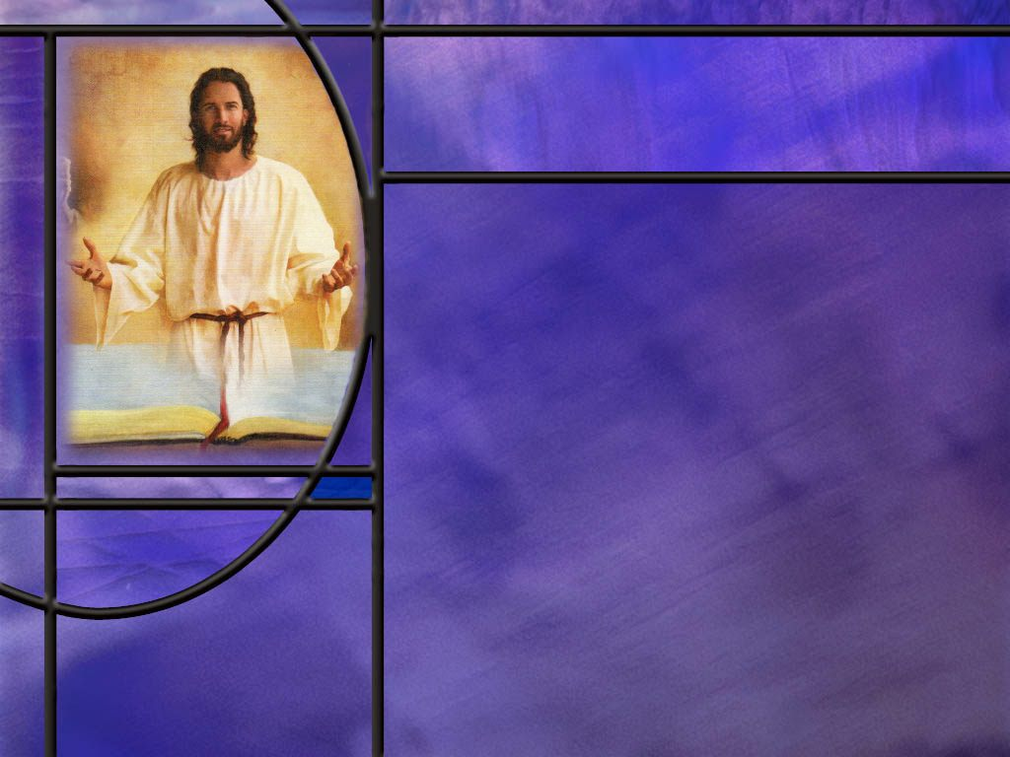
Summary
Many of us can identify with the contrast Paul draws between when our lives were alienated from God and when we were reconciled.
Through the death of Christ for our sins, God has reconciled us to Himself and made us holy and blameless in His sight.
But Paul puts a condition on our reconciliation: “if indeed you continue in the faith…”
This, along with a number of other similar “if statements” in Scripture indicates that we must persevere in the faith in order to be saved.
The doctrine of Once Saved Always Saved is not taught in Scripture, but Once Saved Always Saved as long as you Stay Saved is.

Slide 8
Summary
Paul reminds us of his responsibility to preach the gospel to the Gentiles as he was commissioned by Jesus.
He refers to his commission as a mystery, hidden from generations for ages, but now revealed to believers in Christ.
The mystery is that God’s grace is greater than was generally assumed by many devout Jews.
The Gospel is for everyone, not just the Jews. It includes all who receive the Lord Jesus Christ and trust in Him as a living Person for the forgiveness of their sins.
To the Colossians Paul writes it is “Christ in you the hope of Glory.”

Slide 9
Summary
To the Ephesians Paul writes that “Gentiles are fellow heirs, members of the same body, and partakers of the promise in Christ Jesus through the gospel.
It is Paul’s desire that his teaching and preaching will make all his converts complete in Christ, ready to be saved at His coming.
We too can be complete in Christ, only through the Gospel of righteousness by faith.
When the Great Exchange is made for us, our sins are laid on Christ and His righteousness is laid on us. We are justified by faith and bound for the kingdom.
Will you pray this week for Christ to be in you that your hope of glory may be in Him?

Slide 11
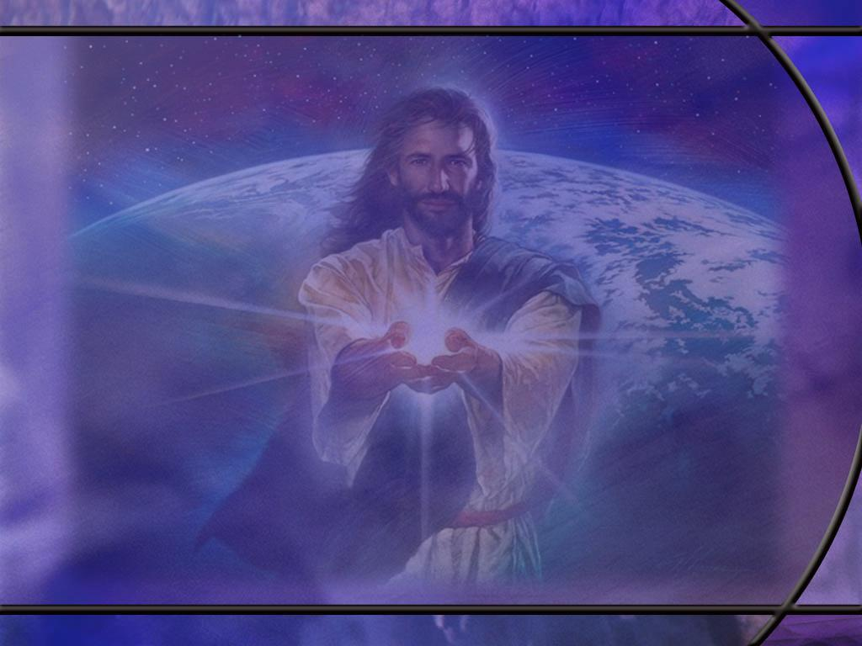
Colossians 1:21 ESV
And you, who once were alienated and hostile in mind, doing evil deeds, [R]
Notes:
Q1: How does Paul describe our condition apart from Christ?
1. Before we came to Jesus we were alienated from God.
2. We were separated from Him by our sins.
3. We loved the world and the things of the world.
4. We had carnal minds as Paul describes in Romans 8
Romans 8:7-8 ESV - For the mind that is set on the flesh is hostile to God, for it does not submit to God's law; indeed, it cannot. 8 Those who are in the flesh cannot please God.
5. Before we came to Christ, we were hostile to God, enemies, so to speak, doing what was evil to please the passions of the flesh.
6. Who knows where we would be now but for the grace of God?
7. The apostle John reminds us:
1 John 2:15-17 KJV - 15 Love not the world, neither the things that are in the world. If any man love the world, the love of the Father is not in him. 16 For all that is in the world, the lust of the flesh, and the lust of the eyes, and the pride of life, is not of the Father, but is of the world. 17 And the world passeth away, and the lust thereof: but he that doeth the will of God abideth for ever.
8. Since we have been redeemed, let us make every effort to turn our backs on the world and the pleasures it offers us, and choose instead to love the Lord our God with all our hearts.

Slide 12
Colossians 1:21-22 NIV
Once you were alienated from God and were enemies in your minds because of your evil behavior. ²² But now he has reconciled you by Christ's physical body through death to present you holy in his sight, without blemish and free from accusation-- [R]
Notes:
Q1: What has happened to the Colossian believers that were alienated from God?
1. They have been reconciled.
2. They have been brought back together with God, no longer separated from God by their sin but accepted.
Q2: Who reconciled them to God? Who gets the credit for this change of status?
1. It is God.
2. Verse 22 says, “But now He [God] has reconciled you.”
Q3: How did God bring about this reconciliation?
1. He did it through Christ’s physical death on the cross.
2. As we discussed in our memory text, God placed their sin to Christ’s account and placed the righteousness of Christ to their account.
3. Because Christ died for their sins, they can be forgiven when they trust in Jesus, repent, confess, and ask forgiveness.
4. And as the apostle John reminds us:
1 John 1:7 KJV - …the blood of Jesus Christ his Son cleanseth us from all sin.
Q4: How does Paul describe our condition when we are cleansed from all sin?
1. We are holy in God’s sight.
2. We are without blemish.
3. We cannot be accused of any sin.
4. We are blameless.
5. God sees us through the righteousness of Christ.
6. As Jesus related in the parable of the wedding feast, we must all be clothed in the robe provided by the groom in order to attend the wedding supper of the Lamb in heaven.
7. Let’s make sure we are wearing that robe even now by trusting in the shed blood of Jesus for the forgiveness of our sins.

Slide 13
Colossians 1:23 ESV
if indeed you continue in the faith, stable and steadfast, not shifting from the hope of the gospel that you heard, which has been proclaimed in all creation under heaven, and of which I, Paul, became a minister. [R]
Notes:
Q1: What condition does Paul give here for being holy and blameless in God’s sight?
1. IF you continue in the faith, stable and steadfast, not shifting from the hope of the gospel that you heard.
2. Here Paul calls the gospel that he preaches “the faith.”
3. And, of course, the gospel is the good news of salvation in Jesus Christ by trusting Him as a living Person for the forgiveness of our sins.
4. The message of the NT is the faith of Jesus or the testimony of Jesus, that Christ is our righteousness.
6. Paul is uncompromising on the gospel of righteousness by faith.
7. To the Galatians he wrote:
Galatians 1:8 ESV - But even if we or an angel from heaven should preach to you a gospel contrary to the one we preached to you, let him be accursed.
8. Paul insists that we need to continue to believe the gospel and it needs to be the correct gospel.
Q2: What can we conclude form this verse about the doctrine of once saved always saved, taught by many evangelical churches?
1. This is the idea that if you once trust Jesus as your Savior, you cannot change your mind.
2. This is a leftover doctrine of Calvinism or predestination.
3. The idea is that God elects some to be saved and others to be lost.
4. If you are part of the elect that is to be saved, you cannot choose to be lost by renouncing your faith in Christ.
5. But the “IF” of this verse clearly holds out the possibility that you can choose not to continue in the faith.
6. In that case you are not holy and blameless but responsible for your own sins.
7. If Once Saved, Always Saved were true there would be no such thing as apostasy.
8. And the Bible clearly teaches that apostasy is possible.
9. Another verse that comes to mind is found in 1 Corinthians 15 where paul defines the gospel.
10. Let’s look at those verses on the next slide.
[Go to next slide.]
[Return here.]
Q3: What do you think Paul means by saying that the gospel has been proclaimed in all creation under heaven? [read ending of verse again.]
1. Based on Paul’s writings in other letters, it is clear that he did not intend this statement to be taken in the literal sense.
2. In Romans 15, Paul expresses a desire to take the gospel to Spain, so it is clear that the gospel had not yet gone everywhere.
3. Perhaps this is exaggeration, called hyperbole, and not intended to be taken literally.
4. Perhaps he is saying that the gospel preached at Colossae is the same gospel preached everywhere else he has preached it.
5. Or perhaps Paul is using the “prophetic perfect” tense in writing Scripture.
6. This is stating the fulfillment of prophecy in the past tense as though it has already come to pass, because its future fulfillment is certain.
7. Remember the prophecy of Jesus in Matthew 24:14
Matthew 24:14 KJV - And this gospel of the kingdom shall be preached in all the world for a witness unto all nations; and then shall the end come.
8. Maybe Paul, certain that this prophecy will be fulfilled, states it in the past tense as though it already were.
9. With Jesus at the head of the church, it surely will be fulfilled.

Slide 14
1 Corinthians 15:1-4 ESV
Now I would remind you, brothers, of the gospel I preached to you, which you received, in which you stand, ² and by which you are being saved, if you hold fast to the word I preached to you--unless you believed in vain. ³ For I delivered to you as of first importance what I also received: that Christ died for our sins in accordance with the Scriptures, ⁴ that he was buried, that he was raised on the third day in accordance with the Scriptures,
Notes:
1. Here in verses 3 and 4 are Paul’s clearest definition of the gospel.
2. But in introducing the gospel, Paul says it is the gospel that he preached and that they received.
3. Then he says it is the gospel by which they are saved, IF…
4. And what is the “IF?”
5. IF they hold fast to the gospel that he preached to them.
6. But if they don’t hold fast to the gospel, he says they have believed in vain.
7. In other words, they believed at one time but then turned away from the gospel, so that their one-time belief was of no benefit to them, it was vain or empty.
8. So Paul is saying here that you can’t give up the faith.
9. You must endure to the end.
10. As Jesus said:
Matthew 24:13 KJV - But he that shall endure unto the end, the same shall be saved.
11. If you give up and turn your back on Christ and the cross, you are lost.
12. So we believe “Once Saved Always Saved as long as you Stay Saved.”
13. IF you don’t stay saved, you’re lost.
14. We can add to these conditional “IF” statements:
Hebrews 3:12-14 ESV - Take care, brothers [fellow believers], lest there be in any of you an evil, unbelieving heart, leading you to fall away from the living God. ¹³ But exhort one another every day, as long as it is called "today," that none of you may be hardened by the deceitfulness of sin. ¹⁴ For we have come to share in Christ, if indeed we hold our original confidence firm to the end.
1. There is one more detail from Col 1:23 that we need to clear up before we go on.
[Return to previous slide.]

Slide 15
Colossians 1:24-25 NLT
I am glad when I suffer for you in my body, for I am participating in the sufferings of Christ that continue for his body, the church. ²⁵ God has given me the responsibility of serving his church by proclaiming his entire message to you. [R]
Notes:
Q1: What kind of suffering is Paul going through as he writes this letter?
1. Paul is writing this letter from Rome, imprisoned under house arrest.
2. He can add this to his long list of perils he has endured in preaching the gospel found in 2 Cor. 11:16 and following.
3. Paul has suffered in his body for the church.
4. Christ suffered in his body for the church.
5. And Paul points out that Christ continues to suffer for His body, the church.
6. Jesus promised His church, “Lo I am with you always.”
7. And as the church suffered persecution under the hands of the Romans, Christ, their sympathetic High Priest, no doubt suffered along with them.
8. Paul identifies himself with Christ in suffering for the church.
9. He rejoices in the opportunity of suffering for Christ by suffering for the church.
Q2: What responsibility has the Lord laid upon Paul according to his testimony here?
1. Paul was commissioned by Christ to preach the gospel to the Gentiles.
2. Here he says the entire message was to be preached to make the gospel fully known.
3. The commission was given to him by Jesus on the road to Damascus.
4. And Jesus told Paul it wouldn’t be easy.
5. In sending Ananias to Paul in Damascus, Jesus told him.
Acts 9:16 ESV - For I will show him [Paul] how much he must suffer for the sake of my name.“
6. Paul did suffer, obediently and joyfully.

Slide 16
Colossians 1:25-27 ESV
… to make the word of God fully known, ²⁶ the mystery hidden for ages and generations but now revealed to his saints. ²⁷ To them God chose to make known how great among the Gentiles are the riches of the glory of this mystery, which is Christ in you, the hope of glory. [R]
Notes:
Q1: What is a “mystery” as Paul uses the word here?
1. It is not something that cannot be known, because he says it has now been revealed.
2. Rather it is something that is not fully known or widely understood.
3. It is something surprising and unexpected to the majority of people.
4. He writes that it is something that has been hidden for ages and generations.
Q2: To whom has the mystery now been revealed?
1. It has been revealed to the saints of the Lord or the holy ones.
2. By this Paul would meant those who have been justified by trusting Jesus as their Savior.
3. That is the only way we can become holy: having Christ’s righteousness placed to our account.
B3: To whom in particular does this mystery apply, Jew or Gentile?
1. This mystery concerns the Gentiles.
2. The Jews did not generally understand or appreciate the extent of God’s grace.
3. They thought salvation was for them only, God’s chosen people.
4. The Gentile dogs were to be destroyed by the judgements of God.
5. But Paul writes that God wanted them to know that the riches and glory of Christ are for you Gentiles, too
6. This is the mystery that the Jewish nation as a whole did not appreciate: God’s kingdom is for everyone who believes in the Lord Jesus Christ.
Q4: How does Paul summarize this mystery?
1. His summary: “Christ in you, the hope of glory.”
2. Gentiles have the same hope of Glory when Jesus returns as the apostles, prophets, and Jewish believers.
3. That hope is the Blessed Hope of the return of Jesus to raise us from the dead, give us eternal life, and take us to live with Him forever.
4. The condition of having this blessed hope is “Christ in you.”
5. Anyone who invites Jesus into their heart and trusts Him as their Savior and Lord, can have the Blessed Hope of salvation when He comes back.

Slide 17
Ephesians 3:4-6 ESV
When you read this, you can perceive my insight into the mystery of Christ, ⁵ which was not made known to the sons of men in other generations as it has now been revealed to his holy apostles and prophets by the Spirit. ⁶ This mystery is that the Gentiles are fellow heirs, members of the same body, and partakers of the promise in Christ Jesus through the gospel. [R]
Notes:
1. Here Paul describes the mystery in the same terms.
2. It not something that cannot be known.
3. Rather it is something that was not generally known or appreciated by previous generations.
4. Now it has been revealed to the apostles and prophets by the Holy Spirit.
Q1: How does Paul define the mystery here?
1. It is that Gentiles are fellow heirs, members of the same body, the church, and partakers of the promise of eternal life in Christ Jesus.
2. The Gospel is for everyone.
3. Believe in the Lord Jesus Christ and you shall be saved.
4. Jew-Gentile, slave-free, male-female, doesn’t matter.

Slide 18
Colossians 1:28 NASB
We proclaim Him [Christ], admonishing every person and teaching every person with all wisdom, so that we may present every person complete in Christ. [R]
Notes:
Q1: What is Paul looking for as the end result of his teaching and preaching?
1. He is looking to bring all Christians to their full potential in Christ.
2. The Greek word rendered “Complete” in this translation is teleios (tel'-i-os).
3. Other translations say fully mature or perfect.
4. The Greek has the meaning of reaching its full potential and purpose; brought to its end, finished; lacking nothing necessary to completeness; perfect.
5. In Christ, we are perfectly righteous because we have His righteousness imputed to our account.
6. Our sins are completely forgiven.
7. Justification is all we need to qualify for heaven.
8. But Paul may also have in mind the changes that the Holy Spirit makes in our lives after we are justified by faith.
9. In Christ, we are filled with the Holy Spirit who is conforming us to the likeness of Jesus, and we are growing into mature, faithful, loving, gracious Christians.
10. While our good works do not add merit for salvation, they are evidence of genuine faith, they are pleasing to God and bring glory to Him, and express our love for Him.
11. This verse reminds us of something similar that Paul wrote to the Corinthians:
2 Corinthians 11:2 KJV - 2 For I am jealous over you with godly jealousy: for I have espoused you to one husband, that I may present you as a chaste virgin to Christ.
12. In Christ we are forgiven, pure, spotless, chaste virgins.

Slide 19
Colossians 1:29 NIV
To this end I strenuously contend with all the energy Christ so powerfully works in me. [R]
Notes:
Q1: Where does Paul find the energy to effectively minister to the Gentiles?
1. Paul points to Christ as the source of the energy that motivates him.
2. But he is not passive in being a channel of this energy.
3. He puts forth his own personal effort saying “I strenuously contend.”
4. This is a beautiful picture of us cooperating with the power of God.
5. Those who are working for Jesus need to put forth personal effort.
6. But they also need to depend on Christ to make our efforts succeed, to give us strength and wisdom, love, patience, and perseverance.
7. We need to pray as if everything depended on God and work as if everything depended on us.
8. In the apostle Paul, we can see an example of how God was powerfully at work in one who was willing to be used.

