Slide 1
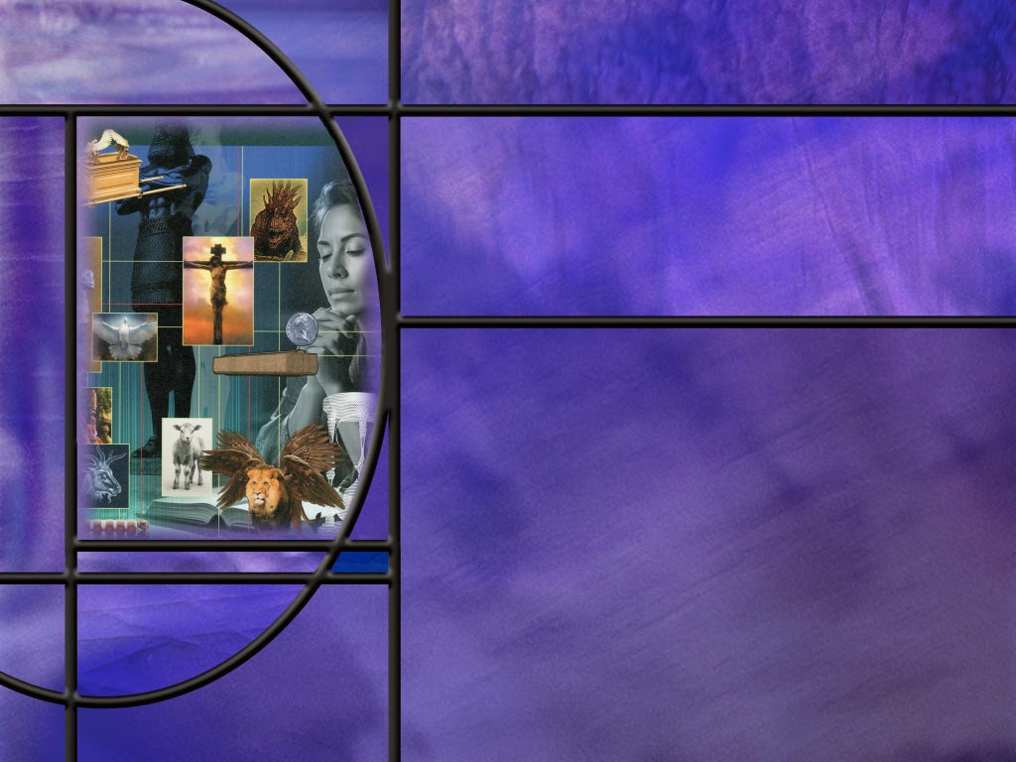
Allusions Images Symbols: How to Study Bible Prophecy
Lesson 9
In the Psalms: Part 2

Slide 2

Memory Text
Psalm 67:3-4 NKJV
Let the peoples praise You, O God; Let all the peoples praise You. ⁴ Oh, let the nations be glad and sing for joy! For You shall judge the people righteously, And govern the nations on earth.
How extensive is this psalmist’s plea for the praise of the living God?
When can we expect this prophetic prayer to be answered that the nations will be glad and sing for joy and God will govern the nations on earth?
How did the Israelites do in fulfilling God’s plan to include the Gentiles in God’s kingdom?
Who has replaced the Israelites as the chosen people of God?
Notes:
B2:
1. He is praying for a time when the name of God will be universally praised.
2. Not just some people, but “let all the people praise You.”
3. Not just the Hebrew people; not just the Jewish people, not just the physical Israelites, but all the people, Jew and Gentile alike.
4. In this psalm we see one more instance in the OT where God reveals His plans to save all people.
B3:
1. Today, God may set up rulers and tear them down, but He doesn’t directly govern the nations.
2. This prayer looks forward to a time when the kingdom of God will be established on the earth.
3. This is a time after the Lord has judged people righteously.
4. The redeemed have been saved in His Kingdom; the wicked have been destroyed in the lake of fire, and God has created new heavens and a new earth.
5. The meek, those who have trusted Jesus for their forgiveness and righteousness, will inherit the earth.
6. This is the eternal state of blessedness where the love of God has triumphed, Satan and sin have been defeated, and Jesus is King.
7. It is then that Paul’s beautiful words in Phil 2:10-11 will be a reality:
8. The name of Jesus will be above every other name
Philippians 2:10-11 KJV - That at the name of Jesus every knee should bow, of things in heaven, and things in earth, and things under the earth; ¹¹ And that every tongue should confess that Jesus Christ is Lord, to the glory of God the Father.
9. Are you looking forward to singing for joy in that kingdom and worshipping the King of kings?
B4:
1. By the time of Jesus, the Jews were not really very evangelistic.
2. They considered the Gentiles unclean dogs.
3. They would be defiled by touching them or going into their houses.
4. While they kept the truth of God alive, they also kept it to themselves.
5. They were a stiff-necked and rebellious people who were more often serving idols than the living God.
6. Finally, God had to punish them by allowing them to be carried off into captivity.
B5:
1. When the Jews rejected Jesus as their Messiah, God rejected them as His chosen people.
2. It is now those who are “in Christ” that are the chosen people of God.
3. In closing the book of Galatians, Paul calls the Christians of Galatia (Jews and Gentiles) “the Israel of God.” (Gal 6:16)
4. Peter applies the OT titles of Israel to the Christians to whom he is writing:
1 Peter 2:9 NKJV: you are a chosen generation, a royal priesthood, a holy nation, His own special people…
5. Paul writes that:
Galatians 3:20 NKJV: if you are Christ’s, then you are Abraham’s seed, and heirs according to the promise.
6. It is His church that Christ has commissioned to preach the everlasting gospel to every nation, kindred, tongue, and people.
7. If you are in Christ, that includes you.

Slide 3
Overview
Many of the Psalms focus on the goodness of God pointing to Him as our help, our hope, our King, our deliverer, our Savior and Lord. These pictures of God encourage us through the difficult times we know are ahead and assure us that His kingdom will prevail as the prophetic word becomes historic reality.
  Our Help and Our Hope
  Our King
  Our Savior
  Summary

Slide 4

Our Help and Our Hope
How does the psalmist describe the uncertainty and turmoil possible in our fallen world? (Ps 46:1-3,6)
How does the psalmist describe the peace and safety that comes from a relationship with the Lord? (Ps 46:7-11)
What assurance of final victory does Daniel give to the people of God in his vision of the pre-advent judgment? (Dan 7:14,18)
What hymn in our hymnal (our book of “psalms”) expresses the help God gives to us and the hope we have in Him? [Hymn 103]
Notes:
B1:
[See notes on linked slide.]
B2:
[See notes on linked slide.]
B3:
[See notes on linked slide.]
B4:
[See notes on linked slide.]

Slide 5
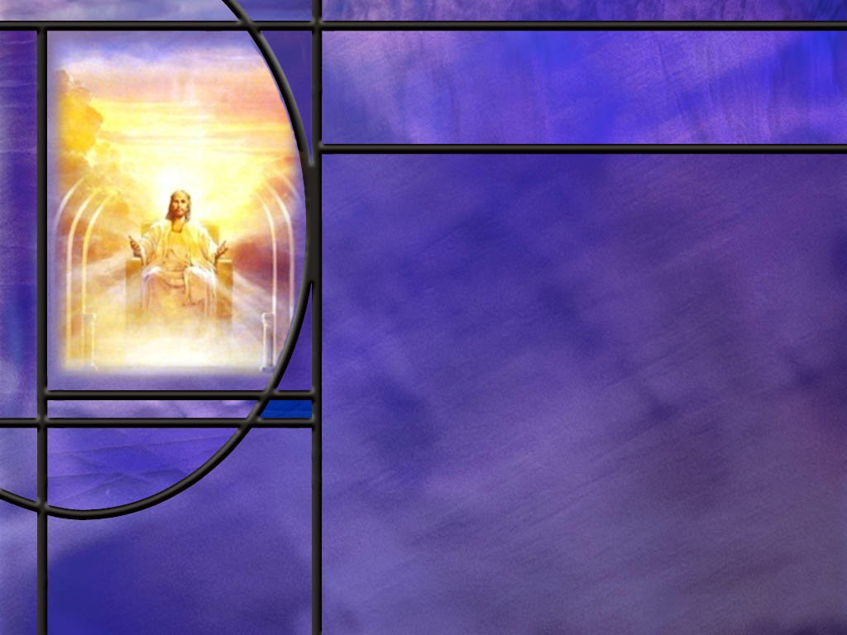
Our King
Who does the psalmist see as the King of kings? (Ps 47:1-2)
Over whom does this King ultimately rule? (Ps 47:6-8)
How does Psalm 2 point to Jesus as King? (Psalm 2:6-9)
How did Jesus respond to Pilate’s question about His kingship? (John 18:33,36)
How does John portray Jesus as he returns in judgment on the wicked? (Rev 19:15-16)
Notes:
B1:
[See notes on linked slide.]
B2:
[See notes on linked slide.]
B3:
[See notes on linked slide.]
B4:
[See notes on linked slide.]
B5:
[See notes on linked slide.]

Slide 6
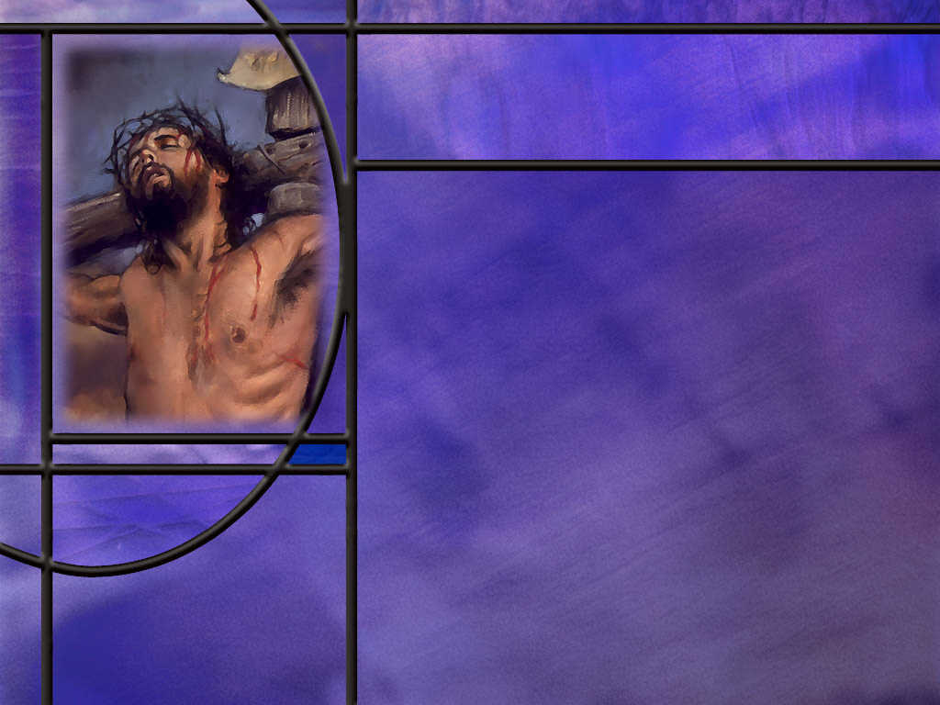
Our Savior
How do the opening and closing verses of Ps 67 express God’s desire for mankind? (Ps 67:1-2,7)
How does Isaiah make God’s desire to save the Gentiles even more explicit? (Isa 49:6)
What does the NT say about God’s desire to save everyone? (2 Peter 3:9; 2 Tim 2:4)
Notes:
B1:
[See notes on linked slide.]
B2:
[See notes on linked slide.]
B3:
[See notes on linked slide.]

Slide 7
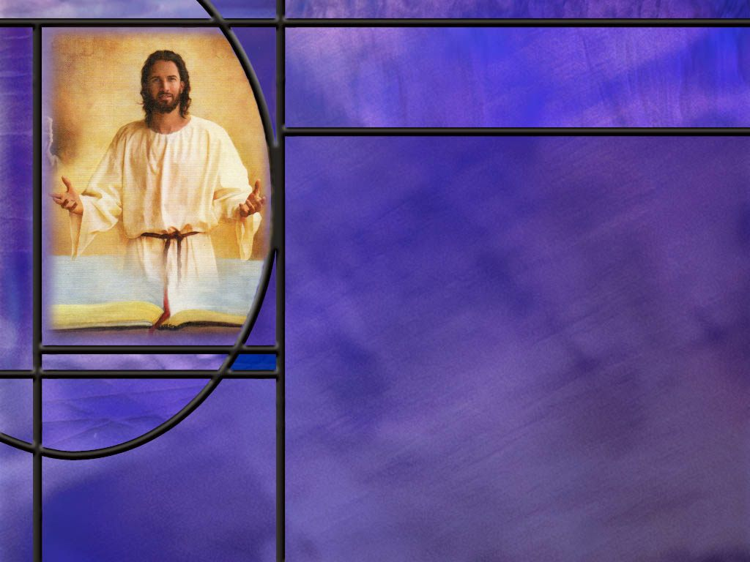
Summary
The psalms in our study this week paint a picture of a God who is engaged in human affairs, and who will see us through difficult times now and especially through end time tribulations.
Ps 46 reminds us that God is our refuge and strength, a very present help in trouble.”
Ps 46 also reminds us to “be still and know that I am God.”
Ps 91 reminds us that only with our eyes shall we “behold and see the reward of the wicked.”
Many other psalms also point to a God who is “our help in ages past, our hope in years to come.” Whatever we face in the time of trouble that lies ahead we can trust in our omnipotent God to deliver us.

Slide 8
Summary
Ps 47 presents the LORD as “a great King over all the earth.”
Ps 2 is a messianic psalm in which Christ is designated by His father as King in Zion and is given authority over the nations to execute judgement as His second coming.
Jesus was acknowledged by the wise men as King of the Jews, was welcomed in Jerusalem as king in the triumphal entry, and was crucified as king of the Jews by Pilate.
At His second coming Jesus will return as King of kings and Lord of lords.
He comes as a conquering king who will overwhelm all the forces of evil and all the governments of man to establish His kingdom of glory on the earth made new.

Slide 9
Summary
Ps 67 reminds us that God intended all nations to know his plan of salvation.
Christ was to be a light to the Gentiles to bring salvation to the ends of the earth.
When the Jews rejected Jesus as their Messiah, God rejected them as His chosen people.
It is now those who are “in Christ” that are the chosen people of God.
It is to the Christian church that God has given the commission to make sure the everlasting gospel is preached to every nation, kindred, tongue, and people.
Will you ask the Lord this week what you can do to help spread the everlasting gospel ?

Slide 11
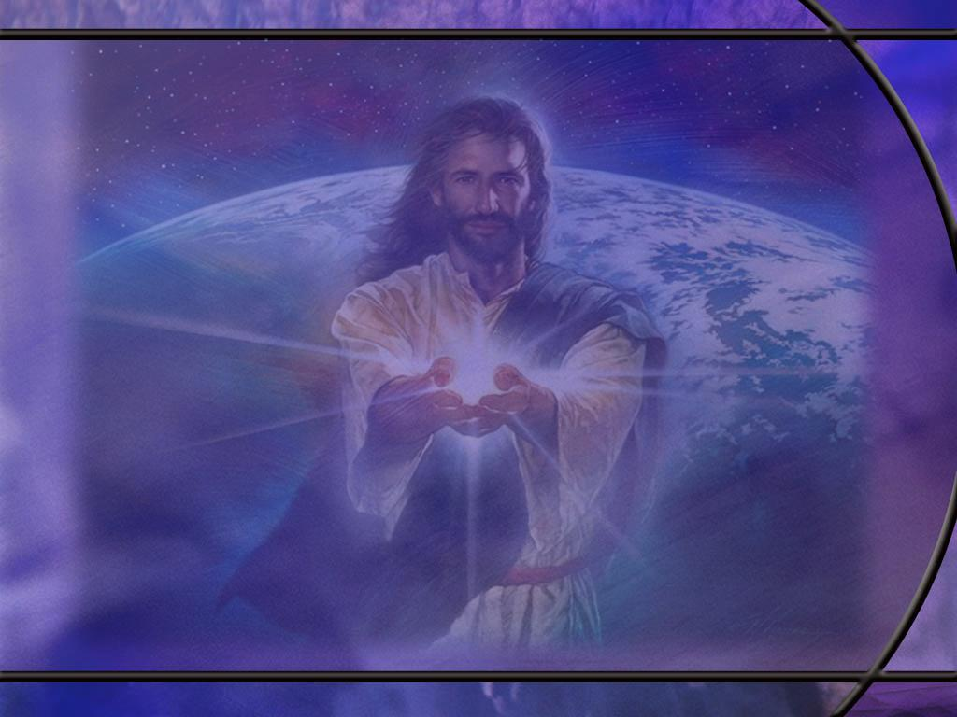
Psalm 46:1-3, 6 ESV
God is our refuge and strength, a very present help in trouble. ² Therefore we will not fear though the earth gives way, though the mountains be moved into the heart of the sea, ³ though its waters roar and foam, though the mountains tremble at its swelling. ... ⁶ The nations rage, the kingdoms totter; he utters his voice, the earth melts. [R]
Notes:
Q1: What kinds of turmoil and disasters may face us in this fallen world?
1. Jesus said:
John 16:33 KJV - In the world ye shall have tribulation: but be of good cheer; I have overcome the world.
2. We all face difficulties and troubles of many kinds.
3. Here the psalmist portrays our troubles as natural disasters that are far beyond our control.
4. We have no reason to fear even though the earth gives way, the mountains are cast into the sea, the tornadoes and hurricanes roar, the earthquakes break the mountains, the nations rage, the kingdoms fall, and the earth melts.
5. We see some of these natural disasters coming in the book of Revelation.
6. Particularly under the seventh plague beginning in Revelation 16:17.
Revelation 16:18, 20-21 NKJV - 18 And there were noises and thunderings and lightnings; and there was a great earthquake, such a mighty and great earthquake as had not occurred since men were on the earth. ... 20 Then every island fled away, and the mountains were not found. 21 And great hail from heaven fell upon men, each hailstone about the weight of a talent.
Q2: Where can we find refuge from such troublous times?
1. Go back to the opening words of this psalm: God is our refuge and our strength.
2. When we come to the time of the final tribulation we can claim the promise of Ps 91:
Psalm 91:8-11 KJV - Only with thine eyes shalt thou behold and see the reward of the wicked. ⁹ Because thou hast made the LORD, which is my refuge, even the most High, thy habitation; ¹⁰ There shall no evil befall thee, neither shall any plague come nigh thy dwelling. ¹¹ For he shall give his angels charge over thee, to keep thee in all thy ways.
3. When we are secure in the arms of Jesus, nothing can separate us from His love.
4. The apostle Paul ends Roman chapter 8 with these words:
Romans 8:38-39 KJV - For I am persuaded, that neither death, nor life, nor angels, nor principalities, nor powers, nor things present, nor things to come, Nor height, nor depth, nor any other creature, shall be able to separate us from the love of God, which is in Christ Jesus our Lord.

Slide 12
Psalm 46:7-11 ESV
The LORD of hosts is with us; the God of Jacob is our fortress. ⁸ Come, behold the works of the LORD, how he has brought desolations on the earth. ⁹ He makes wars cease to the end of the earth; he breaks the bow and shatters the spear; he burns the chariots with fire. ¹⁰ "Be still, and know that I am God. I will be exalted among the nations, I will be exalted in the earth!" ¹¹ The LORD of hosts is with us; the God of Jacob is our fortress. [R]
Notes:
1. Notice that the first and last lines of this stanza are exactly the same.
2. Between these two bookends we have a description of the power of God to intervene in the affairs of men.
3. This psalm is the inspiration for Martin Luther’s hymn, “A Mighty Fortress is Our God.”
Q1: What is God’s objective in intervening in the affairs of mankind?
1. His ultimate objective is to bring peace.
2. He will be the final victor in the long war against God.
3. In the end of the earth, he will make wars cease.
4. The implements of war will be destroyed.
5. Jesus will come…
2 Thessalonians 1:8-9 KJV - In flaming fire taking vengeance on them that know not God, and that obey not the gospel of our Lord Jesus Christ: ⁹ Who shall be punished with everlasting destruction from the presence of the Lord, and from the glory of his power;
Q2: What is God’s council to us here in verse 10 as we face the trials of life?
1. “Be still and know that I am God.”
2. What do you think that means?
3. “Don’t worry. Be calm. Trust in Me. Be confident that I will win in the end.
4. I will be the ultimate victor in the great controversy and will be exalted in the earth.”

Slide 13
Daniel 7:14, 18 ESV
And to him [the Son of Man] was given dominion and glory and a kingdom, that all peoples, nations, and languages should serve him; his dominion is an everlasting dominion, which shall not pass away, and his kingdom one that shall not be destroyed. ... 18 But the saints of the Most High shall receive the kingdom and possess the kingdom forever, forever and ever.’ [R]
Notes:
Q1: As a result of the pre-advent judgment in heaven, who receives the kingdom?
1. It is Jesus the Son who receives a kingdom that is an everlasting kingdom.
2. Here the kingdom of grace becomes the kingdom of glory.
3. The unfallen angels are fully satisfied that God’s judgments are just and true.
4. The redeemed have been identified for the angels, so they can gather the elect for Jesus when He returns.
Q2: With whom does Jesus share His kingdom?
1. The saints of the Most High.
2. These would include unfallen angels and redeemed people.
3. This receiving the kingdom and sharing the kingdom would actually occur when Jesus returns and takes us to heaven where we triumphantly enter the New Jerusalem and share in the wedding feast of the Lamb.
Q3: Is the judgment good news or bad news?
1. It is good news for the saints that are redeemed.
2. It results in the destruction of the forces of evil and the establishment of God’s kingdom of which they will be a part for eternity.
3. It is bad news for those who have not trusted in Jesus for the forgiveness of their sins.
4. They will be punished for their own sins and suffer the final wages of sin.
5. But their punishment will not be as bad as eternal torment, so even they can be thankful, in the end, for the mercy of God.

Slide 14
O God Our Help in Ages Past
O God our help in ages past, our hope for years to come. Our shelter from the stormy blast, and our eternal home.
Under the shadow of Thy throne still may we dwell secure. Sufficient is Thine arm alone, and our defense is sure.
Before the world in order stood or earth received her frame, from everlasting thou art God to endless years the same.
A thousand ages in Thy sight, are like an evening gone, short as the watch that ends the night, before the rising sun.
O God our help in ages past, our hope for years to come. Be thou our guide while life shall last, and our eternal home! [R]
Notes:
1. These words were written by Isaac Watts in 1719, more that 300 years ago.
2. But the thoughts of this hymn are based on the 90th psalm written by Moses nearly 3,500 years ago.
3. They are as true today as when they were written.
Isaiah 40:8 NIV - 8 The grass withers and the flowers fall, but the word of our God endures forever."

Slide 15
Psalm 47:1-2 ESV
Clap your hands, all peoples! Shout to God with loud songs of joy! ² For the LORD, the Most High, is to be feared, a great king over all the earth. [R]
Notes:
Q1: How should the people respond to the LORD reigning as King over all the earth?
1. They should clap their hands, and shout to God with loud songs of joy!
2. When the Lord God is ruler over all the earth, people will be delighted to live under His rulership.
3. No more fighting for supremacy from various political factions.
4. We will all acknowledge that God’s ways are best and we will be delighted to live in His kingdom of love and grace.
5. We will fear the Lord, not in the sense of being terrified of Him, but in the sense of standing in awe of His power, wisdom, love, mercy, grace and goodness.
6. We will acknowledge that God is worthy to rule since He is creator and redeemer and His ways are just and true and right.

Slide 16
Psalm 47:6-8 NIV
Sing praises to God, sing praises; sing praises to our King, sing praises. ⁷ For God is the King of all the earth; sing to him a psalm of praise. ⁸ God reigns over the nations; God is seated on his holy throne. [R]
Notes:
Q1: In what sense does God reign over the nations?
1. First, we can think of God reigning over the nations right now in the sense that He can establish nations and destroy them.
2. We see this clearly in the prophetic sequence of world ruling nations in Daniel 2.
3. Nebuchadnezzar had to learn that:
Daniel 4:25 NKJV - … the Most High rules in the kingdom of men, and gives it to whomever He chooses.
4. God is still in control and can set up or tear down nations as He chooses.
5. Second, If we look forward to the ultimate fulfillment of the reign of God, His direct reign is over the kingdom of God, consisting of those who have been redeemed by the blood of Jesus.
6. In the earth made new, there will be people from every nation, but those nations will have all been destroyed.
7. Every Christian now has a dual citizenship: they are citizens of an earthly nation and citizens of the kingdom of God.
8. So we can understand “God reigns over the nations” in the sense that He reigns over people in His kingdom who used to be citizens of worldly nations.
9. Revelation speaks of a time when
Revelation 11:15 KJV - 15 the seventh angel sounded; and there were great voices in heaven, saying, The kingdoms of this world are become the kingdoms of our Lord, and of his Christ; and he shall reign for ever and ever.
10. When we are under the direct reign of the King of kings, we can say we are current citizens of the kingdom of God and former citizens of the USA.

Slide 17
Psalm 2:2, 6-9 NKJV
The kings of the earth set themselves, And the rulers take counsel together, Against the LORD and against His Anointed, saying, ... [The LORD speaking:] 6 "Yet I have set My King On My holy hill of Zion." 7 "I will declare the decree: The LORD has said to Me, 'You are My Son, Today I have begotten You. 8 Ask of Me, and I will give You The nations for Your inheritance, And the ends of the earth for Your possession. 9 You shall break them with a rod of iron; You shall dash them to pieces like a potter's vessel.’ “ [R]
Notes:
1. So the conversation is a little difficult to understand here, but let’s see if we can follow it.
Q1: First, in verse 2, against whom do the rulers of the world take council?
1. The text says they take council against the LORD and His anointed.
2. When the LORD appears in all caps, it refers to YHWH or Yahweh, the ever present I AM.
3. So, we would think of the LORD in all caps as the Father and His anointed as Jesus His Son.
4. The word Messiah actually means “anointed one.”
5. So they take council against the LORD and His Messiah.
6. In Greek, Messiah becomes Christ.
Q2: Now what is he conversation between Father and Son in verses 6 and following?
1. So, verse 6 and onward is a conversation between Father and Son.
2. In verse 6, the Father is speaking.
3. He says He has set “My King on My holy hill of Zion.”
4. Here He is pointing to His Son as the King of Zion, the city of God, the New Jerusalem.
5. Then in verse 7 it is the Son quoting His Father as saying: “You are my Son, Today I have begotten You.”
6. The word begotten here is a Hebrew word that refers to the enthronement of a king.
7. In the context of this Psalm, the “Today I have begotten you” would refer to the day that Christ was exalted to the right hand of God and took His place in the position of honor and authority.
8. It is on this day that He was invested with royal dignity and authority as the Son of God who had completed His mission of providing salvation for all who would come to God by faith in His blood.
9. So the “begotten” is not in the sense that Jesus only became God’s son on that day.
10. He has been the Son of God from all eternity.
11. The begotten refers to the assumption of full authority to exercise all the prerogatives of His sonship from His position at His Father’s right hand.
12. Verses 8 and 9 continue with the Son quoting the Father as giving Him authority over the nations to carry out God’s judgment upon them at the second coming.
13. So here is a Psalm pointing to Jesus the Messiah as God’s appointed King of Zion.

Slide 18
John 18:33, 36 ESV
So Pilate entered his headquarters again and called Jesus and said to him, "Are you the King of the Jews?" ... 36 Jesus answered, "My kingdom is not of this world. If my kingdom were of this world, my servants would have been fighting, that I might not be delivered over to the Jews. But my kingdom is not from the world.“ [R]
Notes:
Q1: How did Jesus answer the question of whether or not He was a king?
1. His answer was Yes.
2. Three times He said He had a kingdom.
3. So, He admitted He was king of a kingdom.
4. But His kingdom was not of this world.
5. He came preaching the gospel of the kingdom of God.
6. It was not a kingdom with a physical territory, but a kingdom that was received in the hearts of the disciples He made.
7. It was the kingdom of grace that people entered by faith.
8. But when He returns, He will establish His kingdom of glory on the earth made new.
9. But by then, Pilate would be long gone, so Jesus was not threat to him.
10. It is interesting that we see Jesus acknowledged as king only at the beginning and end of His life.
11. At the beginning, the wise men came to worship Him as king of the Jews.
12. At the end, He was welcomed as king in the triumphal entry, acknowledged His kingship to Pilate, and was crucified below the sign that read, Jesus of Nazareth, King of the Jews.

Slide 19
Revelation 19:15-16 ESV
From his mouth comes a sharp sword with which to strike down the nations, and he will rule them with a rod of iron. He will tread the winepress of the fury of the wrath of God the Almighty. ¹⁶ On his robe and on his thigh he has a name written, King of kings and Lord of lords. [R]
Notes:
Q1: What might the sharp sword represent?
1. The sword is a symbol of the word of God.
Hebrews 4:12 ESV - For the word of God is living and active, sharper than any two-edged sword, piercing to the division of soul and of spirit, of joints and of marrow, and discerning the thoughts and intentions of the heart.
2. God’s judgment of all the nations is based on the word of God.
3. Individuals from every nation:
2 Thessalonians 1:9 KJV - 9 … shall be punished with everlasting destruction from the presence of the Lord, and from the glory of his power;
4. There is no earthly power that can stand in the way of the judgments of God.
5. The governments of all the nations will be powerless against the King of Kings and Lord of lords.
6. The Lord will dissolve the nations, taking the redeemed into His kingdom and destroying the wicked, leaving the earth desolate and uninhabited by people.
7. What a solemn thought!
8. Let us make our calling and election sure today.
9. Now is the day of salvation!

Slide 20
Psalm 67:1-2, 7 NIV
May God be gracious to us and bless us and make his face shine on us-- ² so that your ways may be known on earth, your salvation among all nations. ... 7 May God bless us still, so that all the ends of the earth will fear him. [R]
Notes:
Q1: What was God’s desire for the Gentile nations according to these verses?
1. God wanted His way to be known, not just in Israel, but over the entire earth.
2. He wanted the message of salvation to go to all nations.
3. He wanted all the ends of the earth to fear Him in the Biblical sense of awe, respect, reverence, surrender, and worship.
Q2: How does Revelation 14:6 echo this desire for salvation to go to all nations?
Revelation 14:6 KJV - 6 And I saw another angel fly in the midst of heaven, having the everlasting gospel to preach unto them that dwell on the earth, and to every nation, and kindred, and tongue, and people,
1. The everlasting gospel is the gospel of salvation by grace through faith.
2. It is God’s grace in giving us His Son to die for our sins, and us receiving Him by faith and trusting His blood for the forgiveness of our sins and eternal life with God.
3. It is everlasting in the sense that it has never changed from the first sin in Eden to the last sin that is confessed before probation closes.
4. It is based on the everlasting covenant made between Father and Son from the foundation of the world.

Slide 21
Isaiah 49:6 NLT
He [the LORD] says, "You will do more than restore the people of Israel to me. I will make you a light to the Gentiles, and you will bring my salvation to the ends of the earth.“ [R]
Notes:
1. This text is part of the second Suffering Servant Song of Isaiah.
Q1: What will the Suffering Servant do according to this verse?
1. First He will restore the people of Israel to God.
2. All of the first disciples and apostles were Jews.
3. The early church grew like wild fire in Jerusalem: 3,000 on the day of Pentecost alone.
4. Many of the priests were obedient to the faith.
5. So Jesus restored many of the Jews who received Jesus as their Messiah.
Q2: What is the promise of this verse for the Gentiles?
1. This same suffering Servant would be a light to the Gentiles to bring them into the truth of the gospel.
2. Paul writes, “And so all Israel shall be saved.”
3. Spiritual Israel, made up of all who are in Christ, will be saved by His once-for-all sacrifice.
4. It is only Jesus who can bring God’s salvation to the ends of the earth because it is only His blood thar forgives sins and reconciles us to God.

Slide 22
God’s Desire to Save
2 Peter 3:9 NKJV - 9 The Lord is not slack concerning His promise, as some count slackness, but is longsuffering toward us, not willing that any should perish but that all should come to repentance.
1 Timothy 2:4 NKJV - 4 [God] desires all men to be saved and to come to the knowledge of the truth. [R]
Notes:
Q1: What is God’s desire for fallen mankind?
1. He wants us all to come to Jesus, repent, and be saved.
2. He has made provision for all to be saved.
1 John 2:2 NKJV - 2 [Jesus Christ] is the propitiation for our sins, and not for ours only but also for the whole world.
3. The sacrifice is sufficient, the invitation is open, whosoever will can accept Jesus can be saved.
4. Is this good news?
5. It is the best news in all the world.
6. In fact, it is such good news that people tend to dismiss it as wishful thinking.
7. But this is not just some philosophy that somebody has come up with.
8. Christianity is based on real historical facts.
9. And the Bible is God’s word that records those historical facts.
10. The central fact of Christianity is the death and resurrection of Jesus Christ.
11. It is the hinge of history.
12. As someone has aptly said: “If Christ is risen, noting else matters; if Christ is not risen – nothing else matters.”
13. Paul says the same in 1 Cor 15:12 and following.
15. The Bible gives us credible witnesses of the truth of the resurrection.
16. Without it, there would be no Christian church today.

