Slide 1
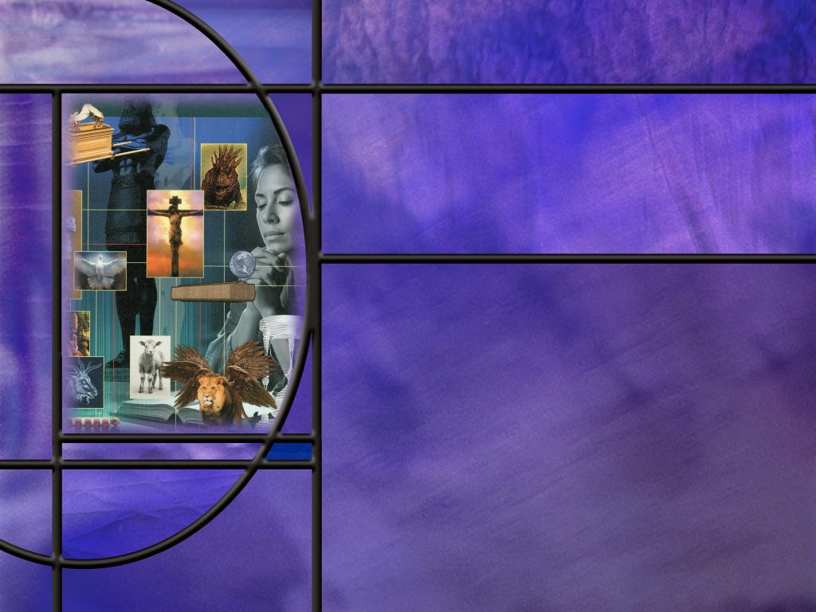
Allusions Images Symbols: How to Study Bible Prophecy
Lesson 7
Foundations for Prophecy

Slide 2
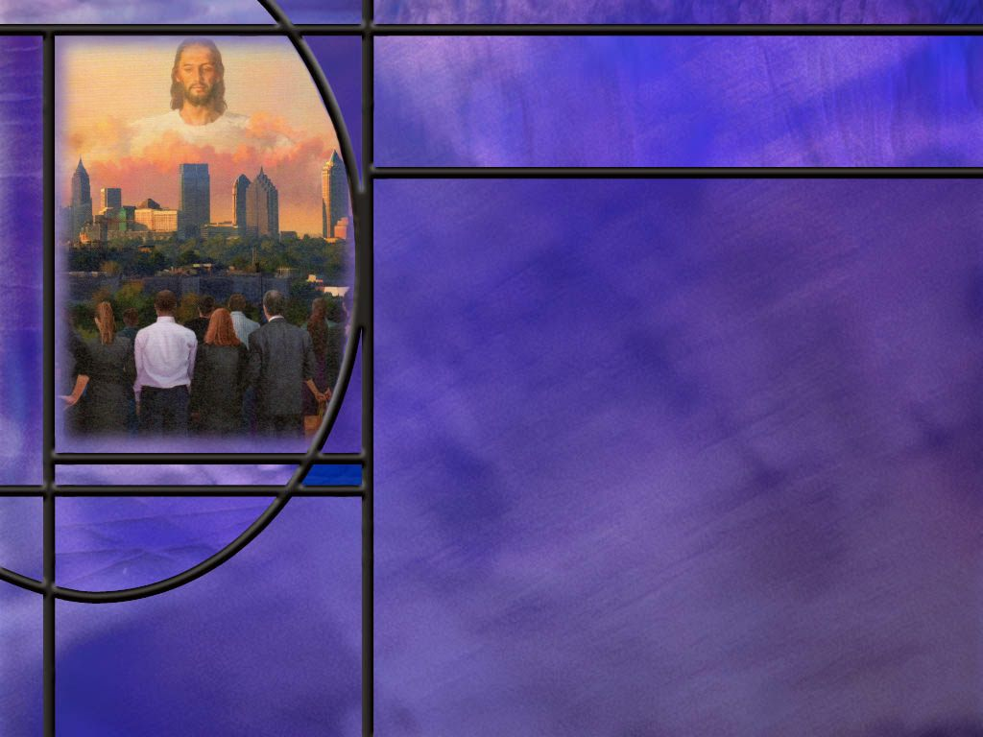
Memory Text
Isaiah 6:8 NKJV
Also I heard the voice of the Lord, saying: "Whom shall I send, And who will go for Us?" Then I said, "Here am I! Send me.“
What is unusual about the pronouns in the question the Lord asks?
What does the singular/plural pronoun usage imply about God?
How did Isaiah respond when he saw this magnificent vision of the LORD high and lifted up whose train filled the temple? (Isa 6:5)
Notes:
B2:
1. Whom shall I send and who will go for us?
2. These two questions are obviously parallel.
3. In the first God is singular and in the second He is plural.
B3:
1. It implies that God exist as three persons but one God.
2. This is one more place in scripture that we can see God referring to Himself in the plural.
Genesis 1:26 NKJV - Then God said, "Let Us make man in Our image, …“(us and our are plural)
3. And in the next verse:
Genesis 1:27 NKJV - So God created man in His own image; (his is singular)
4. When God confused the languages at Babel, He said,
Genesis 11:7 NKJV - "Come, let Us go down and there confuse their language,…
5. So Isaiah gives us one more instance where we see the godhead as plural rather than singular.
B4:
[See notes on linked slide.]

Slide 3
Overview
The Bible gives us tantalizing glimpses into the throne room in heaven where God is worshiped by the unfallen angelic beings including 24 elders and four living creatures that dwell in the throne room and continually worship God. Their worship can serve as a model for ours.
  Isaiah’s Vision
  Visions of Ezekiel and John
  Contrasting Destinies
  Summary

Slide 4
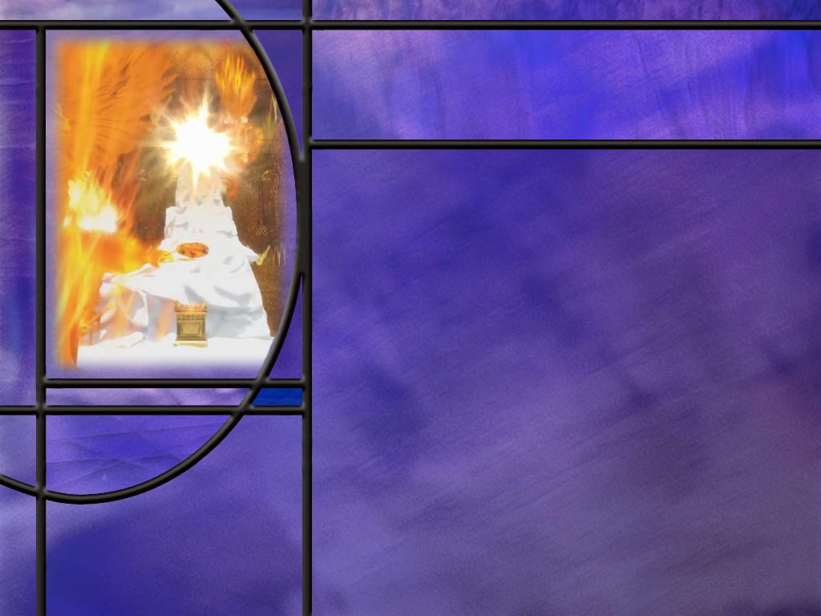
Isaiah’s Vision
What is the Bible’s first mention of cherubim? (Gen 3:24)
How does Isaiah describe the Seraphim in his vision of the heavenly temple? (Isa 6:1-4)
When Isaiah cried out “Woe is me,” what did he point to as the evidence of his sinfulness?
What made Isaiah’s lips unclean? (Matt 12:34)
In his vision, how was Isaiah’s sin dealt with? (Isa 6:6,7)
How does Isaiah now respond to the call of God? (Isa 6:8)
What refining process do we need in order to be fit for God’s service?
Notes:
B1:
[See notes on linked slide.]
B2:
[See notes on linked slide.]
B3:
1. He said, “I am a man of unclean lips and I dwell in the midst of a people of unclean lips.”
B4:
[See notes on linked slide.]
B5:
[See notes on linked slide.]
B6:
[See notes on linked slide.]
B7:
1. We too need our sins forgiven.
2. We need to be justified and declared not guilty by having our sins laid on Christ and His righteousness laid on us.
3. We need to be born of the Spirit with new life from above.
4. Until we are born again, we are not ready to serve God.
5. If the baptism of the Spirit was essential for the apostles to be effective witnesses for Jesus, how much more is it essential for us?
6. Our hope of salvation needs to rest on Christ, not on our good works.
“My hope is built on nothing less than Jesus’ blood and righteousness. I dare not trust the sweetest frame but wholly lean on Jesus’ name. On Christ the solid Rock I stand all other ground is sinking sand. All other ground is sinking sand.”

Slide 5
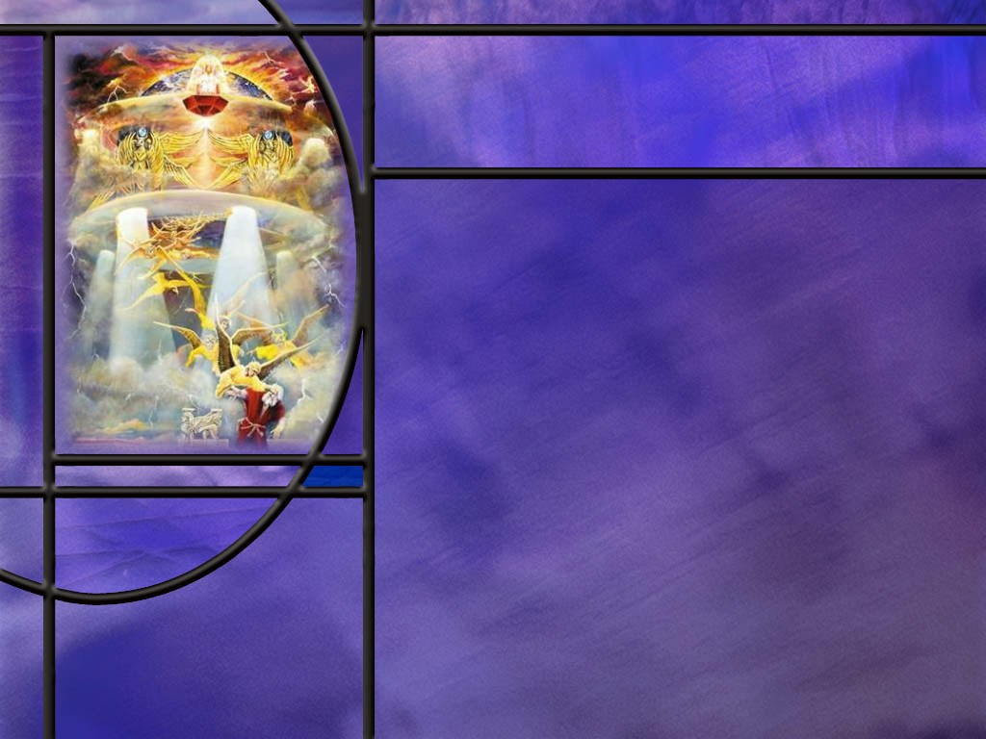
Visions of Ezekiel and John
How did Ezekiel describe the Cherubim that he saw in vision? (Ezek 1:5-8,10-11)
What did the apostle John see in the heavenly throne room? (Rev 4:6-8)
What is the first reason we find God worthy of worship in the heavenly throne room? (Rev 4:10-11)
What is the second reason we find the Lord worthy of worship in the heavenly throne room? (Rev 5:9,13-14)
Notes:
B1:
[See notes on linked slide.]
B2:
[See notes on linked slide.]
B3:
[See notes on linked slide.]
B4:
[See notes on linked slide.]

Slide 6
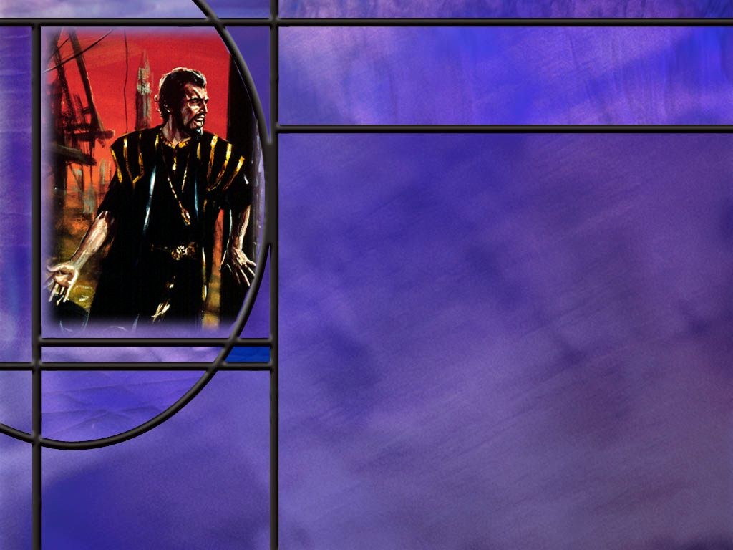
Contrasting Destinies
What contrasts are described in Revelation 14 between what the redeemed can become and what Satan became in his prideful fall? (Rev 14:1-5)
Notes:
B1:
[See notes on linked slide.]
B2:
[See notes on linked slide.]
B3:
[See notes on linked slide.]

Slide 7
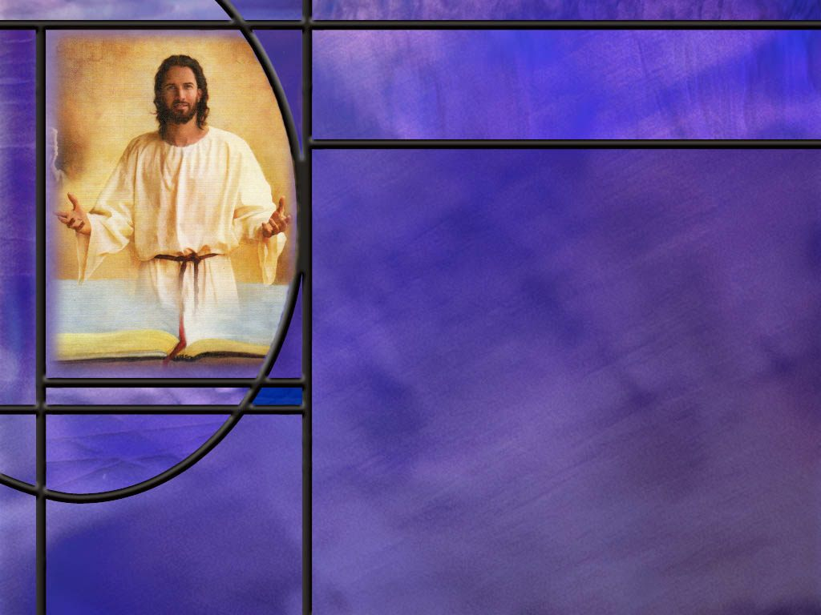
Summary
The Bible describes a spiritual realm inhabited by angelic beings created by God before He created the physical universe and mankind.
The Bible describes war in heaven when Lucifer, a covering cherub, rebelled against God and was cast out of heaven to this earth with his fallen angels.
The demonic influence of Satan and his demons is clearly seen in the evil that has been unleashed on our world, but God has often sent good angels to minister good to His people and counter the forces of evil.
In Isaiah, Ezekiel, and Revelation, the prophets describe visions of God’s throne surrounded by Seraphim, Cherubim, four living creatures, and 24 elders.

Slide 8
Summary
These angelic beings worship God continually in an attitude of reverence and respect proclaiming His holiness and worthiness of Worship.
The Bible’s first mention of cherubim is when the Lord placed them east of Eden to guard the way to the Tree of Life.
In Revelation 4 and 5, the angelic beings in the throne room of God declare that God is worthy of worship because He has created all things, and He has redeemed all people by the blood of the Lamb.
These same historical facts (creation and redemption) should motivate our worship of God, not just on Sabbath, but as we live each day, seeking to walk with Him and bring pleasure to Him by lives that are lived to His glory.

Slide 9
Summary
Revelation 14 presents a group of believers symbolically called the 144,000 who stand with the Lamb on Mt. Zion with godly characters having obtained by surrender to Christ what Satan lost by rebelling against Him.
When God called Isaiah he was overwhelmed by a sense of his own sinfulness in the presence of a holy God. But he confessed his sins, and God forgave his sins and purified him. So too, our greatest need is to be forgiven of our sins and be born again.
This changed Isaiah, and will change us, from “woe is me” to “here am I.”
Trusting in the blood and righteousness of Christ, will you, like Isaiah, answer God’s call with the words, “Here am I, send me?”

Slide 11
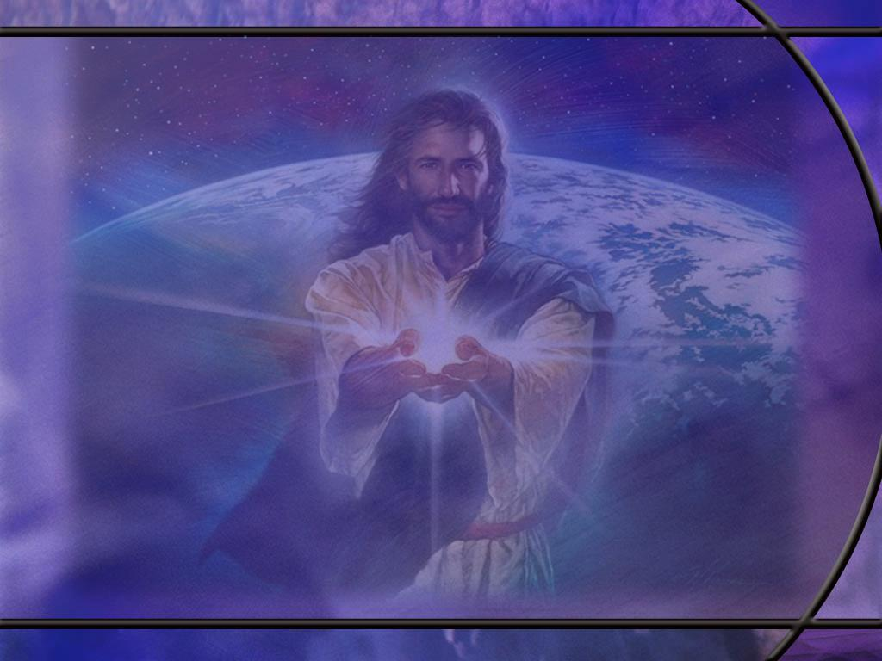
Isaiah 6:5 ESV
And I said: "Woe is me! For I am lost; for I am a man of unclean lips, and I dwell in the midst of a people of unclean lips; for my eyes have seen the King, the LORD of hosts!“ [R]
Notes:
Q1: Why did Isaiah respond to a vision of the Lord with “woe is me?”
1. The infinite holiness of God, His awesome power and glory, His hatred of sin, brings an awareness of our own unworthiness in His presence.
2. We see our inadequacies and sinfulness in contrast to His power and holiness.
3. Our only hope is the blood of Christ to forgive our sins and His righteousness to cover us.
4. The common belief was that no sinner could see God and live.
5. It was believed that God was a consuming fire to sin and sinners.
6. The Hebrew translated “I am lost” can also be translated cutoff, perish, destroy.
7. He thought that he would die as a sinner in the presence of a holy God.
8. This may come from Ex 33:20 where the Lord told Moses:
Exodus 33:20 ESV - "you cannot see my face, for man shall not see me and live."
9. But something happened to Isaiah that changed him from “Woe is me” to “Here am I.”
10. We will get to that in a minute, but first, let’s look at the overview of our lessons today.

Slide 12
Genesis 3:24 ESV
He drove out the man, and at the east of the garden of Eden he placed the cherubim and a flaming sword that turned every way to guard the way to the tree of life. [R]
Notes:
Q1: Why was it necessary to guard the way to the tree of life?
Because the wages of sin is death.
God had already warned them:
Genesis 2:17 ESV - but of the tree of the knowledge of good and evil you shall not eat, for in the day that you eat of it you shall surely die.“
The Hebrew there doesn’t mean they would die that very day.
It means, if they ate, from that day, their death would be assured.
And after they disobeyed and ate, God had pronounced the curse on His creation and on them:
Genesis 3:19 ESV - 19 By the sweat of your face you shall eat bread, till you return to the ground, for out of it you were taken; for you are dust, and to dust you shall return.“
So God placed the cherubim there in Eden so that they could not partake of the Tree of life and live forever.
Q2: What do we learn about cherubim here?
Cherubim are powerful angelic beings that God used to protect the Tree of Life from fallen mankind.
They may have been stationed there until the flood.
Think of Ponce De Leon and his search for the fountain of youth.
If the antediluvian world could have broken into the garden of Eden to partake of the Tree of Life, no doubt they would have done so.
So these cherubim were powerful enough to stop any invasion of the garden of Eden by any mob of sinners that could be assembled by Satan.

Slide 13
Isaiah 6:1-4 ESV
In the year that King Uzziah died I saw the Lord sitting upon a throne, high and lifted up; and the train of his robe filled the temple. ² Above him stood the seraphim. Each had six wings: with two he covered his face, and with two he covered his feet, and with two he flew. 3 And one called to another and said: "Holy, holy, holy is the LORD of hosts; the whole earth is full of his glory!" 4 And the foundations of the thresholds shook at the voice of him who called, and the house was filled with smoke. [R]
Notes:
Note here that Isaiah is describing the Saraphim, which appear to be different from the Cherubim.
This is the only place in the Bible where the name Seraphim is used. The KJV uses the plural Seraphims, but Seraphim is already plural in the original.
Q1: How does Isaiah describe the Seraphim?
They stand above the throne of God, apparently covering the throne.
They each have six wings.
With two wings they cover their face, with two they cover their feet, and with two they fly.
When they speak, the foundations of the temple and the thresholds of the doors shake.
Their name literally means burning ones or shining ones.
Q3: What do these angelic beings say?
Holy, holy, holy is the Lord of hosts.
Why holy three times.
First to emphasize the true holiness of God.
But second, perhaps a reference to the triune nature of God: Father, Son, and HS.
All three persons of the godhead are holy.
Q3: What might the covering of their face symbolize when ministering before the Lord Almighty?
Perhaps covering their face was a sign of humility and respect and reverence before God.
It is an acknowledgment that they are unworthy to look upon the God of infinite holiness.
It can remind us of Job’s response when he could answer none of the Lord’s questions concerning the creation.
Here is Job’s response:
Job 40:4-5 NLT - "I am nothing--how could I ever find the answers? I will cover my mouth with my hand. ⁵ I have said too much already. I have nothing more to say.“
It can also remind us of the Lord hiding Moses in the cleft of the rock so he would not see he face of God.

Slide 14
Matthew 12:34 ESV
You brood of vipers! How can you speak good, when you are evil? For out of the abundance of the heart the mouth speaks. [R]
Notes:
Q1: What makes our lips unclean?
1. It’s an unclean heart.
2. Our lips are unclean because our hearts are unclean, and our hearts are unclean because we are sinners.
3. Apart from the saving blood of Jesus we are evil rather than good.
4. As Jesus said, “there is none good but one, that is God.”
Q2: What did Isaiah recognize as his greatest need?
1. He recognized that his sins needed to be forgiven.
2. He was a sinner standing in the presence of a holy God.
3. He needed a righteousness from God to cover his filthy rags.
4. He needed to allow God to remove his sin as he wrote in Isa 1:18:
Isaiah 1:18 ESV - 18 "Come now, let us reason together, says the LORD: though your sins are like scarlet, they shall be as white as snow; though they are red like crimson, they shall become like wool.
Q3: What is our greatest need and how has God met it?
1. Our greatest need is no different than Isaiah’s: we need to be forgiven and justified through faith in the blood of Jesus.
2. We need a righteousness from God to cover our filthy rags.
3. And God has made all of that possible by grace: sending His own dear Son to die for our sins and allowing Him to take our punishment so we can receive His righteousness by faith.

Slide 15
Isaiah 6:6-7 ESV
Then one of the seraphim flew to me, having in his hand a burning coal that he had taken with tongs from the altar. 7 And he touched my mouth and said: "Behold, this has touched your lips; your guilt is taken away, and your sin atoned for.“ [R]
Notes:
Q1: What did the angel say the burning coal did for Isaiah’s sin?
1. “your guilt is taken away and your sin is atoned for.”
2. This is obviously symbolic.
3. As fire refines gold, so this coal symbolically purified Isaiah.
4. Since this coal came from the altar, the symbolism points us back to the sacrificial system where every blood sacrifice pointed forward to Jesus, the Lamb of God who would take away the sins of the world.

Slide 16
Isaiah 6:8 ESV
And I heard the voice of the Lord saying, "Whom shall I send, and who will go for us?" Then I said, "Here I am! Send me.“ [R]
Notes:
Q1: What made the difference between “woe is me” and “here am I?”
1. With his sins forgiven and purged, Isaiah now recognizes that He is accepted by God.
2. He has been reconciled to Him.
3. He is on God’s side and God is on his.
Rom 5:1 KJV. Therefore being justified by faith, we have peace with God through our Lord Jesus Christ:
4. Now he knows he is on God’s side and God will help him.
5. Isaiah surrendered to the forgiving and purifying touch of the Master’s hand.

Slide 17
Ezekiel 1:5-8, 10-11 ESV
And from the midst of it [a great cloud] came the likeness of four living creatures. And this was their appearance: they had a human likeness, 6 but each had four faces, and each of them had four wings. 7 Their legs were straight, and the soles of their feet were like the sole of a calf's foot. And they sparkled like burnished bronze. 8 Under their wings on their four sides they had human hands. ... 10 As for the likeness of their faces, each had a human face. The four had the face of a lion on the right side, the four had the face of an ox on the left side, and the four had the face of an eagle. 11 … And their wings were spread out above. Each creature had two wings, each of which touched the wing of another, while two covered their bodies. [R]
Notes:
1. Now in this passage, Ezekiel calls these beings “four living creatures.”
2. So it is not clear from this passage that these are cherubim.
3. But when we get to Chapter 10 of Ezekiel, he sees a very similar vision this time in Jerusalem instead of Babylon.
4. And there, throughout the description, they are called Cherubim.
5. Note, in particular, these two verses:
Ezekiel 10:14, 20 ESV - 14 And every one had four faces: the first face was the face of the cherub, and the second face was a human face, and the third the face of a lion, and the fourth the face of an eagle. ... 20 These were the living creatures that I saw underneath the God of Israel by the Chebar canal; and I knew that they were cherubim.
6. So in the vision of chapter 1 and the vision in chapter 10, the four living creatures are cherubim.
Q1: How do the cherubim of Ezekiel differ from the seraphim of Isaiah?
1. The seraphim of Isaiah have six wings (two covering the face, two covering the feet, two for flying)
2. The Cherubim have only four wings (two wings touching adjacent cherubim and two covering their bodies.
3. The Seraphim has only one face to cover with two wings.
4. The Cherubim have four faces: human, lion, ox, and eagle.
5. The description in chapter 10 has the four faces as human, lion, cherub, and eagle.
6. Don’t know why the difference.
7. An additional difference is that the Seraphim appear to be above the throne of God while the Cherubim are below the throne of God.
8. Yet when we come to the ark of the covenant, the two covering angels above the mercy seat are called Cherubim, not Seraphim.
9. And these cherubim on the ark of the covenant apparently have only one face, not four.
10. These four living creatures appear once again in the book of Revelation as John sees a vision of the throne room of God.

Slide 18
Revelation 4:6-8 ESV
and before the throne there was as it were a sea of glass, like crystal. And around the throne, on each side of the throne, are four living creatures, full of eyes in front and behind: ⁷ the first living creature like a lion, the second living creature like an ox, the third living creature with the face of a man, and the fourth living creature like an eagle in flight. ⁸ And the four living creatures, each of them with six wings, are full of eyes all around and within, and day and night they never cease to say, "Holy, holy, holy, is the Lord God Almighty, who was and is and is to come!". [R]
Notes:
Q1: Where does John see these four living creatures?
1. They surround the throne, one on each side.
Q2: What is different about John’s description of the four living creatures compared to Ezekiel’s?
1. Ezekiel describes each living creature with four faces on four sides of its head.
2. John describes only one face, but a different face for each of the four creatures around the throne.
3. This can be reconciled by assuming John is describing what the person sitting on the throne would see.
4. If each of the four living creatures is standing facing the same direction on the four sides of the throne, the person on the throne would see a human face to the front, a lion’s, face to the left, an oxen’s face to the right, and an eagle’s face to the back.
5. An alternative explanation is that the four living creatures can manifest one or all four of their faces.
Q3: How many wings do the four living creatures have in John’s vision here?
1. They have six wings like the Saraphim of Isaiah’s vision rather than the four wings like the Cherubim of Ezekiel’s vision.
Q4: And what do these four living creatures in Revelation say continually?
1. Holy, Holy, Holy, just like the Saraphim of Isaiah’s vision.
2. So even though they are called four living creatures as in Ezekiel’s vision and have the same faces as in Ezekiel’s vision of the cherubim, they have the same number of wings and carry out the same function as the seraphim in Isaiah’s vision.
3. Totally confused? So am I.
4. Some day when we get to the throne room in heaven we will be able to see for ourselves what these four living creatures are and how they exalt the character of God.

Slide 19
Revelation 4:10-11 KJV
The four and twenty elders fall down before him that sat on the throne, and worship him that liveth for ever and ever, and cast their crowns before the throne, saying, ¹¹ Thou art worthy, O Lord, to receive glory and honor and power: for thou hast created all things, and for thy pleasure they are and were created. [R]
Notes:
Q1: Why is the Lord God worthy of worship according to this verse?
1. Because He has created all things.
2. Father, Son, and Holy Spirit were all involved in the creation of this universe.
3. Without the creative power of our God, there would be nothing here.
4. Instead, we have a hundred billion galaxies in the heavens and a biosphere here on earth filled with life.
5. We also have a spiritual realm with myriads of angels existing before the creation of the physical universe.
6. God also created that.
7. So not only mankind, but also the spiritual beings of the spiritual realm can praise and worship God because He created all things.
Q2: What does this verse tell us about why God created?
1. All things exist and were created for God’s pleasure.
2. God took pleasure in creating our world and the inhabitants of it.
3. In other words, it pleased God to create what He did.
4. We can see this in the creation account in Genesis where God looked at what He had made and “saw that it was good.” It pleased Him.
5. So this verse gives us the insight that God created all things according to a plan and a purpose that would please Him.
Q3: How can we live in a way that will fulfill God’s purpose in creating us?
1. As part of God’s creation, He wants us to live in a way that pleases Him.
2. Our lives should bring pleasure to God, not just to ourselves.
3. Enoch’s life pleased God; Abraham’s life pleased God; Job’s life pleased God; and so should ours.
4. Paul wrote:
1 Corinthians 10:31 (KJV)
³¹ Whether therefore ye eat, or drink, or whatsoever ye do, do all to the glory of God.
5. We glorify God by living a life that pleases God: trusting Jesus as our Savior, living in obedience to His commandments, confessing our sins and receiving His forgiveness, growing in love for Him each day, sharing His love with those around us, meditating on His word, communing with Him in prayer, letting our light shine in this world of darkness.
6. We can worship God as our Creator by bringing pleasure to God in the way we live.
7. So the first reason for worship in the heavenly throne room is that God is worthy of worship because He is Creator of all.

Slide 20
Revelation 5:9, 13-14 ESV
And they sang a new song, saying, "Worthy are you to take the scroll and to open its seals, for you were slain, and by your blood you ransomed people for God from every tribe and language and people and nation, ... 13 And I heard every creature in heaven and on earth and under the earth and in the sea, and all that is in them, saying, "To him who sits on the throne and to the Lamb be blessing and honor and glory and might forever and ever!" 14 And the four living creatures said, "Amen!" and the elders fell down and worshiped. [R]
Notes:
Q1: What is it that makes the Lamb worthy, not only to open the seals but to receive worship in the heavenly throne room?
1. He shed His blood to redeem or ransom sinners from every tribe, language, people and nation.
2. So, the second reason for worship in the throne room of heaven is that God has redeemed sinners from the penalty of sin and the power of sin.
3. Christ has paid the price to set us free from the wages of our sin: eternal death.
4. These two great historical events: creation and redemption, provide the motivation for worship in the heavenly throne room.
5. Both of these great events involved the entire godhead: Father, Son, and Holy Spirit.
6/ May our worship here on earth be motivated by these same two great historical realities.

Slide 21
Revelation 14:1, 3-5 ESV
Then I looked, and behold, on Mount Zion stood the Lamb, and with him 144,000 who had his name and his Father's name written on their foreheads. ... 3 and they were singing a new song before the throne and before the four living creatures and before the elders. No one could learn that song except the 144,000 who had been redeemed from the earth. 4 It is these who have not defiled themselves with women, for they are virgins. It is these who follow the Lamb wherever he goes. These have been redeemed from mankind as firstfruits for God and the Lamb, 5 and in their mouth no lie was found, for they are blameless. [R]
Notes:
Q1: How do these verses contrast what the redeemed have gained through Christ to what Satan has lost by rebellion against God?
1. Everything that Satan and his angels have lost has been gained by the redeemed.
Q2: Where are the 144,000 redeemed standing and with whom are they standing?
1. They’re standing with Jesus on Mt. Zion in the heavenly Canaan.
2. Satan has been cast out of Mt. Zion to a desolate earth with no one to tempt.
3. The redeemed have the character of Christ represented by the name of Father and Son on their foreheads; Satan has the character of the antichrist.
Q3: What other contrasts do we see in verses 4 and 5?
1. While the redeemed have not defiled themselves with the false doctrines of the Mother of harlots, Satan is the author of false doctrines.
2. Through the immortality of the soul, he is still pushing the first lie that “ye shall not surely die.”
3. While the redeemed follow the Lamb wherever He goes, Satan is the arch enemy of the Lamb and tries to steal the Lord’s sheep.
4. While the redeemed have no lies in their mouths but speak only the truth, Satan is a liar and the father of it.
5. What Satan lost by rebellion against God, the redeemed have gained by surrender to God.

