Slide 1

Uniting Heaven and Earth: Christ in Philippians and Colossians
Lesson 7
A Heavenly Citizenship

Slide 2
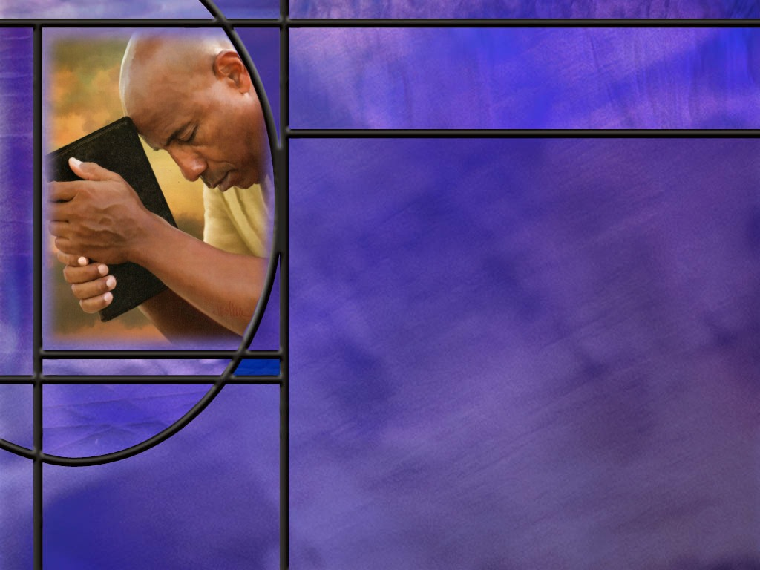
Memory Text
Philippians 4:6 NKJV
Be anxious for nothing, but in everything by prayer and supplication, with thanksgiving, let your requests be made known to God;
What does it mean to be anxious?
What goes along with prayer in this text?
What is the promise of verse 7 that follows our memory text?
Notes:
B2:
1. It means to be upset, worried, concerned, nervous, uneasy, fearful.
2. We might rephrase this as “Don’t be anxious about anything”, or “Don’t worry about anything.”
3. If we look at some other translations, here’s what we find.
KJV - Be careful for nothing;
NIV - Do not be anxious about anything,
NLT - Don't worry about anything;
4. So, as the modern expression goes: “Don’t worry, be happy.”
5. In the simple language of the NLT, this verse begins:
Philippians 4:6 NLT - Don't worry about anything; instead, pray about everything.
6. Don’t worry; take your worries and leave them with the Lord.
[Illustration]
1. I heard a story of a man who was a total worrywart.
2. He was always stressed out, about his finances, relationships, career — even the weather.
3. But suddenly, one day this man completely stopped worrying.
4. One of his friends noticed and remarked, “You seem to be worry free. What happened?”
5. The man replied, "I hired someone to worry for me. I pay him $5,000 a week."
6. Shocked, the man’s friend exclaimed, "$5,000 a week! You don’t make that kind of money! How in the world are you going to pay this guy?”
7. The man just shrugged and answered, “Well, that’s for him to worry about.”
7. Well here’s the good news: we don’t have to hire someone to worry for us.
8. God offers to do it for free!
9. We can pray and let God take care of our worry!
B3:
1. Supplication with thanksgiving.
2. Supplication is seeking, asking, petitioning, requesting.
3. It is where we actually ask God for something.
4. We ask Him to take our worry and give us His peace.
5. How about thanksgiving?
6. We should be thankful that we have a God who is willing to carry our worries for us.
7. We can thank Him for hearing our prayer and for the answers He will provide.
8. Do we have a Friend in Jesus who is willing to carry the load? (Absolutely)
9. He invites us saying:
Matthew 11:28 KJV - Come unto me, all ye that labor and are heavy laden, and I will give you rest.
10. You don’t have to labor under the burden of worry and care.
11. Remember the wonderful hymn, “What a Friend we have in Jesus.”
Are we weak and heavy laden, Cumbered with a load of care?
Precious Savior still our refuge, Take it to the Lord in prayer.
Do thy friends despise, forsake thee, Take it to the Lord in prayer,
In His arms He’ll take and shield thee, Thou wilt find a solace there.
B4:
Philippians 4:7 NIV - And the peace of God, which transcends all understanding, will guard your hearts and your minds in Christ Jesus.
1. For those who pray instead of worrying, God promises a peace that passes understanding.
2. Our part is to live in relationship with Christ, trusting Him to take care of our worries.
3. As long as we are “in Christ” we can claim this promise for peace.
4. We can think of this peace as having both a vertical and a horizontal dimension.
5. First, in Christ we have peace with God.
Romans 5:1 KJV - Therefore being justified by faith, we have peace with God through our Lord Jesus Christ:
6. And then, as we are filled with the Holy Spirit, peace is one of the fruits of the Spirit that makes us peacemakers with our fellow man.
7. When we think of it, when we are in Christ, in a saving relationship with Him, do we have anything to really worry about?
Romans 8:28 NIV - And we know that, in all things, God works for the good of those who love him, who have been called according to his purpose.
8. Paul ends chapter 8 of Romans with the declaration that there is nothing in all of creation that can separate us from the love of God in Christ Jesus our Lord.

Slide 3

Overview
Paul appeals to his readers to avoid the worldly and focus on the heavenly, to live in unity, to always rejoice, to avoid worry and find peace in prayer, to think on the virtuous, and follow Godly examples. He is content with God’s provision, in plenty or need, thankful for their gifts to him, and confident that God will meet their needs in Christ as well.
  True Citizenship
  Right Living
  Finding Contentment
  Summary

Slide 4

True Citizenship
What final warning does Paul give against false teachers? (Phil 3:17-19)
Where does the apostle Paul locate our true citizenship? (Phil 3:20-21)
Notes:
B1:
[See notes on linked slide.]
B2:
[See notes on linked slide.]

Slide 5

Right Living
What joyful exhortation does Paul give these believers even from prison in Rome? (Phil 4:4-5)
What prescription against worry does Paul give to the believers? (Phil 4:6-7)
What appeal does Paul make for the kinds of things Christians should think about? (Phil 4:8-9)
Notes:
B1:
[See notes on linked slide.]
B2:
[See notes on linked slide.]
B3:
[See notes on linked slide.]

Slide 6
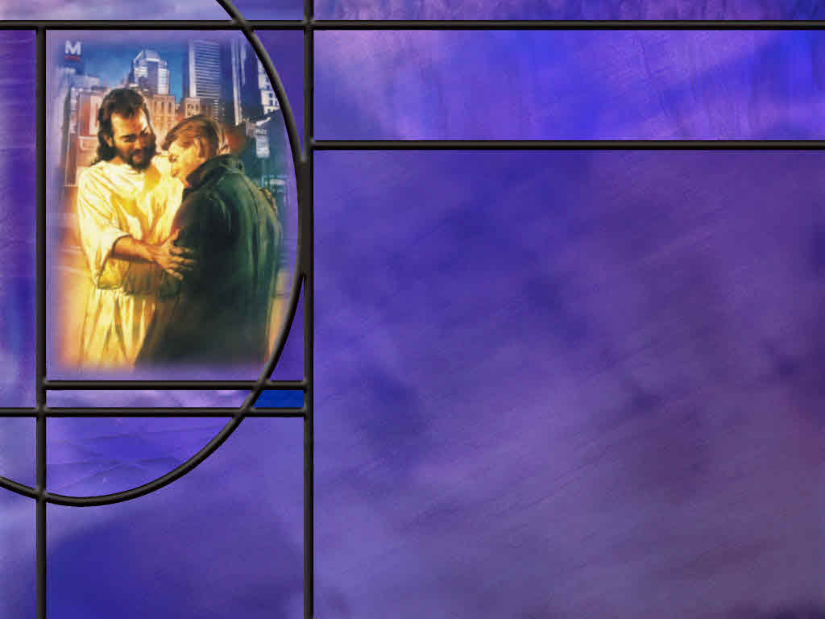
Finding Contentment
How does Paul describe his contentment in His relationship with Jesus? (Phil 4:11-13)
How does Paul assure the Philippians that their needs will also be met? (Phil 4:18-19)
Notes:
B1:
[See notes on linked slide.]
B2:
[See notes on linked slide.]

Slide 7
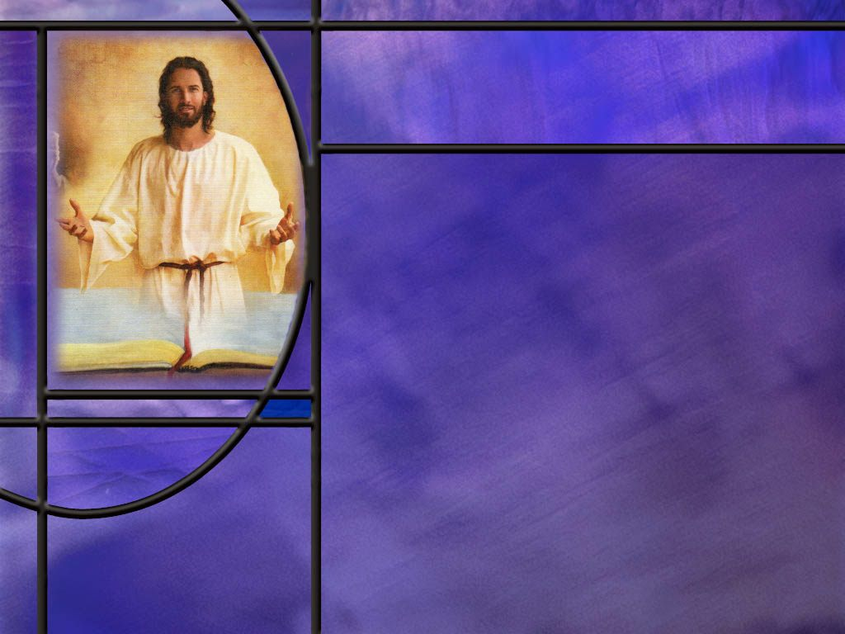
Summary
Paul appealed to the Philippians to follow his example while doing his best to follow the example of Christ.
He warned them against false teachers, this time the antinomians that ignored the law rather than the legalists that taught salvation by it.
He pointed believers to their citizenship in heaven as of surpassing value, and reminded us of the change that is coming for these vile bodies when Jesus returns.
In the resurrection we will have glorious bodies like Jesus in His resurrection with a spiritual dimension that Paul refers to as a spiritual body rather than a natural body.
Perhaps this change gives us access to the spiritual realm

Slide 8
Summary
After a call for unity, Paul appeals for the Philippians to rejoice in the Lord always.
While there are times in our lives (and in the life of Jesus) when mourning is appropriate, we can always look to the future confident that we will rejoice when His promises are fulfilled.
Paul also appeals to us not to worry about anyhing but pray about everything. As we bring our request to God with thanksgiving, we can claim the promise to He will give us a peace that transcends our understanding.
We can be confident that God works in all things for the good of those who love Him.

Slide 9
Summary
Paul lists six virtues that Christians should think about and aim their lives toward: Things that are true, honorable, just, pure, acceptable, and commendable.
From a divine perspective, these virtues are achievable only in a saving relationship with Jesus Christ.
Paul goes on to explain that he is content in every circumstance in life whether he has much or little.
Knowing that God will supply all his need, he can endure whatever test the Lord allows by the strength Christ gives him.
Will you obey the appeal of our Lord this week to Seek first the kingdom of God and His righteousness, confident that all the promises of God are “yes” in Christ?

Slide 11
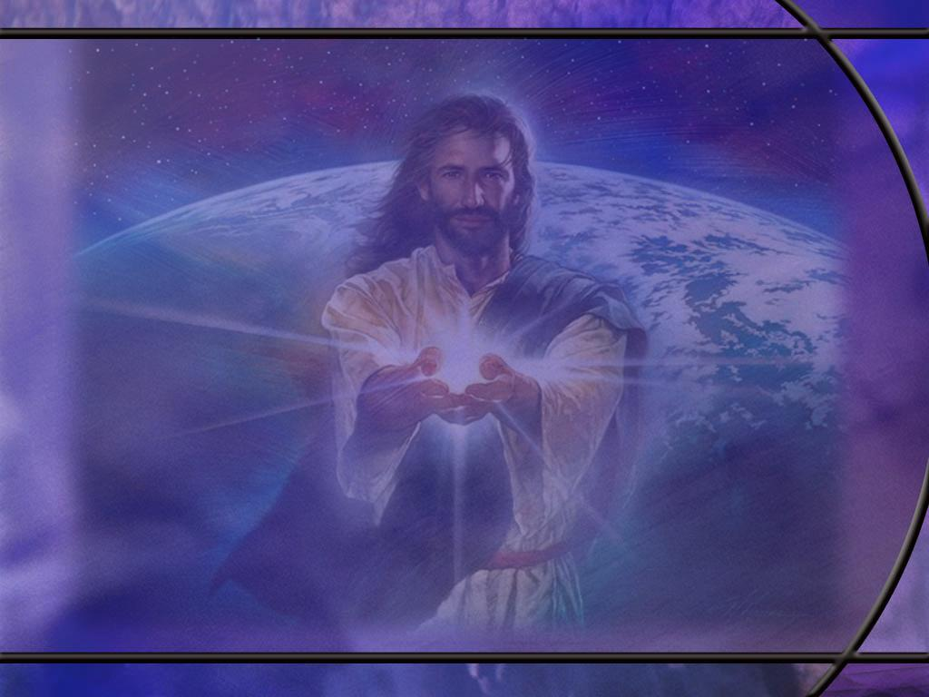
Philippians 3:17-19 ESV
Brothers, join in imitating me, and keep your eyes on those who walk according to the example you have in us. ¹⁸ For many, of whom I have often told you and now tell you even with tears, walk as enemies of the cross of Christ. ¹⁹ Their end is destruction, their god is their belly, and they glory in their shame, with minds set on earthly things. [R]
Notes:
Q1: What example does Paul encourage the Philippians to follow here?
1. Well, Paul holds himself up as the example they should follow.
2. He says imitate me.
3. Keep your eyes on those who walk according to the example that Paul and his coworkers have set for them.
Q2: Why do you think he points them to his example of living rather than to Jesus as their example.
1. It may be that they have not heard much more about Jesus than what Paul has taught them.
2. It took several decades for the gospels to be written and circulated, and perhaps the details of the life of Jesus were not available to the church at Philippi.
3. So, if they had not seen or heard the gospel accounts of the life of Jesus, the best they had in its place was the example of Paul, who knew Jesus and represented Him.
4. And Paul was certain that he was doing his best to follow the example of Jesus.
5. He doesn’t mention that here but he does in:
1 Corinthians 11:1 ESV - Be imitators of me, as I am of Christ.
6. Paul and his coworkers did their best to follow Jesus and manifest His character.
7. So, he can be an example of how Jesus would live to these new converts to the faith.
Q3: Who is Paul warning the Philippians against in verses 18 and 19?
1. This seems to be a different group than the Judaizers he warned them against in our lesson last week (Phil 3:2).
2. These appear to be more like the antinomians who claim that obedience to the commandments of God is not really important.
3. Perhaps these are teachers who turn grace into a license for sin and refused the obedience that love for the Lord should produce.
4. It appears here that they are lovers of sensual pleasures, gluttony, immorality, and worldliness.
5. Remember in Rom 6 Paul mentions the argument that if grace is a good thing, shouldn’t we sin all the more that grace may abound?
6. And Paul’s answer is:
Romans 6:1-2 KJV - 1 What shall we say then? Shall we continue in sin, that grace may abound? 2 God forbid. How shall we, that are dead to sin, live any longer therein?
7. It is grace that leads us to obedience, not more sin.
8. So, for Paul, it is important that we do not fall into either ditch.
9. He warns against the ditch of legalism in Phil 3:2 and against the ditch of antinomianism (anti-law) in Phil 3:17-18).

Slide 12
Philippians 3:20-21 ESV
But our citizenship is in heaven, and from it we await a Savior, the Lord Jesus Christ, 21 who will transform our lowly body to be like his glorious body, by the power that enables him even to subject all things to himself. [R]
Notes:
Q1: Where do those in Christ look for their ultimate dwelling place?
1. If you are “in Christ” you have dual citizenship.
2. You are a citizen of the United States of America and a citizen of the heavenly Kingdom of God.
3. But the time is coming when the kingdom of this world will become the kingdoms of our Lord, and of his Christ; and he shall reign for ever and ever.
4. When the Lord returns, the kingdoms of this world will be destroyed, ground to powder, and blown away (Daniel 2:44).
5. So which citizenship is more important?
This world is not my home. I’m just a passing through,
My treasurers are laid up, somewhere beyond the blue.
6. With Abraham, we look “for a city which hath foundations, whose builder and maker is God.” (Hebrews 11:10 KJV)
Q2: What happens to these bodies we now have when Jesus comes to save us?
1. The promise is that they will be changed to be like Christ’s glorious body.
2. Are you looking forward to that change? (Hallelujah!!)
3. No more death, old age, sickness, sorrow, or pain.
4. The KJV calls our present bodies “vile” in this text.
5. And the older we get the more we might agree with the KJV translation.
Q3: What kind of bodies can we look forward to if they are like the glorious body of Christ?
1. The Bible gives us some hints.
2. After the resurrection, what kind of body did Jesus have?
3. First His body was physical.
4. He said it was flesh and bones.
5. It could be touched and felt and it carried the scars of His crucifixion.
6. It was not a spiritual apparition like a ghost.
7. But He somehow had access to the spiritual realm into which He could move at His ascension.
8. And it may have been that access that allowed Him to appear to His disciples even though all the windows and doors were closed.
9. Paul writes in:
1 Corinthians 15:44 KJV - 44 It is sown a natural body; it is raised a spiritual body. There is a natural body, and there is a spiritual body.
10. So, we suppose a natural body is purely physical like our own, and a spiritual body is some new kind of a body with spiritual access to the spiritual realm.
11. That allows us access to the realm where heaven exists and where Christ has gone, perhaps in another dimension other than the dimensions in which our universe exists.

Slide 13
Philippians 4:4-5 ESV
Rejoice in the Lord always; again I will say, rejoice. ⁵ Let your reasonableness be known to everyone. The Lord is at hand; [R]
Notes:
Q1: What does Paul encourage these believers to do in verse 4?
1. Rejoice! And he says it twice!
2. Here is Paul in prison encouraging the believers to rejoice.
3. And you get the sense that he is rejoicing as he writes this letter.
4. He has a positive attitude of being faithful and obedient to Christ no matter what his circumstances.
Q2: What is the one word in this verse that makes it difficult for us to put this verse into practice?
1. Rejoice how often??
2. Always!!
3. Is anybody in the habit of doing that?
4. We can rejoice some of the time.
5. We can rejoice when things go well.
6. We can eat, drink, and be merry.
7. We can rejoice when our needs are met, when we have peace and prosperity, when our relationships are clicking, when we’re all getting along, when the blessings keep coming, when we’re agreeing with Christian friends, when we’re worshiping God, when we’re meditating on the word, or singing a hymn or spiritual song.
8. There’s lots of times when we can rejoice, but always?
9. But there’s also times when we’re discouraged, or depressed, or sad, or frustrated, or angry, or hurt, or afraid, or feel alone and forsaken.
10. Should we rejoice in the difficult times as well? (It says always!)
Q3: Was Jesus always rejoicing or were there times of sadness in His life?
1. Solomon, in the book of Ecclesiastes writes:
Eccl 3:4 (KJV) [There is] a time to weep, and a time to laugh; a time to mourn, and a time to dance;
2. Even Jesus at the tomb of Lazarus wept in mourning.
3. He mourned the loss of His friend knowing full well that He was going to resurrect him.
4. Job did nothing to rejoice at the great calamity that came upon him.
5. He sat in an ash heap questioning why God had abandoned him.
6. He wished he had never been born.
Q4: How should we reconcile this with Paul’s command to rejoice always?
1. Paul adds this little prepositional phrase “in the Lord.”
2. “Rejoice in the Lord.” Does that change the focus a little?
3. Even though we are sad at losing a loved one to death, we can rejoice in the Lord that He will one day wipe away all tears from our eyes.
4. We can find comfort in the promises of God, knowing that there is nothing that can separate us from His love.
5. We can rejoice in the Lord that He is in control and can work all things together for good.
8. Rejoicing in the Lord focuses on the future promises of God and the joy of the blessings of God that will be ours in Christ, knowing our future is secure in Him, regardless of what happens in the present.
Q5: What is Paul saying in verse 5? What does he mean by reasonableness?
1. The Greek can also be translated, gentleness, mildness, moderation, patience, humility.
2. Paul doesn’t mean to go around telling everyone how humble you are.
3. Let them know your gentleness by the way you live.
Q6: What does he mean by “The Lord is at hand.”
1. He could mean the second coming of the Lord is near.
2. In that case we would have to take it to mean that His coming is near for those who read this epistle.
3. Since the dead have no sense of the passing of time, they have only the rest of their lives to wait before they experience this event.
4. It could also mean that the Lord is at hand in the presence of the Holy Spirit.
5. And this was Christ’s promise to His disciples when He gave them the Great commission: “And lo I am with you always, even to the end of the age.”
6. Christ is always present with every true believer by way of the indwelling Spirit.

Slide 14
Philippians 4:6-7 NLT
Don't worry about anything; instead, pray about everything. Tell God what you need, and thank him for all he has done. ⁷ Then you will experience God's peace, which exceeds anything we can understand. His peace will guard your hearts and minds as you live in Christ Jesus. [R]
Notes:
1. We discussed these two verses at some length in the introduction since verse 6 is our memory verse.
2. Again, we note that this promise of peace is for those who are in Christ Jesus.
3. It is Jesus, the prophesied Prince of Peace that can bring peace and rest to our souls.
4. He said:
John 16:33 KJV - These things I have spoken unto you, that in me ye might have peace. In the world ye shall have tribulation: but be of good cheer; I have overcome the world.
5. He invites you to cast all you care upon Him for He cares for you. (1 Peter 5:7)

Slide 15
Philippians 4:8-9 ESV
Finally, brothers, whatever is true, whatever is honorable, whatever is just, whatever is pure, whatever is lovely, whatever is commendable, if there is any excellence, if there is anything worthy of praise, think about these things. ⁹ What you have learned and received and heard and seen in me--practice these things, and the God of peace will be with you. [R]
Notes:
Q1: What guidance for Christian living do we find in verse 8?
1. Paul is encouraging us to think about the good rather than the evil.
2. The implication is that we not only think about the good but that we do the good.
3. In verse 9, Paul is saying that this is the kind of life he tries to live, so the Philippians can follow his example and God will be well pleased.
4. In verse 9, Paul appeals to them to “practice these things.”
5. So this is the kind of a life we should live:
A life that is true: true to God, to His word, to His commandments. True to the Gospel trusting Jesus as the way the truth and the life.
A life that is honorable: a life the God can honor by granting us a place in His eternal kingdom.
A life that is just: We can only be just or righteous by faith in Christ trusting in His blood for the forgiveness of our sins.
A life that is pure: A life the is cleansed from sin by the precious blood of Jesus and wrapped in the robe of His righteousness.
A life that is lovely: This word in Greek can be also translated as acceptable or pleasing. Only in Christ can our lives be acceptable and pleasing to God.
A life that is commendable: This is a life to which God can say “Well done thou good and faithful servant… Enter into the joy of thy Lord.” (Matt 25:21)
Then just in case he has missed anything he adds anything that is excellent or praiseworthy.
6. So all of these virtues find their fulfillment in a saving relationship with the Lord Jesus Christ.

Slide 16
Philippians 4:11-13 ESV
Not that I am speaking of being in need, for I have learned, in whatever situation I am, to be content. ¹² I know how to be brought low, and I know how to abound. In any and every circumstance, I have learned the secret of facing plenty and hunger, abundance and need. ¹³ I can do all things through him who strengthens me. [R]
Notes:
Q1: What has Paul learned about the ups and downs of life?
1. He has learned to be content in every situation.
2. He has had plenty and he has been in need.
3. He has been full and he has been hungry.
4. But he has learned through it all to be content, trusting that God will supply all of his needs.
5. In this context, we come to Phil 4:13, which is a favorite Bible text of many.
6. It is often quoted from the NKJV as:
Philippians 4:13 NKJV - I can do all things through Christ who strengthens me.
Q2: Looking at the context, how should we understand Phil 4:13?
1. Paul is not saying here that he can do anything through the strength Christ gives him.
2. He cannot bench press 1,000 pounds.
3. He cannot hold his breath for three hours.
4. He cannot jump over a ten-story building.
5. He cannot flap his arms and fly through the air.
6. This verse is not talking about doing the impossible because we believe in Christ.
7. The context is that Paul can endure all things, he can go through all the difficult circumstances that God allows him to face because of the strength that Christ gives him.
8. With Christ, Paul knows that his needs will be met and he can endure the difficult knowing the good is coming.
9. Paul writes something related to the Corinthians.
1 Corinthians 10:13 NIV - 13 No temptation [testing] has overtaken you except what is common to mankind. And God is faithful; he will not let you be tempted [tested] beyond what you can bear. But when you are tempted [tested], he will also provide a way out so that you can endure it.
(The Greek translated temptation can also be translated testing)

Slide 17
Philippians 4:18-19 NIV
I have received full payment and have more than enough. I am amply supplied, now that I have received from Epaphroditus the gifts you sent. They are a fragrant offering, an acceptable sacrifice, pleasing to God. ¹⁹ And my God will meet all your needs according to the riches of his glory in Christ Jesus. [R]
Notes:
Q1: What had Paul received from the Philippian Christians?
1. They had sent gifts to Paul imprisoned at Rome under house arrest.
2. He doesn’t say what the are but he is thankful for them and sees them as amply supplying his needs.
3. Just as they have supplied his needs, he assures them that their needs will also be supplied.
4. This echoes what Jesus said in the sermon on the mount.
Matthew 6:33 KJV - But seek ye first the kingdom of God, and his righteousness; and all these things shall be added unto you.
5. Verse 19 here is worth memorizing.
6. Again, we see this common phrase used by the apostle: in Christ Jesus.
7. We can go back to second Corinthians where Paul speaks of all the promises of God.
2 Corinthians 1:20 NIV - 20 For no matter how many promises God has made, they are "Yes" in Christ.
8. If we are “in Christ” trusting Him as our Savior and Lord, the promises of God are “Yes” for us.

Slide 18
Outline of Philippians
I. Greeting (1:1-2)
II. Thanksgiving and prayer (1:3-11)
III. Paul’s personal Circumstances (1:12-26)
IV. Exhortations (1:27-2:18)
  A. Living a worthy life (1:27-30)
  B. Being a Servant like Jesus (2:1-18)
V. Fellow Servants in the Gospel (2:19-30)
  A. Timothy (2:19-24)
  B. Epaphroditus (2:25-30)
VI. Warnings (3:1-4:1)
  A. Against legalists (3:1-16)
  B. Against lawlessness (3:17-4:1)
VII. Final exhortations, Thanks, and Conclusions (4:2-23)
Notes:
Not used in this lesson.

