Slide 1
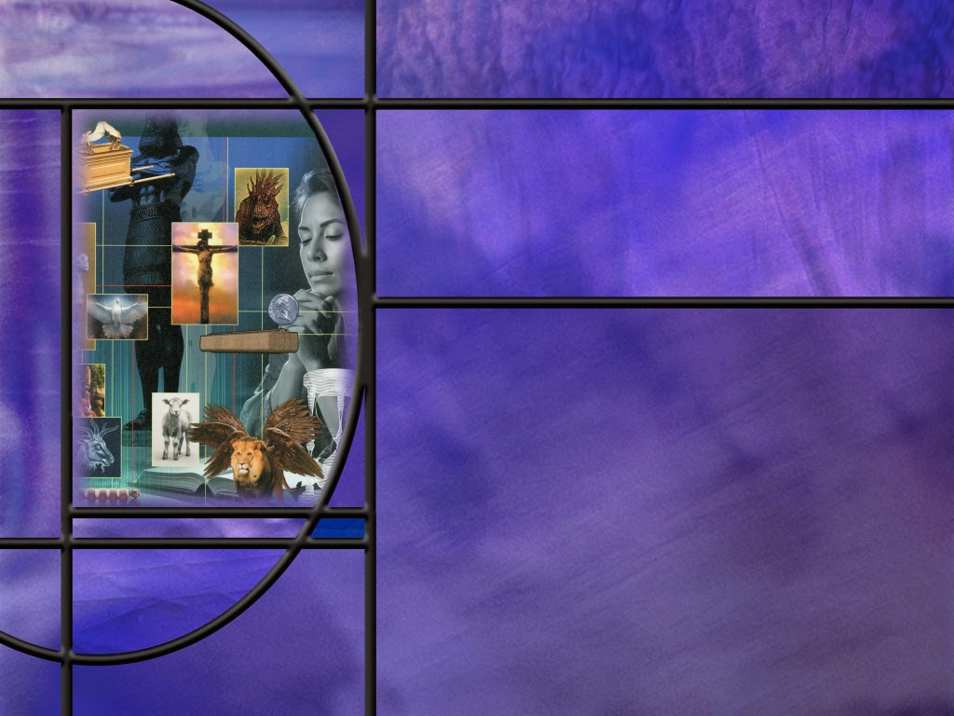
Allusions Images Symbols: How to Study Bible Prophecy
Lesson 6
Understanding Sacrifice

Slide 2
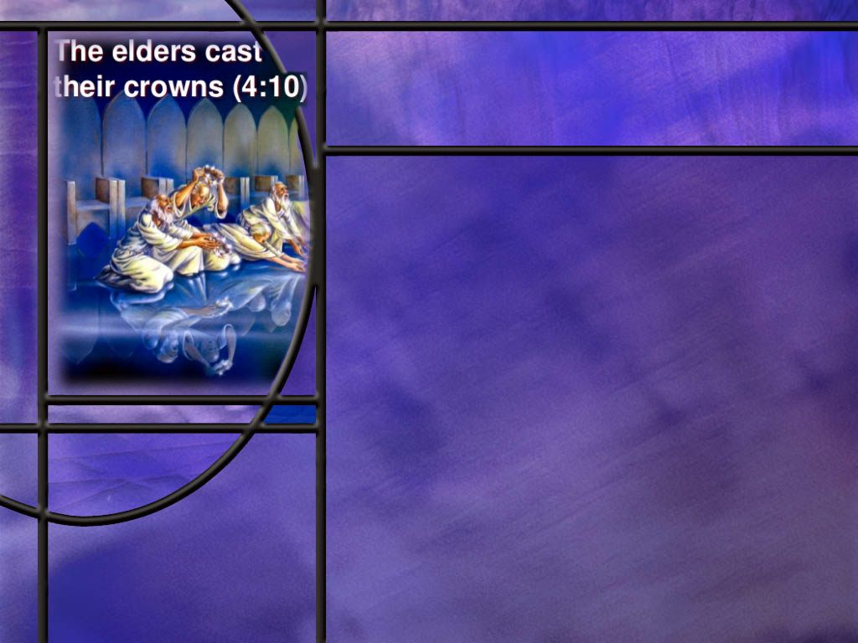
Memory Text
Revelation 5:9-10 ESV
And they sang a new song, saying, "Worthy are you to take the scroll and to open its seals, for you were slain, and by your blood you ransomed people for God from every tribe and language and people and nation, 10 and you have made them a kingdom and priests to our God, and they shall reign on the earth.“
Where does this scene take place?
Who is singing this new song of praise?
Why is the Lamb worthy? What has He done?
What is the promise of verse 10?
What assurance do you find in this promise?
Notes:
B2:
1. This scene takes place in the throne room in heaven where the one on the throne has a scroll in his right hand sealed with seven seals.
2. And John wept because no one was found worthy to open the seals.
3. But then John ”saw a Lamb standing, as though it had been slain.”
4. And this new song pronounces Him worthy to open the seals.
B3:
1. The words of this song were sung by the 24 elders around the throne in heaven.
2. John describes these words as forming “a new song.”
3. So a number of commentators have looked at Chapter 5 as a picture of the enthronement of Christ following His ascension.
4. Our memory text is “a new song” in heaven because the rightful King has now been enthroned.
5. It is “a new song” because the Lamb has been slain and has proved to be worthy to break the seals of the scroll.
B4:
1. The Lamb is worthy because He was slain, and by His shed blood He redeemed people for God from every nation.
2. That is according to the more modern translations, like the NIV in this case.
3. These translations go back to the oldest and best manuscripts.
4. If you read this verse in the KJV or the NKJV it has the 24 elders saying: “For You were slain, And have redeemed us to God by Your blood.”
5. This would imply that the 24 elders were redeemed from the earth and are in heaven at the ascension of Jesus before any of the seven seals are broken.
6. As far as we know from scripture, Enoch, Moses, and Elijah are the only humans currently in heaven.
7. The four living creatures and the 24 elders in the throne room appear to be a special order of creation separate from God’s creation of mankind.
8. In any case, it is absolutely clear that the Lamb is our Lord and Savior, Jesus Christ.
9. It is interesting that in Roman culture a person’s last will and testament was sealed with 7 seals.
10. When the person died, it was unsealed and read in the presence of the original witnesses, and then it was executed.
11. That is, the person’s possessions were divided as stipulated in the last will and testament.
12. So now here in Revelation, we have the Lamb that was slain.
13. John sees this Lamb standing in the center of the throne room of God Almighty, indicating that He is alive.
14. The Lamb is the only one in the universe that is worthy to open the seals of the scroll.
15. As He does so , the new messianic age of the Christian era begins, and this new song also looks forward to the future of redeemed humanity in verse 10.
B5:
1. It is a promise to those who have been purchased by the blood of Jesus.
2. The promise is that they will share in the reign of Christ upon the earth.
3. Remember the promise to the Laodicean church:
Revelation 3:21 (NKJV)
²¹ To him who overcomes I will grant to sit with Me on My throne, as I also overcame and sat down with My Father on His throne.
4. This is not reigning over unbelievers on the earth, but reigning with Christ in the kingdom of God.
5. The kingdom of God will be established here on the earth when the New Jerusalem descends at the end of the millennium.
6. And in some way, all of us will have a part to play in carrying out God’s government.
B6:
1. It is the assurance of victory.
2. We will reign with Christ.
3. Christ will be victorious in the GC with Satan.
4. God will pronounce judgment in favor of the saints.
5. Christ will receive His kingdom and share it with the saints.
6. Christ’s death, His resurrection, ascension, and enthronement in heaven seal the defeat of Satan and his angels.
7. Victory is assured for all who are in Christ.

Slide 3
Overview
The sacrificial system throughout the OT was a type that pointed forward to Christ, the antitype, whose sacrifice of himself on Calvary takes away the sin of the world. His atoning sacrifice is effective to redeem all who receive Him as Savior and Lord and trust in Him as a living Person for the forgiveness of their sins.
  Better than Sacrifice
  Animal Sacrifice
  Our Passover
  Summary

Slide 4
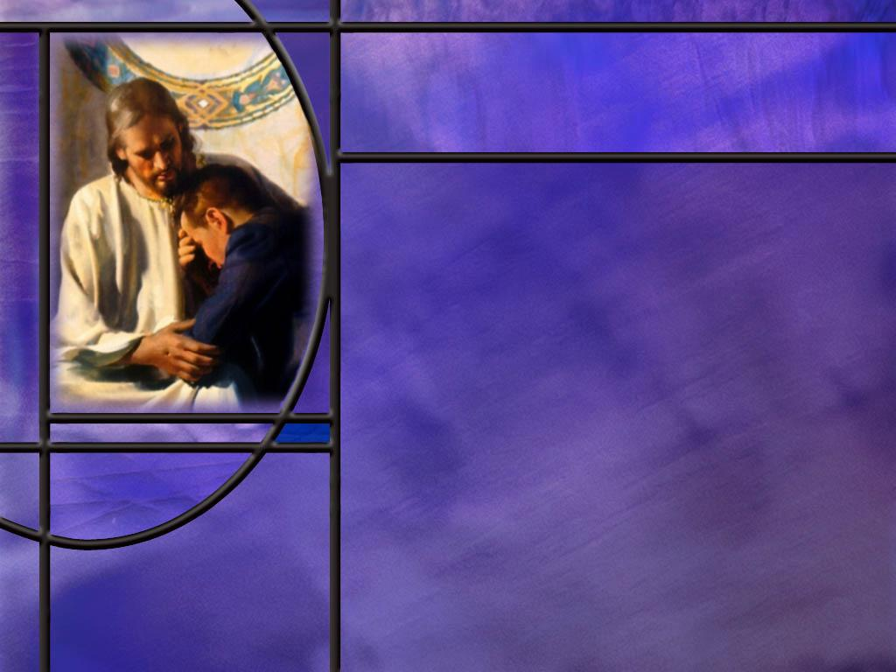
Better than Sacrifice
What did Samuel tell Saul that was better in God’s eyes than sacrifices? (1 Sam 15:22)
What did David have to say about sacrifices in his psalm of confession for his sin with Bathsheba? (Ps 51:16-17)
Notes:
B1:
[See notes on linked slide.]
B2:
[See notes on linked slide.]

Slide 5
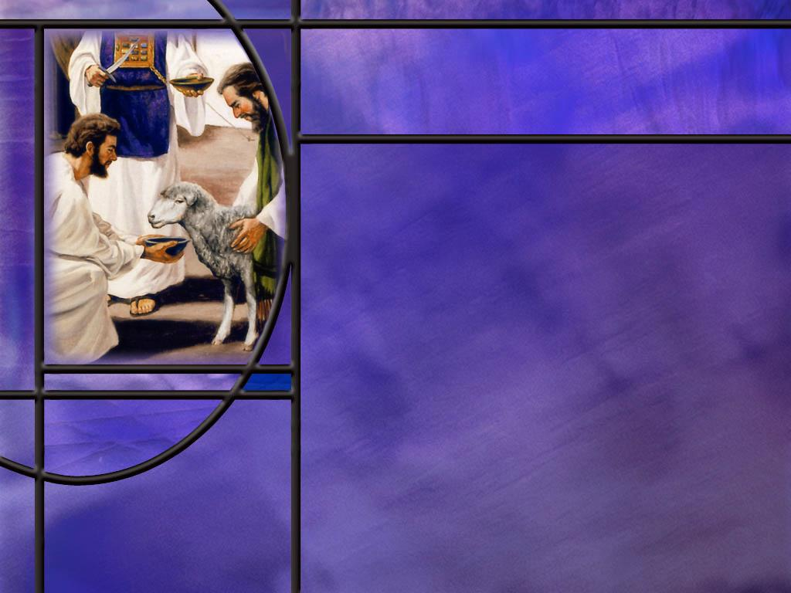
Animal Sacrifices
Where and when did the sacrificial system begin? (Gen 3:21)
Why did the Lord accept Abel’s offering but not Cain’s? (Heb 9:22; Lev 17:11)
How does the book of Hebrews add to our understanding of the difference between these two brothers and their offerings? (Heb 11:4)
What do you think God was trying to get across to sinners through the sacrificial system in the OT?
How did the Hebrew sacrificial system differ from pagan sacrifices?
Notes:
B1:
[See notes on linked slide.]
B2:
[See notes on linked slide.]
B3:
[See notes on linked slide.]
B4:
1. The sacrificial system was all about sin and atonement or at-one-ment.
2. What did God tell Adam and Eve would happen to them if they ate the forbidden fruit? (They would surly die.)
Ezekiel 18:20 (NKJV)
²⁰ The soul who sins shall die.
Romans 6:23 (NKJV)
²³ For the wages of sin is death,
3. Sin separates us from God and brings death.
4. This is the first lesson from the sanctuary.
5. The second lesson is that an innocent substitute can take our place and die in place of us.
6. For us to be brought back together with God, the blood of the substitute must be shed, and atonement must be made with the blood.
7. The sanctuary service was God’s teaching tool in the OT times to teach the gospel of forgiveness of sins and reconciliation to God by faith.
8. It taught the awful consequences of sin and the good news of forgiveness through God’s provision.
9. Forgiveness in OT times was provisional.
10. Hebrews tells us :
Hebrews 10:4 (NKJV)
⁴ For it is not possible that the blood of bulls and goats could take away sins.
11. So forgiveness was provisional until Jesus died on Calvary to fulfill all of the animal sacrifices and pay the price for the sin of the whole world.
12. The sanctuary was a teaching tool to teach the everlasting gospel of “substitutionary atonement.”
13. Sins can be forgiven by the death of an acceptable substitute: the substitute was Christ.
B5:
1. Pagans sacrificed animals, humans, children to their gods to appease them and turn away their wrath.
2. The idea was that if they could appease their gods with sacrifices, the gods would bless them in various ways.
3. In paganism, the sacrifice was something the deity needed.
4. In the Hebrew sacrificial system, it was not Yahweh that needed the sacrifice, it was the sinner.
5. Blood was shed and atonement was made for the sinner.
6. In the Hebrew system the sacrifice pointed to a reality beyond the life of the animal.
7. It pointed to God’s plan for the redemption of mankind: The Son of God would become the Lamb that takes away the sins of the world.
8. The Hebrew sacrifice pointed to the grace of God in providing forgiveness through a substitute.

Slide 6
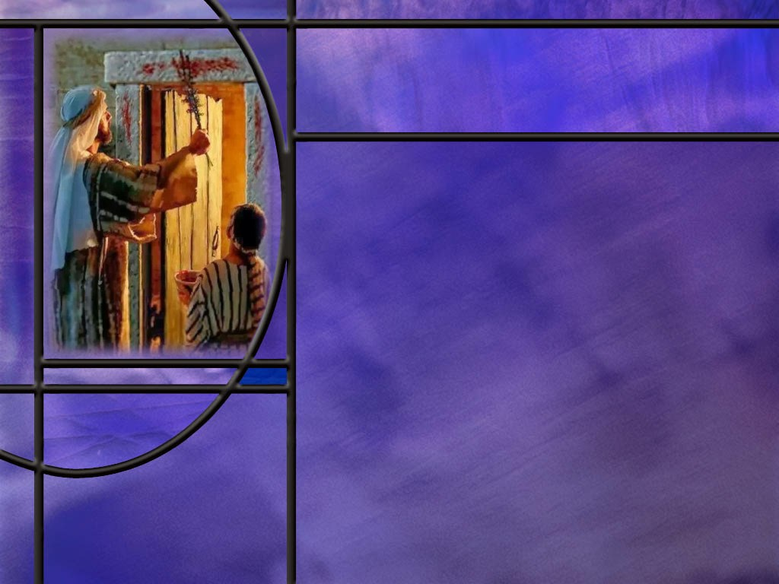
Our Passover
How did Jesus fulfill the OT Spring Festivals in the timing of His death, resurrection and outpouring of the Holy Spirit? (1 Cor 5:7-8).
What event in the temple marked the end of the sacrificial system. (Mark 15:38)
How does the writer to the Hebrews point out the superiority of Christ’s sacrifice to those offered in the OT? (Heb 9:25-28)
Notes:
B1:
[See notes on linked slide.]
B2:
[See notes on linked slide.]
B3:
[See notes on linked slide.]

Slide 7
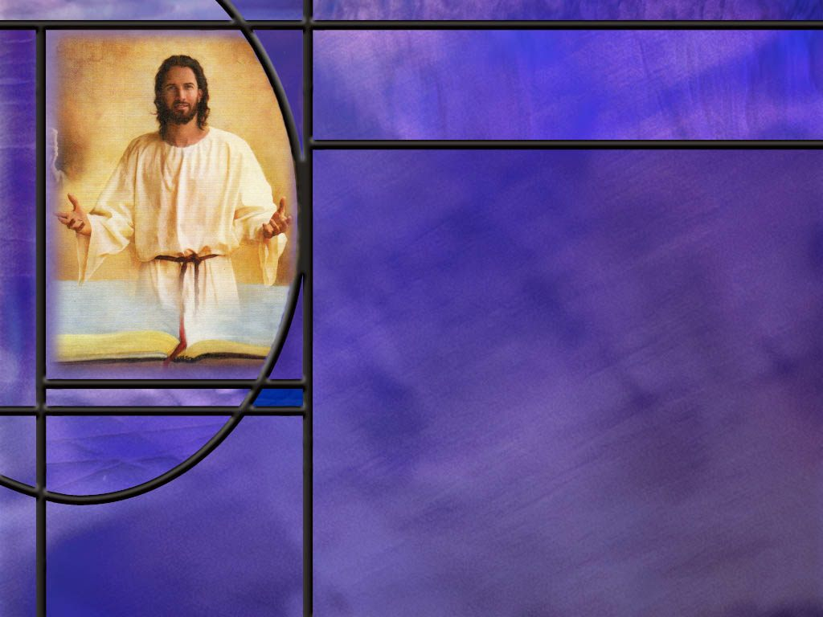
Summary
The Lamb in the book of Revelation is a very common symbol for Jesus Christ.
In John’s throne room vision in Rev. 5, Jesus is portrayed as the Lamb that was slain but is now alive, and is the only one in the universe worthy to unseal the scroll.
He is worthy because He was slain to redeem men from every tribe and nation. This is consistent with John the Baptist’s description of Jesus as the Lamb of God that takes away the sin of the world.
God instituted the sacrificial system in Eden after the first sin, as He clothed Adam and Eve with garments of skin, laying their sin on an innocent substitute.
It was “by faith” that Abel and his sacrifice were acceptable to God.

Slide 8
Summary
His sacrifice of a lamb pointed forward to the sacrifice of Jesus, and He came trusting in God for the forgiveness of his sins.
Cain, on the other hand, came trusting his own works rather than the grace of God.
Throughout the OT, the sacrificial system was used as a teaching tool to impress on God’s people the gospel of salvation by grace through faith.
The sacrificial system taught that the wages of sin is death. But the good news is that an innocent substitute can die in our place. We can be forgiven and reconciled to God by “substitutionary atonement.”
All of the animal sacrifices pointed forward to Jesus who would be the sinless Substitute that would die in our place.

Slide 9
Summary
Jesus is also the fulfillment of the Passover typology. He died at the very hour the Passover lambs were sacrificed. As the Passover blood delivered the Israelites from the angel of death, so the blood of Jesus delivers us from the second death.
When Jesus died, the veil in the temple was torn from top to bottom signifying the end of the sacrificial system.
We now have direct access to the Father as Jesus intercedes for us at His right hand.
His once-for-all sacrifice is sufficient to redeem all those who receive Him as Savior and Lord and are trusting His shed blood for their forgiveness.
Are you trusting Him today as a living Savior for the forgiveness of your sins?

Slide 11
1 Samuel 15:22 ESV
And Samuel said, "Has the LORD as great delight in burnt offerings and sacrifices, as in obeying the voice of the LORD? Behold, to obey is better than sacrifice, and to listen than the fat of rams. [R]
Notes:
Q1: What does the Lord say is better than sacrifices and burnt offerings?
1. Obedience.
2. The Lord has no special interest in the abundance of sacrifices.
3. He had commanded Saul to obliterate the Amalekites.
4. But Saul returned with the best of the animals as plunder.
5. And here is the excuse he offered Samuel:
1 Samuel 15:21 ESV - But the people took of the spoil, sheep and oxen, the best of the things devoted to destruction, to sacrifice to the LORD your God in Gilgal.“
6. So Saul admitted he had disobeyed the Lord’s instruction, but he had lots of animals to offer to cover his sin!
7. Well, the Lord prefers obedience to sacrifice.
8. If he had obeyed the Lord to begin with, he wouldn’t need to offer sacrifices for sin.
9. The same is true for us today.
10. If we obey the Lord, we won’t have to ask forgiveness for our sins.
11. So let us not rebel against the Lord’s commandments, thinking we can always ask forgiveness later.
12. God is pleased with an obedient attitude that puts God first and shuns sin and evil.

Slide 12
Psalm 51:16-17 ESV
For you will not delight in sacrifice, or I would give it; you will not be pleased with a burnt offering. 17 The sacrifices of God are a broken spirit; a broken and contrite heart, O God, you will not despise. [R]
Notes:
Q1: What kind of sacrifice is God looking for when we have sinned?
1. He is looking for an attitude of humility, of repentance, of confession, of admission of guilt.
2. He is looking for sorrow for sin and a broken heart because we broke the heart of God.
3. He is looking for a longing desire to be forgiven and restored to fellowship.
4. Refusal to confess our sins places us in danger of grieving the Holy Spirit.
5. God is looking for a contrite heart that longs to be restored through forgiveness.
6. Rituals and external forms won’t cut it with God who looks not on the outward appearance but on the heart.
7. God desires not forms and rituals but loving relationship and devotion.
8. As Jesus said to the woman at the well.
John 4:24 ESV - God is spirit, and those who worship him must worship in spirit and truth.“

Slide 13
Genesis 3:21 NKJV
Also for Adam and his wife the LORD God made tunics of skin, and clothed them. [R]
Notes:
Q1: Where did God get the skins to make the coats?
1. God introduced the sacrificial system right after the first sin.
2. The coats of skin came from animal sacrifices that pointed forward to Christ the Redeemer.
3. John the beloved apostle writes this about Jesus:
1 John 2:2 (NIV) ² He is the atoning sacrifice for our sins, and not only for ours but also for the sins of the whole world.
4. God put into effect the everlasting covenant of salvation established from the foundation of the world.
5. God the Son would die for the sins of His own creatures.
6. And God the Father would accept His death in place of ours as the wages of our sin.
7. Because of the curse, we continue to die the first death, but, because of Christ, those who trust Him will escape the second death.
1 Corinthians 15:22 (NKJV)
²² For as in Adam all die, even so in Christ all shall be made alive.
Q2: What is the significance of the last two words of this verse, that the Lord God “clothed them?”
1. Following the sacrifice for their sin, it was the Lord who clothed them.
2. The fig leaves of their own devising were an insufficient covering.
3. Their nakedness was even less appropriate.
4. To be reconciled to God and stand in His presence, we need a covering that He alone can provide.
5. Our own righteousness is filthy rags as Isaiah records.
6. The righteousness that saves is a righteousness that comes from God.
7. As God clothed them, so He must clothe us in a robe of Christ’s righteousness.
8. It was the sacrifice that provided their covering: the same is true for us.
9. Christ our sacrifice provides His robe of righteousness in which there is not one thread of our own devising.

Slide 14
Hebrews 9:22; Leviticus 17:11 NKJV
… and without shedding of blood there is no remission. (Heb 9:22)
'For the life of the flesh is in the blood, and I have given it to you upon the altar to make atonement for your souls; for it is the blood that makes atonement for the soul.’ (Lev 17:11 NKJV) [R]
Notes:
Q1: What kind of an offering was the Lord looking for when Cain and Abel came before Him to worship?
1. He wasn’t looking for a thank offering; He was looking for a sin offering.
2. Apparently both Cain and Abel has been instructed in the sacrificial system and knew what God expected.
3. Abel followed the instructions; Cain did not.
4. When we, as sinners, come before a holy God, we should not just be thankful for His blessings, but we should be sorry for our sins.
5. It is really our sins that separate us from our God and break our fellowship with Him.
6. If our worship is to be from the heart, we must acknowledge that we are sinners seeking to come into the presence of a holy God.
7. Able brought a sin offering by which he acknowledged his need of forgiveness.
8. He and his offering were accepted and God’s forgiveness was granted, looking forward to the Lamb of God who would ultimately take away the sin of the world.
9. God rejected Cain and his offering since it did not express the desire for forgiveness.
10. He acknowledged no sin, and his sacrifice could shed no blood for forgiveness.

Slide 15
Hebrews 11:4 NKJV
By faith Abel offered to God a more excellent sacrifice than Cain, through which he obtained witness that he was righteous, God testifying of his gifts; and through it he being dead still speaks. [R]
Notes:
Q1: What is the key word here that distinguishes between Cain and Abel and their offerings?
1. This is the great faith chapter and that is the key difference.
2. It was “by faith” that Abel and his sacrifice were acceptable to God.
3. He came trusting in God for the forgiveness of his sins.
4. His sacrifice of a lamb pointed forward to the sacrifice of Jesus.
5. God’s acceptance of his offering implied the forgiveness of his sins.
6. He received God’s grace of forgiveness by faith in God’s promise.
7. Cain, on the other hand, thought the works of his hands were sufficient to give him a right relationship with the Lord.
8. He came trusting his own works rather than the grace of God.
Q2: Do you think Abel still speaks today, and, if so, what is he saying?
1. He is saying what the author of Hebrews says in Heb 11:6
Hebrews 11:6 NIV - … without faith it is impossible to please God.
2. You cannot be forgiven of your sins by the works of the law.
3. There is only one way to be forgiven and saved, by receiving the grace of God through faith.
4. Saving faith is trusting in Jesus Christ as a living person for forgiveness of sins and for eternal life with God.
5. There is no other way to be saved.

Slide 16
1 Corinthians 5:7-8 ESV
Cleanse out the old leaven that you may be a new lump, as you really are unleavened. For Christ, our Passover lamb, has been sacrificed. ⁸ Let us therefore celebrate the festival, not with the old leaven, the leaven of malice and evil, but with the unleavened bread of sincerity and truth. [R]
Notes:
Q1: Is Paul here against celebrating the Passover festival?
1. Not at all! He says, let us therefore, celebrate the festival.
2. But he wants to celebrate it in a new way, recognizing that Christ is our Passover Lamb, and that He has already been sacrificed for us.
3. We don’t need to sacrifice a Passover lamb, we need only to accept Christ by faith as our Passover Lamb.
4. As the Passover was a celebration of deliverance from bondage in Egypt, so Christ delivers us from the bondage of sin.
5. As the angel of death passed over the Israelite houses that had the blood of the lamb on the door posts, so the angel of death passes over us who have the blood of the Lamb on the doorposts of our hearts.
6. As the blood of the lamb delivered their first-born from death, so the blood of the Lamb delivers us from the wages of sin.
7. Jesus died at the very hour the Passover lambs were being sacrificed.
8. The Passover was on Sabbath in the year Jesus was crucified, and that Sabbath began Friday at sunset.
9. The sacrifice of Passover lambs would begin at 3:00 on Friday afternoon, the very hour Marks records Jesus dying on the cross.
10. This was also the very hour of the evening sacrifice in the temple.
Q2: What other Spring Festivals were fulfilled by Jesus?
1. The wave sheaf offering was to be offered on the first day after the Sabbath.
2. This would have been on Sunday.
3. On this day, the priest was to wave the first fruits of the barley harvest before the Lord in thanksgiving.
4. On that day, Jesus rose from he dead as the first fruits of the resurrection.
5. We recall what Paul wrote in 1 Cor 15:23
1 Corinthians 15:23 (KJV) But every man in his own order: Christ the firstfruits; afterward they that are Christ's at his coming.
6. As Israel was thankful for the first fruits of the barley harvest, so we are thankful for the resurrection of Jesus, the first fruits of the mighty harvest of souls that will occur when He returns.
7. Pentecost fifty days later was the wheat harvest festival in Israel.
8. This harvest festival typifies the ingathering of the redeemed.
9. In the parable of the wheat and the tares, Jesus portrayed the wheat as being gathered into His barn.
10. Pentecost is a fitting representation of the work of the Holy Spirit in producing a harvest of souls ready to be gathered into God’s kingdom.
11. So, in His death and resurrection, Jesus fulfilled all of the Jewish spring festivals given in Leviticus 23.
12. He died as our Passover Lamb to save us from sin and its wages.
13. He rose as the firstfruits of the resurrection to be our living and life-giving Savior.
14. And He sent the Holy Spirit on Pentecost to empower the gospel message and produce a harvest at His coming.

Slide 17
Mark 15:38 ESV
And the curtain of the temple was torn in two, from top to bottom. [R]
Notes:
Q1: What was the function of this curtain in the temple?
1. It separated the holy place from the most holy place.
2. In Solomon’s temple, the most holy place was where the ark of the covenant was with the mercy seat between the two cherubim with the shekinah glory representing the presence of God hovering above the mercy seat.
3. Beneath the mercy seat was the ten commandments in the ark, along with a few other things.
4. But after the Babylonian captivity, the temple restored by Ezra and Nehemiah did not have the ark of the covenant or the shekinah glory.
5. Apparently, someone had taken the ark and hidden it so that it would not be captured by the Babylonians.
6. It is still missing today. Its discovery would be the greatest archaeological find in history.
7. But still in Herod’s temple of Jesus’ day, the most holy place was thought of as housing the presence of God.
8. So the tearing of this curtain of separation indicated that God is no longer separated from His people.
9. Levitical priests are no longer required to intercede before the veil offering incense and prayers of intercession for sinners.
10. We can go behind the veil by the intercession of Jesus our living Savior.
11. As the writer to the Hebrews puts it:
Hebrews 6:19-20 ESV - We have this as a sure and steadfast anchor of the soul, a hope that enters into the inner place behind the curtain, ²⁰ where Jesus has gone as a forerunner on our behalf, having become a high priest forever after the order of Melchizedek.
Q2: What is the significance of the veil being torn from top to bottom rather than from bottom to top?
1. From top to bottom was an indication that this was a divine act rather than a human one.
2. Perhaps the angel of the Lord was dispatched to the temple to rip the veil at the moment of Jesus’ death.
3. As a divine act this is the first indication we have that the death of Jesus was accepted by the Father as the ultimate sacrifice for sin.
4. Of course, there were other signs with the crucifixion: the three hours of darkness, the earthquake, the words of the Centurion.
5. But this was the first indication from the Father that Jesus had accomplished His mission.
6. The sacrificial types offered in the temple and met their fulfillment in the death of Christ, the antitype.
7. The animal sacrifices had served their purpose and were replace by an infinitely better sacrifice.

Slide 18
Hebrews 9:25-28 NIV
Nor did he enter heaven to offer himself again and again, the way the high priest enters the Most Holy Place every year with blood that is not his own. ²⁶ Otherwise Christ would have had to suffer many times since the creation of the world. But he has appeared once for all at the culmination of the ages to do away with sin by the sacrifice of himself. ²⁷ Just as people are destined to die once, and after that to face judgment, ²⁸ so Christ was sacrificed once to take away the sins of many; and he will appear a second time, not to bear sin, but to bring salvation to those who are waiting for him. [R]
Notes:
1. This is just one of many places in the book of Hebrews that points out the superiority of Christ’s sacrifice.
2. The writer declares in Heb 10:4 that:
Hebrews 10:4 NIV - It is impossible for the blood of bulls and goats to take away sins.
3. Only the blood of Jesus can do that.
4. In this passage he points out that Jesus’ sacrifice was made only once and is efficacious for taking away all sin.
5. He doesn’t need to be offered over and over again like the animal sacrifices which were in themselves ineffective, but pointed forward to God’s final solution to the sin problem.
6. Christ’s once-for-all sacrifice is sufficient to take away all sins.
7. So when He returns, he will not come to deal with sin.
8. He did that at His first coming and in His High Priestly ministry in the heavenly sanctuary.
9. When He appears again it will be to save those who are trusting in His blood for their justification.
10. Are you waiting for Jesus, trusting Him for the forgiveness of your sins?
11. Then He’s coming for you and He’s coming for me.

