Slide 1
Growing in a Relationship with God
Lesson 4
The Role of the Bible

Slide 2

Memory Text
Hebrews 4:12 (NKJV)
¹² For the word of God is living and powerful, and sharper than any two-edged sword, piercing even to the division of soul and spirit, and of joints and marrow, and is a discerner of the thoughts and intents of the heart.
How do you understand the word of God as “living and powerful?”
What does the word of God do that’s like a sword, dividing what appears to be indivisible?
Notes:
B2:
1. First, how is the word of God powerful?
2. When God speaks is there power in his word?
3. The Bible repeatedly refers to the entire creation being brought into existence by the word of God.
4. In this same book, the author writes:
Hebrews 11:3 (KJV)
³ Through faith we understand that the worlds were framed by the word of God, so that things which are seen were not made of things which do appear.
Psalm 33:6&9 (NKJV)
⁶ By the word of the Lord the heavens were made, And all the host of them by the breath of His mouth. ⁹ For He spoke, and it was done; He commanded, and it stood fast.
5. What similar power to create do we find in the written word of God?
6. It is through the written word that God creates a new heart within us.
7. It is in the written word that we find the gospel of righteousness by faith.
8. As Paul wrote to Timothy, the Scriptures are able to make you wise unto salvation.
9. So while we can clearly see the power of the word of God in creation, we can also see the power of the written word of God in our own lives.
10. It is through the gospel revealed in Scripture that we are justified and born again.
11. What does it mean that the word of God is living or alive?
12. This is a figurative way of saying that it gives life.
13. The law of biogenesis says that life comes only from life.
14. And our life as Christians and children of God comes from the life-giving word of God.
15. The Word of God is essential in conveying to our hearts and minds the truth of how to be saved.
16. We are saved by grace through faith.
17. Grace is God’s part: giving His Son to die for our sins.
18. And faith is our part: receiving Jesus as Savior and Lord and trusting in His shed blood for the forgiveness of our sins and eternal life with God.
19. But where does saving faith come from?
20. It comes from recognizing God’s word as truth and believing the gospel.
21. Paul says it in Romans 10:17:
Romans 10:17 KJV - So then faith cometh by hearing, and hearing by the word of God.
22. Or, I think the NLT is more accurate here when it translates it as:
Romans 10:17 NLT - So faith comes from hearing, that is, hearing the Good News about Christ.
B3:
1. We understand that this verse is using figurative language.
2. The sword is a metaphor for the word of God.
3. Perhaps in today’s language, the writer would say it’s like a surgeon’s scalpel.
4. The “soul and the spirit” are like “the life and the breath:” pretty much inseparable.
5. Same with the joints and the marrow.
6. The marrow is inside the bones, and you can’t get it without breaking the bones.
7. But what might be difficult or impossible for the sword or the scalpel is possible for the word of God.
8. The point here is that the word of God does not just judge our outward actions, it judges our thoughts and motives.
9. Man looks on the outward appearance, but where does God look? (on the heart. 1 Sam 16:7)
10. So God’s word encourages us to be pure in heart.
11. In the beatitudes, Jesus says, “Blessed are the pure in heart for they shall see God.” (Matt 5:8)
12. The word of God provides us with clear principles for decerning between right and wrong, not just in outward acts but for our inner thoughts and motives.

Slide 3
Overview
Growing in a relationship with God depends on recognizing the Bible as truth, receiving Jesus as the Truth, and allowing the Holy Spirit to lead us into all truth. The Bible is unique because it is inspired by God and conveys His unchanging truth. We must approach it in humility and biblical fear seeking the Spirit’s guidance to understand and apply it.
  The Uniqueness of the Bible
  The Truth of the Bible
  Our Approach to the Bible
  Summary

Slide 4

The Uniqueness of the Bible
What is it that makes the Bible unique above all other books ever written? (2 Tim 3:16-17)
How prolific is the sale and distribution of the Bible?
How do each of the following characteristics of the Bible demonstrate its uniqueness:
  Its Unity
  Its historical accuracy
  Its faithful transmission
  Its fulfilled prophecy
  Its ability to change lives.
Notes:
B1:
[See notes on linked slide.]
B2:
1. Every year, guess which book is the best seller in the world.
2. No other book comes close.
3. Over 100 million Bibles are sold or given away for free every year in the world, according to The Economist.
4. Do you think that’s just a coincidence?
5. No. This is God’s book and its going to all the world for a witness to all nations.
6. It has been published in so many languages that it can be read by 95% of the world’s population.
7. No other book has been so widely distributed and read.
B3:
Unity:
1. The 66 books of the Bible were written by some 40 different writers that spanned 1600 years of history from about 1500 BC to about 100 AD.
2. The writers of the Bible included: a tax collector, a doctor, shepherds, craftsmen, kings, farmers, fishermen, government officials, scribes, men from all walks of life.
3. Some were educated; some were not.
4. Some were very wealthy; some were poor.
5. In spite of all their diversity and the changing times in which they wrote, they all agree on the scores of controversial subjects they write about.
6. How can we explain the unity of the Bible when the writers of the Bible were such a diverse group, and diverse people tend to disagree on controversial subjects?
7. The answer is simple: The Bible is not simply the ideas of 40+ different men.
8. The author of the Bible is God. He used these different men to write down the thoughts He gave them.
9. The reason they are in complete agreement is that they were inspired by God.
10. Thus the unity of scripture is a testimony to the divine source of the message it contains.
Historical Accuracy:
The renowned Jewish archaeologist Nelson Glueck made this statement: “It may be stated categorically that no archaeological discovery has ever controverted a biblical reference.”
Renowned American archaeologist William F. Albright said this: “Discovery after discovery has established the accuracy of innumerable details, and has brought increased recognition to the value of the Bible as a source of history.”
3. To mention just one example, in the mid-1800’s there was no archaeological evidence for the Hittite civilization.
4. On the other hand, the Hittites were mentioned very prominently in the OT: 47 different verses mention the Hittites.
5. Uriah the Hittite was the husband of Bathsheba.
6. Higher critics scoffed at the idea of the Hittites.
7. But in 1879, Scholar Archibald Henry Sayce was the first to identify a Hittite inscription.
8. Through archaeology, this lost civilization was rediscovered, and the Hittites turned out to be just as great as the Bible describes them.
Faithful Transmission:
1. Critics try to argue that the Bible is full of copying mistakes and transmission errors.
2. However, the Jewish scribes known as the Talmudists (AD 100-500) and Massoretes (AD 500-900) were meticulous at copying the OT scriptures.
3. And for the NT transmission, we have over 5,000 early Greek manuscripts making it possible by textual criticism to get back very close to the original autographs.
4. The oldest of these manuscripts is a portion of John’s gospel dated about 130 AD, very close to the time of the original.
5. “The Massoretes undertook a number of calculations…They numbered the verses, words, and letters of every book. They calculated the middle word and the middle letter of each…These trivialities…had the effect of securing minute attention to the precise transmissions of the text.” (Sir Frederic Kenyon).
6. The dead sea scrolls prove the accuracy with which the scribes transmitted the OT text.
7. Taking the dead sea scroll version of Isa 53 as a test case, the oldest Massoretic text (written about 1,000 years later) has only one different word of three letters, and it makes no difference in the meaning.
Fulfilled Prophecy:
1. Prophetic fulfillment is the greatest objective evidence we have that the Bible is God’s word.
2. With each new year, the psychics do their best to predict coming events, but their predictions have proven to be colossal failures.
3. But the Bible predicts the future with amazing accuracy and amazing detail.
4. Look at Daniel 2: the sequence of world ruling kingdoms from Daniel’s time to the stone kingdom at Christ’s return:
5. Babylon, Medo-Persia, Greece, Rome, the breakup of Rome into parts that could not be united, the coming of Christ’s kingdom in the days of Rome’s division.
6. We see the expansion of this prophecy in Dan 7 and 8 to include the Little Horn power that accurately predicts the rise of the papacy.
7. We have the 70 week prophecy of Daniel 9 perfectly fulfilled in the baptism of Jesus, His crucifixion, and the stoning of Stephen, all on time.
8. Historical prophecies concerning cities nations and peoples have been fulfilled.
9. Just as the Bible predicts, the city of Babylon became a wasteland never to be rebuilt.
10. Then we have the Messianic prophecies all fulfilled in Christ.
11. To me, fulfilled prophecy proves the power of God to do what He says.
Isaiah 46:11 (NIV): What I have said, that I will bring about; what I have planned, that I will do.
12. God tells us beforehand His plan and His purpose, then He acts in the affairs of men to do it and bring it to pass.
13. We can count on God’s prophetic fulfillment because the omnipotent God will work it out.
14. God will always make good on His word, and every time He does, this is one more proof that the Bible is God’s word.
Changed Lives:
1. There are many stories about the power of the Bible to change lives.
2. One of the most famous is the aftermath of the mutiny on the Bounty and what happened on Pitcarin Island as a result of the Bible found in the captain’s chest.
3. But we don’t even have to go there.
4. Just look at your own life and see the difference that Christ has made.
5. If you are a better person now than before you trusted Jesus as your Savior, you can attribute your changed life to the truth that is found only in God’s word.

Slide 5
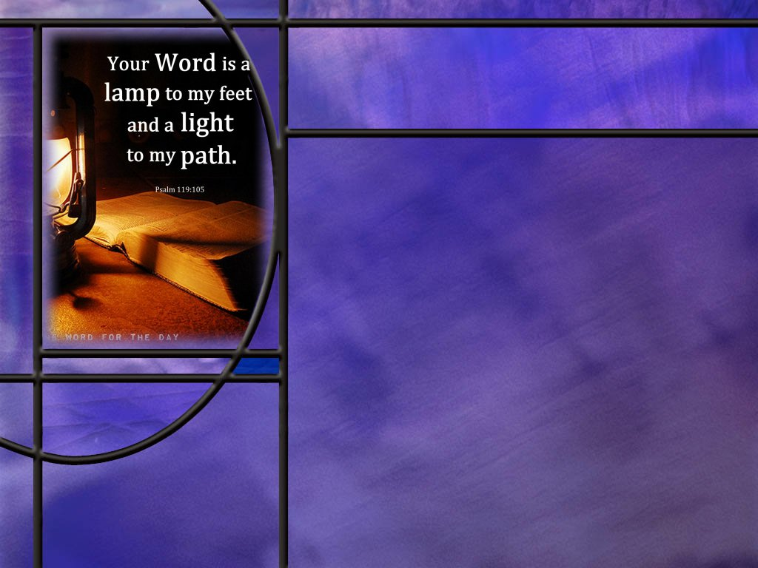
The Truth of the Bible
What did Jesus say about the word of God? (John 17:17)
What did Jesus say about the permanence of God’s word? [Permanence]
What other texts emphasize the word of God as truth?
  Isaiah 8:20
  Ps 119:160
  Ps 119:142
  Prov 30:5
What are some of the things the Word of God can do for you? [Word in Action]
Notes:
B1:
[See notes on linked slide.]
B2:
[See notes on linked slide.]
B3:
[See notes on linked slide.]
B4:
[See notes on linked slide.]

Slide 6
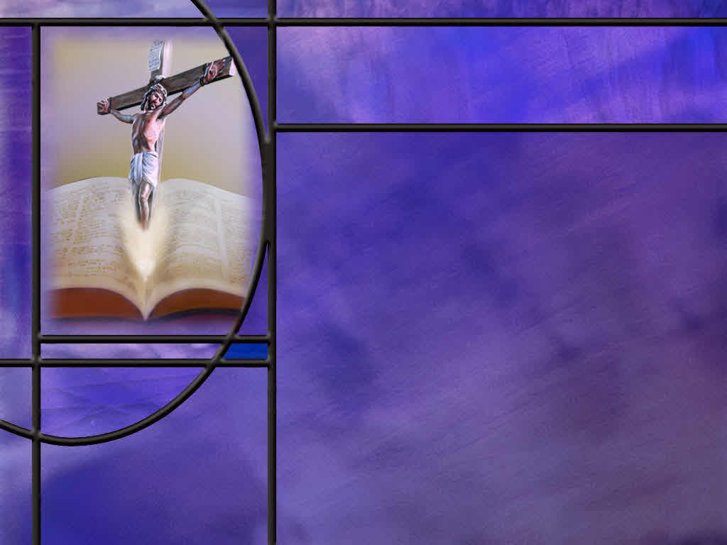
Approach to the Bible
Where do we start to find true biblical wisdom and knowledge of the truth? (Ps 111:10; Prov 1:70)
What warning does Paul give about understanding Scripture? (1 Cor 2:14)
What parallels do you see between the written word of God and the Word of God made flesh (Jesus)?
Notes:
B1:
[See notes on linked slide.]
B2:
[See notes on linked slide.]
B3:
1. There is an interesting parallel in the divine-human nature of each.
2. Jesus was conceived by the Holy Spirit, but He was born into this world by a woman.
3. The Bible has the Holy Spirit as its ultimate author, but it was written by human writers.
4. Both are a combination of the divine and human.
5. Jesus in His incarnation assumed the innocent infirmities of the human race yet lived without sin.
6. The Bible assumed the liabilities and limitations of human language yet infallibly reveals the will of God.
7. Jesus stepped into human history at a particular time and place yet He is the only Redeemer for all history at all times and all places.
8. The Bible was written about God’s acts in human history at particular times and places yet its message is applicable to all people in all times and all places.
9. Both Jesus and the Bible are God’s absolute truth for all times and places.

Slide 7
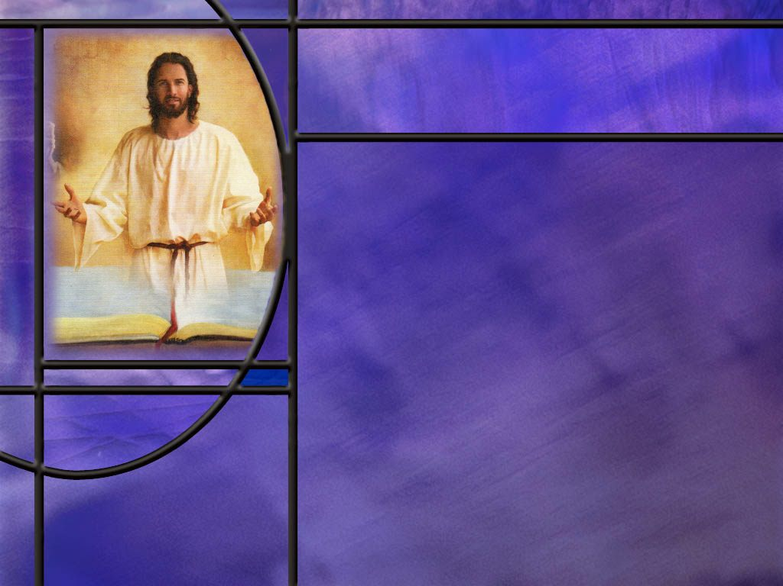
Summary
The book of Hebrews describes the word of God as living and powerful.
We certainly see this in creation where the word of God created the universe and all living things.
We also see it in the written word of God that is able to lead us to Christ and create in us a new heart.
Saving faith comes by hearing the good news about Christ and what He did to save us.
The Bible is unique in that it continues to be the runaway best seller year after year, with 100 million copies printed each year and now available as phone apps that make it conveniently available to many more people.

Slide 8
Summary
We can have confidence that the Bible is God’s word because of its unity, its archaeological confirmation, its fulfilled prophecy, its careful transmission, and its ability to change lives.
When we conclude that God’s Word is true and trustworthy, we can trust Christ to meet our greatest need: the forgiveness of our sins.
Jesus described God’s word as truth, able to sanctify His disciples. He declared its permanence, changeless as the character of God.
Paul told Timothy the Scriptures lead to salvation by faith in Christ.
Psalm 119 describes the word in our hearts as preventing sin and guiding us into truth.

Slide 9
Summary
In order to benefit from the spiritual truth of the Bible, we must approach it with humility and openness of mind praying for wisdom and for the Holy Spirit to reveal God’s truth to us.
We should approach it with a willing attitude to put its guidance into practice so we can be “doers of the word and not hearers only.”
Jesus (the Word) and the Bible (the word) are inseparable. All the truth we know about Jesus comes from the Bible, and all the Bible offers us comes only through Jesus.
Will you read the Bible this week accepting it, not as the words of men, but as it is in truth, the word of God?

Slide 11
2 Timothy 3:16-17 NKJV
All Scripture is given by inspiration of God, and is profitable for doctrine, for reproof, for correction, for instruction in righteousness, ¹⁷ that the man of God may be complete, thoroughly equipped for every good work. [R]
Notes:
Q1: What is it that makes Scripture unique?
Paul writes that all scripture is inspired by God.
In Greek this is all one word that literally means “God breathed.” (theopneustos)
Somehow, God is at work in all scripture breathing into it divine truth.
This makes the Bible unique, a one-of-a-kind book.
It is in the Bible that God reveals to us the truth that He wants us to know about Himself, His creation, the fall, the plan of redemption, the gift of His Son to pay the price for sin, forgiveness, the resurrection, and life everlasting, and many other things.
Q2: What is unique about the

Slide 12
John 17:17 NKJV - 17
"Sanctify them by Your truth. Your word is truth. [R]
Notes:
Q1: Who is Jesus praying for in this prayer?
1. Here He is praying for His disciples, and, by extension, for us.
2. He wants us to be sanctified by God’s truth.
Q2: What does it mean to be sanctified?
1. To be set apart for a holy use.
2. Here Jesus reveals that it is the truth of God’s word that can sanctify us and lead us to a holy life.
3. The Bible is all we need to find Jesus, receive Him as our Savior and Lord, be filled with the Holy Spirit, and live a holy life as defined in His Word.

Slide 13
Permanence of Scripture
John 10:35 NKJV – “the Scripture cannot be broken…”
Matthew 5:18 KJV - For verily I say unto you, Till heaven and earth pass, one jot or one tittle shall in no wise pass from the law, till all be fulfilled.
Matthew 24:35 KJV - Heaven and earth shall pass away, but my words shall not pass away. [R]
Notes:
Q1: How does Jesus regard Scripture?
1. Here Jesus points to the permanence of the word of God and the law of God.
2. It lasts forever; it is unchanging; it is as permanent as God Himself.
Malachi 3:6 KJV - For I am the LORD, I change not;
3. This is referring to the character of God.
4. Jesus is the same:
Hebrews 13:8 KJV - 8 Jesus Christ the same yesterday, and to day, and for ever.
Q2: In contrast to Jesus’ view of truth, what view are modern philosophers taking?
1. Modern philosophy takes the view that there is no such thing as absolute objective truth.
2. They teach that truth is subjective: everyone is free to define truth for themselves.
3. There is no such thing as right and wrong: There’s right for me, and right for you, and we all have to live the truth we make for ourselves.
4. This gives them license to live as they please, disregarding God’s standard of truth and morality.
5. So now, in this country, we have an explosion of sexual perversion.
6. And now the push is not only for this perversion to be accepted as normal, everybody must celebrate it.
7. And if you are not in favor of the alphabet soup people (LGBTQAI2S+) you get marginalized and canceled.

Slide 14
God’s Word as Truth
Isaiah 8:20 NKJV - To the law and to the testimony! If they do not speak according to this word, it is because there is no light in them.
Psalm 119:160 NKJV - The entirety of Your word is truth, And every one of Your righteous judgments endures forever.
Psalm 119:142 KJV - Thy righteousness is an everlasting righteousness, and thy law is the truth.
Proverbs 30:5 ESV - Every word of God proves true; he is a shield to those who take refuge in him. [R]
Notes:
Q1: Where do we find God’s objective truth?
1. It is in His word.
Q2: Whose work are the modern philosophers doing when they claim there is no objective truth?
1. This is the work of Satan.
2. We are going to be judged by the word of God, not by the truth we make up for ourselves.
3. Jesus said:
John 12:48 ESV - The one who rejects me and does not receive my words has a judge; the word that I have spoken will judge him on the last day.
4. So the words of Jesus, and, by extension, the word of God, will judge the wicked on the last day.

Slide 15
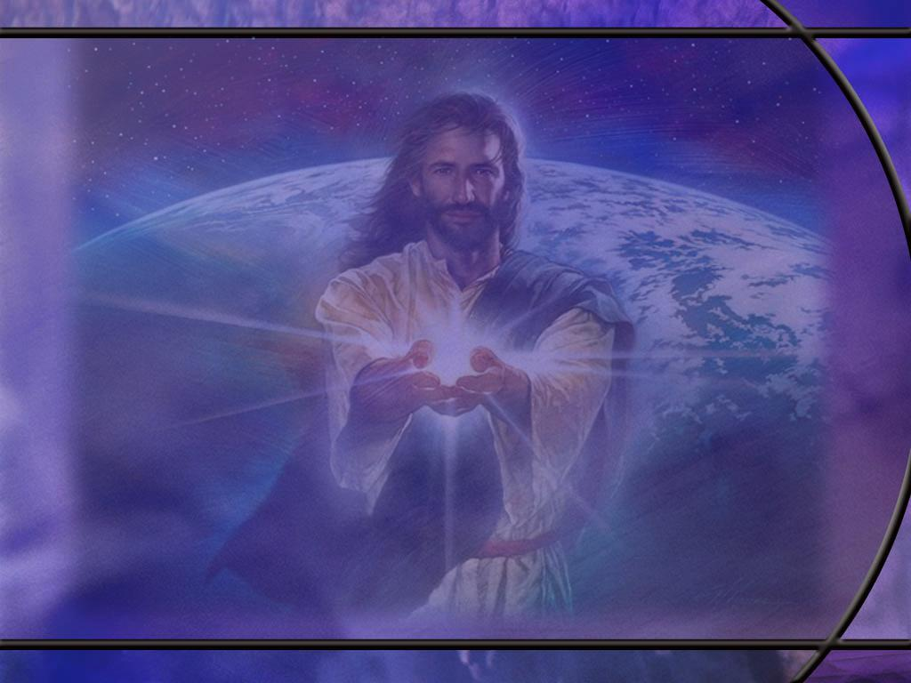
Word of God in Action
2 Timothy 3:15 NKJV - and that from childhood you have known the Holy Scriptures, which are able to make you wise for salvation through faith which is in Christ Jesus.
Psalm 119:11 NKJV - Your word I have hidden in my heart, That I might not sin against You.
Psalm 119:105 NKJV - Your word is a lamp to my feet And a light to my path. [R]
Notes:
Q1: What is the word of God able to do for us in these verses?
1. First, the word brings us to Jesus to find salvation in Him.
2. Second, it teaches us right and wrong and the consequences of sin so that we will not sin against God.
3. Third, it is a guide to us so that we can walk in the light of God’s truth and not in the darkness of the devil’s error.
4. To this we could add our memory text where the word of God “is a discerner of the thoughts and intents of the heart.”
5. The word of God allows us to examine ourselves to expose our thoughts and motivations, not just our outward actions.
6. Jesus said, “out of the abundance of the heart, the mouth speaks.”
7. And “blessed are the pure in heart, for they shall see God.”
8. In addition to these there are many other things that the word of God does for us.
9. It tells us of God’s actions in the past and the future, It tells us what God is like, in gives us great and precious promises, it gives us hope for the future, it gives us a mission and a ministry, it sets forth true Christian doctrine, It gives us laws to live by, and so much more.

Slide 16
Psalm 111:10; Prov 1:7 NKJV
The fear of the LORD is the beginning of wisdom…
The fear of the LORD is the beginning of knowledge... [R]
Notes:
Q1: What does it mean to fear the Lord?
1. As we have discussed before, in Scripture, the fear of the Lord is living in respect, and reverence, and love, and obedience to God.
2. It is standing in awe of His greatness and goodness, and giving Him honor, glory, praise, and worship for who He is and what He has done.
3. It is being thankful to Him for His grace, His compassion, His forgiveness, and His acceptance.
4. Those who fear the Lord is a description of those who are surrendered to the Lord as their God and are seeking to live for Him.
5. This is the kind of attitude we need as we approach the Bible to seek to understand it.
6. We come in humility with a teachable spirit open to the truth that God has for us.
Q2: How is the fear of the Lord the beginning of wisdom?
1. Wisdom is making good decisions in life that will lead to a successful outcome.
2. What would you consider a successful outcome to your life?
3. A life that ends with eternal life in the kingdom of God would have to be considered a success.
4. A life that ends in eternal death in the lake of fire would have to be considered a failure.
5. So the connection is very clear: fearing God is the first step toward accepting His provision for salvation that leads to a successful life.

Slide 17
1 Corinthians 2:14 NKJV
But the natural man does not receive the things of the Spirit of God, for they are foolishness to him; nor can he know them, because they are spiritually discerned. [R]
Notes:
Q1: How should we understand the “natural man” here?
1. We might think of the natural man as a non-Christian, one who has not made a commitment of his life to Christ.
2. He approaches the Scriptures from the perspective of human reason with a natural bias against the miraculous and the acts of God in history.
3. He thinks of the Scriptures as a myth that somebody made up to enforce their own moral standards on people.
4. Such people look at the Bible as foolishness.
5. They do not fear God and have no faith that He even exists.
6. So they come to scripture with a closed mind, thinking it cannot be true.
7. Paul warns that this kind of an approach will not discern the truth of the Word of God.
Q2: How can the natural man become a spiritual man?
1. The natural man needs to be converted and born again.
2. This is not easy to do if he has a closed mind toward scripture.
3. But faith comes by hearing the good news about Christ.
4. So the place to start is with Jesus and what He did to save sinners.
5. Once we accept Christ, we are filled with the Holy Spirit and we can discern spiritual truth, and the Bible begins to make sense.
6. In my years of rebellion against God, I was the “natural man.”
7. But I had loving parents who continued to pray for me.
8. The birth of our first child seemed miraculous, and caused me to question the dogmas of evolution.
9. I began to question whether or not the Bible was true and came to the conclusion that it was.
10. Faith was not a leap into the dark but a step into the light.
11. God has given us plenty of reasons for faith in His word and faith in His Son.
Q3: What did Jesus point out as one of the functions of the Holy Spirit for helping us to discern spiritual truth?
John 16:13 NKJV - "However, when He, the Spirit of truth, has come, He will guide you into all truth;
1. We need the HS to help us understand the truth of Scripture.
2. So, we should approach the Bible with a humble spirit, recognizing our limitations in understanding, asking for God’s wisdom and guidance through the HS to lead us into all truth.
3. There is a wonderful promise in the book of James that says this:
James 1:5 NKJV - If any of you lacks wisdom, let him ask of God, who gives to all liberally and without reproach, and it will be given to him.
4. Let’s claim that promise today, especially as we study Scripture.

