Slide 1
Growing in a Relationship with God
Lesson 3
Pride vs. Humility

Slide 2
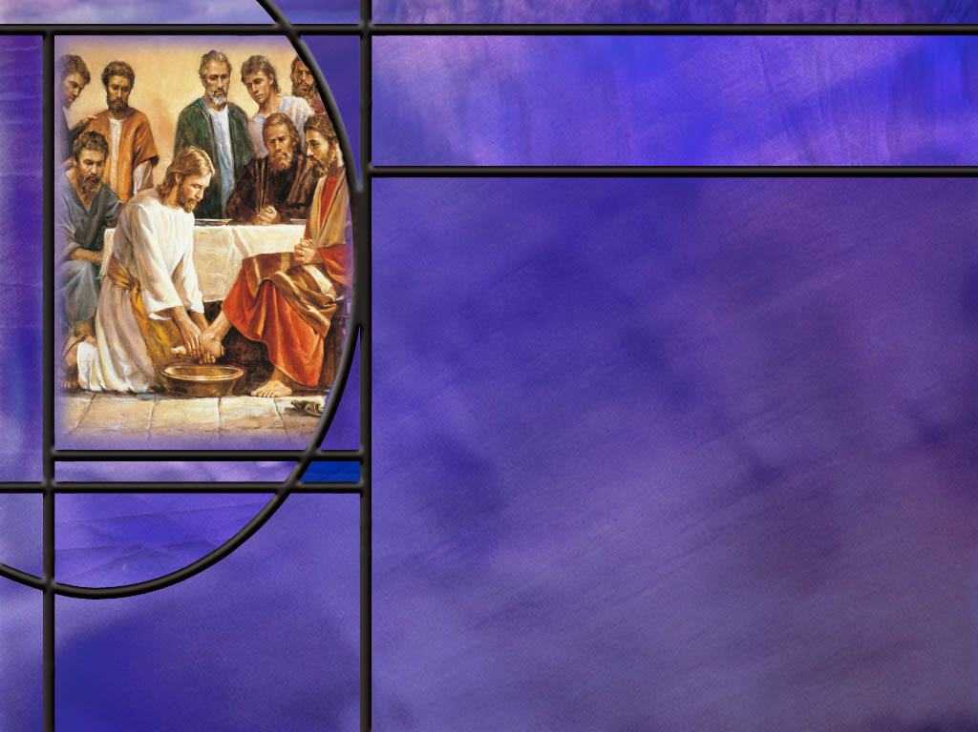
Memory Text
Luke 14:11 NKJV
"For whoever exalts himself will be humbled, and he who humbles himself will be exalted.“
What practical advice did Jesus give about where to sit at a wedding feast before ending with our memory text?
How would you explain the deeper spiritual truth of Jesus’ statement here? How does humility bring final exaltation?
Notes:
B2:
1. Jesus advised his listeners to by humble in their choice of seats.
2. The best seats are those closest to the bridal party, where you can see all that goes on with the bride and groom.
3. Most wedding parties have assigned seats now, but apparently that was not the case in Jesus’ day.
4. Jesus said:
Luke 14:8-10 ESV - "When you are invited by someone to a wedding feast, do not sit down in a place of honor, lest someone more distinguished than you be invited by him, ⁹ and he who invited you both will come and say to you, 'Give your place to this person,' and then you will begin with shame to take the lowest place. ¹⁰ But when you are invited, go and sit in the lowest place, so that when your host comes he may say to you, 'Friend, move up higher.' Then you will be honored in the presence of all who sit at table with you.
5. And then comes the punch line of the story, which is our memory text.
6. Our sense is that the punch line carries a deeper truth than honor or dishonor at someone’s wedding feast.
7. Jesus spoke the same words to the Pharisees as He began His lament in Matthew 23: “Woe to you scribes and Pharisees, hypocrites!”
8. We come to the same words again in Luke 18, to which we will return in our lessons today.
B3:
1. We can think back to Solomon’s statement:
Proverbs 16:18 KJV - Pride goeth before destruction, and an haughty spirit before a fall.
2. In entering the kingdom of God, pride is a serious impediment and humility is a great advantage.
3. Pride leads to an attitude of self-sufficiency and self-dependence that does not see the need of dependence on God.
4. Humility realizes that apart from total dependence on what Christ has done for us and making Him Savior and Lord, there can be no final success in life.
5. In Matt 23, Jesus is speaking about the Pharisees and their self righteousness.
6. They made a great outward display of righteousness and piety, but they were all sinners in need of a Savior.
7. Those who exalt themselves and their own righteousness now will be humbled in the judgment.
8. In the judgment they will be shown to be sinners who needed to repent but did not.
9. Those who humble themselves now, recognizing their spiritual need for forgiveness, will be exalted in the judgment.
10. They will be shown to have repented and asked forgiveness and received pardon by the blood of Christ.
11. So here’s Jesus’ point: if you trust in your own righteousness you’re doomed in the judgment.
12. If you confess and repent of your sin and ask forgiveness, you will be justified and exalted in the judgment.
13. Here Jesus is very clearly teaching righteousness by faith and not by works.

Slide 3
Overview
Growing in a relationship with God depends on recognizing our need of forgiveness and total dependence on Christ for salvation. Pride and self-sufficiency tends to place self on the throne of one’s heart instead of Christ. God resists the proud but gives grace to the humble.
  Pride and Humility
  Two Prayers
  Resisting the Proud
  Humble Examples
  Summary

Slide 4

Pride and Humility
What does the book of Proverbs have to say about pride? [Proverbs & Pride]
How would you define the kind of pride the Bible condemns?
Is it possible to have a kind of pride that the Bible approves? How so? (Jer 9:23-24)
How would you define the kind of humility the Bible commends?
How can we get rid of personal pride and get more Biblical humility?
Notes:
B1:
[See notes on linked slide.]
B2:
1. Webster begins his definition of Pride with this:
1. Inordinate self-esteem; an unreasonable conceit of one's own superiority in talents, beauty, wealth, accomplishments, rank or elevation in office, which manifests itself in lofty airs, distance, reserve, and often in contempt of others.
2. We might think of arrogance as a synonym.
3. It is thinking of yourself as superior to others and looking down on them.
4. Ultimately, pride puts self at the center.
5. It leads to self-sufficiency and the idea that you don’t need God or a relationship with Him to succeed in life.
6. It put’s self on the throne of the heart rather than the Lord.
7. That why it is so dangerous and such an abomination to God.
8. It elevates self-worship above the worship of God.
B3:
[Se notes on linked slide.]
B4:
1. The kind of humility the Bible commends is truthful self-understanding before God: knowing who God is and who we are.
2. It recognizes that everything we are and have comes from Him.
3. As a result, we do not exalt ourselves, but neither do we despise ourselves.
4. Biblical humility is not self-hatred or weakness.
5. It is an attitude of dependence on God, openness to learn His truth, and willingness to serve in His name.
6. Biblical humility receives correction with gratitude, values others above self, and serves quietly without needing recognition.
7. It acknowledges God’s authority and grace in every area of life.
8. It does not pretend to be worthless or act timidly.
9. Scripture commends people who are confident in God’s calling yet modest about themselves.
10. In that sense, humility is the opposite of pride, not the opposite of strength.
11. Biblical humility says: “I am not the center; God is, and I am here to obey, learn, and serve.”
B5:
1. First and foremost, we need Jesus and the Holy Spirit.
2. This is not something we can produce in our own strength.
3. We need to receive Jesus as our Lord and Savior and trust in His shed blood for the forgiveness of our sins.
4. That brings us justification by faith and sets us apart for a holy use.
5. When we receive Jesus and are baptized in His name, we also receive the Holy Spirit whose work is to give us the new birth from above and develop a Christ-like character in us.
6. As we grow in grace, personal pride will decline and biblical humility will increase.
7. The Holy Spirit will lead us into all truth, including that Biblical truth of who God is and who we are.
8. Pride will decline and humility increase when we recognize that God is the holy, almighty, Creator God, who will judge us all, and we are sinners saved by grace.
9. Our greatest need is to be forgiven of our sins, which only Christ can do.
10. As the fruit of the Spirit grows in our life, we will become more like Jesus who is our ultimate example of humility.
11. Just think of the first facet of the fruit of the Spirit: agape love.
12. It is a love that acts in the eternal best interest of others regardless of how they respond.
13. It is love focused on the good of others rather than self.
14. So, as we become more like Jesus, our personal pride will fade away and Biblical humility will take its place.

Slide 5
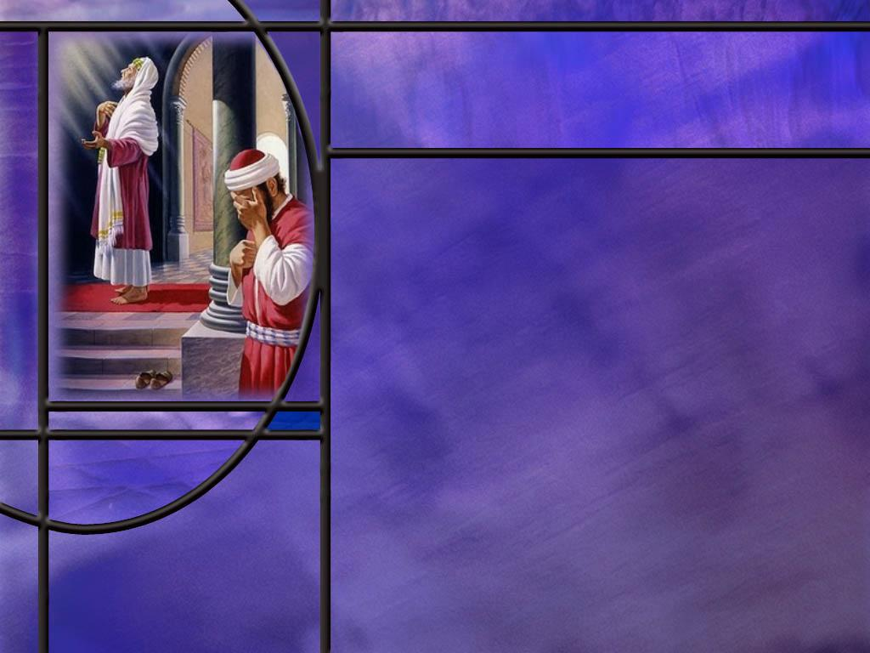
Two Prayers
Read Luke 18:9-14
What kind of a prayer did the Pharisee pray?
What kind did the tax collector pray?
Which man went down to his house justified (forgiven). Why?
What principle of prayer can we take from this parable?
Notes:
B2:
1. It was a self-centered prayer, informing God how good he was.
2. It was not only to inform God, it was to inform everyone else as well.
3. Here is a proud and arrogant man who thinks he can inform God of his goodness.
4. Did he need to tell God that he paid his tithe or fasted twice a week?
5. And, of course, he is so self-righteous he couldn’t even begin to think that he may have committed a sin or two.
6. We may recall Jesus’ words to the rich young ruler.
Luke 18:19 (NIV)
¹⁹ “No one is good—except God alone.
B3:
1. He saw his own sinfulness. He stood afar off. He felt unworthy to lift his eyes to heaven.
2. He beat his breast as a sign of guilt and repentance.
3. He acknowledged that he was a sinner and cried out for God’s mercy.
4. It was a short, humble, sincere, heartfelt prayer.
B4:
1. The tax collector.
2. The Pharisee has acknowledged no sin and did not ask for forgiveness.
3. The tax collector recognized himself as a sinner in need of forgiveness.
4. He prayed to God and asked for mercy and forgiveness.
5. His confession and repentance came from the heart.
6. He trusted in God for forgiveness.
7. Of course, this was before Jesus made the atoning sacrifice for sin.
8. So this forgiveness of the tax collector would fit the OT methods of justification.
B5:
1. We don’t have to inform God of anything. If we know it, He knows it.
2. God is not interested in self-righteous prayers.
3. Repentance, confession, asking for forgiveness, and trusting in the mercy and grace of God brings justification.
4. Today, that justification comes through the blood of Jesus shed for the remission of our sins.
5. Justification is appropriated by prayer.
6. We cannot even become a Christian without prayer because it is by prayer that we repent, confess, ask forgiveness, and receive Jesus.
7. Nor can we stay a Christian without prayer. No prayer, no relationship.

Slide 6
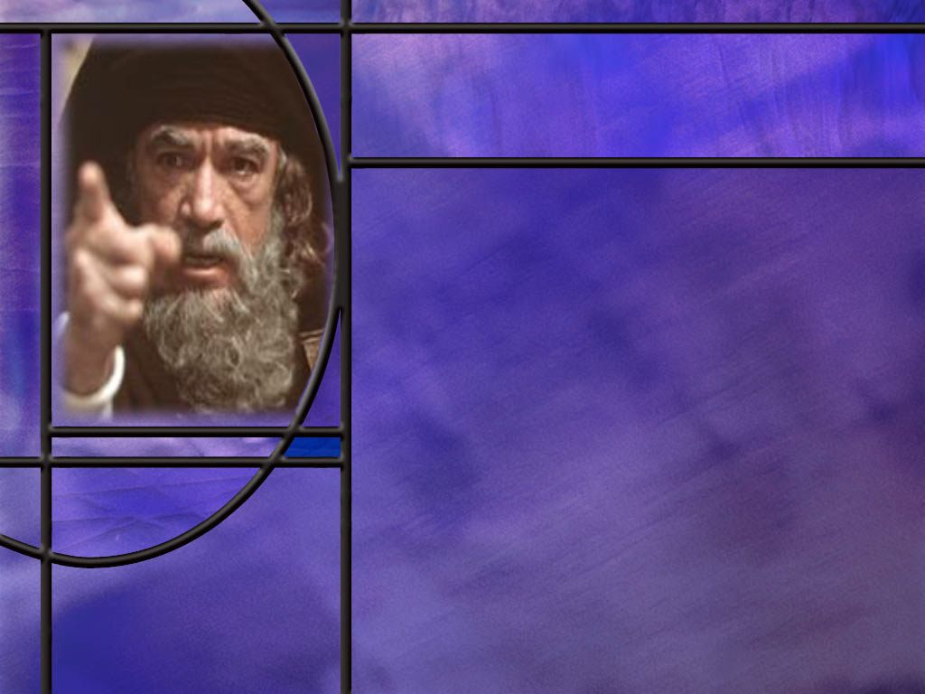
Resisting the Proud
How should we understand what the Bible says about how God treats the proud and the humble? (1 Peter 5:5; James 4:6)
Notes:
B1:
[See notes on linked slide.]

Slide 7
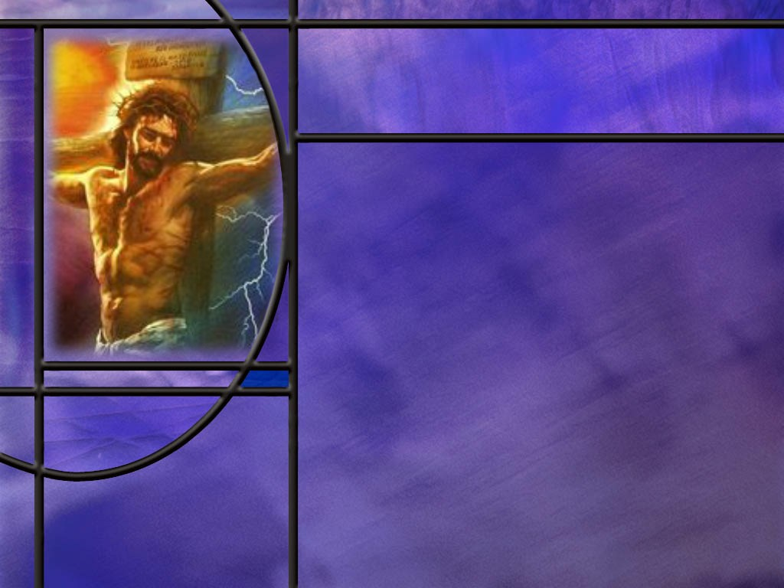
Humble Examples
What does Scripture record abut the choice that Moses made? (Heb 11:24-26)
How did Paul set Jesus forth as an example of humility for us? (Phil 2:3-8)
What did Jesus tell His disciples when they were arguing about who would be greatest in the kingdom? (Matt 20:26-28)
Notes:
B1:
[See notes on linked slide.]
B2:
[See notes on linked slide.]
B3:
[See notes on linked slide.]

Slide 8
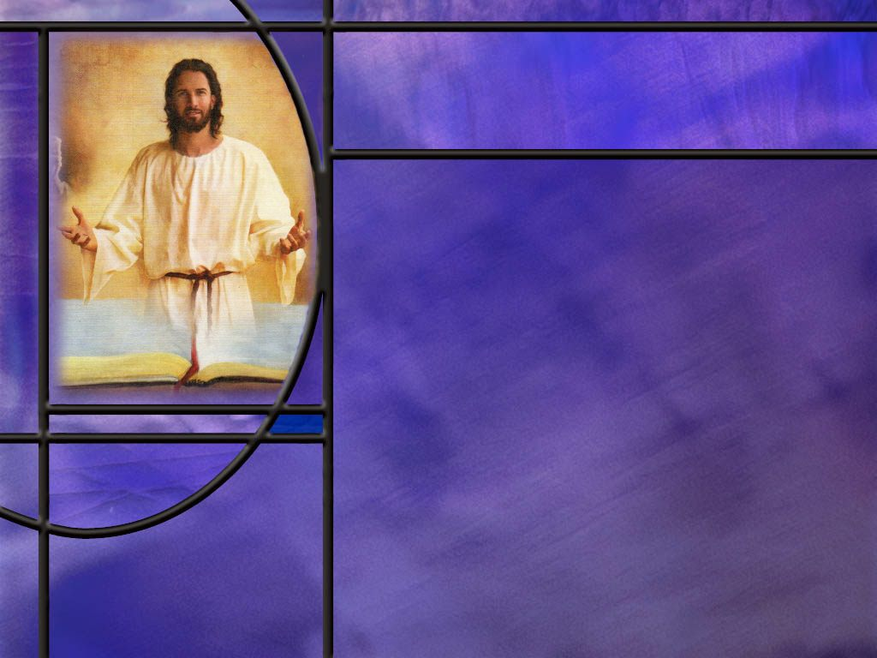
Summary
Growing in a relationship with God depends on recognizing our need of forgiveness and total dependence on Christ for salvation.
Pride and self-sufficiency tends to place self on the throne of one’s heart instead of Christ.
Personal pride is an attitude that God detests. It ultimately produces sin, disgrace, and destruction.
However not all pride is sinful. We can be proud of the goodness of God, of the gospel that saves, of our church, our country, our kids, our school, even a job well done when the glory goes to God.
Pride can be healthy when we keep God at the center and recognize Him as the source of all that is good.

Slide 9
Summary
But when we make self the center, pride separates us from God and we end up worshipping ourselves rather than the living God that made us.
Jesus illustrated the effects of personal pride in the story of the prayers of a Pharisee and tax collector in the temple.
The humble tax collector who admitted his sin and asked for forgiveness was forgive;, the proud Pharisee who admitted no sin was not.
The biblical thought that God resists the proud and gives grace to the humble can be understood as God permitting the proud to resist His grace and the humble to receive it. In Hebrew thought, God is often spoken of as actively causing what He only permits.

Slide 10
Summary
Moses sets a wonderful human example of humility as the servant of the Lord. His example teaches us that a humble person can lead, speak, and act with strength and confidence while still remaining teachable and dependent on God.
Jesus is our ultimate example of humility. In the incarnation, He stepped down from equality with God to death on a cross as a criminal in order to redeem us from eternal death.
We are challenged to have His mindset to humbly treat others with love and grace.
Seeing the dangers of personal pride to a relationship with God, will you ask the Lord to take your pride and make you a humble servant for His kingdom this week?

Slide 12
Proverbs and Pride
Proverbs 8:13 NIV - I hate pride and arrogance.
Proverbs 11:2 NIV - When pride comes, then comes disgrace, but with humility comes wisdom.
Proverbs 16:5 NIV - The LORD detests all the proud of heart.
Proverbs 21:4 NIV - Haughty eyes and a proud heart …produce sin.
Proverbs 16:18 NIV - Pride goes before destruction, a haughty spirit before a fall. [R]
Notes:
Q1: What does Solomon tell us about pride here?
1. It is all negative; nothing good about personal pride in the Bible.
2. It is seen as an attitude that God hates and detests.
3. It ultimately produces sin, disgrace, and destruction.
4. So, when the Bible speaks about personal pride and arrogance, it is consistently condemned as sinful and destructive.
5. And, of course, this carries over into the NT that we will look at a little later.

Slide 13
Jeremiah 9:23-24 NIV
This is what the LORD says: "Let not the wise boast of their wisdom or the strong boast of their strength or the rich boast of their riches, ²⁴ but let the one who boasts boast about this: that they have the understanding to know me, that I am the LORD, who exercises kindness, justice and righteousness on earth, for in these I delight," declares the LORD.
Notes:
Q1: What does the Lord say we should not be prideful and boast about?
1. Don’t boast about your wisdom, your strength, or your riches.
2. After all, what do have that you didn’t get from God.
3. Paul writes in:
1 Corinthians 4:7 NIV - 7 For who makes you different from anyone else? What do you have that you did not receive? And if you did receive it, why do you boast as though you did not?
4. Everything we have is a gift from God.
5. Every good and perfect gift is from above.
Q2: But on the other hand, what is it ok to boast about?
1. It is ok to boast about our God and His goodness.
2. It is ok to give Him the glory and be proud of the kind of God He is.
3. So this is a good pride that is the opposite of self-glory, personal pride and arrogance.
Q3: Of what was the apostle Paul proud as he opened his letter to the Romans?
[See text on next slide.]

Slide 14
Romans 1:16-17 NKJV
For I am not ashamed of the gospel of Christ, for it is the power of God to salvation for everyone who believes, for the Jew first and also for the Greek. ¹⁷ For in it the righteousness of God is revealed from faith to faith; as it is written, "The just shall live by faith." [R]
Notes:
Q1: Of what is Paul proud here?
1. He says he’s not ashamed of the gospel.
2. In other words, his is proud of the gospel.
3. It has a power to save everyone who believes.
4. The gospel is that Christ died for our sins and rose again.
5. Paul was proud of it, and he shared it everywhere he went.
Q2: Is it ok to be proud of your kids, and tell them so?
1. I think the Lord would approve of that as a good kind of pride.
2. It is building others up and encouraging them, reinforcing good behavior.
3. Likewise, we can be proud of our church, proud of our country, proud of our school, proud of our sports teams, etc.
4. These are not personal pride about our own superiority.
Q3: Is it ok to be proud of accomplishments as long as we recognize the Lord’s help and give the glory to Him?
1. I think it is ok to have a sense of satisfaction in jobs that are well done.
2. But we need to be quick to recognize that every talent and ability we have is a gift from God.
3. When things turn out well, let’s pass the glory to God who has given us life, and health, and strength, and wisdom, and understanding, and an ability to solve problems and get things done.
4. So, I think we can see both a healthy and an unhealthy side of pride.
5. Pride can be healthy when we keep God at the center and recognize Him as the source of all that is good.
6. But when we make self the center, pride separates us from God and we end up worshipping ourselves rather than the living God that made us.

Slide 15
Luke 18:9-14 ESV (1)
He also told this parable to some who trusted in themselves that they were righteous, and treated others with contempt: 10 "Two men went up into the temple to pray, one a Pharisee and the other a tax collector. 11 The Pharisee, standing by himself, prayed thus: 'God, I thank you that I am not like other men, extortioners, unjust, adulterers, or even like this tax collector.
Notes:
Q1: To whom was this parable directed?
1. Notice what it says in verse 9 [read again.]
2. So here you have a group of Pharisees who think they are righteous.
3. And if you think you are righteous, you have no sins to confess.
4. And that’s just the attitude of this Pharisee in Jesus’ parable.
5. He has no sins to confess!
6. He is telling God what a wonderful saint he is.
7. He thanks God that he is not a sinner like the tax collector.
8. “O God, how lucky you are to have a righteous man like me!!”
9. Let’s read the rest of his prayer.
[Go to next slide]

Slide 16
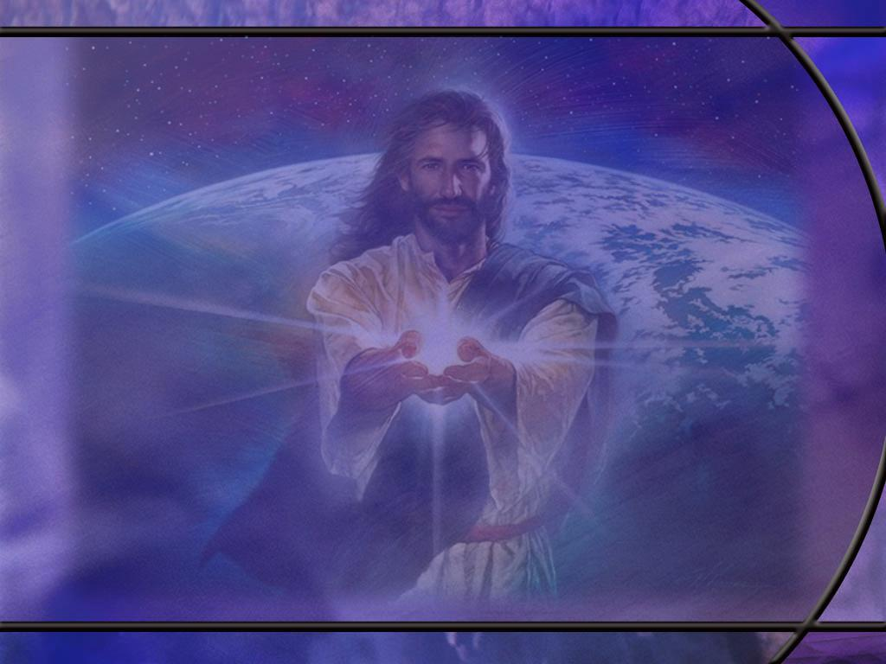
Luke 18:9-14 ESV (2)
I fast twice a week; I give tithes of all that I get.' ¹³ But the tax collector, standing far off, would not even lift up his eyes to heaven, but beat his breast, saying, 'God, be merciful to me, a sinner!' ¹⁴ I tell you, this man went down to his house justified, rather than the other. For everyone who exalts himself will be humbled, but the one who humbles himself will be exalted.“ [R]
Notes:
Q1: Notice the ending of this parable. Where have we seen these words before?
1. These are the exact same words of our memory text from Luke 14:11.
2. He says it again in Matt 23:12, so three times it is recorded of Jesus as saying these words.
3. So, let’s unpack this story that Jesus told.

Slide 17
James 4:6; 1 Peter 5:5 KJV
God resisteth the proud, but giveth grace unto the humble. (James 4:6)
for God resisteth the proud, and giveth grace to the humble. (1 Peter 5:5) [R]
Notes:
1. These texts both quote words that first appear in Proverbs 3:34.
Q1: Is this respect of persons with God? Is God treating the proud one way and the humble another?
1. This is not so much respect of persons as it is respect of attitude.
2. This does not have anything to do with a person’s status in society; it has to do with the thoughts and intents of his heart.
3. Pride makes it difficult to come to God; humility makes it much easier.
Q2: How does that work? Does God pick and choose to whom He will give grace?
1. God is not restricting grace to some and giving it to others.
2. Grace is available to all, but only those who humble themselves can actually receive it.
3. Grace is the gift of God in Christ that saves us (Eph 2:8-9)
4. Grace comes only to those who, by faith, receive Jesus as Savior and Lord.
5. God’s grace forgives our sins when we humbly confess our sins, repent, and ask to be forgiven for Christ’s sake.
6. This requires humility rather than pride.
7. Pride sees no need of a savior; it refuses to give up control and make Jesus Lord.
8. Pride admits to no wrong and acknowledges no sin.
9. Pride seeks to place self on the throne instead of God.
10. It is the proud who resist God’s grace; the humble receive it.
11. This is another instance of Hebrew thought, attributing to God as actively causing what He does not prevent.
12. It is more the proud resisting God’s grace than it is God resisting the proud.

Slide 18
Hebrews 11:24-26 ESV
By faith Moses, when he was grown up, refused to be called the son of Pharaoh's daughter, ²⁵ choosing rather to be mistreated with the people of God than to enjoy the fleeting pleasures of sin. ²⁶ He considered the reproach of Christ greater wealth than the treasures of Egypt, for he was looking to the reward. [R]
Notes:
Q1: What do these verses tell us about the choice that Moses made?
1. Moses understood what he was giving up and what he was gaining.
2. He was giving up the chance to be the most powerful ruler in the richest and most powerful nation on earth.
3. He refused to be called the son of Pharaoh’s daughter.
4. He chose instead to become a slave and stand on God’s side with God’s covenant people.
5. Egypt offered him power, fame, pleasure, riches, but it was all fleeting.
6. The Lord God offered Him something of even greater value: eternal life in the kingdom of God: a relationship with the Lord and the redeemed that would keep on giving forever.
7. Moses chose life over death by faith in the living God.
8. He trusted in God and in the ultimate sacrifice for sin that God would send.
9. His faith in the living God resulted in hope, trusting in the promises of God.
10. “He had respect unto the recompense of the reward.”
11. As the NIV translates it: “He was looking ahead to his reward.”
12. That same choice is available to us today.
13. What will you choose? The fleeting pleasures of sin, or the reproach of Christ and the eternal reward He offers you?
Q2: Where did Moses learn humility?
1. After 40 years in Egypt, Moses murdered an Egyptian, fled to Midian, and tended sheep for Jethro for the next 40 years.
2. When God called him from the burning bush, Moses obeyed and became God’s reluctant and humble emissary to Egypt to lead the Israelites out.
3. His last 40 years from 80 to 120, were spent leading God’s people through the wilderness and being the servant of God, His prophet, His spokesman, His appointed leader.
4. Numbers describes him in these words:
Numbers 12:3 NKJV - (Now the man Moses was very humble, more than all men who were on the face of the earth.)
Q3: Do you visualize Moses as a weak or a strong leader?
1. Strong!
2. He was the servant of the Lord.
3. He faithfully delivered the word of the Lord to the people and the decisions of the people back to God.
4. He interceded for His people.
5. He led them faithfully for 40 years.
6. He knew the Lord personally and talked with Him as with a friend.
7. He knew who God was and he humbled himself to be His servant and to carryout all that God gave him to do.
8. Moses teaches us that humility is not weakness; it is strength under control.
9. A humble person can lead, speak, and act with confidence while still remaining teachable and dependent on God.

Slide 19
Philippians 2:3-8 NIV
Do nothing out of selfish ambition or vain conceit. Rather, in humility value others above yourselves, ⁴ not looking to your own interests but each of you to the interests of the others. ⁵ In your relationships with one another, have the same mindset as Christ Jesus: ⁶ Who, being in the form of God, did not consider equality with God something to be used to his own advantage; ⁷ rather, he made himself nothing by taking the form of a servant, being made in human likeness. ⁸ And being found in appearance as a man, he humbled himself by becoming obedient to death--even death on a cross! [R]
Notes:
Q1: To whom does Paul point as our example of humility?
1. He tells them to have the same mindset as Jesus Christ.
2. Here Paul describes the incarnation.
3. Jesus was in the form of God and was God.
4. But He took on human flesh, not as a king coming to be worshipped, but as a slave to be killed.
5. He died a criminal’s death on a cross, and you can’t get any lower than that.
6. This is amazing grace.
7. God the Son trades His throne for a manger and a cross.
8. He leaves the holiness of heaven for our sin-polluted world.
9. He leaves the adoration of angels for rejection, ridicule, and crucifixion by His own creatures.
10. This is love and grace in action and the ultimate example of humility.
11. So Paul can tell the Christians in Philippi to be humble like Christ, value others above yourself, and look out for their interests too.
12. Christ humbled Himself for our sakes much more than we can ever think of humbling ourselves.

Slide 20
Matthew 20:26-28 NIV
Not so with you. Instead, whoever wants to become great among you must be your servant, ²⁷ and whoever wants to be first must be your slave-- ²⁸ just as the Son of Man did not come to be served, but to serve, and to give his life as a ransom for many." [R]
Notes:
Q1: What is the mark of greatness in the kingdom of God?
1. The mark of greatness in the kingdom is humble service.
2. Become a slave or a humble servant for Christ.
3. Again, we see that Christ is our example in this.
4. He did not come demanding that we serve Him.
5. But He came to serve us, to take our sins, to pay our penalty, to die that we might live.
6. He ransomed us with His precious blood.
7. So let’s follow His example by being His humble servants.

