Slide 1
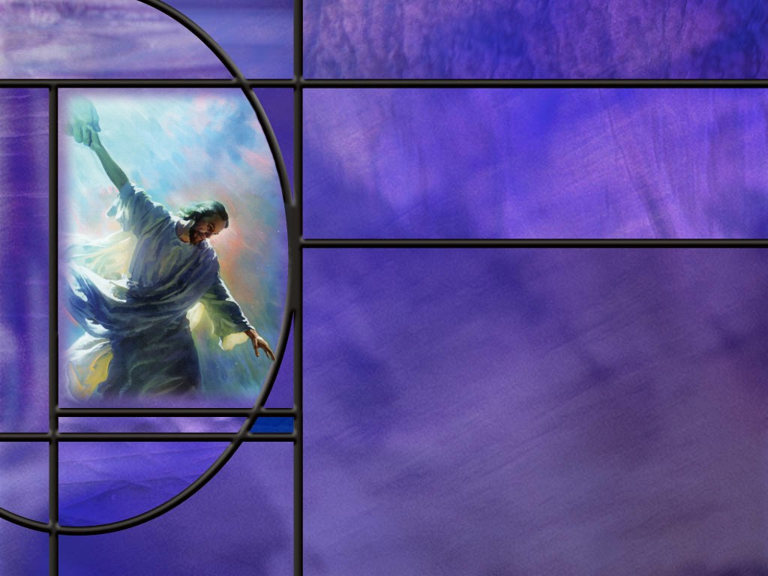
Uniting Heaven and Earth: Christ in Philippians and Colossians
Lesson 3 Life and Death

Slide 2
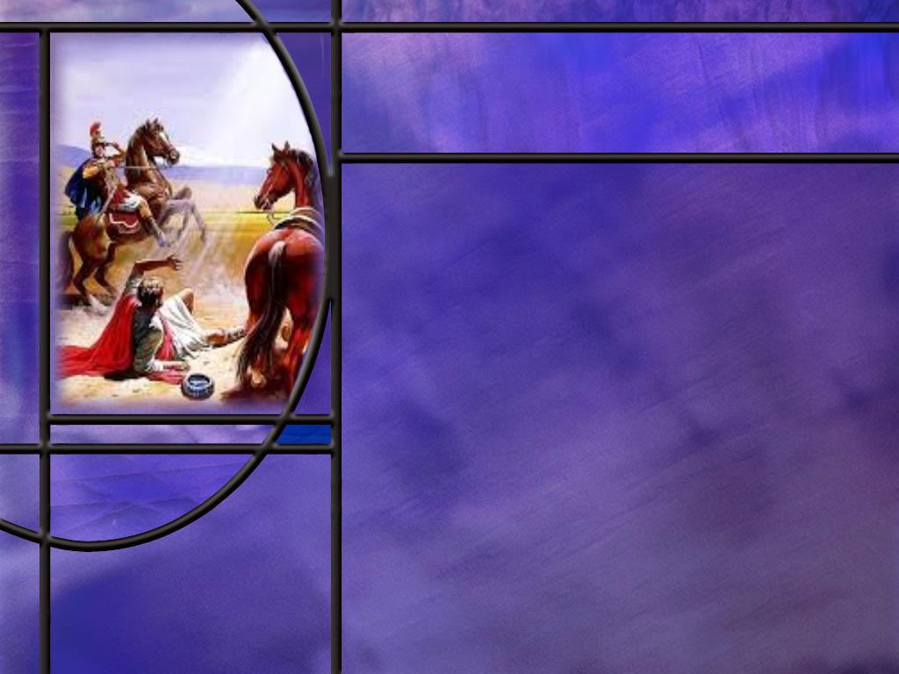
Memory Text Philippians 1:21 NKJV
For to me, to live is Christ, and to die is gain.
What do your think the apostle Paul meant when he wrote, “to live is Christ?”
What happened to Paul to change him from anti-Christ to pro-Christ?
How might Paul think that “to die is gain?”
Notes:
B2:
1. Perhaps he was expressing that the most important thing for him as he lived was the truth about Christ.
2. For Paul, to live was to know Christ, to believe in Christ, to preach Christ, to uplift Christ, to make Christ the focus and the center of his life.
3. He preached the Good News about Christ, that He is the Son of God, that He died for our sins, that He rose again, that He intercedes for us in the heavenly sanctuary.
4. He preached salvation in Christ, justification by faith in Christ, adoption into the family of Christ, eternal life for those who are in Christ.
5. To the Corinthians he wrote in:
1 Corinthians 2:2 KJV - For I determined not to know any thing among you, save Jesus Christ, and him crucified.
6. Christ was the center of Paul’s life.
7. But Paul certainly didn’t start out that way.
8. He started out as anti-Christ.
9. He was trying his best to stamp out the Christian faith.
10. He was arresting Christians and putting them in jail, consenting to the death of Stephen and holding the coats of those who stoned him to death.
11. The word Christ in the Greek is Christos which means “anointed one.”
12. And the equivalent word in Hebrew is Messiah which also means the “anointed one.”
13. So, Paul’s persecution of the Christians meant that he did not believe that Jesus of Nazareth was the Messiah.
14. And the central belief of the Christian faith is that Jesus of Nazareth is Christ, the Messiah.
B3:
1. It was his experience on the road to Damascus where the risen Christ appeared to him and struck him blind for three days.
2. And notice how the Lord identifies himself to Paul:
Acts 9:4-5 NIV - 4 He [Paul] fell to the ground and heard a voice say to him, "Saul, Saul, why do you persecute me?" 5 "Who are you, Lord?" Saul asked. "I am Jesus, whom you are persecuting," he replied.
3. All of a sudden, Paul stopped in his tracks and realized that Jesus was the Christ, the Messiah.
4. So, Paul was changed from one who persecuted Christ and His followers to one who made Jesus Christ the center and the song of his life.
5. Can Jesus do the same for you and me?
6. Absolutely!
7. The gospel that Paul preached has the power to save sinners and make us saints.
8. As Paul told the Philippian jailer: “Believe on the Lord Jesus Christ, and you will be saved. (Acts 16:31 NKJV)
9. To the Romans he wrote:
Romans 1:16-17 ESV - For I am not ashamed of the gospel, for it is the power of God for salvation to everyone who believes, to the Jew first and also to the Greek. ¹⁷ For in it the righteousness of God is revealed beginning and ending with faith, as it is written, “The one who by faith is righteous shall live."
B4:
1. We will study this more in our lesson today.
2. But for now, we may see this as a statement of his desire to be with Christ in the kingdom of glory after Christ comes to resurrect the saints and take them to heaven with Him.
3. If we die in Christ, we will be resurrected to immortality when He returns.
4. The gain is going from our present condition of being separated from our Lord to being united with Him in His eternal kingdom.
5. The kingdom of God will be far better than this world of sin.

Slide 3

Overview
In our lesson this week, Paul describes his state of mind imprisoned in Rome, weighing life and death, satisfied with either as long as the gospel goes forward, calling the church to unity for that purpose and to suffer for the cause of Christ.
To Live or Die?
Ours Condition in Death
Unity for Success
Summary

Slide 4
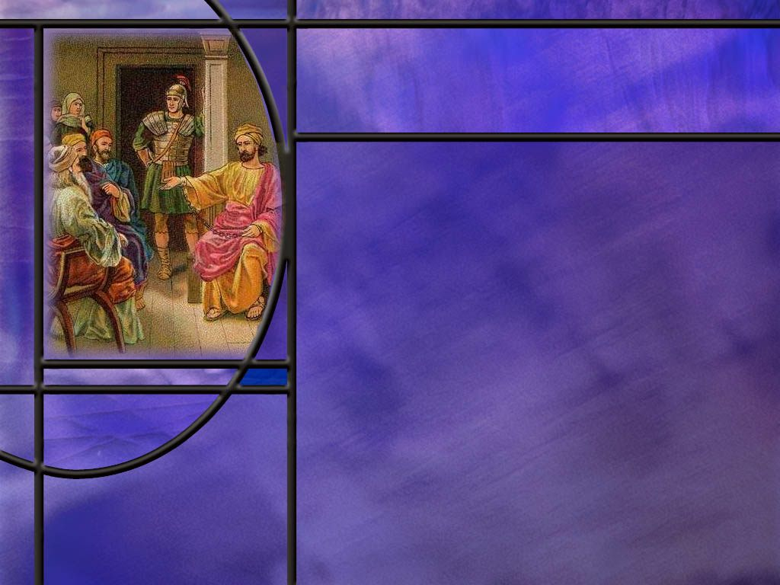
To Live or Die?
What is Paul’s expectation concerning his imprisonment? (Phil 1:19-20)
How does Paul weigh the options of life and death? (Phil 1:21-24)
After considering the two options, what is the apostle Paul compelled to choose? (Phil 1:24-26)
What phrase in Phil 1 is used most frequently to “prove” the immortality of the soul? (Phil 1:23)
Notes:
B1:
[See notes on linked slide.]
B2:
[See notes on linked slide.]
B3:
[See notes on linked slide.]
B4:
[See notes on linked slide.]

Slide 5
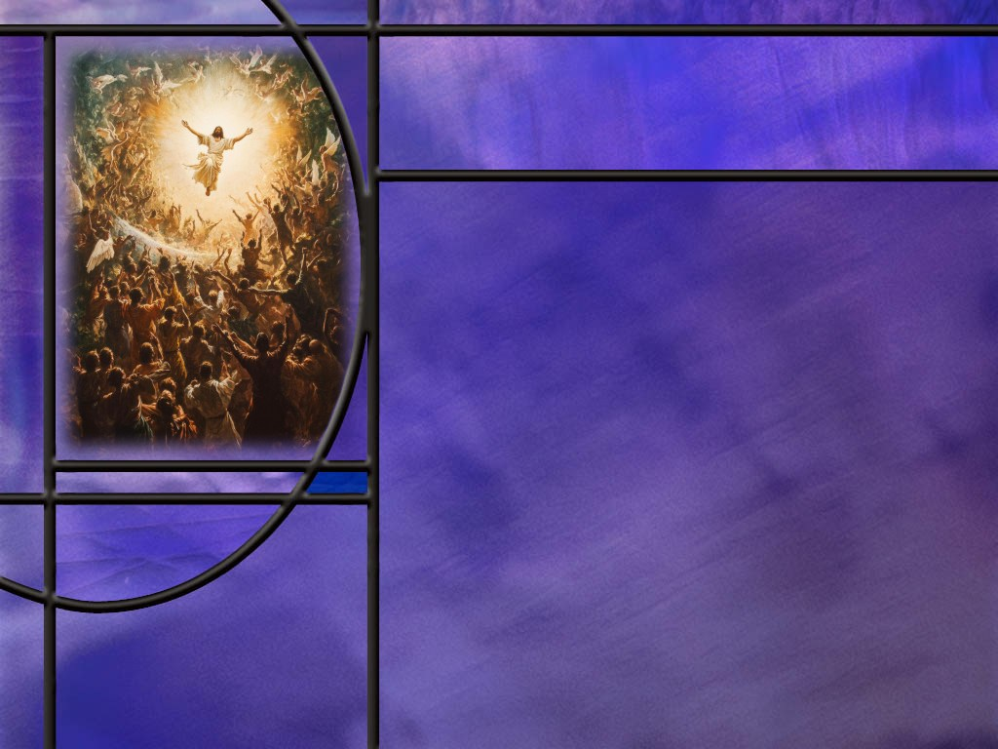
Our Condition in Death
How did Jesus describe Lazarus’ condition in death? (John 11:11-14)
To what hope did Jesus point Martha to comfort her in her brother’s death? (John 11:23-26)
What did Lazarus report from the “other side” after he was raised back to life again?
How were some of the Thessalonian believers struggling with the death of their fellow believers? (1 Thes 4:13-14)
How did the apostle Paul describe how we depart to be with the Lord? (1 Thes 4:15-18)
Notes:
B1:
[See notes on linked slide.]
B2:
[See notes on linked slide.]
B3:
1. He had nothing to report.
2. He did not complain about being brought back from heaven.
3. He did not express his gratitude for being brought back from hell.
4. He had nothing to say, because he was unconscious in death.
B4:
[See notes on linked slide.]
B5:
[See notes on linked slide.]

Slide 6

Unity for Success
What does Paul desire to see in the Philippian church? (Phil 1:27)
Notes:
B1:
[See notes on linked slide.]

Slide 7
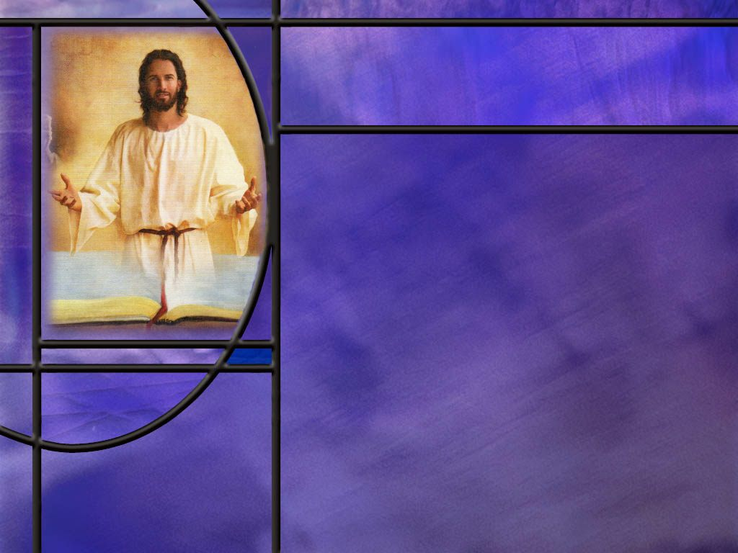
Summary
Paul‘s hope and expectation is that he will be delivered from his current imprisonment in Rome through the prayers of the saints and the work of the Spirit.
But whether he lives of dies, his desire is to honor Christ. This gets him thinking about life and death.
Paul declares that for him, “to live is Christ.” This expresses his complete allegiance to Christ and the gospel of salvation by grace through faith in Him.
But in the same breath, he is not afraid of death considering that it could be far better by providing rest from the burdens of this life and joy in the eternal kingdom when he awakens to eternal life.

Slide 8
Summary
While he claims he doesn’t know which to choose, the choice is God’s not his, and, in the end, he is content to live and continue to minister as the Lord leads and provides strength.
His statement that he desires to depart and be with Christ is often used by those who believe in the immortality of the soul to support their position.
However, in Paul’s experience he will perceive no delay between his death and being present with the Lord.
Because the dead are unconscious, it seems to them that their death is followed immediately by the return of the Lord and the resurrection to eternal life.

Slide 9
Summary
In describing the state of the dead, Jesus described Lazarus as sleeping, before plainly saying he was dead.
He comforted Martha by pointing her to the resurrection and pointing to Himself as the Resurrection and the Life.
After being dead four days, Lazarus gave no report of any consciousness in death.
To the grieving saints in Thessalonica Paul presented the second coming of Jesus, the resurrection or translation of those “in Christ,” and our meeting the Lord together in the air as the blessed hope of Christians. It was in this way, as opposed to any other, that we would ever be with the Lord.
Will you accept Paul’s challenge to the Philippians to live a life worthy of the gospel, trusting in Jesus for the forgiveness of your sins and for His perfect righteousness to be imputed to you?

Slide 11
Philippians 1:19-20 ESV
for I know that through your prayers and the help of the Spirit of Jesus Christ this will turn out for my deliverance, ²⁰ as it is my eager expectation and hope that I will not be at all ashamed, but that with full courage now as always Christ will be honored in my body, whether by life or by death. [R]
Notes:
Q1: What is Paul depending on for his release from prison?
1. He says here that he is depending on the prayers of the saints there in Philippi and on the work of the Holy Spirit that Jesus sent.
2. Of course, I am sure he is depending on the prayers of all the saints in all the churches as well as those in Philippi.
3. He knows he is innocent and trusts that Roman justice will release him from house arrest.
4. We know from history that Paul’s expectations were fulfilled.
5. It was not until maybe 5 years later that he was again imprisoned and martyred at that time.
Q2: But what if things didn’t work out as expected? What was Paul’s main concern then?
1. His main concern was that Christ would be honored regardless of the outcome.
2. Whether by life or by death, he wanted the name of Jesus to be lifted up.
3. So this is where Paul introduces the subject of life and death.
4. He expects to live, but if not, he wants to honor Christ in the way he dies.
5. So this sets the table for the next few verses where Paul speaks about these two options, life and death, and how he is not afraid of either.
6. Perhaps he is overly favorable to the death option in a way that the readers of this letter will follow his example and be willing also to die for the faith without fear knowing their future is secure in Christ.

Slide 12
Philippians 1:21-24 NKJV
For to me, to live is Christ, and to die is gain. ²² But if I live on in the flesh, this will mean fruit from my labor; yet what I shall choose I cannot tell. ²³ For I am hard-pressed between the two, having a desire to depart and be with Christ, which is far better. ²⁴ Nevertheless to remain in the flesh is more needful for you. [R]
Notes:
Q1: What does Paul say about life in these verses?
1. For Paul, to live is to live for Christ, to preach Christ, to work for Christ.
2. To the Galatians he wrote:
Galatians 2:20 NKJV - "I have been crucified with Christ; it is no longer I who live, but Christ lives in me; and the life which I now live in the flesh I live by faith in the Son of God, who loved me and gave Himself for me.
3. What a beautiful picture of the centrality of Christ in Paul’s life!
4. We too can be crucified with Christ and live a new life by faith in Him.
5. In verse 22 he goes on to say that, if he lives, he will continue to labor for the Lord Jesus and bear fruit for His kingdom.
6. This is obviously a very good thing!
7. And in verse 24, Paul recognizes that living will be a help and a blessing to the church there in Philippi.
Q2: How can death bring gain?
1. The gain is going from our present condition of being separated from our Lord to being united with Him in His eternal kingdom when He returns.
2. If we die in Christ, we will be resurrected to immortality when He returns.
3. Life with Christ in the Kingdom of God is going to be “far better” than life in this world without Him.
Q3: If death is the last enemy that shall be destroyed at Christ’s coming, why is Paul so positive about it here?
1. Here, I think Paul wants to pass along a word of encouragement to all those who read this book.
2. He was not afraid to die for Christ, and he wanted to pass along to other believers that they don’t need to be afraid either.
3. There is nothing that can separate us who believe from the love of Christ.
4. That is how he ends chapter 8 of Romans.
Romans 8:38-39 NKJV - For I am persuaded that neither death nor life, nor angels nor principalities nor powers, nor things present nor things to come, ³⁹ nor height nor depth, nor any other created thing, shall be able to separate us from the love of God which is in Christ Jesus our Lord.
5. Let’s remember that Paul is in prison here.
6. The life he is considering is to be judged innocent, be released, and to continue his missionary work for the Lord Jesus.
7. The death he is considering is to be judged guilty, and to be executed for his faith.
8. In death, he will become a martyr and follow His Lord in giving all for the cause of Christ.
9. And he says, that’s not so bad.
10. Scripture holds a special place for those who are martyred for their faith.
11. And perhaps Paul is thinking that if he has to die, that would be good way to go.
12. The book of Hebrews seems to indicate a “better resurrection” for those who are martyred for their faith.
13. Listen to Hebrews 11:35
Hebrews 11:35 NIV - Women received back their dead, raised to life again. There were others who were tortured, refusing to be released so that they might gain an even better resurrection.
14. Perhaps there is a greater reward in the resurrection for those who have suffered most for their faith.

Slide 13
Philippians 1:24-26 ESV
But to remain in the flesh is more necessary on your account. ²⁵ Convinced of this, I know that I will remain and continue with you all, for your progress and joy in the faith, ²⁶ so that in me you may have ample cause to glory in Christ Jesus, because of my coming to you again. [R]
Notes:
Q1: What does Paul choose here, life or death?
1. Of course, he chooses life.
2. Even though he may feel discouraged and want to lay down the burdens of this life, he has a mission to complete.
3. As long as we have life in the providence of God, we have a work to complete and a witness to bear.
4. Paul here was looking forward to visiting this church again and encouraging them in the faith.

Slide 14
Philippians 1:23 ESV
I am hard pressed between the two. My desire is to depart and be with Christ, for that is far better. [R]
Notes:
Q1: How do those who believe in the immortality of the soul understand this verse?
1. They understand that Paul is desiring to depart or die and that his conscious immortal soul will go immediately to be with Christ in heaven.
2. That will be far better for him than continuing his earthly existence in this world of sin.
3. If this were the only verse in the Bible on the state of the dead, I would tend to agree with them.
4. But this goes against all the other scriptural references to death as an unconscious sleep until the resurrection.
5. We’ll come to some of these in our next subject.
Q2: But how should we understand this verse?
1. First, the vast weight of evidence from all the other texts says that we do not depart consciously to be with Christ at death.
2. Rather we sleep in unconsciousness until the resurrection.
3. So we bring to bear on this one unusual text the overwhelming testimony of scripture.
4. Second, we can say that maybe Paul in this text is simply ignoring the intermediate state of unconsciousness since it is not relevant to his experience with Christ.
5. Paul is looking at what he will experience in death.
6. He will not experience any time lapse between the time he dies and the time the Lord returns to resurrect him.
7. His next conscious thought will be that he is being caught up to meet the Lord in the air and will be with Him forever.
8. In Paul’s experience, he no sooner dies than he is present with the Lord.
9. Third, for Paul, those who have died believing in Christ are “sleeping in Christ.”
10. Death does not separate us from Christ as he writes in Romans 8.
11. In writing to the Colossians he says:
Colossians 3:3 KJV - For ye are dead, and your life is hid with Christ in God.
12. So we are still “with Christ” in death even though we are unconscious of that fact until the resurrection comes.
13. In this case, the “far better” would have to be understood as being sure of the resurrection to life rather than continuing to live and risking the possibility of falling away.

Slide 15
John 11:11-14 NKJV
These things He said, and after that He said to them, "Our friend Lazarus sleeps, but I go that I may wake him up." ¹² Then His disciples said, "Lord, if he sleeps he will get well." ¹³ However, Jesus spoke of his death, but they thought that He was speaking about taking rest in sleep. ¹⁴ Then Jesus said to them plainly, "Lazarus is dead.” [R]
Notes:
Q1: What clear picture does Jesus give us of the state of the dead?
1. He compares death to a sleep.
2. He compares resurrection to waking from a sleep.
3. So death is an unconscious state like a dreamless sleep.
4. We are not in heaven, we are not in hell or purgatory, we are unconscious in death.

Slide 16
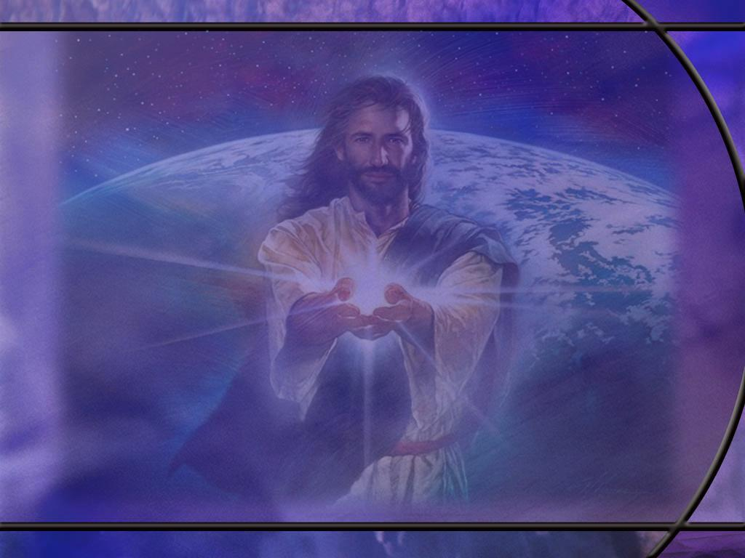
John 11:23-26 NKJV
Jesus said to her, "Your brother will rise again." ²⁴ Martha said to Him, "I know that he will rise again in the resurrection at the last day." ²⁵ Jesus said to her, "I am the resurrection and the life. He who believes in Me, though he may die, he shall live. ²⁶ "And whoever lives and believes in Me shall never die. Do you believe this?“ [R]
Notes:
Q1: What words of comfort did Jesus have for Martha in verse 23?
1. “Your brother will rise again.”
2. Jesus points her to the resurrection.
3. He doesn’t tell her that her brother is up in heaven singing in the angel choir.
4. Our comfort in death is the resurrection of the righteous who are in Christ.
Q2: When does Martha expect to see her brother again?
1. “In the resurrection at the last day.”
2. So the context for Jesus’ reply to her in vs. 25 and 26 is the resurrection at the last day.
Q3: How does Jesus point to both the resurrection and the translation in His reply to Martha in vs. 25 and 26?
1. In verse 25, if a believer dies, He will live again through the resurrection at the last day.
2. In verse 26, if a believer is alive at the last day when Jesus comes back, he will never die.
3. In other words, he will be translated.
4. If he never dies, what kind of life is Jesus talking about here? (eternal life).
5. So this is not a temporary resurrection like He is going to do for Lazarus.
6. This is the permanent resurrection to eternal life at the end of the age when Jesus returns.
Q3: What condition does Jesus give for someone to be resurrected or translated?
1. “He who believes in Me.”
2. Jesus is the resurrection and the life for those who believe in Him and trust in Him.
3. For those who don’t believe or trust in Him, no eternal life.
Q4: How did Mary respond to Jesus’ last question here?
John 11:27 NKJV - She said to Him, "Yes, Lord, I believe that You are the Christ, the Son of God, who is to come into the world.“
1. This is the same thing Paul came to realize after his road-to-Damascus experience.

Slide 17
1 Thessalonians 4:13-14 KJV
But I would not have you to be ignorant, brethren, concerning them which are asleep, that ye sorrow not, even as others which have no hope. ¹⁴ For if we believe that Jesus died and rose again, even so them also which sleep in Jesus will God bring with him. [R]
Notes:
Q1: What was going on with the saints in Thessalonica?
1. They appear to be continuing in sorrow for their dead loved ones longer than normal.
2. Now it is normal to mourn the loss of a loved one.
3. But as Christians, we have the hope of eternal life in Christ.
4. And eventually we need to get our focus off of death and onto the promise of a glorious eternal future.
5. That’s what Paul is reminding them of here.
Q2: How does Paul refer to these loved ones being mourned?
1. He calls them “them which are asleep.”
2. They are sleeping in the unconsciousness of death.
Q3: What do those who believe in the immortal soul think about these verses?
1. They look at verse 14 and try to argue that when Jesus returns, He brings with Him the immortal souls or spirits of those who have died and puts them back into their resurrected bodies.
2. But are the dead sleeping in heaven? Daniel says they are sleeping in “the dust of the earth.”
3. In John 5:28, Jesus tells us where the dead are: He says “all who are in the graves will hear His voice .”
4. The dead are in their graves, not in heaven.
5. So what is Paul saying in verse 14?
6. Take the whole verse together because the first part explains the last part.
7. If we believe that Jesus died and rose again, then we can believe that those who died in Jesus will rise again also.
8. God will bring them forth from the grave “with Jesus.”
9. Paul explains this is 2 Cor 4:14
2 Corinthians 4:14 (NKJV)
¹⁴ knowing that He who raised up the Lord Jesus will also raise us up with Jesus, and will present us with you.
10. The same Greek word is used for “with” in both of these verses. (Greek “syn”) (“with Him” in 1 Thes and “with Jesus” in 2 Cor)
11. Just as God used His Son as the active agent in creation, so He will use His Son as the active agent in resurrection.
12. So these two verses may be saying that it is with the power of the Son that we are resurrected.
13. Or they could be saying that we are resurrected with Jesus in the sense of being in the same immortal group that He is.
14. But whatever the meaning of “with,” it is clear that both these verses are speaking of a resurrection not of Jesus coming back with immortal souls.
[Skip Q4 if time is short]
Q4: Why does Paul say that “God will bring with Him” rather than He [Jesus] will bring with Him?
1. Is he referring to Jesus as God or is he saying that God the Father will bring the departed souls with Himself, and the Father will come with Jesus?
2. In Paul’s writings, it would be very unusual for him to switch from Jesus to God and mean, by God, Jesus.
3. Usually when he uses Jesus and God together he means Jesus the Son and God the Father.
4. No other passages on the second coming indicate that God the Father is coming back with departed souls.
5. Finally, those “which sleep in Jesus” (verse 14) don’t descend with God; rather, as Paul says in verse 16, “the dead in Christ shall rise first.”
7. The dead are going up, not coming down!

Slide 18
1 Thessalonians 4:15-18 NKJV
For this we say to you by the word of the Lord, that we who are alive and remain until the coming of the Lord will by no means precede those who are asleep. ¹⁶ For the Lord Himself will descend from heaven with a shout, with the voice of an archangel, and with the trumpet of God. And the dead in Christ will rise first. ¹⁷Then we who are alive and remain shall be caught up together with them in the clouds to meet the Lord in the air. And thus we shall always be with the Lord. ¹⁸Therefore comfort one another with these words. [R]
Notes:
Q1: What is Paul’s authority for this passage?
1. It is the word of the Lord.
2. Apparently this is what Jesus taught about His second coming while here on earth.
3. We don’t have these exact words in the gospels, but Jesus certainly taught his disciples about the resurrection.
Q2: Would those living at the second coming have any advantage over those who had died?
1. No. Paul says the living will not precede the dead into the presence of God. We will go together.
2. In fact, the dead in Christ will rise first, then the living will be caught up together with them.
Q3: Who comes to resurrect those who are dead in Christ?
1. The Lord Himself.
Q4: And what voice does he speak with?
1. The voice of the archangel.
2. The archangel’s voice is really Jesus’ voice.
3. John describes the voice of the Son of Man, Jesus, as the one whose words speak life at the resurrection.
John 5:28-29 (KJV) (Jesus speaking)
²⁸ Marvel not at this: for the hour is coming, in the which all that are in the graves shall hear his [Jesus’] voice,²⁹ And shall come forth;
4. So the voice of the archangel that brings resurrection is really the voice of Jesus who has the divine power to resurrect the dead.
Q5: What about the trump of God? What did Jesus say about that?
1. In Matthew 24, speaking of His second coming, Jesus says:
Matthew 24:31 KJV - And he [Jesus] shall send his angels with a great sound of a trumpet, and they shall gather together his elect from the four winds, from one end of heaven to the other.
2. Paul has it right in our text here: It is Jesus who blows the trumpet, not Gabriel.
3. It is laughable that some try to claim that this verse describes the secret rapture.
4. This is the noisiest verse in the Bible.
5. There is nothing secret about the second coming of Jesus.
Q6: What does Paul have to say in the last line of v 17 about how we go to be with the Lord?
1. He says, “and thus.”
2. The Greek word here is houtō (hoo’-to)
3. It can be translated: thus, so, in this manner.
4. In this manner or in this way, as opposed to any other way, we shall always be with the Lord.
5. This means that it is through resurrection or translation at the second coming that we go to be with the Lord, not by an immortal soul or spirit when we die.
Q7: How should we comfort those who are mourning the loss of loved ones?
1. Certainly, if they died in Christ, these are the words of comfort that provide a true picture of our future hope.
2. Our comfort is not the false notion that our loved ones are enjoying the presence of Jesus and the angels in heaven.
3. It is looking forward to their resurrection at the second coming of Jesus when we all go together.

Slide 19
Philippians 1:27 ESV
Only let your manner of life be worthy of the gospel of Christ, so that whether I come and see you or am absent, I may hear of you that you are standing firm in one spirit, with one mind striving side by side for the faith of the gospel, [R]
Notes:
Q1: What does Paul want to see in the lives of the Philippian Christians?
1. He wants to see them living for Jesus according to the gospel of Christ.
2. The gospel of Christ is the good news of salvation by grace through faith in the blood of Jesus shed for the remission of sins.
3. Concerning the gospel of salvation, they need to be unified in their understanding of it and their desire to share it.
Q2: Would Paul want the same for our church today?
1. No doubt.
2. We should all be united on the fundamentals of the Christian faith.
3. Fundamental to Paul’s ministry was the primacy of the gospel.
4. Yes, the law is important.
5. God wants us to keep all of the commandments.
6. He wants us to live in love for Him and for one another.
7. But as sinners, we continue to miss the mark.
8. Our righteousness is filthy rags as Isaiah points out.
9. Our own righteousness can never save us.
10. We need the perfect righteousness of Christ.
11. That only comes through the gospel: the doing and dying of Jesus to take our sins and give us His righteousness.
12. Here is the gospel in one verse:
Romans 6:23 KJV - For the wages of sin is death; but the gift of God is eternal life through Jesus Christ our Lord.
13. Our greatest need is to be forgiven of our sins and have the righteousness of Christ placed to our account.
14. Do you understand it?
15. Do you believe it?
16. Can you share it?
17. Let’s do it!

Slide 20
Outline of Philippians
I. Greeting (1:1-2)
II. Thanksgiving and prayer (1:3-11)
III. Paul’s personal Circumstances (1:12-26)
IV. Exhortations (1:27-2:18)
A. Living a worthy life (1:27-30)
B. Being a Servant like Jesus (2:1-18)
V. Fellow Servants in the Gospel (2:19-30)
A. Timothy (2:19-24)
B. Epaphroditus (2:25-30)
VI. Warnings (3:1-4:1)
A. Against legalists (3:1-16)
B. Against lawlessness (3:17-4:1)
VII. Final exhortations, Thanks, and Conclusions (4:2-23)
Notes:
Not used in this lesson.

