Slide 1
Growing in a Relationship with God
Lesson 2
To Know God

Slide 2
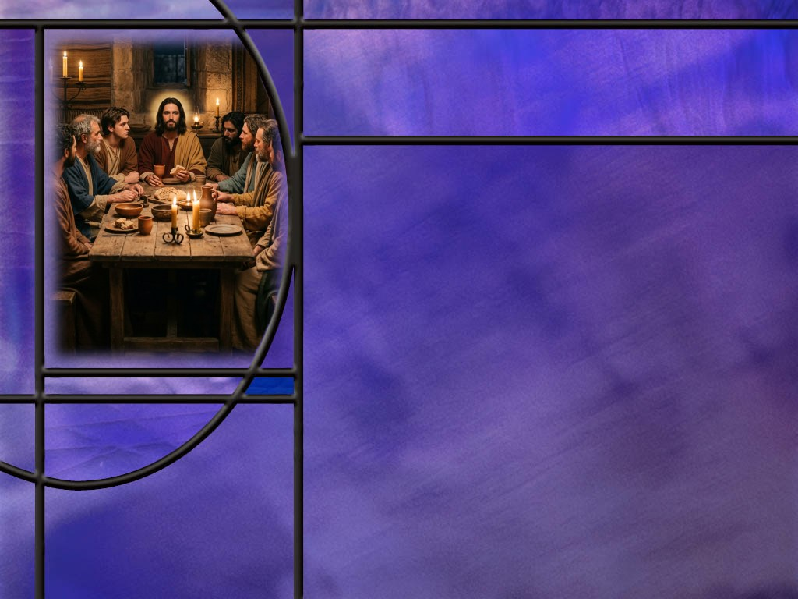
Memory Text
John 17:3 NKJV
"And this is eternal life, that they may know You, the only true God, and Jesus Christ whom You have sent.”
Who is praying this prayer?
What important subject does Jesus address here?
What is Jesus’ answer to how we can have eternal life?
What do you think Jesus means by “know” the Father and Son?
Notes:
B2:
1. It may not seem like it from this one verse, but this is Jesus’ prayer with His disciples at the Last Supper.
2. In His prayer to His Father, it would be unusual for Jesus to refer to himself as “Jesus Christ” rather than simply saying “Me.”
3. But perhaps, because He knew His disciples were listening, He wanted to make it clear.
4. Or perhaps, in John’s recording of it, He wanted to make it clear to his readers.
5. The whole chapter (John 17) is Jesus’ prayer.
6. It is often referred to as the High Priestly Prayer of Jesus.
7. This is the longest prayer of Jesus recorded in scripture.
8. As we mentioned last week, the apostle John must have taken a lot of notes on what Jesus said and did on that last night with His disciples.
9. This prayer of Jesus covers three basic subjects:
10. First, He prays for himself that He might fully glorify the Father.
11. Second, He prays for His disciples, that they might be faithful, and unified, and protected from the evil one.
12. Third, He prays for us that we might be unified in the faith, filled with God’s love and saved in God’s kingdom.
13. Because He intercedes with the Father for His followers, this has become known as the High Priestly Prayer of Jesus.
B3:
1. He is addressing the subject of how to have eternal life.
2. Is there any subject in the Bible that is more important for human beings than this one?
3. So, our ears should perk up and our minds snap to attention.
4. Here Jesus is giving us the answer to one of mankind’s most essential questions.
5. Is it possible to have eternal life, and if so, how?
B4:
1. Jesus says here that eternal life comes by knowing God the Father and Jesus Christ the Son.
2. Jesus says that the Son is the one sent from the Father.
3. Here Jesus refers to His divinity and unity with the Father.
4. He is even more explicit in His last petition for himself in:
John 17:5 NKJV - "And now, O Father, glorify Me together with Yourself, with the glory which I had with You before the world was.
5. So, Jesus says here that knowing the Father and the Son is eternal life.
B5:
1. He means something more than simply knowing about the Father and Son.
2. James points this out when he wrote:
James 2:19 NKJV - You believe that there is one God. You do well. Even the demons believe--and tremble!
3. The demons know and believe that there is one true God, but they don’t know Him in the sense of the word that Jesus uses here.
4. Here Jesus is using this Greek word ginōskō (ghin-oce’-ko) in a much more intimate sense.
5. If we look at the first usage of this word in the NT, here is what we find in:
Matthew 1:24-25 NKJV - Then Joseph, being aroused from sleep, did as the angel of the Lord commanded him and took to him his wife, ²⁵ and did not know her [same Greek word] till she had brought forth her firstborn Son. And he called His name JESUS.
6. So this Greek word “ginosko” can be used in Hebrew thought to describe the love and sexual intimacy of a married couple.
7. We see this also in:
Genesis 4:1 NKJV - 1 Now Adam knew Eve his wife, and she conceived and bore Cain, and said, "I have acquired a man from the LORD."
8. So, Jesus is talking about knowing Father and Son in an intimate love relationship where we are the bride (the church) and He is our Husband, our Head, our Lord, our Savior.
9. Knowing God with this intimate love relationship leads to a permanent bond with Him that saves us.
10. Central to this saving relationship is justification: trusting Jesus for the forgiveness of our sins, followed by sanctification: allowing the HS to change us into His likeness.
11. As we studied last week:
12. When we know Him, we love Him.
13. When we love Him, we obey Him.
14. When we obey Him, we abide in Him.
15. When we abide in Him, we bear fruit for His glory.
16. Spiritual fruit in our lives is evidence that we have been justified and that the HS is at work changing us into Chrit’s likeness.

Slide 3
Overview
Growing in a relationship with God depends on how we view His character. Satan has done his best to smear God’s character. The truth about God is revealed in His inspired word and especially in the life and ministry of Jesus.
  Devil’s deception
  Goodness of God
  Witness of Jesus
  Summary

Slide 4
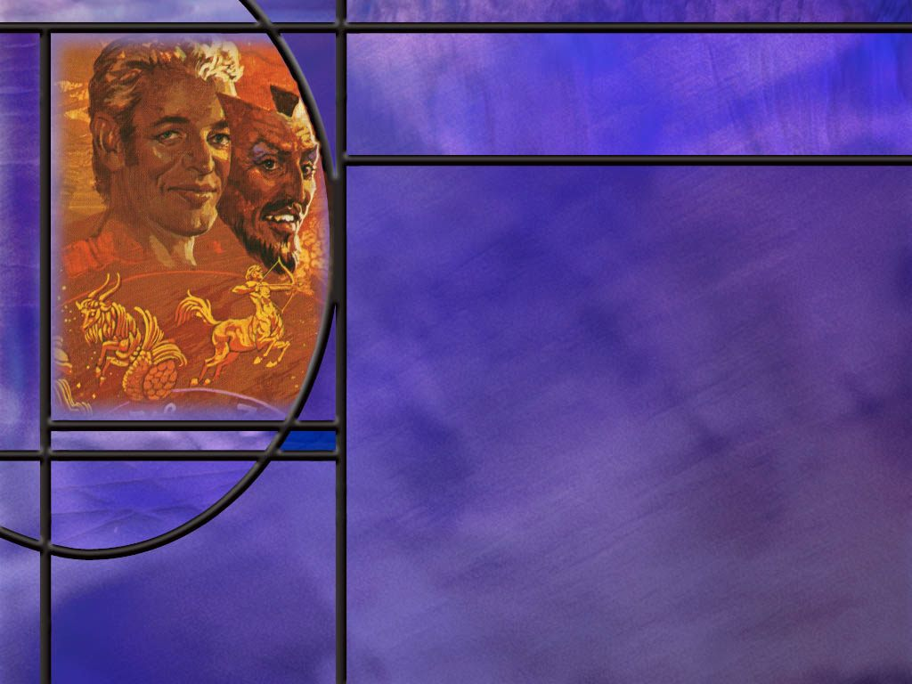
Devil’s Deception
What means has the devil used to smear the character of God?
How did Satan deceive Eve in the Garden of Eden? (Gen 3:4-5)
Should Adam and Eve have died that very day? (Gen 2:17)
What should we call natural disasters instead of an “act of God?”
How can we be guilty of smearing the character of God?
Notes:
B1:
1. The devil has promoted all kinds of opposition to the truth about God.
2. Just look at all the “isms” we have that claim to have spiritual truth.
3. The word of God today is under assault by all kinds of philosophies, religions, and beliefs that are contrary to the word of God.
4. A few that come to my mind are: humanism, hedonism, materialism, relativism, atheism, agnosticism, communism, paganism, evolution instead of creation, homosexuality, transgenderism, abortion, euthanasia, spiritism, occultism, immortality of the soul, eternal torment, Anti-Sabbatarianism, infant baptism, anti-Trinitarianism, and so many more.
5. Everybody worships something, and most of the world worships something other than the true God of Scripture.
6. And that’s just what Satan wants: he wants to be worshipped rather than God.
7. Satan is still promoting his first lie, “Ye shall not surely die.”
8. He has promoted spiritism and the immortality of the soul which leads naturally to eternal torment in the flames of a never-ending hell.
9. If ever there was a doctrine of the devil, this is it!
10. This makes God a million times worse than Hitler and Stalin, and Mao, and Pol Pot and all the other mass murderers of history.
11. Paul wrote these words to Timothy:
1 Timothy 4:1 KJV - Now the Spirit speaketh expressly, that in the latter times some shall depart from the faith, giving heed to seducing spirits, and doctrines of devils;
12. We see the truth of this prophecy all around us.
B2:
[See notes on linked slide.]
B3:
[See notes on linked slide.]
B4:
1. God is not busy in hurricane season creating the next tropical storm.
2. He is not sending tornadoes or earth quakes or fires or floods.
3. Nor is Satan in control of the weather.
4. The weather and natural disasters is a consequence of the fall and sin.
5. Our weather patterns are the aftermath of the worldwide flood that was sent because of the wickedness of mankind upon the earth.
6. And who caused the wickedness upon the earth? (Satan).
7. So all the natural disasters that occur are a result of sin, the fall, the curse, the flood.
8. If Adam and Eve and their posterity had obeyed God, there would be no natural disasters.
9. So, while the insurance companies can call it “an act of God,” we know that it was the act of a rebellious angel who deceived Eve and caused the whole creation to spiral downward.
B5:
1. When we claim to be Christians but live like the devil, we dishonor the God we claim to serve.
2. When we are angry, bitter, unforgiving, harsh, quick-tempered, malicious, we are denying the power of God to change us.
3. We need to be abiding in Jesus by obeying His commandments to love God supremely and love others as ourselves.
4. As we abide, the good fruit will grow.
5. When we fail, confess, ask forgiveness, and seek to right the wrongs we have caused.
6. So, as Paul wrote to the Corinthians:
2 Corinthians 13:5 KJV - Examine yourselves, whether ye be in the faith;
7. Let’s make sure we are living in agape love toward those around us so that they can see that God is love.

Slide 5

Goodness of God
How do the angels of heaven declare the character of God? (Isa 6:5; Rev 4:8)
How does John define the relational attributes of God’s character? (1 John 4:8)
How did God describe His own character to Moses? (Ex 34:6-7)
What are some of the other characteristics of God that define His being? [List & Texts]
Notes:
B1:
[See notes on linked slide.]
B2:
[See notes on linked slide.]
B3:
[See notes on linked slide.]
B4:
[See notes on linked slide.]

Slide 6
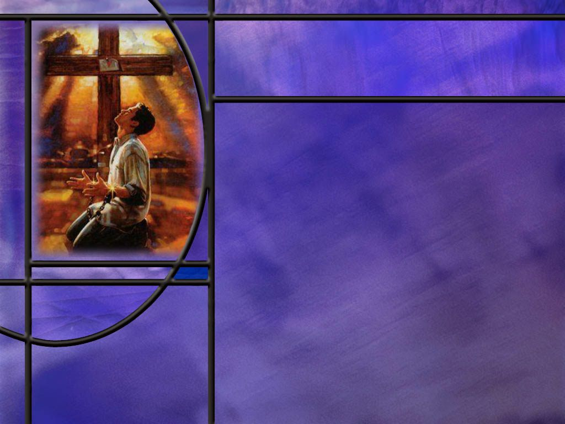
Witness of Jesus
How did God finally reveal His character to us? (Heb 1:1-2)
How did Jesus describe His relationship to the Father? (John 14:9; John 10:30)
How did Matthew and Luke describe the divinity of Jesus at His birth? (Matt 1:23; Luke 1:35)
How has Jesus made the love of God real for you?
Notes:
B1:
[See notes on linked slide.]
B2:
[See notes on linked slide.]
B3:
[See notes on linked slide.]
B4:
1. In His exposition on the vine and the branches, Jesus said this:
John 15:13 NKJV - "Greater love has no one than this, than to lay down one's life for his friends.
2. That is exactly what Jesus did for me.
3. He clearly displayed the love of God by dying for our sins.
Romans 5:8 NKJV - 8 But God demonstrates His own love toward us, in that while we were still sinners, Christ died for us.
4. The cross is the greatest demonstration of the love of God for us.
5. What God did for us there will be our song through the ages of eternity.
Redeemed how I love to proclaim it,
Redeemed by the blood of the Lamb.
Redeemed through His infinite mercy,
His child and forever I am!

Slide 7
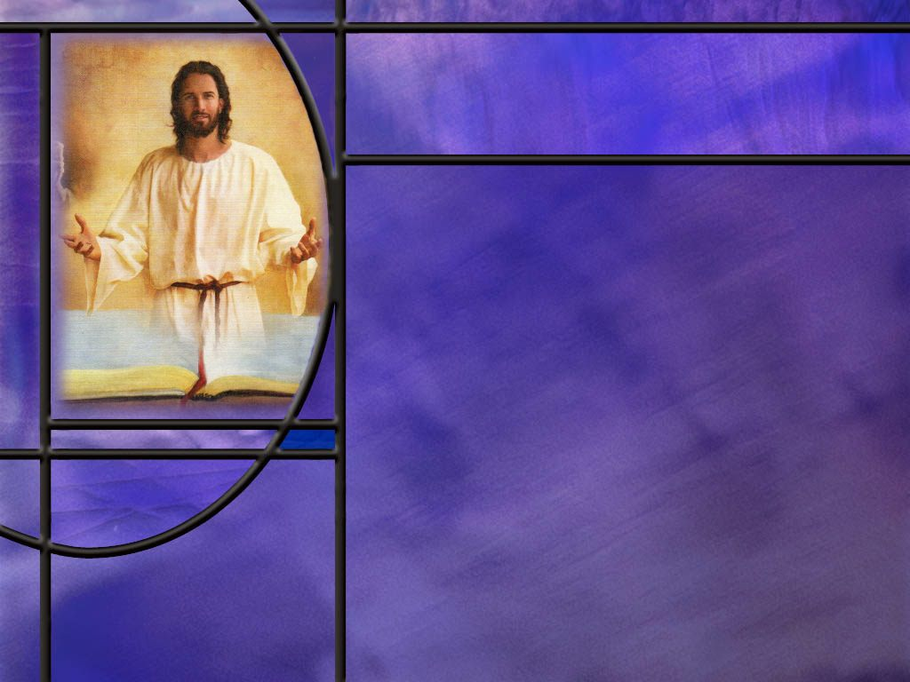
Summary
In His High Priestly Prayer, Jesus equated eternal life with knowing the Father and Himself.
The “knowing” of which He speaks is not just knowing about God, but having a loving faith relationship with Him that leads to justification, sanctification, and a permanent bond of love.
The devil has sought to smear the character of God, and he seems to be having great success in our country today and around the world.
He is the father of lies who deceived Eve in the garden. His first lie leads to all kinds of spiritual error including prayers to the dead and eternal torment. His second lie was that they would become like God when actually they sinned and became like him.

Slide 8
Summary
While Satan spreads lies about God, Scripture reveals the truth about God.
Perhaps the most basic attribute of God’s character is His holiness that sets Him apart from everything else as morally perfect and pure, with no taint of evil or sin, the definer of good and evil, right and wrong,
God’s holiness ensures that all of His other attributes will be used for good rather for evil.
God’s greatest relational attribute is agape love which acts in the eternal best interest of others.

Slide 9
Summary
The Bible gives us many other attributes of God including: He is eternal, merciful, gracious, faithful, just, righteous, omnipotent, omniscient, omnipresent, immutable, sovereign, good, transcendent, and imminent.
In these last days, God speaks His love, His grace, His goodness, His forgiveness, His acceptance, His reconciliation, His covenant promises, and His salvation through His Son.
Our clearest picture of the goodness of God is seen in Jesus who declared the love of God for us in that while we were yet sinners, Christ died for us.
Seeing God’s goodness through Jesus, will you make it your plan this week to know Him, love Him, obey Him, and abide in Him?

Slide 11
Genesis 3:4-5 NKJV
Then the serpent said to the woman, "You will not surely die. ⁵ "For God knows that in the day you eat of it your eyes will be opened, and you will be like God, knowing good and evil.“ [R]
Notes:
Q1: What was Satan’s first lie?
1. Satan’s first lie was that she would not surely die.
2. Here he directly contradicts God’s word.
3. Did everyone who ate the fruit die? (Absolutely)
4. God told the truth; Satan lied.
Q2: Is Satan still telling the same lie today? How?
1. Satan is pushing the same lie in the form of the immortality of the soul.
2. Your body may die, but your immaterial soul or spirit continues to live.
3. This has led to all kinds of theological errors including prayers to the dead, to Mary and the saints, to belief in purgatory and eternal torment and to spiritism and contacting the dead (demons)
Q3: What was the second lie Satan told to Eve?
1. We find the second lie in verse 5.
2. The second lie was “you will be like God knowing good and evil.”
3. Were Adam and Eve more like God before they ate the fruit or after they ate the fruit?
4. Before they ate the fruit, they were sinless; they communed with God face to face.
5. They had access to the Tree of Life and could live forever like God.
6. God met with them in the garden and talked with them in the cool of the day.
7. They were created in the image of God before they sinned.
8. After they ate the fruit, they were sinners, separated from God, condemned to death, the image of God defaced.

Slide 12
Genesis 2:17 NKJV
"but of the tree of the knowledge of good and evil you shall not eat, for in the day that you eat of it you shall surely die." [R]
Notes:
Q1: How can this verse be troubling to some readers of Scripture?
1. It seems to imply that they would die on the very day that they ate the forbidden fruit.
2. But Adam lived for 930 years!
3. This can be resolved by noting that the Hebrew word for day can also be translated “time,” simply meaning “when” you eat of it you will surely die.
4. This comes through in some of the more modern translations:
Genesis 2:17 NIV - but you must not eat from the tree of the knowledge of good and evil, for when you eat from it you will certainly die.“
Genesis 2:17 NLT - except the tree of the knowledge of good and evil. If you eat its fruit, you are sure to die.“
Genesis 2:17 NET - but you must not eat from the tree of the knowledge of good and evil, for when you eat from it you will surely die."
5. Here we see God’s mercy, grace, love, and patience in allowing Adam a time of probation to repent.
6. Another way to look at this verse is that on the day they ate the forbidden fruit, they began to die.
7. They were driven from the garden and lost their access to the Tree of Life.
8. Without the tree of life, death was inevitable.

Slide 13
Angels’ Testify
Isaiah 6:3 ESV - And one [seraphim ] called to another and said: "Holy, holy, holy is the LORD of hosts; the whole earth is full of his glory!"
Revelation 4:8 ESV - And the four living creatures, each of them with six wings, are full of eyes all around and within, and day and night they never cease to say, "Holy, holy, holy, is the Lord God Almighty, who was and is and is to come!“ [R]
Notes:
Q1: How many holies do we have in the angel’s witness?
1. Three times.
2. Many see here a reference to the triune God, Father, Son, and Holy Spirit, the three persons of the godhead, contribute to the fullness of the holiness of God.
3. Others see the thrice repeated word as the ultimate emphasis of God’s holiness.
4. If the angels in heaven declare the holiness of God, we should certainly take note of this as a primary declaration of God’s character.
Q2: What does it mean that God is holy?
1. It means that God is different, set apart, perfectly pure, and infinitely greater than all creation.
2. God is uniquely majestic, and morally perfect—without sin or impurity.
3. He is uniquely worthy of worship, praise, honor, adoration, awe, and respect.
4. He is morally perfect and defines good and evil, right and wrong.
5. Holiness is the characteristic of God’s nature that is at the very core of His being.
6. Many see it as His most fundamental character quality.
Q3: How does the holiness of God provide the basis for His goodness?
1. Since holiness defines God as morally perfect without any taint of impurity, sin, or evil, God is necessarily good.
2. If God is holy, He will use all of His other characteristics for good.
3. He will use His omnipotence for good, His omniscience for good, His omnipresence for good.
4. He will use His love for good, His mercy or good, His grace for good, His forgiveness for good, His friendship for good, His creative powers for good.
5. Because He is a holy God, He will be a good God.

Slide 14
1 John 4:8 ESV
Anyone who does not love does not know God, because God is love. [R]
Notes:
Q1: What does this tell you about God? What word in Greek do you suppose is used here to describe the kind of love God is?
1. Of course, the Greek word is agape.
2. God’s nature is to love with agape love.
3. Agape love focuses on others rather than self.
4. And it focuses on actions more than on feelings.
5. Agape love acts in the eternal best interest of others regardless of how they respond.
6. It is an unconditional love.
7. God loves us, not because we are lovable, but because He is loving: that’s His nature.
Q2: What does love have to do with His creation of the physical universe and us being created in His image?
1. God created us to love us and enjoy the pleasure of us loving Him in return.
2. Love needs to be shared; it needs to be lavished on someone.
3. So God created a new order of beings: human beings in a physical universe.
4. We were created in His image so that we could understand our Creator and return His love for us.
5. Later on in this same chapter, John will point out why we love Him:
1 John 4:19 KJV - We love him, because … He first loved us.
Q3: Who did God love before the creation of the world?
1. God had created an order of beings slightly above us in a spiritual dimension called heaven: the angels.
2. As far as we know, the good angels are not subject to death, but have become ministering spirits that are able to interact with our physical universe.
3. And, of course, there has always been love among the members of the godhead, Father, Son, and Holy Spirit.

Slide 15
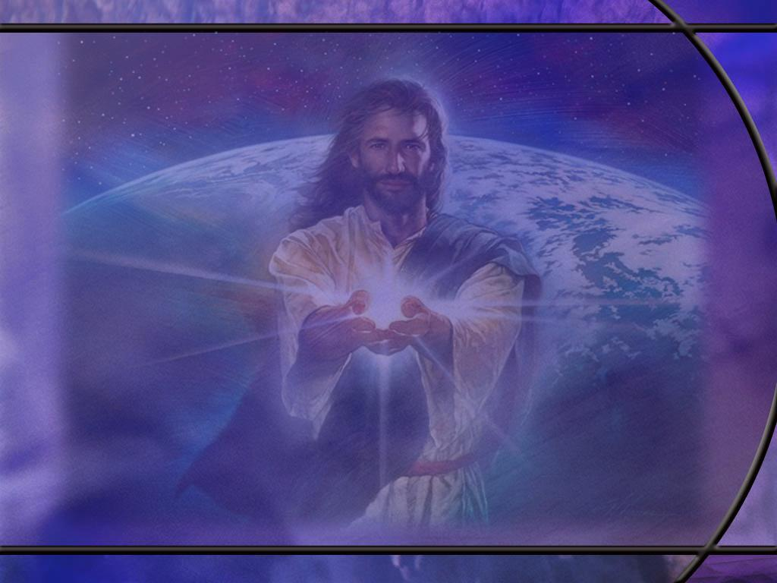
Exodus 34:6-7 ESV
The LORD passed before him and proclaimed, "The LORD, the LORD, a God merciful and gracious, slow to anger, and abounding in steadfast love and faithfulness, ⁷ keeping steadfast love for thousands [of generations], forgiving iniquity and transgression and sin, but who will by no means clear the guilty…” [R]
Notes:
Q1: What would you say about the Lord based on His self-revelation?
God is good!!
Just fall into His everlasting arms of love.
Confess your sins and He will forgive you.
Surrender to Him and let Him save you and love you for eternity.
What a God we serve!!!
What great and precious promises we have!!
What a future He has planned for us!

Slide 16
Summary of God’s Character
Attribute | Bible Reference
Holy | “Holy, holy, holy is the LORD of hosts” — Isaiah 6:3
Love | “God is love” — 1 John 4:8
Eternal | “The eternal God is your dwelling place” — Deuteronomy 33:27
Merciful | “The LORD, the LORD, a God merciful and gracious” — Exodus 34:6
Gracious | “The LORD, the LORD, a God merciful and gracious” — Exodus 34:6
Faithful | “Know therefore that the LORD your God is God, the faithful God” — Deuteronomy 7:9

Slide 17
Summary of God’s Character (2)
Attribute | Bible Reference
Just | “The Rock, his work is perfect, for all his ways are justice” — Deuteronomy 32:4
Righteous | “The LORD is righteous in all his ways” — Psalm 145:17
Omnipotent | “With God all things are possible” — Matthew 19:26
Omniscient | “God is greater than our heart, and he knows everything” — 1 John 3:20
Omnipresent | “Where shall I go from your Spirit?” — Psalm 139:7

Slide 18
Summary of God’s Character (3) [R]
Attribute | Bible Reference
Immutable | “I the LORD do not change” — Malachi 3:6
Sovereign | “Our God is in the heavens; he does all that he pleases” — Psalm 115:3
Good | “Oh, taste and see that the LORD is good” — Psalm 34:8
Truth | “God is light, and in him is no darkness at all” — 1 John 1:5
Wisdom | “To God... be wisdom” — Romans 16:27
Notes:
To these I would add two more:
First, He is transcendent.
He is above, beyond, outside, independent of the physical universe He created.
He existed before the universe and He will exist after it is gone.
He had to exist independent of it before He created it.
Second, He is imminent.
He is not a distant God, but He is very close to every one of us.
Here we can use:
Acts 17:27-28 KJV - That they should seek the Lord, if haply they might feel after him, and find him, though he be not far from every one of us: 28 For in him we live, and move, and have our being; …
Our God is an amazing God!

Slide 19
Hebrews 1:1-2 NIV
In the past God spoke to our ancestors through the prophets at many times and in various ways, ² but in these last days he has spoken to us by his Son, whom he appointed heir of all things, and through whom also he made the universe. [R]
Notes:
Q1: How has God now spoken to us in the Christian era?
1. When God wanted to give us an even fuller revelation of who He is and what He is like, He sent us His Son.
2. The apostle John called Him the Word.
3. The Word was made flesh and dwelt among us. (John 1:14)
4. And here the author of Hebrews tells us that God’s ultimate word to us is revealed in Jesus.
5. Here the testimony of Jesus becomes an addition to the OT word of God.
6. This new testimony of Jesus is the New Testament, inspired by the HS and written down by the apostles of Jesus or their near associates.
7. It becomes God final word of truth.
8. So now we have an even fuller test of truth.
9. Do you remember what Isaiah wrote about discovering truth?
Isaiah 8:20 KJV - To the law and to the testimony: if they speak not according to this word, it is because there is no light in them.
10. So now we can still have the law and the testimony as the twofold witness to truth, but the law would apply to the OT Scriptures and the testimony would apply to the NT writings as the Testimony of Jesus.
11. So if God is now speaking to us through His Son, then we ought to pay attention to Jesus.
12. We need to listen to Him, understand what He says, understand who He is, understand what He has done, and receive Him as our Savior our Lord our Friend.
13. In these last days, God speaks His love, His grace, His goodness, His forgiveness, His acceptance, His reconciliation, His covenant promises, and His salvation through His Son.

Slide 20
Jesus Reveals the Father
John 14:9 NKJV Jesus said to him, "Have I been with you so long, and yet you have not known Me, Philip? He who has seen Me has seen the Father;
John 10:30 NKJV - 30 "I and My Father are one." [R]
Notes:
Q1: What is the claim of Jesus in these verses?
1. He claims to be the divine Son of God who can reveal the character of His Father in heaven.
2. And when John described Jesus as the Word he ends by saying:
John 1:18 ESV - 18 No one has ever seen God; God the only Son, who is in the Father’s bosom, he has made him known.
3. So, we see in Jesus the character of God the Father, the invisible God.
4. Jesus revealed mainly the relational character of God: His love, grace, mercy compassion, forgiveness, righteousness, holiness, and justice.
5. In his physical state, there were certain other characteristic such as omnipresence, and transcendence that he would not be able to reveal.
6. But to a large degree, we can clearly see the Father in the Son.

Slide 21
Divine Son
Matthew 1:22-23 NKJV - So all this was done that it might be fulfilled which was spoken by the Lord through the prophet, saying: ²³ "Behold, the virgin shall be with child, and bear a Son, and they shall call His name Immanuel," which is translated, "God with us.“
Luke 1:35 NKJV - 35 And the angel answered and said to her, "The Holy Spirit will come upon you, and the power of the Highest will overshadow you; therefore, also, that Holy One who is to be born will be called the Son of God. [R]
Notes:
Q1: What is Matthew’s statement that points to the divinity of Jesus?
1. He sees Jesus as the fulfillment of Isaiah’s prophecy of the virgin birth.
2. And the one born of this virgin shall be called Immanuel.
3. The meaning of the name Immanuel is “God with us.”
4. God was present with us in the person of the Son: Jesus.
Q2: How does Luke point to the divinity of Jesus?
1. No other baby born in all of human history has been called that Holy One.
2. But here we see the relationship with the Father in heaven with Jesus being called the Son of God.

