Slide 1
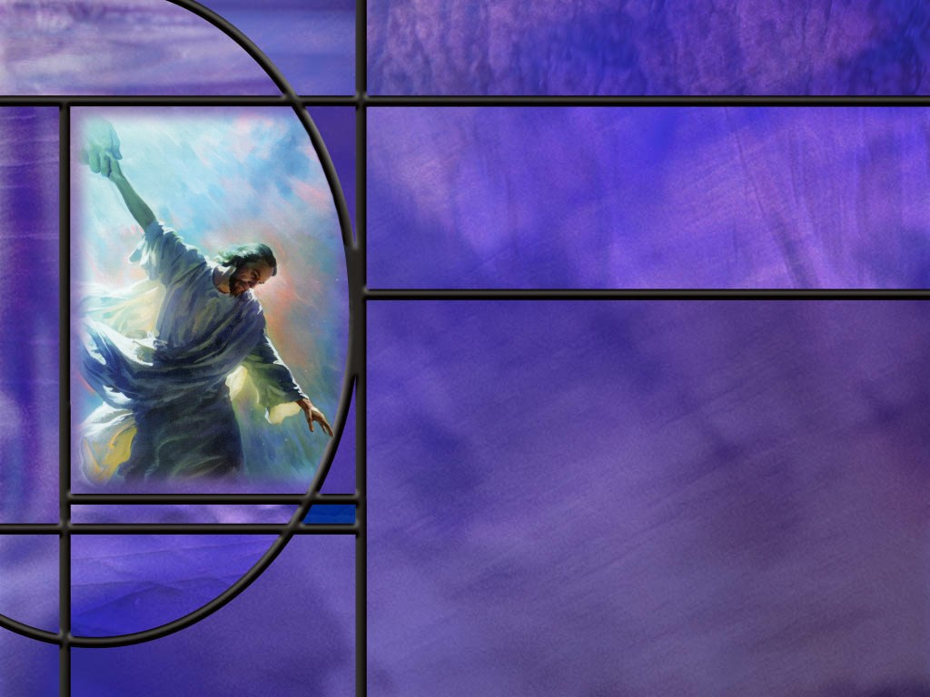
Uniting Heaven and Earth: Christ in Philippians and Colossians
Lesson 2 Reasons for Thanksgiving and Prayer

Slide 2
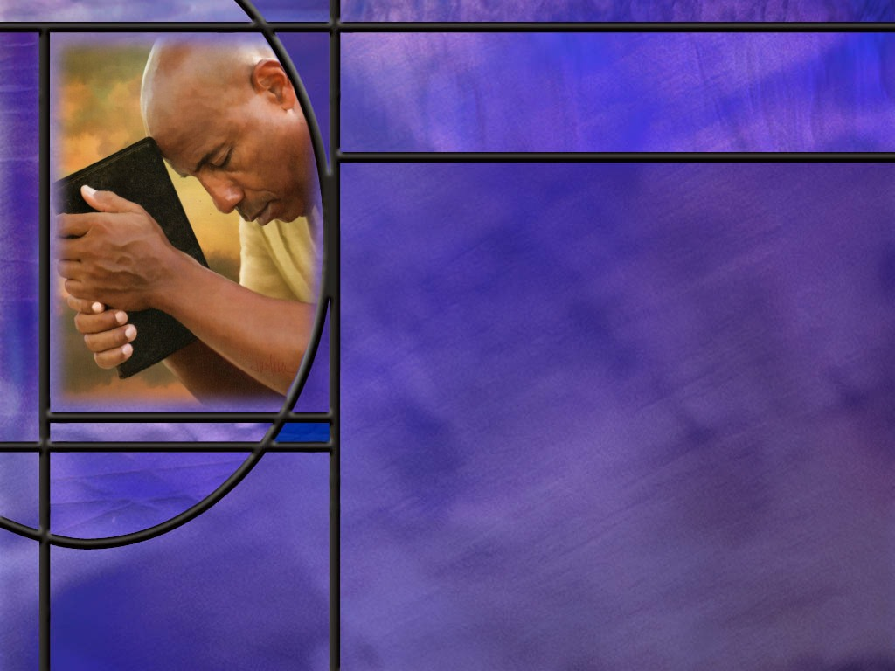
Memory Text Philippians 1:6 NKJV
Being confident of this very thing, that He who has begun a good work in you will complete it until the day of Jesus Christ;
What is the “good work” that Paul is talking about in this verse?
What do you think this verse is promising the Christian believer?
Does this verse mean “Once Saved, Always Saved?”
Notes:
B2:
1. It is always helpful to go back and try to understand the context when we study a particular verse.
2. We get a better insight if we go back to verse 5.
3. Here are verses 5 and 6 from the ESV:
Philippians 1:5-6 ESV - because of your partnership in the gospel from the first day until now. ⁶ And I am sure of this, that he who began a good work in you will bring it to completion at the day of Jesus Christ.
4. So from verse 5, the good work is their partnership in the gospel.
5. They have accepted the Gospel, they have been changed by the gospel, and they are helping to spread the gospel.
6. Here’s how it reads in the NLT:
Philippians 1:5-6 NLT - for you have been my partners in spreading the Good News about Christ from the time you first heard it until now. 6 And I am certain that God, who began the good work within you, will continue his work until it is finally finished on the day when Christ Jesus returns.
7. So the good work begun by God is the Gospel of salvation in Jesus Christ His Son.
8. It is by God’s grace that Jesus came to die for our sins, so salvation begins with Him.
9. And when we , like the Philippians, accept Jesus as our Savior from sin and trust His blood for forgiveness, we are justified by faith and accounted righteous for His sake.
10. Then God gives us the Holy Spirit to make us new creatures in Christ as we are born again and given a new direction in life.
11. It is the work of the Holy Spirit to help us grow in grace as we live for Jesus each day and become more like Him.
12. This whole process of salvation by grace through faith, becoming Christians and living the Christian life, is the “good work” that was begun in the lives of the Philippian believers.
B3:
1. It is a promise that God will not give up on us or reject us.
2. The Holy Spirit will continue to work in our lives until the day that Jesus comes back.
3. Sanctification or growing to be more like Jesus is the work of a lifetime.
4. This verse is a promise that God will continue that work in our lives until the day we die or until Jesus comes again.
5. He will not give up on you!
B4:
1. Many who believe in OSAS use this text.
2. However, the focus of this verse is on God’s part.
3. He will not give up on you.
4. But there is also human choice required for God’s plan to be completed in us.
Matthew 24:13 NKJV - "But he who endures to the end shall be saved.
5. We have to persevere in our relationship with Christ in order to be saved.
6. The Bible is very clear that there is such a thing as apostasy.
7. If we can freely choose to believe in Christ, we can also freely choose to reject Him at a later time.
8. The Bible has a number of examples of apostasy:
1 Timothy 1:20 NIV - Among them are Hymenaeus and Alexander, whom [Paul writes] I have handed over to Satan to be taught not to blaspheme.
9. Others we might consider are Judas Iscariot, King Saul, and King Jeroboam.
10. And Hebrews 6:4-6 clearly sets out the possibility of apostasy.
11. If we are willing to keep trusting in Jesus as our Savior and Lord, God will continue to fill us with His Spirit and conform us to the image of Christ.
12. God will not give up on us; let’s not give up on Him!

Slide 3
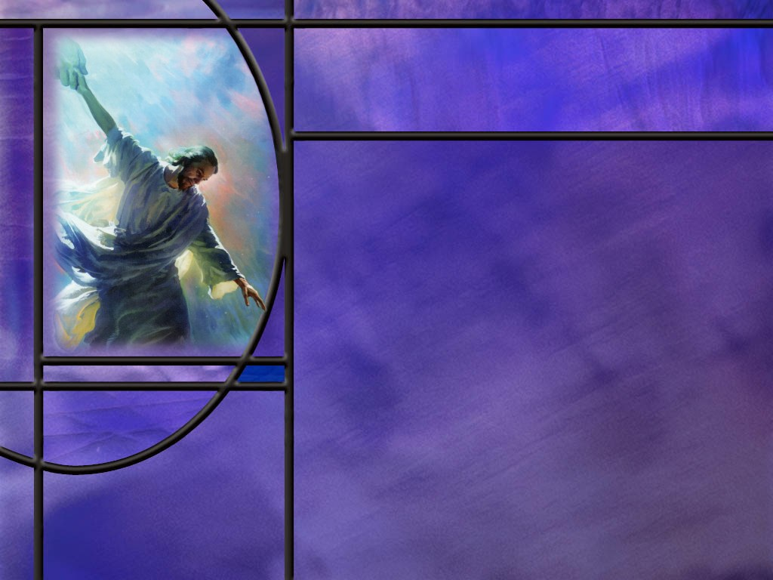
Overview
The first chapters of Philippians and Colossians give us insights into the prayer life of the apostle Paul and the kinds of things he finds of greatest importance for the success of these churches. The petitions recorded here will also bring success to our churches today.
Prayer for the Philippian Church
Prayer for the Colossian Church
Prayer for Our Church
Summary

Slide 4
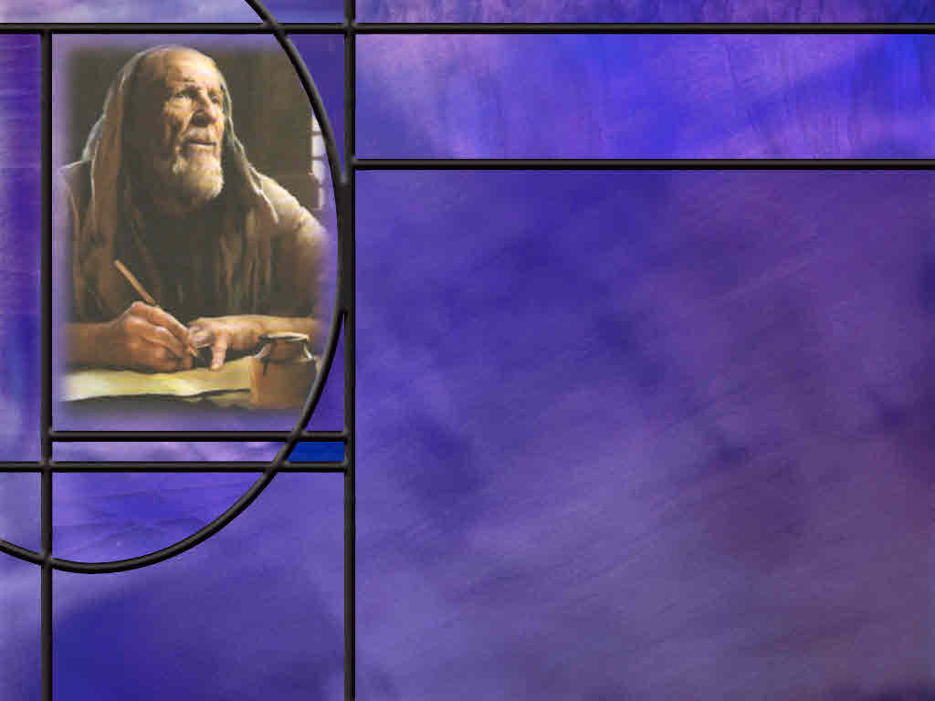
Prayer for the Philippian Church
What reasons does Paul give for thanksgiving and joy as he writes to the church at Philippi? (Phil 1:3-5)
How does Paul express his love for this church? (Phil 1:7-8)
What is Paul’s prayer for the Philippian Christians? (Phil 1:9-11)
How does Paul describe his situation in Rome? (Phil 1:12-14)
What is happening that makes Paul rejoice in prison? (Phil 1:15-18)
Notes:
B1:
[See notes on linked slide.]
B2:
[See notes on linked slide.]
B3:
[See notes on linked slide.]
B4:
[See notes on linked slide.]
B5:
[See notes on linked slide.]

Slide 5
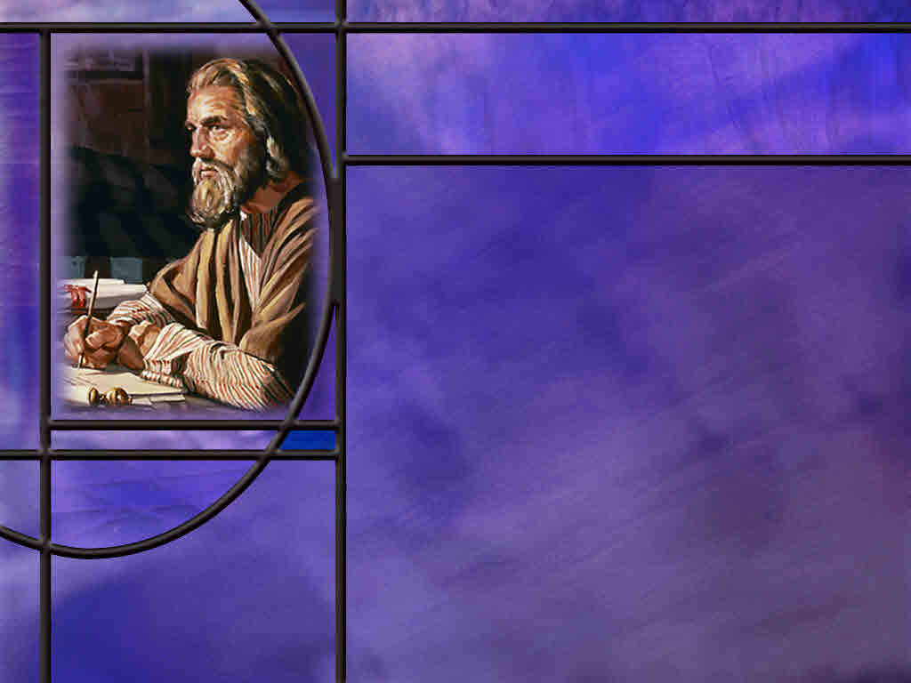
Prayer for the Colossian Church
For what three character traits does Paul commend the Colossians? (Col 1:3-5)
How did the gospel of salvation get to the Colossians? (Col 1:5-8)
What is Paul’s prayer for the Colossian Christians? (Col 1:9-12)
Notes:
B1:
[See notes on linked slide.]
B2:
[See notes on linked slide.]
B3:
[See notes on linked slide.]
B4:
[See notes on linked slide.]

Slide 6
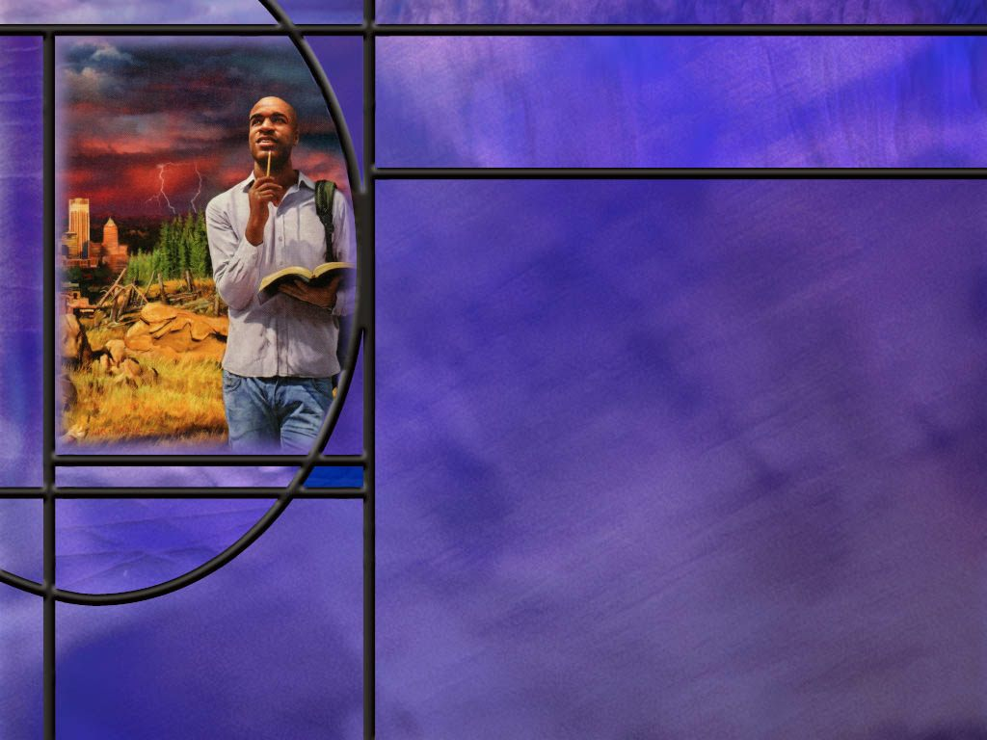
Prayer for Our Church
Suppose that the apostle Paul wrote a letter to our church. For what do you think he might pray for us?
Paul is no longer here to pray for our church, so who should be praying for us?
What are some keys that can help us to properly discern the will of God?
Notes:
B1:
1. Considering the similarity of his prayers for these two churches, it is likely that he would pray something similar for our church.
2. The things that he prayed for are things that every Christian needs.
3. We need our love for God and each other to continue to grow and overflow.
4. We need divine wisdom and understanding to know the will of God and to follow it.
5. We need to live pure and blameless lives as we await the return of our Lord.
6. We need to be filled with the Spirit and growing in grace, becoming more like Jesus so that our lives will bring glory to God.
7. We need to be qualified to share in the inheritance of God’s holy people in the kingdom of light.
8. We need to have our sins forgiven and have the righteousness of Christ placed to our account.
B2:
1. We should all be praying for each other.
2. Let us not neglect this challenge or think that someone else will do it.
3. Each of us should have a time of prayer when we can lift up our brothers and sisters in prayer.
4. Let’s not just pray for their physical healing.
5. But let’s pray for an outpouring of God’s Spirit upon them, that they might live a life worthy of the Lord and please him in every way.
6. That they might have divine wisdom and understanding to discern the will of God and live a life dedicated to His glory.
7. That they might know the gospel of righteousness by faith and trust in Jesus for the forgiveness of their sins and eternal life with God.
B3:
1. First and foremost, the word of God reveals the will of God.
2. We see there the commandments of God.
3. We see there the example of Jesus and the apostles and other spiritual leaders of the OT and NT.
4. As we study the life of Jesus, we can see how He responds to the needs of others and how He loved people, and how He laid down His life for our sins, and what He taught about the Kingdom of God.
5. And the more we get to know Jesus, the more we can ask ourselves in each situation we face, “What would Jesus do?”
6. And if we do that, chances are very good that we will live a life pleasing to God.
7. A second key to discerning the will of God is to pray.
8. In prayer, we can claim the promise of James 1:5:
James 1:5 NKJV - If any of you lacks wisdom, let him ask of God, who gives to all liberally and without reproach, and it will be given to him.
9. With divine wisdom, we can make choices that will be pleasing to God.
10. A third key is to invite the Holy Spirit to fill us each day and make us more like Jesus.
11. It is the work of the HS to conform us to the image of Christ to reflect His character.
12. As the fruit of the Spirit grows in our life, we will become more faithful in knowing and doing the will of God.
13. And the gifts of the Spirit include discernment, wisdom, and knowledge.
14. As we behold Christ in the Word, the HS transforms us into His likeness.
15. And Jesus always did the will of God.
16. Is it your desire to be like Him?
17. May God help us to follow in His footsteps.

Slide 7
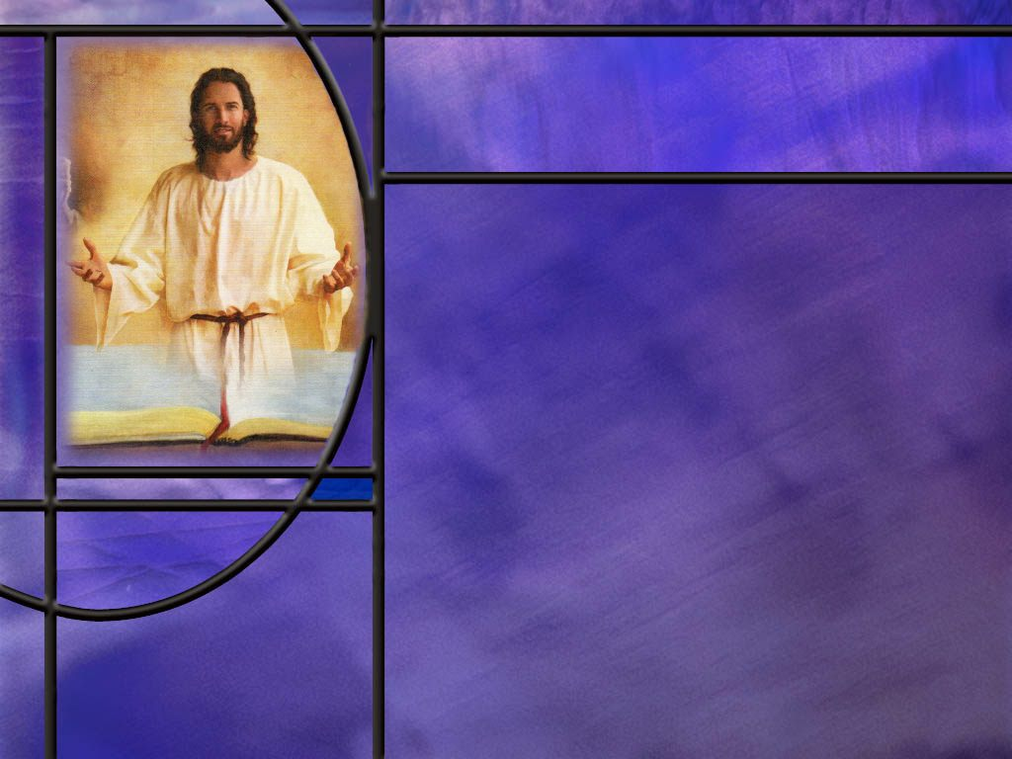
Summary
Paul opens his epistles to the Philippians and Colossians with words of thankfulness, commendation, and prayer.
Paul established the church at Philippi and he sees them as partners in spreading the Good News about Christ.
He acknowledges a special bond of love and affection for them.
He prays for them that they will continue to grow in love, knowledge, and understanding; that they will understand that God wants them to live pure and blameless lives; that they may grow to be more like Jesus; and that their lives will bring glory to God.
Paul sees his imprisonment in Rome as advancing the Gospel.

Slide 8
Summary
Under house arrest he is still free to witness to the imperial guard, to Caesar’s household, to direct the work, to encourage the other workers, and to write epistles.
He rejoices that Christ is proclaimed whether by friend or foe.
Paul gives thanks for the Colossian church and commends them for their faith, hope, and love.
He prays that they will receive divine wisdom and understanding to know God’s will and live a life fully pleasing to Him.
He prays that their lives will bear good fruit, that their knowledge of God will increase, that they will receive divine strength to endure with joy.

Slide 9
Summary
Noting the similarities between Paul’s prayer for these two churches, we can suppose that he would pray a similar prayer for our church today.
We too need to be growing in love for God and others, to understand the will of God and follow it, to be living pure and blameless lives, to be filled with the Spirit and growing in grace.
His example challenges us to pray for these things for each other.
Will you pray for your fellow church members this week that we will come to a deeper understanding of the will of God and that we will live lives that are fully pleasing to Him, seeking to follow Jesus and become more like Him?

Slide 11
Philippians 1:3-5 NLT
Every time I think of you, I give thanks to my God. ⁴ Whenever I pray, I make my requests for all of you with joy, ⁵ for you have been my partners in spreading the Good News about Christ from the time you first heard it until now. [R]
Notes:
Q1: For what does Paul give thanks as he begins this letter?
1. He gives thanks for the Philippian believers.
2. He gives thanks for this church.
3. When he prays for them, he does so with joy in his heart.
4. Even though he is in prison, as we will see a little later, the very thought of them brings him joy.
Q2: What have they done that is so precious to Paul?
1. They have been his partners in spreading the Gospel of the Lord Jesus.
2. They have taken the message they received from Paul and spread it to their families and friends.
3. And it looks like they didn’t have to spend a lot of time preparing to do it.
Q3: When did they start spreading the good news?
1. From the time they first heard it.
2. And they didn’t stop! They were still doing it as he was writing this letter.
3. O how I wish we could say that about the church at Haverhill!
4. We need to be spreading the Good News about Christ to those around us.
5. If Jesus has forgiven your sins and given you a new life, you have a testimony to share.
6. Don’t wait to share it!
7. As Peter would write in:
1 Peter 3:15 NIV - Always be prepared to give an answer to everyone who asks you to give the reason for the hope that you have. But do this with gentleness and respect,
8. In addition, we have this from:
Psalm 107:2 KJV - Let the redeemed of the LORD say so, whom he hath redeemed from the hand of the enemy;
9. Has the Lord redeemed you from the hand of the enemy? (Absolutely)
10. So let’s not be afraid to say so!

Slide 12
Philippians 1:7-8 NLT
So it is right that I should feel as I do about all of you, for you have a special place in my heart. You share with me the special favor of God, both in my imprisonment and in defending and confirming the truth of the Good News. ⁸ God knows how much I love you and long for you with the tender compassion of Christ Jesus. [R]
Notes:
Q1: Why does Paul have such a close relationship these people?
1. He says, “you have a special place in my heart.” Why?
2. Paul was the one who established the church in Philippi.
3. These are like his children in the faith.
4. He has labored for their salvation.
5. There is a special bond between Christians as fellow believers.
6. We will spend eternity together.
7. How much more a special bond between those who were instrumental in bring us to Christ.
8. Here Paul also sees them as continuing his ministry as he is confined to house arrest in Rome.
9. They are free to defend and confirm the truth of the Gospel.
10. They are bound together with Paul by their common mission of sharing the Gospel and defending the truth.
11. There is a bond between Christians that tie our hearts together.
“Blest be the tie that binds our hearts in Christian love; the fellowship of kindred minds is like to that above.”

Slide 13
Philippians 1:9-11 NLT
I pray that your love will overflow more and more, and that you will keep on growing in knowledge and understanding. ¹⁰ For I want you to understand what really matters, so that you may live pure and blameless lives until the day of Christ's return. ¹¹ May you always be filled with the fruit of your salvation--the righteous character produced in your life by Jesus Christ--for this will bring much glory and praise to God. [R]
Notes:
Q1: For what does Paul pray that God will do for this church?
1. He prays that their love will continue to grow and overflow.
2. He prays that they will grow in divine knowledge and understanding.
3. He prays that they will understand how God wants them to live.
4. That He wants them to live pure and blameless lives until Jesus returns for them.
5. He prays that they may be filled with the fruit of their salvation: the new birth, the fruit of the Spirit, growing in grace to be more like Jesus in character.
6. In that way their lives will bring glory to God.
Q2: How much of this prayer would you like to see in your own life?
1. 100%.
2. What a beautiful prayer.
3. “Lord, so let it be for me! Amen!”
4. Not a word about his own afflictions.
5. Not a prayer for relief from the difficulties and trials of life.
6. But all about spiritual blessings and growing in grace and love and righteousness and reflecting the character of Jesus and bringing glory to God.
7. He Paul’s focus is on others, not on himself.

Slide 14
Philippians 1:12-14 ESV
I want you to know, brothers, that what has happened to me has really served to advance the gospel, ¹³ so that it has become known throughout the whole imperial guard and to all the rest that my imprisonment is for Christ. ¹⁴ And most of the brothers, having become confident in the Lord by my imprisonment, are much more bold to speak the word without fear. [R]
Notes:
Q1: What has happened to the spread of the gospel as a result of Paul’s imprisonment?
1. Paul sees the upside of his imprisonment.
2. Far from an attitude of discouragement, he sees the gospel advancing even while he is in prison.
3. He is under house arrest in Rome, but he can still have visitors and encourage fellow workers in the spread of the gospel.
4. Everybody in the imperial guard knows he is being imprisoned for his faith.
5. He has the opportunity to witness to those who guard him.
6. He is having an effect for good on the household of Caesar.
7. He is able to coordinate the work and send workers where they are needed.
8. He has time to write epistles to encourage the saints and continue the work in the churches that have been raised up.
9. Others are picking up his courage and fearless witnessing in Rome and are themselves speaking and witnessing without fear.
10. Far from being discouraged and complaining, he is seeing the progress and rejoicing in what the Lord is doing.
Q2: What can we learn from Paul’s example?
1. Don’t murmur and complain; look for reasons to rejoice and be thankful.
2. We can remember how James starts his epistle:
James 1:2-4 ESV - Count it all joy, my brothers, when you meet trials of various kinds, ³ for you know that the testing of your faith produces steadfastness. ⁴ And let steadfastness have its full effect, that you may be perfect and complete, lacking in nothing.
3. It is through the trials of life that God gives us the opportunities to grow and become mature and unmovable in the faith.

Slide 15
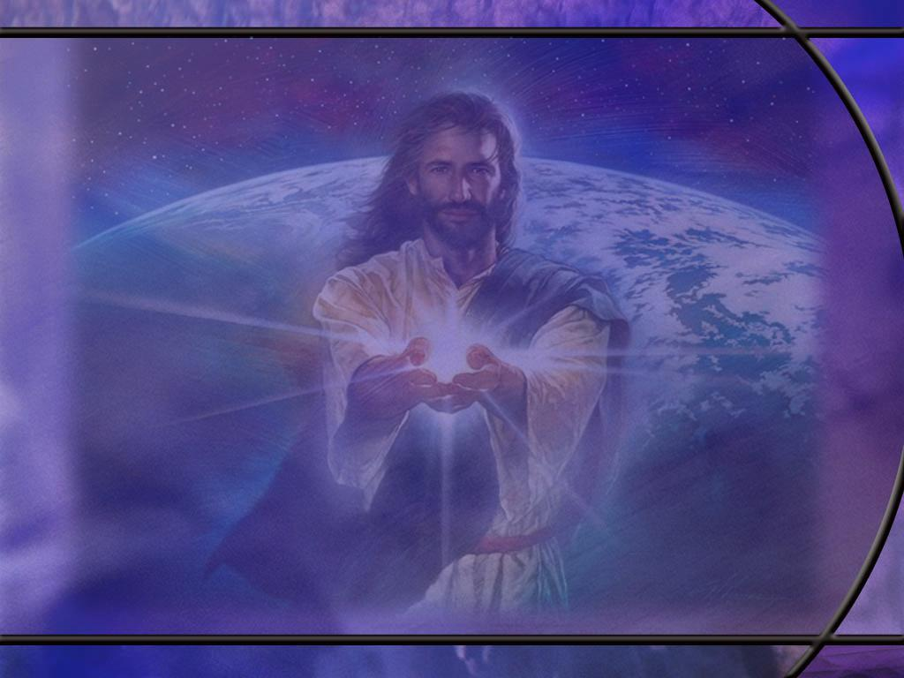
Philippians 1:15, 18 ESV
Some indeed preach Christ from envy and rivalry, but others from good will. ... ¹⁸ What then? Only that in every way, whether in pretense or in truth, Christ is proclaimed, and in that I rejoice. Yes, and I will rejoice, [R]
Notes:
Q1: What is it that makes Paul rejoice?
1. He rejoices that the gospel of Jesus Christ is proclaimed.
2. And he will continue to rejoice in that.
3. He says that some are preaching it our of envy and rivalry, taking advantage of Paul’s imprisonment to make a name for themselves.
4. Others are preaching it out of good will seeking to carry on Paul’s ministry out of love for him.
5. Either way, Paul rejoices that the gospel is being preached.
6. Who cares who gets the credit, as long as people are getting saved?
7. Paul also wrote:
1 Corinthians 3:6 KJV - I have planted, Apollos watered; but God gave the increase.
8. It is the HS that convicts us of sin, of righteousness, and of judgment.

Slide 16
Colossians 1:3-5 NLT
We always pray for you, and we give thanks to God, the Father of our Lord Jesus Christ. ⁴ For we have heard of your faith in Christ Jesus and your love for all of God's people, ⁵ which come from your confident hope of what God has reserved for you in heaven. You have had this expectation ever since you first heard the truth of the Good News. [R]
Notes:
Q1: For what three things does the apostle commend these believers?
1. First, for their faith in Jesus Christ.
2. Second, for their love for all God’s people.
3. Third, for their hope of what God has reserved in heaven for them.
4. As Paul writes in the great love chapter:
1 Corinthians 13:13 KJV - 13 And now abideth faith, hope, love, these three; but the greatest of these is love.
5. What makes love the greatest?
6. Someday, when Jesus comes, our faith will be sight, our hope will be fulfilled, but love will go on forever and ever.
Q2: Where do we get faith, hope, and love?
1. Saving faith comes from our choice to believe the Gospel and trust Jesus as our Savior from sin.
Romans 10:17 NLT - So faith comes from hearing, that is, hearing the Good News about Christ.
2. Saving faith comes from hearing the gospel, believing the gospel, and trusting Jesus for the forgiveness of our sins and eternal life with God.
3. Hope comes from believing the promises of God to do all that He has said he will do.
4. Love comes from realizing what Christ has done to save us and loving Him because He first loved us.
5. These characteristics grow to maturity as we are filled by the Holy Spirit and the fruit of the Spirit grows in us.
6. The first fruit of the Spirit is agape love, the seventh is faithfulness, and the fourth is patience or endurance, standing firm, confident in the promises of God, which is hope.
7. So if we want our faith, hope, and love to grow, we need to be walking in the Spirit and growing in grace.

Slide 17
Colossians 1:5-8 ESV
You have heard before in the word of the truth, the gospel, ... ⁷ just as you learned it from Epaphras our beloved fellow servant. He is a faithful minister of Christ on your behalf, ⁸ and has made known to us your love in the Spirit. [R]
Notes:
Q1: Who was Epaphras?
1. He was a fellow servant of Jesus Christ along with the apostle Paul.
2. As we studied last week, it was probably in Ephesus that Epaphras heard Paul preach the Gospel and joined him in spreading the good news to other cities in the region.
3. Epaphras belonged to the church at Colossae, and Paul credits him with bringing the gospel there and establishing the church.
4. Apparently Epaphras had traveled to Rome to visit Paul there and is mentioned in Paul’s final greetings in Col 4:12 as always praying for them.

Slide 18
Colossians 1:9-12 NIV
For this reason, since the day we heard about you, we have not stopped praying for you. We continually ask God to fill you with the knowledge of his will through all the wisdom and understanding that the Spirit gives, ¹⁰ so that you may live a life worthy of the Lord and please him in every way: bearing fruit in every good work, growing in the knowledge of God, ¹¹ being strengthened with all power according to his glorious might so that you may have great endurance and patience, ¹² and giving joyful thanks to the Father, who has qualified you to share in the inheritance of his holy people in the kingdom of light. [R]
Notes:
Q1: For what does Paul pray for the Colossian Christians?
1. He prays that they would be filled with divine knowledge of God’s will.
2. He prays for them to receive divine wisdom and understanding.
3. He prays that they will live a life fully pleasing to God.
4. He prays that their lives will bear good fruit, that their knowledge of God will increase, that they will receive divine strength to endure with joy.
5. This prayer is similar in many ways to Paul’s prayer for the Philippians.
6. For the Philippians, he also prayed for divine knowledge and understanding.
7. That they will understand how God wants them to live.
8. That He wants them to live pure and blameless lives until Jesus returns for them.
9. Here in Colossians, we see the same concerns that Paul has for the believers.
10. His prayer is for spiritual blessings, that will bring them closer to God and fit them to live a life pleasing to Him.
Q2: Looking at verse 12, How has God qualified us to share in the inheritance of his holy people in the kingdom of light?
1. This is the Gospel of righteousness by faith.
2. Our own righteousness is filthy rags.
3. We have no righteousness that is acceptable to a holy God.
4. The only thing that can qualify us as holy people for the kingdom of God is the perfect righteousness of Christ.
5. This is the amazing grace of righteousness by faith.
6. When we trust in Jesus and confess our sins, God lays our sins on Him and lays His righteousness on us.
7. God qualifies us for heaven by placing the righteousness of Christ to our account.
8. Paul describes the great exchange in 2 Cor 5:21
2 Corinthians 5:21 NKJV - For He [God] made Him [Christ] who knew no sin, to be sin for us, that we might become the righteousness of God in Him.

Slide 19
Outline of Philippians
I. Greeting (1:1-2)
II. Thanksgiving and prayer (1:3-11)
III. Paul’s personal Circumstances (1:12-26)
IV. Exhortations (1:27-2:18)
A. Living a worthy life (1:27-30)
B. Being a Servant like Jesus (2:1-18)
V. Fellow Servants in the Gospel (2:19-30)
A. Timothy (2:19-24)
B. Epaphroditus (2:25-30)
VI. Warnings (3:1-4:1)
A. Against legalists (3:1-16)
B. Against lawlessness (3:17-4:1)
VII. Final exhortations, Thanks, and Conclusions (4:2-23)
Notes:
Not used in this lesson.

